Slide 1
Co-regulation and self-regulation
Prof.ssa Sveva Del Gatto

Slide 2

Self and co-regulation
A further outcome of the current EU CSR agenda has been an emphasis on improving self and co-regulation processes.
In the environmental context, an important technique for achievieng this has been the use of voluntary environmental agreements, i.e. agreements entered into by private parties aimend at achievieng environmental objective.

Slide 3
Self and co-regulation
These may include self regulatory arrangements where the agreement is put in place by market actors on voluntary basis, whether in the form of binding agreements or gentelmen's agreements.
Alternativily, co-regulation may be used i.e. where a legislative or regulatory act entrusts attainment of environmental aims to non state actors.

Slide 4

Eco-management standards
A further type of corporate voluntary environmental initiative is the use of eco-management standards

Slide 5
Eco-management standards
Some environmental management standards are mandatory,
But:
a substantial number are voluntary, with firms choosing sign up to eco-management systems in order to enjoy regulatory rewards and/or enhanced consumer reputation.

Slide 6

The Eco-Management and Audit Scheme (EMAS)
The Eco-Management and Audit Scheme (EMAS) is a voluntary environmental management instrument, which was developed in 1993 by the European Commission.
It enables organizations to assess, manage and continuously improve their environmental performance.

Slide 7
The Eco-Management and Audit Scheme (EMAS)
Proposed by the European Community and first established in 1993, it is currently in its third revision, with Regulation (EC) No. 1221/2009.
The scheme is globally applicable and open to all types of private and public organizations.

Slide 8
Eco-management standards
An EMAS helps an organization address its regulatory requirements in a systematic and cost-effective manner.
This proactive approach can help reduce the risk of non-compliance and improve health and safety practices for employees and the public.

Slide 9
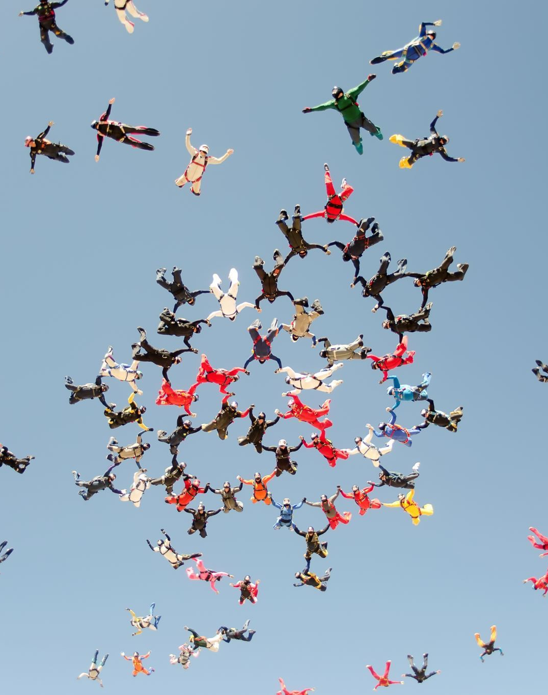
Eco-management standards
The best-known such standard is ISO 14001, setting out the criteria for an environmental management system (EMS). Together with a set of supporting documents it forms the ISO 14000 family of standards.

Slide 10
EMAS
Participants in EMAS are committed to evaluating and improving their own environmental performance, complying with relevant environmental legislation, preventing pollution, and providing relevant information to the public (via verified environmental audits).
Regulation (EC) No 1221/2009 of 25 November 2009 revised EMAS to increase the participation of companies and reduce the administrative burden and costs, particularly for small and medium-sized enterprises.

Slide 11

Better environmental performance: European Eco-Management and Audit Scheme (EMAS)"
As specified in "Better environmental performance: European Eco-Management and Audit Scheme (EMAS)," the European Commission uses the scheme to reduce the environmental impact of activities through:
more efficient use of natural resources;
reduction of CO2 emissions;
prevention of waste generation (through recycling and reuse);
implementation of green public procurement;
promotion of sustainable mobility.

Slide 12
Differences between ISO 14001 and EMAS
Currently, the Certification of a Corporate Environmental Management System can be carried out on the basis of these two different schemes:
the ISO 14001 standard and
the European Eco-Management and Audit Scheme (EMAS) regulation.

Slide 13
Differences between ISO 14001 and EMAS
Both regulatory schemes define the requirements that a business organization system aimed at compliance with current environmental legislation, control of its activities, the interaction between the company and the environment, and progressive reduction over time of the impact resulting from its activities must have.

Slide 14
Differences between ISO 14001 and EMAS
Through the various editions of the Standard over the years, the two regulatory schemes have become progressively closer.
Both schemes require compliance with laws, effective control of the environmental impacts of a company's activities, and a focus on improving and reducing environmental impacts.
However, some substantial differences remain between ISO 14001 and the European EMAS regulation.

Slide 15

Differences between ISO 14001 and EMAS
The EMAS regulation generally requires greater staff involvement and more carefull communication within the company and to the outside world.

Slide 16
Differences between ISO 14001 and EMAS
The certification mechanism stipulates that for ISO 14001, following a successful audit by qualified personnel from accredited bodies, a certificate is immediately issued.

Slide 17
Differences between ISO 14001 and EMAS
With the EMAS regulation, on the other hand, following verification by qualified inspectors, an environmental statement validated by the inspectors is sent to the Ecolabel-Ecoaudit Committee, which, after verification of legislative compliance, authorizes registration of the company in the EMAS public register with authorization to use the EMAS logo.

Slide 18

Enabling consumers and civil society in environmental regulation
The key legal method of enabling individuals and civil society to become involved in environmental regulation and decision making is clearly the Aarhus Convention.

Slide 19

Aarhus Convention
It is based on the principles of:
Access to information
Public participation
Access to justice

Slide 20

Enabling Consumers and Civil Society
The EU eco label regulation is perhaps its leading instruments aimed at nudging european consumers towards environmentally friendlier behaviour.
This voluntary scheme was established in 1992 leading to the award of the EU flower logo.

Slide 21

Eco Label Regulation
Applicant manufacturers must apply to the relevant national competent authority to be awarded the EU's flower eco-label.
Although the Eco-Label Regulation sets out broad criteria for the award, detailed requirments are developed through the EU ecolabelling Board.

Slide 22
Eco Labelling Board
The Eco Labelling Board is composed of national competent authorities and a consultation forum comprising a "balanced participation of all relevant interested parties concerned with that product group".

Slide 23
Eco Label Regulation reform
In 2010, a new eco label regulation were passed, aimed in large part at increasing the label's effectiveness.

Slide 24

Focus Eco Label – What is EL?
The EU Ecolabel is the European Union's eco-label for products and services that are characterised:
by providing high performance standards,
by a reduced environmental impact during their entire life cycle.

Slide 25

When was it established?
It was established in 1992 by Regulation (EEC) No. 880/1992 and is now governed by Regulation (EC) No. 66/2010 as amended by Regulation (EU) No. 782/2013.

Slide 26
When was it established?
It is in force in the 28 countries of the European Union and the countries belonging to the European Economic Area - EEA (Norway, Iceland, Liechtenstein).

Slide 27
What kind of instrument is it?
The EU Ecolabel has the characteristics of a voluntary Type I label (as defined by ISO 14024):
it is based on scientifically defined criteria in relation to the entire life cycle of products (from the extraction of raw materials, to the production phase, packaging and transport, use and recovery and disposal).

Slide 28
What kind of instrument is it?
The criteria cover various environmental aspects including the use of energy, water, chemicals and waste generation (multi-criteria system),
They also cover the functionality of the product and the quality of its performance;

Slide 29
What kind of instrument is it?
Compliance with the criteria is verified by an independent third party (the Ecolabel and Ecoaudit Committee). The EU Ecolabel criteria, which are defined at European level with the broad participation of stakeholders, including producer, consumer and environmental associations, also cover aspects of consumer health and safety and, where relevant, the main social and ethical aspects of production processes.

Slide 30
The Competent Body: the COMMITTEE
The Italian national competent body for the implementation of Regulation (EC) No 66/2010 Ecolabel is the Italian Ecolabel Section of the Ecolabel and Ecoaudit Committee, established at the Ministry of the Environment by Decree 413/1995, as amended by Decree 236/1998.

Slide 31

The Italian Ecolabel Section
The Italian Ecolabel Section consists of a President and six members appointed by decree by the Minister for the Environment and Protection of Land and Sea (MATTM).

Slide 32
The Italian Ecolabel Section
The President may be designated by the Minister of the Environment or the Minister of Economic Development, while two members are designated by the Minister of the Environment, two by the Minister of Economic Development, one by the Minister of Economy and Finance, and one by the Minister of Health.

Slide 33

The Eco Label for consumers
The EU Ecolabel is aimed at consumers to whom it guarantees that certified products, in addition to their high performance, have a reduced environmental impact throughout their entire life cycle certified by independent bodies (national competent bodies) recognised at European level.

Slide 34
The Eco Label for consumers
There are 3 good reasons to buy ecolabel products:
they help to protect the environment by reducing the amount of waste and pollution, energy and water consumption, and reducing/eliminating the use of hazardous chemicals that damage the health and biodiversity of animal and plant species;

Slide 35
The Eco Label for consumers
2. are easily available and are sold at affordable prices: in Italy there are about 18,000 products/services with the EU Ecolabel on the market. Almost all large retailers have their own EU Ecolabel certified product line, in particular for the product groups 'tissue paper' and 'detergents' for household or personal use;

Slide 36
The Eco Label for consumers
3. are also verified with respect to usage performance.
Consumers with their purchasing choices have the power to steer the market and stimulate supply. Consumers who choose more sustainable and environmentally friendly EU Ecolabel products help to reduce the environmental impacts of products and thus protect the environment.

Slide 37
Conclusion
The regulatory tools seen and analyzed are all characterized by being voluntary.
We are therefore talking about self regulation.
Or co-regulation because there is a regulatory framework.

Slide 38
Conclusion
The objective of these tools is to "push" companies to adopt virtuous behavior without forcing them by law.

Slide 39
Conclusion
Why self-regulate? Why decide to voluntarily submit to obligations?

Slide 40
Conclusion
Because for example, as seen when talking about Eco Label, consumers are directed to choose virtuous companies that do not pollute.
And these companies are indicated by the State thanks to the eco-label certification.

Slide 41
Conclusion
In this way:
- the State sets the criteria based on the environmental protection objectives it wants to pursue.
- Companies pursue those objectives because it is convenient for them in terms of greater profits.
- Consumers choose the most virtuous companies in terms of environmental protection.

Slide 42
Look at these videos
What we need to know about eco labelling (youtube.com)
What are Eco-Labels or Sustainability Labels? Different types of Eco Labelling. (youtube.com)

Slide 43
Other Eu Labelling Measures
A variety of other Eco Labelling Measures coexist with the flower label. Some of which are mandatory, some voluntary.
Examples of mandatory measures include:
the EU's organic farming Regulation, which sets down requirements for organic production
and the energy class rating system, which identifies refrigerators, freezers and other household equipment which are particularly economical in terms of electricity consumprion.

