Slide 1
Environmental rights in Europe
Prof.ssa Sveva Del Gatto

Slide 2

Why environmental (human) Rights?
Man has the fundamental right to freedom, equality and adequate conditions of life, in an enviroment of quality that permits a life of dignity and well being, and he bears a solemn responsibility to protect and improve the environment for present and future generations.
(principle 1, Report of the UN Conference on the Human Environment Declaration of the UN Conference on the Human Environment, UN Doc. (5-16 June 1972 The Stockolm Declaration)

Slide 3
Why Environmental Human Rights?
In addition to the regulatory techniques discussed, a further important mean of achieving environmental protection in Europe is by recognising environmental rights.

Slide 4
Why Environmental Human Rights?
The enviornmental rights discourse has become more prevalent in Europe in recent years.
As a consequence, there are many different understandings of what precisely is meant by an environmental right.

Slide 5
Why Environmental Human Rights?
And there are also many different understandings of what the consequences of breach of such a right might be..

Slide 6
Why Environmental Human Rights?
Conceptualising environmental protection in terms of a human right to an environment of a decent quality is nothing new (see The Stockholm Declaration 1972)

Slide 7
Why Environmental Human Rights?
Yet, over 30 years after this Declaration, the application of human rights principles to environmental issues remains contested.
Central questions of controversy include the following:

Slide 8
Central questions of controversy include the following:
Who should have standing to enforce environmental human rights? Should standing be limited to the victims of breaches of rights, as is traditional in many human rights regimes, or should those acting in the public interest have standing to bring environmental rights claims?

Slide 9
Central questions of controversy include the following:
How can we ensure that the interests of future generations, who may be severely affected by environmental degradation occurring now, are represented?

Slide 10
Central questions of controversy include the following:
Does a human rights based approach to environmental protection risk prioritising anthropocentric, human focused concerns over other environmental concerns?

Slide 11
Central questions of controversy include the following:
Does a human rights based approach to environmental protection mean applying existing general human rights law to environment related issues (i.e. 'greening' existing human rights)? Or should we recognise a self standing right to a decent environment?

Slide 12
Central questions of controversy include the following:
Alternatively, should we focus on embedding procedural rights such as those ensuring that the public is informed of, and can participate in and challenge, environmental decisions, rather than trying to define a substantive right to a decent environment?

Slide 13
In substance: why environmental protection should be treated as a human rights issue ?
There are many views on this debate
It is clear that a human rights-based approach enables the effects of environmental damage on the lives and property of individuals to be directly addressed in a way that may not be possible using environmental regulation focused on protecting the environment as such.

Slide 14

In substance: why environmental protection should be treated as a human rights issue ?
Human rights approaches might also increase environmental protection, in that many States have signed up to far-reaching human rights obbligations, and have given human rights a pre-eminent status within their legal order in a way which they have not done for environmental concerns more generally.

Slide 15
In substance: why environmental protection should be treated as a human rights issue ?
Against this, however, some have argued that human rights approaches to environmental protection are based on an unacceptably reductivist philosophy of environmental law...

Slide 16
In substance: why environmental protection should be treated as a human rights issue ?
...whereby the environment is valued largely because of its utility to humans.

Slide 17
Environmental (human) rights
One of the striking features of environmental human rights protection within Europe is the variety of different sources of such protection.
The relationship between these sources is at times complex, not only because of differences in the substantive definitions of rights protected by each regime...
...but also because of institutional differences between the regimes.

Slide 18
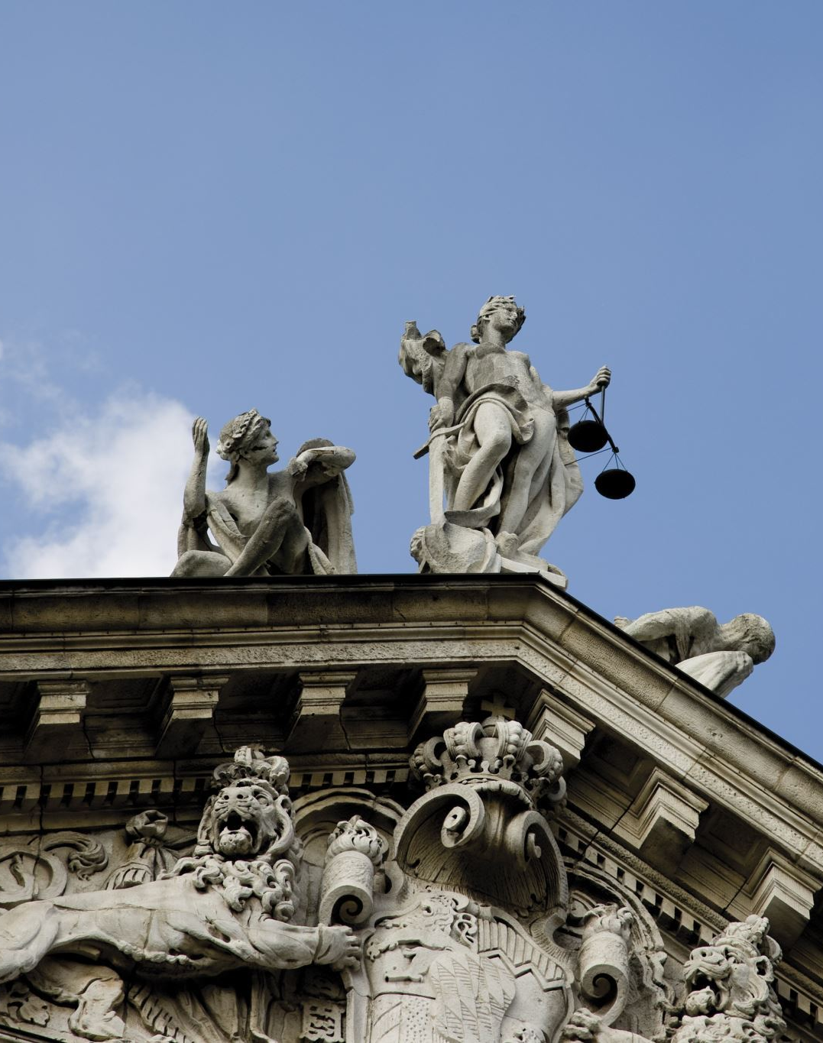
Sources of environmental rights protection within Europe
Rights originating from the Council of Europe
Rights originating from EU Law
Rights contained in the 1998 Convention on Access to information, Public Participation in decision-making and Access to justice in environmental Matters (the Aarhus Convention).

Slide 19

Rights originating from the Council of Europe
The 1950 European Convention for the Protection of Human Rights and Fundamental Freedoms (the "ECHR")
The ECHR was concluded under the auspices of the Council of Europe, and has been ratified to date by 47 States.

Slide 20
Rights originating from the Council of Europe
The European Convention on Human Rights is an international treaty established by the Council of Europe in 1950 to help protect people's human rights and fundamental freedoms.

Slide 21
The 1950 European Convention for the Protection of Human Rights and Fundamental Freedoms (the "ECHR")
Dealing essentially with civil and political rights.
It falls under the ultimate jurisdiction of the European Court of Human Rights (ECtHR) in Strasbourg which consists of 47 permanent full-time judges that is, one per Contracting State.

Slide 22
The 1950 European Convention for the Protection of Human Rights and Fundamental Freedoms (the "ECHR")
The EU Member states have ratified the ECHR in their own right.
The EU is not currently a party.
The Treaty of Lisbon expressly enabled the EU to accede to ECHR.

Slide 23
The 1950 European Convention for the Protection of Human Rights and Fundamental Freedoms (the "ECHR")
The art. 6, par.1 of the Treaty on European Union (TEU), in particular, recognizes the Charter of Fundamental Rights of the EU, as having the same legal value as the treaties.

Slide 24
The 1950 European Convention for the Protection of Human Rights and Fundamental Freedoms (the "ECHR")
The art. 6, par. 2 of the TEU establishes that the Union adheres to the European Convention for the Protection of Human Rights and Fundamental Freedoms (ECHR) and that such accession does not modify the competences of the Union defined by the Treaties.

Slide 25
The 1950 European Convention for the Protection of Human Rights and Fundamental Freedoms (the "ECHR")
The ECHR does not contain any express provision concerning the environment.
Nevertheless, the ECtHR's jurisprudence applying ECHR rights to environmental issues is, by now, considerable.
These cases largely concern Article 8 ECHR which protects the right of an individual to respect for his or her private and family life, home and correspondence.

Slide 26
The 1950 European Convention for the Protection of Human Rights and Fundamental Freedoms (the "ECHR")
They also have involved :
Article 2: the right to life
Article 6: the right to a fair hearing in the determination of civil rights and obbligations
Article 10: freedom of expression
Article 1, Protocol 1, ECHR: the right to property

Slide 27

The 1950 European Convention for the Protection of Human Rights and Fundamental Freedoms (the "ECHR")
NO RIGHT TO A DECENT ENVIRONMENT:
The ECtHR has refused to recognise any right to a healty or decent environment as such in the ECHR.
In Kyrtatos v. Greece, the ECtHR addressed this issue head on, in refusing to extend the scope of article 8 ECHR to the protection of the environment as such, in the absence of proof of interference with the applicant's private or family life.

Slide 28

Kyrtatos v. Greece
The applicants contended that urban development in the area in question had led to the destruction of their physical environment and had affected their life.

Slide 29
Kyrtatos v. Greece
They relied on Article 8 of the Convention, which provided: “1. Everyone has the right to respect for his private and family life, his home and his correspondence.”
They complained that urban development had destroyed the swamp which was adjacent to their property and about other environmental pollution.

Slide 30
Kyrtatos v. Greece
With regard to the first complaint, the Court noted that severe environmental pollution could affect individuals’ well-being and prevent them from enjoying their homes in such a way as to affect their private and family life adversely.

Slide 31
Kyrtatos v. Greece
Yet the crucial element for the violation of the rights in Article 8 was the existence of a harmful effect on a person’s private or family sphere and not simply the general deterioration of the environment.

Slide 32
Kyrtatos v. Greece
Neither Article 8 nor any of the other Articles of the Convention were specifically designed to provide general protection of the environment as such; to that effect, other international instruments and domestic legislation were more pertinent in dealing with this particular aspect.

Slide 33
Kyrtatos v. Greece
In the present case, even assuming that the environment had been severely damaged by the urban development of the area, the alleged damage to the birds and other protected species living in the swamp was not of such a nature as to directly affect their own rights under Article 8 § 1 of the Convention.

Slide 34
Kyrtatos v. Greece
It could have been otherwise if, for instance, the environmental deterioration complained of had consisted in the destruction of a forest area in the vicinity of the applicants’ house, a situation which could have affected more directly the applicants’ own well-being.
In conclusion, the Court could not accept that the interference with the conditions of animal life in the swamp constituted an attack on the private or family life of the applicants.

Slide 35
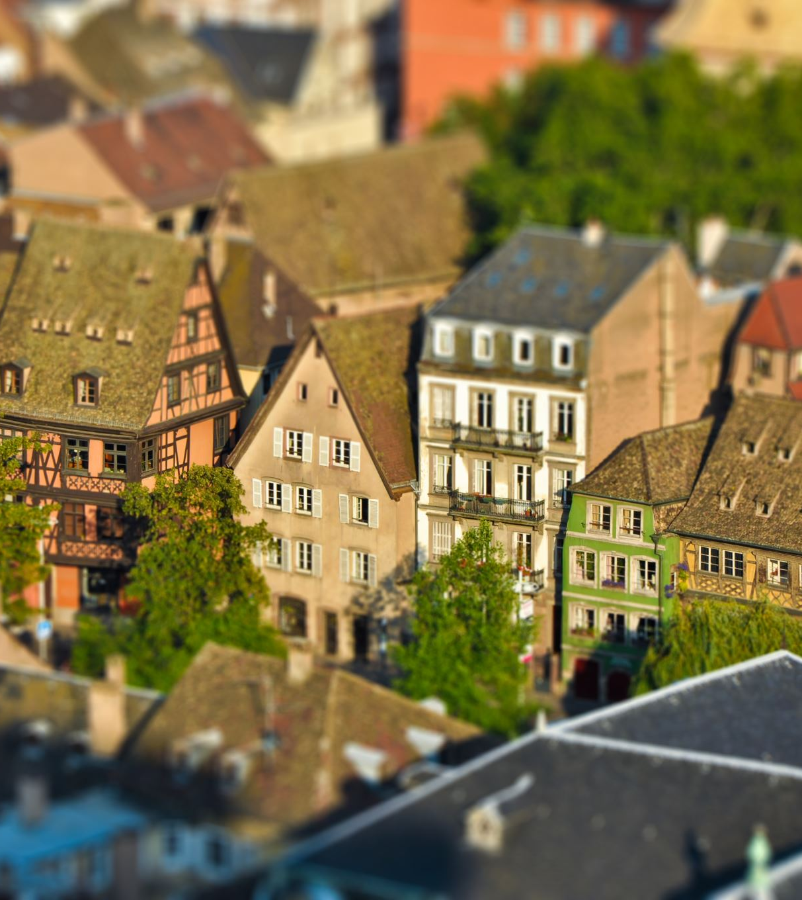
A right to a decent environment and the ECHR
Numerous efforts have been made over the years to insert a right to a decent environment into the ECHR, beginning with a German proposal of 1973 wich was rejected by the Committe of Ministers on the basis that there was no need for such a povision.

Slide 36

A right to a decent environment and the ECHR
The Parliamentary Assembly of the Council of Europe has, more recently, called for the addition of a protocol to the ECHR on the right to a healty and viable environment.

Slide 37
A right to a decent environment and the ECHR
As the triple planetary crisis of climate change, pollution and biodiversity loss intensifies, the importance of protecting the human right to a clean, healthy and sustainable environment was reflected by the UN Human Rights Council in 2021, the UN General Assembly in 2022.

Slide 38
Recommendation on Human Rights and Environmental Protection,
In a Recommendation on Human Rights and Environmental Protection, the Council of Europe calls on its 46 member states to actively consider the recognition at the national level of the right to a clean, healthy and sustainable environment as a human right.

Slide 39
Recommendation on Human Rights and Environmental Protection,
The Committee of Ministers emphasises the increased recognition of a form of right to a clean, healthy and sustainable environment in international legal instruments (including regional human rights instruments) and in national constitutions, legislation and policies.

Slide 40

Recommendation on Human Rights and Environmental Protection,
According to the Committee, in implementing this Recommendation, Member States should ensure compliance with a number of principles: the general principles of international environmental law, such as the 'do no harm' principle, the precautionary principle and the 'polluter pays' principle, the need for intergenerational equality, the principle of non-discrimination, non-discriminatory access to information and justice in environmental matters, participation in environmental decision-making, and environmental education.

Slide 41

Recommendation on Human Rights and Environmental Protection,
The Committee also expressed concern about the disproportionate effect environmental degradation could have and called on member states to take appropriate measures to protect the rights of those most vulnerable or most at risk from environmental damage.

