Slide 1
Environmental Human Rights
Prof.ssa Sveva Del Gatto

Slide 2

Article 6 EHCR
Environmental issues have also arisen in the context of article 6 EHCR.
Article 6 provides for the right to a fair and public hearing within a reasonable time by an indipendent and impartial tribunal established by law.

Slide 3
Art. 6 EHCR
In many instances, these cases have concerned challenges to limits set by national procedural law on the ability to obtain effective access to justice in national court.

Slide 4
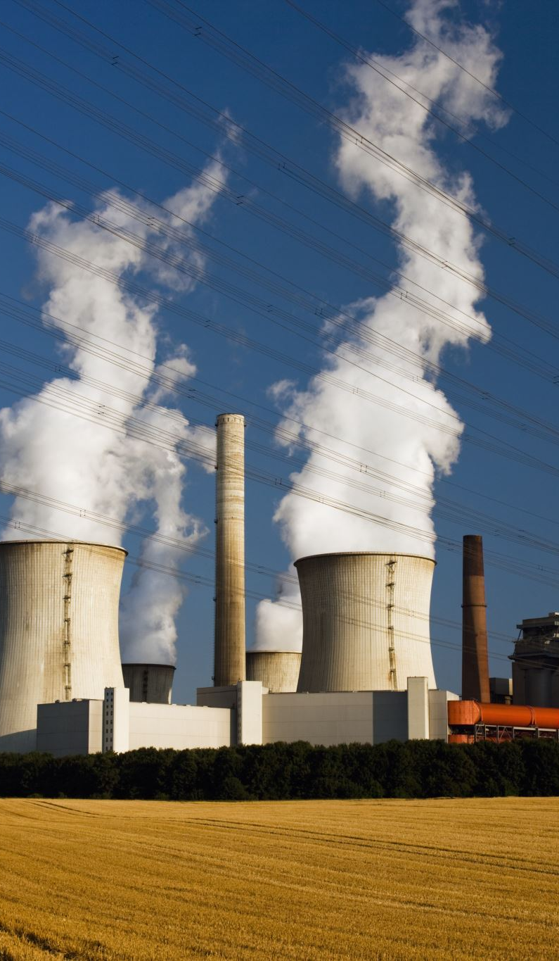
Balmer Scharfroth v. Swizerland
In this case, the applicants resided in villages between four and five kilometres from nuclear power station and claimed that their right to a fair trial had been violated by their inability to bring any judicial challenge to a decision to grant the power station’s operator an indefinite extension to its permit and permission to expand its operation.

Slide 5

Balmer Scharfroth v. Swizerland
The ECtHR held that article 6 was not applicable.
It reasoned that was what at issue was of a technical, not legal nature and, even supposing that the courts had the necessary knoledge and time to hear the case, the moral and political responsibility for the decision nonetheless lay with the political authorities.

Slide 6

Article 1, protocol 1: The Right to Property
The right to property has also been raised in environmental cases.
Often raised by landowners refusing to comply with the requirments of environmental regulation.

Slide 7
Article 1, protocol 1: The Right to Property
The ECtHR has largely rejected such efforts.
In Hamer v. Belgium, the ECtHR affirmed the public interest in environmental protection and the legitimacy of prioritising environmental over (individual) economic interests.

Slide 8
Article 1, protocol 1: The Right to Property
Hamer v. Belgium:
“While none of the Articles of the Convention is specifically designed to provide general protection of the environment as such, in today’s society the protection of the environment is an encreasingly important consideration”

Slide 9
Article 1, protocol 1: The Right to Property
Hamer v. Belgium:
“Financial imperatives and even certain fundamental rights, such as ownership, should not be afforded priority over environmental protection considerations.”

Slide 10
Article 1, protocol 1: The Right to Property
The restriction on property rights may be allowed on condition that a fair balance is maintained between the individual and collective interests concerned.

Slide 11

The 1961 European Social Charter
Like the ECHR, the ESC was concluded under the auspicies of the Counsil of Europe.
It has to date been ratified by 27 States.

Slide 12

The 1961 European Social Charter
The ESC is monitored by the European Committee of Social Rights (ECSR) a quasi judicial body which consists of 15 member.

Slide 13

The 1961 European Social Charter
The ESC have the power to issue conclusion in respect of national annual reports submitted by eligible NGOs, trade unions and employers’ organisations.

Slide 14
The 1961 European Social Charter
The ESC is divided into PARTS which have different functions.
Part 1 contains a list of rights that attainment of which the parties accept as the aim of their policy, to be pursued by all appropriate means both national and international in character.

Slide 15

The 1961 European Social Charter
Part 1
Many of the rights concern social and employment rights.
Article 11 is also included.
It concerns the right to the protection of healt:
“Everyone has the right to benefit from any measures enabling him or her to enjoy the highest possible standard of healt attainable”.

Slide 16
The 1961 European Social Charter
Part 2 of the ESC specifies the obbligations by which the parties undertake to “consider themselves bound”.

Slide 17
The 1961 European Social Charter
Part 2
In relation to article 2, these obbligations are specified in the following terms:
With a view to ensuring the effective exercise of the right to protection of healt, the Parties undertake to take appropriate measures designed:

Slide 18

The 1961 European Social Charter
To remove as far as possible the causes of ill healt
To provide advisory and educational facilities for the promotion of healt and the encouragement of individual responsibility in matters of healt
To prevent as far as possible epidemic, endemic and other diseases as well as accident

Slide 19
The 1961 European Social Charter
The ESC has interpreted Article 11 as including the rights to a healty environment.

Slide 20
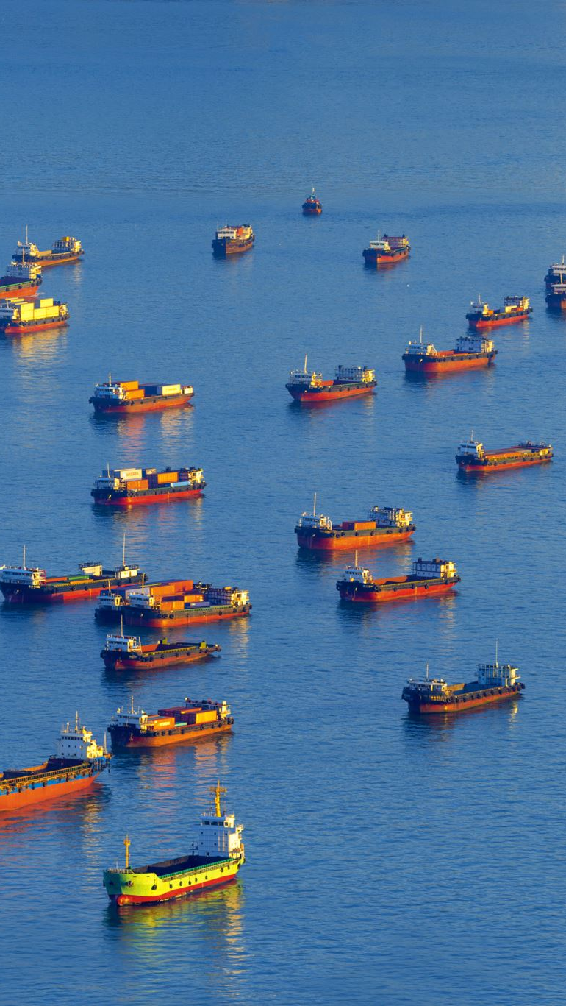
Marangopoulos foundation for human rights v. Greece
In this case, the applicant NGO lodged a complaint that Greece had failed to comply with article 11 of the ESC as it had failed to take sufficient account of the environmental effects of lignite mining, or to develop an appropriate strategy to prevent and combat public healt risks.

Slide 21
Marangopoulos foundation for human rights v. Greece
The ECSR upheld the complaint.
In recognising that the right to the protection of healt included the right to a healty environment, the ECSR considered that it was interpreting article 11 in the light of current conditions and explicitly drew on a variety of other sources of international law.

Slide 22
Marangopoulos foundation for human rights v. Greece
The ECSR found that:
Greece had a significant body of relevant environmental law
There were a significant gap in implementation

Slide 23

Marangopoulos foundation for human rights v. Greece
In fact, information was not passed on and very little had be done to organise monitoring of environmental and healts effects.

Slide 24
Marangopoulos foundation for human rights v. Greece
It followed that the margin of discretion granted to the Greek authorities had been exceeded and that Greece had not managed to strike a reasonable balance between the interests of persons living in the lignite mining areas and the general interest.

Slide 25

The Charter of Fundamental Rights of the EU (the Charter)
The Charter is proclaimed by the European Parliament, the Council of the EU and the European Commission in 2000.
It became legally binding on all EU member States with the entry into force of the Treaty of Lisbon on 1 december 2009.

Slide 26
The Charter of Fundamental Rights of the EU (the Charter)
The Charter is under the ultimate jurisdiction of the Court of Justice of the European Union in Luxembourg.
The provision of the Charter should be read alongside its Explanations which (as provided by article 52), must be given “due regard” by the EU and national courts.

Slide 27
The Charter of Fundamental Rights of the EU (the Charter)
A key aim of the Charter is was to
“strengthen the protection of fundamental rights in the light of changes in society, social progress and scientific and technological developments by making those rights more visible in a Charter”.

Slide 28
The Charter of Fundamental Rights of the EU (the Charter)
As with the ECHR, the Charter does not contain any right to a decent environment.
However, Article 7 of the Charter (Title II on freedom) provides for the right to expect for private and family life, home and communications.

Slide 29
The Charter of Fundamental Rights of the EU (the Charter)
The Explanations make clear that the rights conferred by article 7 of the Charter “correspond to those guaranteed by article 8 of the ECHR”.
This has also been confirmed by the CJEU.

Slide 30
The Charter of Fundamental Rights of the EU (the Charter)
The Preamble to the Charter indicates a definite environmental sensibility in its aims, recalling the EU aim of “promoting balanced and sustainable development” and perhaps more significantly, that enjoyment of its rights “entails responsibilities and duties with regard to other persons to the human community and future generation”

Slide 31

The Charter of Fundamental Rights of the EU (the Charter)
A further significant environmental provision is Article 37 of the Charter (title IV on “Solidarity”)
It provides “A high level of environmental protection and the improvement of the quality of the environment must be integrated into the policies of the Union and assured in accordance with the principle of sustainable development”

Slide 32
The Charter of Fundamental Rights of the EU (the Charter)
This provision is similar in its terms to article 11 TFEU that provides:
"Environmental protection requirements must be integrated into the definition and implementation of the Union's policies and activities, in particular with a view to promoting sustainable development".

Slide 33
The Charter of Fundamental Rights of the EU (the Charter)
However, the text of article 37 which specifies that:
“A high level of environmental protection must be …. assured”
is stronger than that of the article 11 TFUE.

Slide 34
The Charter of Fundamental Rights of the EU (the Charter)
The effects of this stronger language must be appreciated in light of the distinction made between “rights” and “principles”.
Article 37 should be considered as a principle rather than a right.

Slide 35
The Aarhus Convention on access to information, Public Participation in Decision Making and Access to Justice in environmental Matters
Aside from these sources of European human rights law, no discussion of environmental rights within Europe can be complete without treatment of the 1998 Aarhus Convention on Access to Information, Public Participation in Decision Making and Access to justice in Environmental Matters.

Slide 36
The Aarhus Convention on access to information, Public Participation in Decision Making and Access to Justice in environmental Matters
Together with the 1991 Espoo Convention on Environmental Impact Assessment in a Transboundary Context, the Aarhus Convention forms one of the two key environmental conventions negotiated under the auspicices of the UN Economic Commission for Europe (UNECE).

Slide 37

The Aarhus Convention on access to information, Public Participation in Decision Making and Access to Justice in environmental Matters
The Aarhus Convention and the Espoo Convention on Environmental Impact Assessment in a Transboundary Context constitute regional instruments of international law which are specific to Europe.

Slide 38

The Aarhus Convention on access to information, Public Participation in Decision Making and Access to Justice in environmental Matters
The Aarhus Convention has been hailed by Secretary General of the United Nations, Ban Ki Moon, as
“the most ambitious venture in the field of environmental democracy under the auspices of the United Nations”

Slide 39
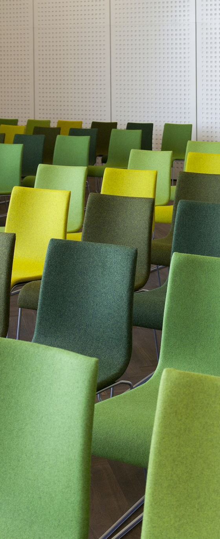
The Aarhus Convention on access to information, Public Participation in Decision Making and Access to Justice in environmental Matters
The approach of the Aarhus Convention is firmly aimed at increasing citizens’ involvement in achieving environmental protection, following on from Principle 10 of the Rio Declaration adopted by the 1992 Rio Conference on Environmental and Development.

Slide 40
The Aarhus Convention on access to information, Public Participation in Decision Making and Access to Justice in environmental Matters
Principle 10 of the Rio Declaration adopted by the 1992 Rio Conference on Environmental and Development provides that:

Slide 41

Principle 10 Rio Declaration
Environmental issues are best handled with participation of all concerned citizens, at the relevant level. At the national level, each individual shall have appropriate access to information concerning the environment that is held by public authorities, including information on hazardous materials and activities in their communities, and the opportunity to participate in decision-making processes.

Slide 42
Principle 10 Rio Declaration
States shall facilitate and encourage public awareness and participation by making information widely available. Effective access to judicial and administrative proceedings, including redress and remedy, shall be provided.

Slide 43
The three pillars of the Convention
The three pillars of the Convention have at their core, the aims of improving:
Transparency
Democracy
Accountability
In decision affecting the environment.

Slide 44
The three pillars of the Convention
Central to this approach is the idea that, by enabling citizens to access information on their environment, to participate in environmental decision-making and to challenge environmental decision before courts/tribunal, this will in itself contribute to achieving a higher level of environmental protection.

Slide 45
A procedural approach
The Convention adopts an essentially procedural approach to environmental rights.

Slide 46
A procedural approach
The preambol of the Convention makes it clear that its authors envisaged these procedural rights not as an end in themeselves but as a means of achieving what they recognised as a universal right:
“to live in an environment adequate to his or her healt and well-being, to protect the environment for the benefit of present and future generations”

Slide 47
The three pillars of the Convention
Similarly Article 1 provides:
OBJECTIVE: In order to contribute to the protection of the right of every person of present and future generations to live in an environment adequate to his or her health and well-being, each Party shall guarantee the rights of access to information, public participation in decision-making, and access to justice in environmental matters in accordance with the provisions of this Convention

Slide 48

The Aarhus Convention
The Aarhus Convention was signed in 1998 by 35 of the UNECE Member States and by European Community in its own right.
It entered into force in October 2001 following ratification by 16 States.

Slide 49
The Aarhus Convention
Implementation of the Aarhus Convention is monitored by the Aarhus Convention Compliance Committee (the Compliance Committee), composed of 9 part-time members.

Slide 50
The Compliance Committee
The Compliance Committee can consider submissions on compliance made by other States, referred by its own secretariat or by the members of the public.
It can examine compliance issues on its own initiative and draw up a report and recommendations thereon, which are subsequently considered and decided upon the Meeting of the Parties.

Slide 51

The Compliance Committee
The Compliance Committee cannot take binding decisions in its own capacity and is non-judicial in nature.

Slide 52

The AARHUS Convention: three pillars
Access to environmental information:
The right of the citizens to receive environmental information that is held by public authorities
2. Public participation in environmental decision making:
The right of the citizens to participate in preparing plans, programmes, policies, and legislation that may affect the environment.

Slide 53

The AARHUS Convention: three pillars
3. Access to justice:
The right of the citizens to have access to review procedures when their rights with respect to access to information or public participation have been violated.

Slide 54

The AARHUS Convention: objective
Art. 1:
In order to contribute to the protection of the right of every person of present and future generations to live in an environment adequate to his or her health and well-being, each party shall guarantee the rights of access to information, public participation in decision making, and access to justice in environmental matters in accordance with the provisions of this Convention.

Slide 55

"Environmental information”
Any information in written, visual, electronic or any other material form on:
(a) The state of elements of the environment, such as air and atmosphere, water, soil, land, landscape and natural sites, biological diversity and its components, including genetically modified organisms, and the interaction among these elements;

Slide 56
"Environmental information”
(b) Factors, such as substances, energy, noise and radiation, and activities or measures, including administrative measures, environmental agreements, policies, legislation, plans and programmes, affecting or likely to affect the elements of the environment within the scope of subparagraph (a) above, and cost-benefit and other economic analyses and assumptions used in environmental decision-making;

Slide 57
"Environmental information”
(c) The state of human health and safety, conditions of human life, cultural sites and built structures, inasmuch as they are or may be affected by the state of the elements of the environment or, through these elements, by the factors, activities or measures referred to in subparagraph (b) above;

Slide 58
ACCESS TO ENVIRONMENTAL INFORMATION
Access to information refers to the public’s right to receive environmental information held by public authorities. This includes:
information on the state of the environment.
policies or measures affecting the environment.
public health and safety where these are affected by the state of the environment.

Slide 59

Art. 4 ACCESS TO ENVIRONMENTAL INFORMATION
Each Party shall ensure that, subject to the following paragraphs of this article, public authorities, in response to a request for environmental information, make such information available to the public, within the framework of national legislation, including, where requested and subject to subparagraph (b) below, copies of the actual documentation containing or comprising such information.

Slide 60
Art. 4 ACCESS TO ENVIRONMENTAL INFORMATION
The environmental information referred to in paragraph 1 above shall be made available as soon as possible and at the latest within one month after the request has been submitted, unless the volume and the complexity of the information justify an extension of this period up to two months after the request. The applicant shall be informed of any extension and of the reasons justifying it.

Slide 61
Art. 4 ACCESS TO ENVIRONMENTAL INFORMATION
A request for environmental information may be refused if:
(a) The public authority to which the request is addressed does not hold the environmental information requested;
(b) The request is manifestly unreasonable or formulated in too general a manner; or
(c) The request concerns material in the course of completion or concerns internal communications of public authorities where such an exemption is provided for in national law or customary practice, taking into account the public interest served by disclosure.

Slide 62

PUBLIC PARTICIPATION
Public participation refers to the public’s right to participate in environmental decision-making.
Public authorities are required to allow the general public and environmental NGOs to meaningfully participate in decision-making regarding projects affecting the environment and plans and programmes relating to the environment.

Slide 63

Article 7 PUBLIC PARTICIPATION CONCERNING PLANS, PROGRAMMES AND POLICIES RELATING TO THE ENVIRONMENT
Each Party shall make appropriate practical and/or other provisions for the public to participate during the preparation of plans and programmes relating to the environment, within a transparent and fair framework, having provided the necessary information to the public. Within this framework, article 6, paragraphs 3, 4 and 8, shall be applied.

Slide 64
Article 7 PUBLIC PARTICIPATION CONCERNING PLANS, PROGRAMMES AND POLICIES RELATING TO THE ENVIRONMENT
The public which may participate shall be identified by the relevant public authority, taking into account the objectives of this Convention.

Slide 65
Article 8 PUBLIC PARTICIPATION DURING THE PREPARATION OF EXECUTIVE REGULATIONS AND/OR GENERALLY APPLICABLE LEGALLY BINDING NORMATIVE INSTRUMENT
Each Party shall strive to promote effective public participation at an appropriate stage, and while options are still open, during the preparation by public authorities of executive regulations and other generally applicable legally binding rules that may have a significant effect on the environment.

Slide 66
Article 8 PUBLIC PARTICIPATION DURING THE PREPARATION OF EXECUTIVE REGULATIONS AND/OR GENERALLY APPLICABLE LEGALLY BINDING NORMATIVE INSTRUMENT
To this end, the following steps should be taken:
(a) Time-frames sufficient for effective participation should be fixed;
(b) Draft rules should be published or otherwise made publicly available; and
(c) The public should be given the opportunity to comment, directly or through representative consultative bodies.
The result of the public participation shall be taken into account as far as possible.

Slide 67
Article 9 ACCESS TO JUSTICE
Access to justice refers to the public’s right to review by a court or another independent body to ensure that public authorities respect the rights to access to information and public participation, and environmental law in general.

Slide 68
Article 9 ACCESS TO JUSTICE
Each Party shall, within the framework of its national legislation, ensure that any person who considers that his or her request for information under article 4 has been ignored, wrongfully refused, whether in part or in full, inadequately answered, or otherwise not dealt with in accordance with the provisions of that article, has access to a review procedure before a court of law or another independent and impartial body established by law.

Slide 69
Article 9 ACCESS TO JUSTICE
In the circumstances where a Party provides for such a review by a court of law, it shall ensure that such a person also has access to an expeditious procedure established by law that is free of charge or inexpensive for reconsideration by a public authority or review by an independent and impartial body other than a court of law.

Slide 70
The AARHUS Convention: Which legal effects?
As an international agreement, the Aarhus convention is not directly legally binding.
The EU has implemented it into a number of directives.
In relation to EU institution decision making and legal processes, the three pillars of the convention have been implemented through regulation 1367/2006/ EC on the application of the provisions of the Aahrus convention on access to information, public participation in decision making and access to justice in environmental matters to community institutions and bodies.

Slide 71
The AARHUS Convention: Which legal effects?
The “Aarhus Regulation” (Regulation (EC) N° 1367/2006 as amended by Regulation (EC) 2021/1767) contributes to the implementation of the Aarhus Convention to the EU’s institutions, bodies, offices and agencies.

Slide 72
The AARHUS Convention: Which legal effects?
Access to information
The Aarhus Regulation extended Regulation (EC) No 1049/2001 of the European Parliament and of the Council regarding public access of environmental information to all EU institutions and bodies.

Slide 73
The AARHUS Convention: Which legal effects?
Public participation
The Aarhus Regulation requires EU institutions and bodies to provide for public participation in preparing, modifying or reviewing plans and programmes relating to the environment.

Slide 74
The AARHUS Convention: Which legal effects?
Access to justice
Under the Aarhus Regulation, environmental NGOs and other members of the public that meet certain criteria can request an internal review of acts adopted, or omissions, by EU institutions and bodies, where these violate EU environmental law.

