Slide 1
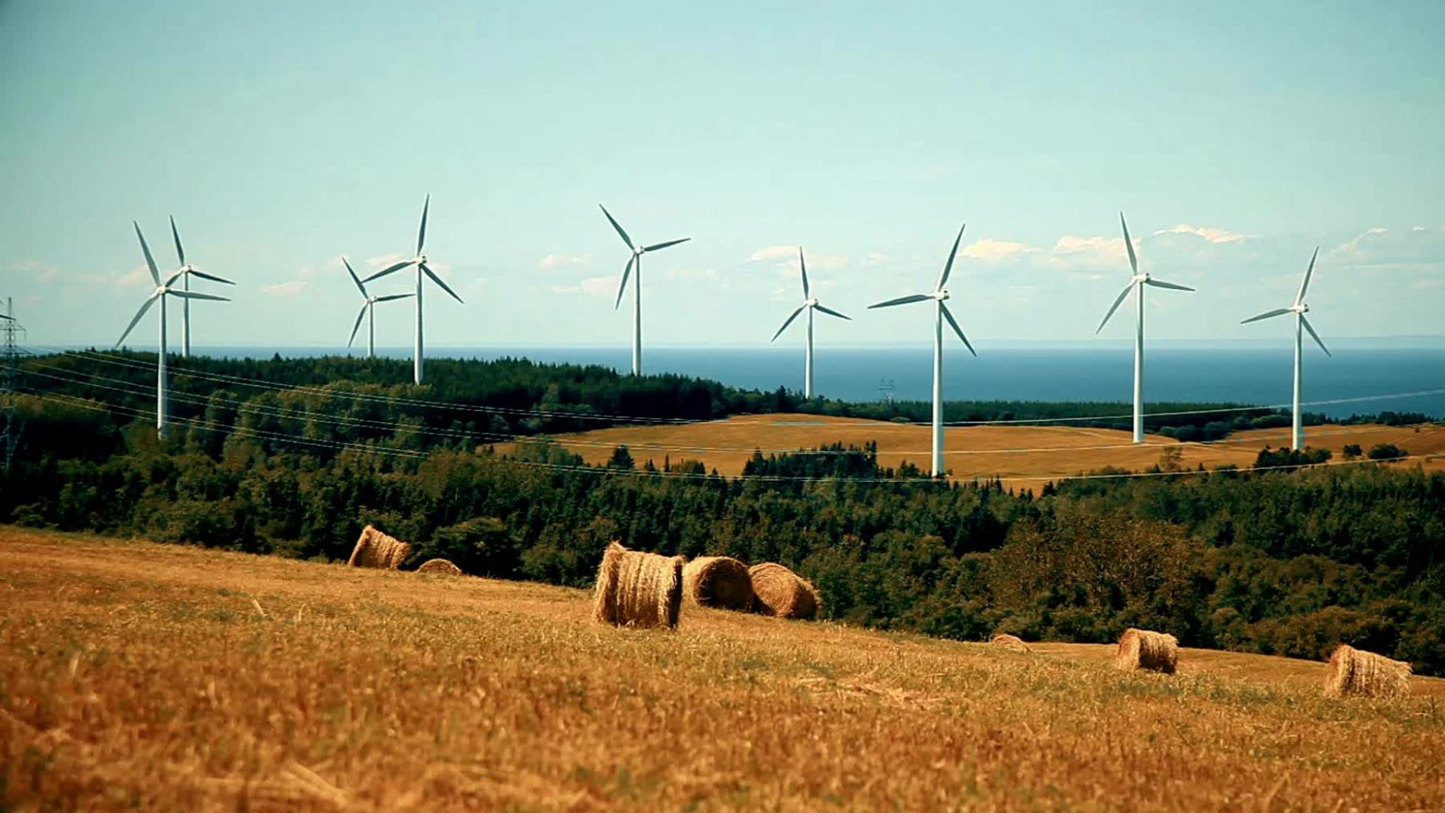
Techniques of Regulating the Environment
Prof.ssa Sveva Del Gatto

Slide 2

The changing regulatory toolbox
The techniques that the European Union regulator for environmental issues are changed dramatically over the past 40 years.
For around the 1st 20 years of its existence community environmental policy relied almost exclusively on what we might call traditional regulatory techniques.

Slide 3

The changing regulatory toolbox
These techniques relied primarily on the article prescriptions by lawmakers to be enforced by public authorities
For example the imposition of the environmental standards order that banning of environmental hazardous substances to be enforced by agencies or courts

Slide 4

THE CHANGING REGULATORY TOOLBOX
These techniques called hierarchical, direct or command and control regulation were implemented in the 1990s by an increasing of the reliance upon market mechanism achieve environmental aims.

Slide 5

THE CHANGING REGULATORY TOOLBOX
Such market based instruments such as emissions trading or the environmental taxes and charges, now play a vital role in the EU's regulatory mix.

Slide 6

So called market based instruments
This change reflects the ideological shift that had taken place under Reagan in the USA and Thatcher in the UK towards neoliberalism and the belief that free market values should apply throughout not only economic but also social political and environmental lives.

Slide 7

SO CALLED MARKET BASED INSTRUMENTS
While traditional direct regulation remains important within the EU, the use of market based instrument is being considered in increasingly wide areas of environmental policies including areas such as habitat conservation where it was formerly talked in appropriated.

Slide 8

Network-based governance
A third important part of the regulatory mix in contemporary environmental policy is the increasing use of instruments aimed at encouraging individuals and organisation to get involved in achieving the European union's environmental policy goal.

Slide 9
Network-based governance
These instruments may be viewed as forming part of the development of network based governance, i.e. reliance on non-hierarchical societal driving methods of achieving policy aims.

Slide 10
Network-based governance
The principles of access to information, participation and access to justice (Aarhus Convention) can also be used as part of the effort to get non-governmental individuals and organisations involved in Environmental Protection.

Slide 11
Network-based governance
This enabling of civil society through the increased recognition of environmental rights, now forms an important part of the regulatory toolkit for improving environmental protection.

Slide 12
Network-based governance
Viewed together with the EU's embrace of market-based instruments, it represents a change in the architecture of EU environmental governance, from a state-centred approach to a more pluralist harnessing of business and society in pursuit of the EU's environmental aims.

Slide 13

The European environmental regulatory techniques
Three groups:
Hierarchy techniques
Market based techniques
Network techniques

Slide 14

Hierarchy: Direct or command and control techniques
Direct regulation which is sometimes termed the command and control regulations, remains the primary regulatory tool of European Union environmental policy also if it is often now combined with market based and voluntary approaches.

Slide 15
HIERARCHY: DIRECT OR COMMAND AND CONTROL TECHNIQUES
Direct regulation typically involves a state prescribed command backed by the state's authority to impose negative sanction, the control.

Slide 16
Command and control regulation
Command and Control Regulation can be defined as “the direct regulation of an industry or activity by legislation that states what is permitted and what is illegal”.
This approach differs from other regulatory techniques, e.g. the use of economic incentives, which frequently includes the use of taxes and subsidies as incentives for compliance.

Slide 17
Command and control regulation
The ‘command’ is the presentation of quality standards/targets by a government authority that must be complied with.
The ‘control’ part signifies the negative sanctions that may result from non-compliance.

Slide 18

HIERARCHY: DIRECT OR COMMAND AND CONTROL TECHNIQUES
In the environmental sphere, command and control regulation normally entails the adoption of standards by the State or its environmental protection bodies, which standards are enforced by public authorities and/or private persons via the courts.

Slide 19

DIRECT OR COMMAND AND CONTROL TECHNIQUES in environmental law
In this regulatory scenario, public authorities play a central role.
Direct regulation is often characterised by the use of permits (i.e.: licensing or authorisations) systems or complete prohibition (for example of an activity or substances.

Slide 20
DIRECT OR COMMAND AND CONTROL TECHNIQUES in environmental law
The typical traditional model of direct regulation has, since the 1990s, been modified by two important trends in regulatory technique at European Union level.

Slide 21

Flexible Direct Regulation: framework directives
The first is the trend towards flexibility in direct regulation:
A traditional directive that set out the essential principles and regulatory architecture for the field covered
An other Directive (a daughter directive) flesh out the detail for particular sub-fields, leaving MS with a significant degree of discretion on how to implement the objectives of the Directive.

Slide 22

Proceduralised Direct regulation
A second important regulatory trend is the trend towards proceduralization of direct regulation that is to say the use of direct regulation not to set down substantive standards per se, but rather to establish procedures aimed at evaluating the effects of regulatory or administrative action on the environment

Slide 23
Proceduralised Direct regulation
The trend towards proceduralisation, participation and consultation is evident in the 1998 UNECE Aarhus convention.

Slide 24

The pros and cons of direct environmental regulation
Direct regulation is well-suited to certain areas of environmental regulation:
setting pollution limits for specific installation (e.g.: larger industrial installations as covered by the industrial emissions directive)

Slide 25

THE PROS AND CONS OF DIRECT ENVIRONMENTAL REGULATION
In this fields, market mechanism and private law rights have traditionally been regarded as insufficient to achieve protection of natural resources and preservation of biodiversity.

Slide 26

THE PROS AND CONS OF DIRECT ENVIRONMENTAL REGULATION
Direct regulatory techniques suffer from a range of drawbacks.
There is a problem of time lag: with traditional direct regulation, standards are fixed by the regulator at given points in time.

Slide 27
THE PROS AND CONS OF DIRECT ENVIRONMENTAL REGULATION
Though more or less frequent revision to the standards may be built into the system, even the most ambitious programme will probably fail to keep up with technical innovations in the industry...

Slide 28

THE PROS AND CONS OF DIRECT ENVIRONMENTAL REGULATION
… As a result direct regulation may sometimes disincentivise innovation:
Industry has little incentive to develop more cost-effective , efficient methods of reducing pollution if this mean going beyond their legal obbligations under the applicable standard set down by law.

Slide 29
THE PROS AND CONS OF DIRECT ENVIRONMENTAL REGULATION
Direct regulatory techniques suffer from a range of drawbacks.
2) A further problem is regulatory information deficit: regulators may lack accurate , up-to-date information as to what type of regulations or which standards are best for an industry which may lead to over or under regulation.

Slide 30

THE PROS AND CONS OF DIRECT ENVIRONMENTAL REGULATION
The path towards flexibility and consultation is an attempt to remedy each of these problems.

Slide 31
THE PROS AND CONS OF DIRECT ENVIRONMENTAL REGULATION
3) Perhaps the core disadvantage of direct environmental regulation is that is dependant on effective public enforcement which in turn depends on the level of public resources available.

Slide 32

Marked based instruments
Economic environmental regulatory instruments otherwise known as incentive or market-based instruments, came into vogue in EU environmental policy in the 1990s sparked by a similar rise in interest in the USA.

Slide 33
Marked based instruments
The essential feature of marked-based instruments is that market mechanism are used to provide inventives to guide behaviour towards an environmentally favourable outcome.

Slide 34
The influence of the Law and economics movement
The origins of this wave can be traced back to the Law and Economics movement.
In the environmental context, this movement has found expression in instruments and principle that seek to adopt an economic solution to the environmental problems

Slide 35

Public goods and externalities
Environmental resources are public goods, this leads to overexploitation of the resources.
In economic terms therefore environmental damage is traditionally viewed as a negative externalities.

Slide 36

Negative externalities
In economics, a negative externality is a situation where one actor's production or consuption decision have an unintentional negative impact on another's utility or profit, for which no compensation is made.

Slide 37
Negative externalities
In other words, absent corrective regulation, I will not have to pay (enough) if I cause environmental damage that negatively affects others.

Slide 38
Negative externalities
As a result, economic theory holds that, without corrective regulation, the operation of the market will result in more pollution being produced than efficiency requires (i.e.: market failure) because market actors do not have to pay for the cost to society of their pollution.

Slide 39

The solution
Environmental economic instruments aim to tackle this problem by internalising negative environmental externalities into market actors' decision making processes.

Slide 40
The solution
Consistently with the PPP of article 191 TFUE, this is normally achieved by placing a price on pollution, whether this price is decided upon by the state (in the case of environmental charges or taxes) ...

Slide 41
The solution
… or by market operators themselves (in the case of tradable permit systems).

Slide 42

GREEN PAPER on market-based instruments for environment and related policy purposes
EU Commission - Brussels, 28.3.2007 COM(2007) 140 final
"This paper launches a discussion on advancing the use of market-based instruments in the Community. In line with the announcement in the Action Plan on Energy Efficiency, the green paper explores possible ways forward with the Energy Taxation Directive with the aim of launching its announced review.

Slide 43
GREEN PAPER on market-based instruments for environment and related policy purposes
EU Commission - Brussels, 28.3.2007 COM(2007) 140 final
"In this sense the paper fits into the framework set by the new integrated energy and climate change agenda where market-based instruments and fiscal policies in general will play a decisive role in delivering the EU's policy objectives.

Slide 44
GREEN PAPER on market-based instruments for environment and related policy purposes
The case for using market-based instruments as policy tools:
The economic rationale for using market-based instruments lies in their ability to correct market-failures in a cost-effective way.

Slide 45
GREEN PAPER on market-based instruments for environment and related policy purposes
Market failure refers to a situation in which markets are either entirely lacking (e.g. environmental assets having the nature of public goods) or do not sufficiently account for the "true" or social cost of economic activity.

Slide 46
GREEN PAPER on market-based instruments for environment and related policy purposes
The case for using market-based instruments as policy tools:
Public intervention is then justified to correct these failures and, unlike regulatory or administrative approaches, MBIs have the advantage of using market signals to address the market failures.

Slide 47
GREEN PAPER on market-based instruments for environment and related policy purposes
The case for using market-based instruments as policy tools:
Whether by influencing prices (through taxation or incentives), or setting absolute quantities (emission trading), or quantities per unit of output, MBI implicitly acknowledge that firms differ from each other and therefore provide flexibility that can substantially reduce the costs of environmental improvements.

Slide 48

MBI carry certain advantages over regulatory instruments:
They improve price signals, by giving a value to the external costs and benefits of economic activities, so that economic actors take them into account and change their behaviour to reduce negative – and increase positive - environmental and other impacts.

Slide 49

MBI CARRY CERTAIN ADVANTAGES OVER REGULATORY INSTRUMENTS:
They allow industry greater flexibility in meeting objectives and thus lower overall compliance costs.
They give firms an incentive, in the longer term, to pursue technological innovation to further reduce adverse impacts on the environment (“dynamic efficiency”).

Slide 50

MBI CARRY CERTAIN
ADVANTAGES OVER
REGULATORY INSTRUMENTS:
• They support employment when used in the context of environmental tax or fiscal reform.

Slide 51
MBI CARRY CERTAIN ADVANTAGES OVER REGULATORY INSTRUMENTS:
At the international level, the use of economic instruments has been officially championed since the 1990s.
An example is Principle 16 of the Declaration of the 1992 UN Rio Conference:

Slide 52

The rio conference
PRINCIPLE 16
National authorities should endeavour to promote the internalization of environmental costs and the use of economic instruments, taking into account the approach that the polluter should, in principle, bear the cost of pollution, with due regard to the public interest and without distorting international trade and investment.

Slide 53

The fifth environmental Action programme (1992-2002)
THE FIFTH ENVIRONMENTAL ACTION PROGRAMME (1992-2002) "Towards Sustainability" identified five particular types of economic instruments on which the Community would focus:

Slide 54
The fifth environmental Action programme (1992-2002)
Charges and levies
Fiscal incentives
State aids
Environmental auditing
Environmental liability

Slide 55
The fifth environmental Action programme (1992-2002)
Tradable permits were mentioned as an "alternative" to these instruments to be studied in further depth.

Slide 56

The other EU acts
The EU six EAP (2002-2012) continued the emphasis on marked based approach.
This was followed by the EU Commission's 2007 Green Paper on MBI in environmental policy.

Slide 57
The other EU acts
The GP was followed by a resolution of the European Parliament wich was generally supportive of an increase in the use of market based instruments in EU environmental policy.

Slide 58

Tradable permit schemes
The main examples of market based instruments have been its use of a tradable permit scheme to help achieve its climate objectives and the development of a policy on environmental state subsidies and taxes

