Slide 1

Environmental Regulatory Techniques
TRADABLE PERMIT SCHEMES
Prof.ssa Sveva Del Gatto

Slide 2
TRADABLE PERMIT SCHEMES
A tradable permit scheme is a regime whereby polluters are granted (or sold) a limited number of pollution rights (in the case of emissions trading schemes, rights to emit).

Slide 3

TRADABLE PERMIT SCHEMES
Should they pollute less than allowed by their permit, they may sell the excess to other polluters.
In this way, tradable permit schemes can minimise costs, by encouraging firms that would find it costly to reduce their emission to purchase the right to pollute from firms for which this cost is lower.

Slide 4

TRADABLE PERMIT SCHEMES
In principle, such schemes can allow for economic development to be reconcilied with environmental protection, by allowing new industrial activities in the area covered by the scheme without necessarily increasing the total volume of emissions from that area.

Slide 5

TRADABLE PERMIT SCHEMES
One of the first emission trading schemes widely recognised as successful was the US sulphur dioxide emissions trading schemes, brought in by the 1990 amendments to the Clean Air Act and which subsequently inspired the Kyoto Protocol and the EU's ETS.

Slide 6

TRADABLE PERMIT SCHEMES
The USA's switch to a tradable permit scheme for sulphur dioxide emissions reduced such emissions by 50 per cent over ten years, achieving an estimated accumulated capital saving of 10 billion dollars on the costs of complying with the Clean Air Act.

Slide 7
TRADABLE PERMIT SCHEMES
Emission trading schemes may broadly be divided into two categories:
Cap and trade (absolute regimes)
Baseline and credit systems (relative regimes)

Slide 8

Cap and trade versus
Baseline and credit schemes
Cap and trade and baseline and credit systems are two forms of carbon pricing, which aim to reduce global carbon emissions and maintain a sustainable planet for future generations. Because they are two
different systems with different methodologies, it is important to understand their differences.

Slide 9
Cap and trade versus
Baseline and credit schems
Cap and trade and baseline and credit are two sustainability tools that can help individuals and organizations lower their carbon footprints. Each is used to accomplish specific tasks, but their overall goal is to reduce global carbon emissions.

Slide 10
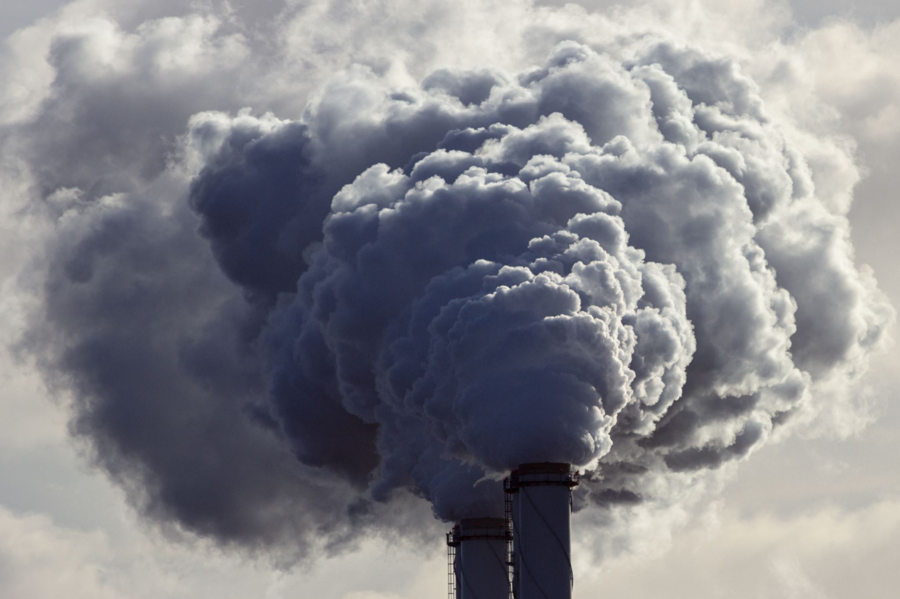
Caps limit harmful emissions
The government sets the cap across a given industry, or ideally the whole economy.
It also decides the penalties for violations.
Carbon dioxide and related pollutants that drive global warming are main targets of such caps.

Slide 11
Caps limit harmful emissions
Other pollutants that contribute to smog can also be capped.
In carbon dioxide's case, the heat-trapping greenhouse gas mixes into the upper atmosphere and has a global effect. Reducing emissions locally lowers levels around the world.

Slide 12
Companies are allowed to emit set amounts
The total amount of the cap is split into allowances, each permitting a company to emit one ton of emissions.

Slide 13
Companies are allowed to emit set amounts
The government distributes the allowances to the companies, either for free or through an auction.
The cap typically declines over time, providing a growing incentive for industry and businesses to reduce their emissions more efficiently, while keeping production costs down.

Slide 14
Companies are allowed to emit set amounts
Companies that cut their pollution faster can sell allowances to companies that pollute more, or "bank" them for future use.

Slide 15
Companies are allowed to emit set amounts
This market — the "trade" part of cap and trade — gives companies flexibility. It increases the pool of available capital to make reductions, encourages companies to cut pollution faster and rewards innovation.
Because there are only so many allowances available, total pollution drops as the cap falls.

Slide 16
Cap and trade
Cape and trade regimes generally set a total cap or absolute maximum quantity of emissions (measured over a specified period of time), on all emissions from the sources covered by the regime.

Slide 17
Cap and trade
This quantity is then allocated as individual allowances, either free of charge or by auction – a process which in effect, creates new transferable property rights.

Slide 18
Cap and trade
After the allocation, companies can either choose to reduce their emissions an sell the excess, or increase their emissions and buy others excess allowances.

Slide 19
Cap and trade
Such trading systems have a fixed compliance period, at the end of whic companies must be able to show that they have sufficient allowances to cover their actual emissions.

Slide 20
Cap and trade (absolute regimes)
Baseline and credit systems (relative regimes)
In addition, the cap may be reduced over time, to improve environmental quality.
Examples of current cap and trade systems are the scheme envisaged by Kyoto Protocol and the EU's Emissions Trading Scheme (ETS).

Slide 21
Focus on: cape and trade systems
It’s a system designed to reduce pollution in our atmosphere.
The cap on greenhouse gas emissions that drive global warming is a firm limit on pollution. The cap gets stricter over time.

Slide 22
Focus on: cape and trade systems
The trade part is a market for companies to buy and sell allowances that let them emit only a certain amount, as supply and demand set the price. Trading gives companies a strong incentive to save money by cutting emissions in the most cost-effective ways.

Slide 23
Cap and trade (absolute regimes)
Baseline and credit systems (relative regimes)
In contrast, baseline and credit systems have relative targets: no total cap of emission is fixed; rather a relative target is set by defining a baseline.
However, due to the relative nature of these targets, they do not give the same certainty of environmental outcome which cap and trade systems have in principle.

Slide 24
Focus on baseline and credit systems
Baseline and credit systems set a standard level for carbon emissions.
“Baseline and Credit: baseline emissions levels are defined for individual regulated entities and credits are issued to entities that have reduced their emissions below this level.”
The World Bank

Slide 25
Focus on baseline and credit systems
If an entity reduces their emissions below the baseline, more than they are otherwise obliged to, they generate carbon credits which can be sold to others looking to stay below their baselines.

Slide 26
Focus on baseline and credit systems
Those emitting more than their baseline do not necessarily face penalties, but they would also not generate carbon credits.

Slide 27
Tradable permit schemes
Overall, typical components of a tradable permit scheme are:
A binding (absolute or relative) target;
A unit of trade (for emissions trading normally one tonne of carbon dioxide equivalent);

Slide 28
Tradable permit schemes
Overall, typical components of a tradable permit scheme are:
A system for distributing allowances to participants;
A compliance period at the end of which participants must have enough allowances to cover their emissions, failing which they are subject to a penalty.

Slide 29

The Differences Between and Advantages of Cap and Trade and Baseline and Credit
Both cap and trade and baseline and credit represent ways in which we can mitigate carbon emissions and global warming.
But they are also different methods of climate action, making it important to understand their differences.

Slide 30
The Differences Between and Advantages of Cap and Trade and Baseline and Credit
The main difference between cap and trade and baseline and credit is that cap and trade sets an upper limit on carbon emissions, and entities must buy extra credits if they exceed this limit.

Slide 31
The Differences Between and Advantages of Cap and Trade and Baseline and Credit
Baseline and credit sets a standard level of carbon emissions, and entities reducing their emissions below this level can earn carbon credits to then sell to others.

Slide 32
The Differences Between and Advantages of Cap and Trade and Baseline and Credit
Also, cap and trade systems are based on emissions, whereas baseline and credit systems are based on emission intensity. Unlike cap and trade, there is no certainty that targets will be met with baseline and credit.

Slide 33

The Differences Between and Advantages of Cap and Trade and Baseline and Credit
The following are key advantages of cap and trade:
Caps on carbon emissions can be set strictly
Unused carbon credits can be traded to other entities
Incentivizes companies to invest in greener technologies

Slide 34
The Differences Between and Advantages of Cap and Trade and Baseline and Credit
The following are key advantages of baseline and credit:
Generated credits can be sold to other entities
No pressure to buy credits if the baseline is exceeded
Incentivizes the switch to low-carbon alternatives

Slide 35

The Kyoto Protocol
The Kyoto Protocol, which follows the United Nations Framework Convention on Climate Change (UNFCCC), is one of the most important international legal instruments to combat climate change.

Slide 36
The Kyoto Protocol
It is the first international agreement that contains the commitments of industrialized countries to reduce the emissions of some greenhouse gases, responsible for global warming. It was adopted in Kyoto, Japan on December 11, 1997 and entered into force on February 16, 2005.

Slide 37
The Kyoto Protocol
The Kyoto Protocol concerns the emissions of six greenhouse gases:
carbon dioxide (CO2);
methane (CH4);
nitrous oxide (N2O);
hydrofluorocarbons (HFC);
perfluorocarbons (PFC);
sulfur hexafluoride (SF6).

Slide 38
The Kyoto Protocol
The main feature of the Kyoto Protocol is that it establishes binding and quantified targets for the limitation and reduction of greenhouse gases in the ratifying countries, or rather the 37 industrialized countries and the European Community.

Slide 39
The Kyoto Protocol
The industrialized countries (listed in Annex I of the UNFCCC), recognized as being responsible for the levels of greenhouse gases concentration in the atmosphere, undertook to reduce their greenhouse gas emissions, in the period 2008-2012, by at least 5% compared to 1990 levels.

Slide 40
The Kyoto Protocol
The Kyoto Protocol requires countries to achieve their reduction targets primarily through national measures. However, the protocol allows to reduce greenhouse gas emissions through market-based mechanisms, the so-called "Flexible Mechanisms".
These are:

Slide 41
The Kyoto Protocol
International Emission Trading (ET): allows the exchange of emission credits between industrialized Countries and economies in transition; a Country that has achieved a decrease in its greenhouse gas emissions higher than its target can thus transfer (using ET) these "credits" to a Country that, on the contrary, has not been able to meet its reduction commitments greenhouse gas emissions;

Slide 42
The Kyoto Protocol
Clean Development Mechanism-CDM: allows industrialized and economies in transition Countries to carry out projects in developing Countries, which produce environmental benefits in terms of reducing greenhouse gas emissions and the economic and social development of guests Countries and, at the same time, generate emission reduction credits (CER) for the Countries promoting the interventions;

Slide 43
The Kyoto Protocol
Joint Implementation-JI: it allows industrialized and economies in transition Countries to carry out projects to reduce greenhouse gas emissions in another Country of the same group and to use the resulting credits (ERU), jointly with the host country.

Slide 44
The 2003/87 EU ETS Directive
The EU ETS is a cornerstone of the EU’s policy to combat climate change and its key tool for reducing greenhouse gas emissions cost-effectively. It is the world’s biggest carbon market.
On 14 July 2021, the European Commission proposed the revision of the EU ETS Directive under the “Fit for 55” package of legislative proposals, in view to achieve climate neutrality in the EU by 2050, including the intermediate target of an at least 55% net reduction in greenhouse gas emissions by 2030.

Slide 45
The 2003/87 EU ETS Directive
This Directive establishes a Community GHG emissions trading scheme from 2005, to enable the Community and the Member States to meet their Kyoto Protocol commitments.

Slide 46
The 2003/87 EU ETS Directive
Directive 2004/101/EC reinforces the link between the EU's emission allowance trading scheme and the Kyoto Protocol by making the latter's 'project-based' mechanisms (Joint Implementation and the Clean Development Mechanism) compatible with the scheme.

Slide 47
The 2003/87 EU ETS Directive
From 2005, all installations in the energy sector, iron and steel production and processing, the mineral industry, and the wood pulp, paper and board industry, and emitting the specific GHG associated with that activity, must possess a permit issued by the appropriate authorities.

Slide 48
The 2003/87 EU ETS Directive
Each Member State must draw up a national plan indicating the allowances it intends to allocate for the relevant period and how it proposes to allocate them to each installation.

Slide 49
The 2003/87 EU ETS Directive
The Directive also provides for flights that arrive or depart from a Member State's territory to be subject to the EU ETS (from 2012), measure that so far applies to intra-EU flights.

Slide 50
The 2003/87 EU ETS Directive
Any operator failing to surrender the quantity of allowances commensurate with the emissions from his/her installation during the previous year will have to pay EUR100 (USD 125) per tCO2e and buy allowances for the excess emissions.

Slide 51

The EU Directive 2023/959
In pursuit of the “Fit for 55” environmental policy plan, an expansive and visionary strategy introduced by the EU Commission in July 2021, a profound revamping of the European Emission Trading System (EU ETS) is underway.

Slide 52
The EU Directive 2023/959
The objective is clear: reducing net emissions by 55 percent by 2030 and attaining net zero emissions by 2050.

Slide 53
The EU Directive 2023/959
Directive 2023/959, adopted by the European Parliament on April 18 and ratified by the Council on April 25, 2023, is now in effect as of June 5, 2023.
This directive amends Directive 2003/87/EC and Decision 2015/1814, providing the legislative foundation for the ETS and the Market Stability Reserve, respectively.

Slide 54
The EU Directive 2023/959
Firstly, directive 2023/959 targets energy-intensive sectors such as power generation and aviation, setting an impressive emissions reduction target of 62% by 2030 compared to 2005.
Previously, the target was 55%, highlighting the ambitious nature of the new goal.

Slide 55
The EU Directive 2023/959
Additionally, free allowances granted to companies across all sectors will be gradually phased out by 2034, starting from 2026.
This means that all participants in the ETS will bear the cost of their emissions, fostering greater accountability.

Slide 56
The EU Directive 2023/959
Market Stability Reserve for Equilibrium and Growth
The Market Stability Reserve, a reform introduced in this directive as a critical mechanism for maintaining equilibrium in the ETS, will undergo significant reinforcement.

Slide 57
The EU Directive 2023/959
Market Stability Reserve for Equilibrium and Growth
Originally established in 2019 to address the surplus of allowances resulting from the global financial crisis, the reserve regulates the supply of allowances through auctions.

Slide 58
The EU Directive 2023/959
Market Stability Reserve for Equilibrium and Growth
Under the reform, the reserve will double its input rate to 24% annually, and the minimum number of allowances allocated to the reserve will be raised to 400 million by December 31, 2030.

Slide 59
The EU Directive 2023/959
The Carbon Border Adjustment Mechanism (CBAM)
The directive also introduces a taxation mechanism called the Carbon Border Adjustment Mechanism (CBAM).
This mechanism aims to counteract carbon leakage risks by taxing imported goods based on their embodied emissions.

Slide 60
The EU Directive 2023/959
Lastly, the directive outlines the utilization of ETS profits. The revenue generated from the sale of allowances will contribute to establishing the Social Climate Fund, supporting individuals and businesses affected by rising energy prices, especially in heating and transportation.

Slide 61

Other examples of the EU'embrace of marked based instruments
Ever, in spite of this support for national energy taxes, the EU continues to have difficulty in progressing proposals in relation to a harmonised EU-level energy tax.
Aside from the 2003 Directive there are few examples of environmental charges, and taxes currently in use at the EU level are few, due mainly to the reluctance of Member States to allow the EU to legislate on fiscal matters, which is still subject to umanity of voting under the legal bases for indirect taxation and direct taxation.

Slide 62
Look at these videos
What is carbon trading? | CNBC International (youtube.com)
The Story of Cap & Trade (youtube.com)

