Slide 1
INCOTERMS®

Slide 2
SALES CONTRACT
KEY ELEMENTS

Slide 3
Identification of the Parties
Description of the Services and/or Goods
Payment Plan
Delivery
Cost of delivery
Transfer of risks
Method of delivery
Place for delivery
Time for delivery
Liability for a failed delivery or damage
Insurance
Delivery/transport document
Export/import clearance
Checking/packaging/marking
Inspection Period
Warranties
Miscellaneous Provisions
Governing law /Jurisdiction

Slide 4
Description of the Services and/or Goods
This is typically the most important aspect of a sales contract because it lists the exact goods or services that the buyer is paying for. For this reason, a description of goods should include key details, like:
Model number
Type
Size
Weight
Color
Quantity

Slide 5
Payment Plan
The payment is usually the term of a sales contract that is most negotiated, which is why it's so important to put it in writing as soon as you reach an agreement. Aside from the agreed-upon price, including any adjustments or deposits, your sales contract should outline:
How and when the buyer will receive an invoice
The timeline for payment
Acceptable payment methods, like email transfer, bank draft, certified check, cash, etc
Whether payments can be made in installments or paid in one lump sum

Slide 6
Payment Plan
In cases where the buyer isn't paying the full invoice right away, a promissory note is usually added to the sales contract. A promissory note is a document that goes into greater detail about the repayment terms, including any interest that will be charged and the schedule for repayment.

Slide 7
Delivery
Details about the delivery of the goods and/or services should also be addressed in a sales contract. This can include things like the:
Cost of delivery
Transfer of risks
Method of delivery
Place for delivery
Time for delivery
Liability for a failed delivery or damage
Insurance
Delivery/transport document
Export/import clearance
Checking/packaging/marking

Slide 8
Delivery
It's also pretty common for a sales contract to include what's known as a force majeure, which is a clause that discusses the inability to deliver due to things that are out of both parties' control, such as riots, floods, and other natural disasters.

Slide 9
Inspection Period
An inspection period isn't included in all sales contracts, but it can be a great way to bolster a buyer's confidence and give them a chance to examine an item to make sure that it meets the terms of the agreement.
The time allotted for an inspection period varies depending on the type of goods that are involved. For example, when perishable items are involved, buyers typically have to inspect and then accept or reject the goods as soon as they are delivered. On the other hand, when the sale involves more expensive items, like machinery, the buyer is usually given as long as a month to inspect the goods.

Slide 10
Warranties
A warranty is a legally enforceable guarantee assuring a buyer that the goods or services provided will meet the expected level of reliability and quality.
Usually the contract set out remedies and the rights of the buyer in case of defects

Slide 11
Miscellaneous Provisions
Depending on the goods or services you're providing, you can include these additional provisions in your sales agreement:
              • Governing Law: Also known as choice of law, this outlines which state law is applicable for the interpretation and enforcement of the contract.
              • Severability: This provision is made to ensure that all other provisions are still valid and enforceable even if part of the contract is unenforceable or invalid.
              • Confidentiality: In transactions where confidential information is shared, this provision explicitly limits the distribution of these private details.

Slide 12
Miscellaneous Provisions
              • Breach of Contract: A breach of contract outlines what would happen if one party violates the contract, when a contract can be terminated, and any actions a party can take to recover their losses in the event of a breached contract.
              • Notices: This section describes how all communication should take place. Aside from the mode of communication, it sometimes even outlines the days and times that communication should occur.
              • Amendments: An amendments section addresses the steps that should be taken in the event that the contract's terms and provisions need to be formally altered.

Slide 13
INCOTERMS
WHAT ARE THEY FOR

Slide 14
Introduction
The Incoterms are a set of commercial/trade rules established by the International Chamber of Commerce (“Icc”) that are used in international sale contracts. Incoterms® are referred to as International Commercial Terms.
Incoterms are a set of 11 internationally recognized rules which define the responsibilities of sellers and buyers.
In a nutshell: Incoterms specify who is responsible for paying for and managing the shipment, insurance, documentation, customs clearance, and other logistical activities.

Slide 15
Introduction
Each Incoterms rule clarifies the tasks, costs, and risks to be borne by buyers and sellers in a given transaction.
Incoterms® were first published in 1936 and are continually updated over time to reflect the changing global business environment to be continually used in 2022 and beyond.
The International Chamber of Commerce ICC published the latest version of Incoterms® 2020.

Slide 16
Introduction
The ICC originally published Incoterms® in 1936 and have continually made updates to reflect the changes to the global trade environment.
The Incoterms are not mandatory rules – for them to receive legal effect, they must be explicitly incorporated by the parties into their contract.
Although the ICC recommends using Incoterms® 2020 beginning January 1, 2020, parties to a sales contract can agree to use any version of Incoterms after 2020. They need to clearly specify the chosen version of Incoterms being used (i.e., Incoterms® 2010, Incoterms® 2020, or any earlier version).

Slide 17
Incoterms Clarify Responsibilities of Parties to a Sales Transaction
In each Incoterm rule, a statement is provided as to seller’s responsibility to provide the goods and commercial invoice in conformity with the contract of sale.
Each Incoterm rule has a statement stipulating which party is responsible for obtaining any export license or other official authorization required for export and for carrying out the customs formalities necessary for the export to proceed.

Slide 18
Incoterms Clarify Responsibilities of Parties to a Sales Transaction
Similarly, each rule has a corresponding statement as to which party is responsible for obtaining any import license or other official authorization required for import and for carrying out the customs formalities required for the import of goods. These statements also specify which party bears the cost of handling these tasks.

Slide 19
Incoterms Clarify Responsibilities of Parties to a Sales Transaction
Similarly, each Incoterm rule specifies which party to the transaction, if any, is obligated to contract for the carriage of the goods.
Each rule also contains statements, as to which party is responsible for packing the goods for transport overseas and for bearing the costs of any pre-shipment inspections.

Slide 20
What Incoterms Do Not Cover
Incoterms are generally incorporated in the contract of sale, however, they do not:
address all the conditions of a sale;
identify the goods being sold nor list the contract price;
reference the method nor timing of payment;
specify which documents must be provided by the seller to the buyer to facilitate the customs clearance process at the buyer’s country;
address liability for the failure to provide the goods in conformity with the contract of sale, delayed delivery,
nor dispute resolution mechanisms.

Slide 21
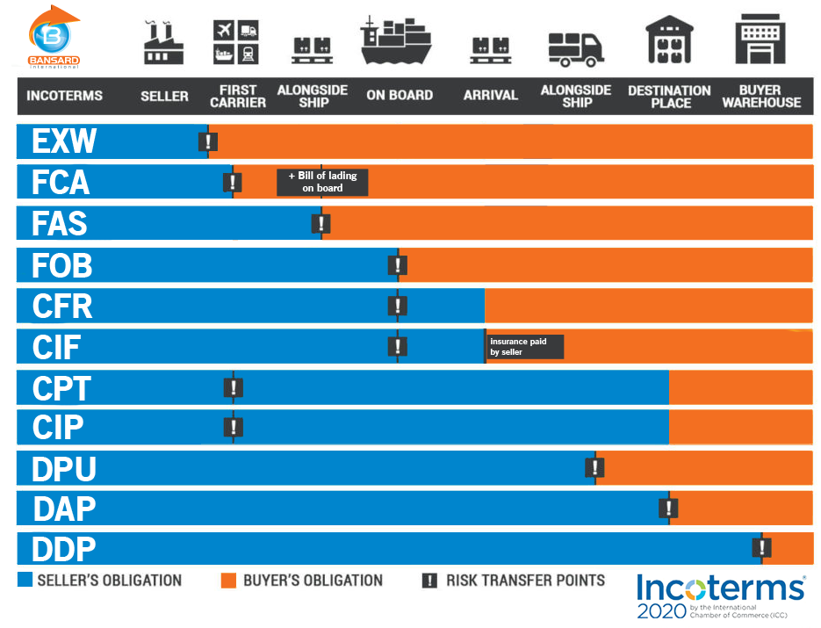

Slide 22
Classification of Incoterms
The Incoterms are divided into four principal categories: E, F, C and D.
Category E (Departure), which contains only one trade term, i.e. EXW (Ex Works).
Category F (Main Carriage Unpaid), which contains three trade terms:
  FCA (Free Carrier)
  FAS (Free Alongside Ship)
  FOB (Free on Board)

Slide 23
Classification of Incoterms
Category C (Main Carriage Paid), which contains four trade terms:
  CPT (Carriage paid to)
  CIP (Carriage and Insurance paid to)
  CFR (Cost and Freight)
  CIF (Cost, Insurance and Freight)
Category D (Arrival), which contains three trade terms:
  DAP (Delivered at Place)
  DPU (Delivered at Place Unloaded)
  DDP (Delivered Duty Paid)

Slide 24
Classification of Incoterms
The four above-mentioned categories can also be classified as per the means of transportation:
Incoterms for any mode of transport: EXW, FCA, CPT, CIP, DPU, DAP and DDP;
Incoterms only for sea and inland waterway transport: FAS, FOB, CFR and CIF.

Slide 25
Each Incoterm contains a set of rules of interpretation for the obligations of both the seller (A1-A10) and the buyer (B1-B10) covering the following issues:
A1/B1 – General Obligations,
A2/B2 – Delivery,
A3/B3 – Transfer of risks,
A4/B4 – Carriage,
A5/B5 – Insurance,
A6/B6 – Delivery/transport document,
A7/B7 – Export/import clearance,
A8/B8 – Checking/packaging/marking,
A9/B9 – Allocation of costs, and
A10/B10 – Notices.

Slide 26
EXW Incoterm (Ex Works)
The EXW Incoterm imposes only minimum obligations on the seller. More particularly, the seller is simply required to deliver the goods to the buyer at a named place of delivery which is usually the seller’s place of business, but can be any particular location such as a warehouse, factory, etc., and within the agreed time specified in the contract.

Slide 27
EXW Incoterm (Ex Works)
Until the goods have not been delivered as specified in the sale contract, the seller bears all risks of loss or damage to the goods. Once delivered, such risk is automatically shifted to the buyer. The same is true for any costs relating to the goods – until the delivery of the goods, the costs are to be borne by the seller; after their delivery, by the buyer.

Slide 28
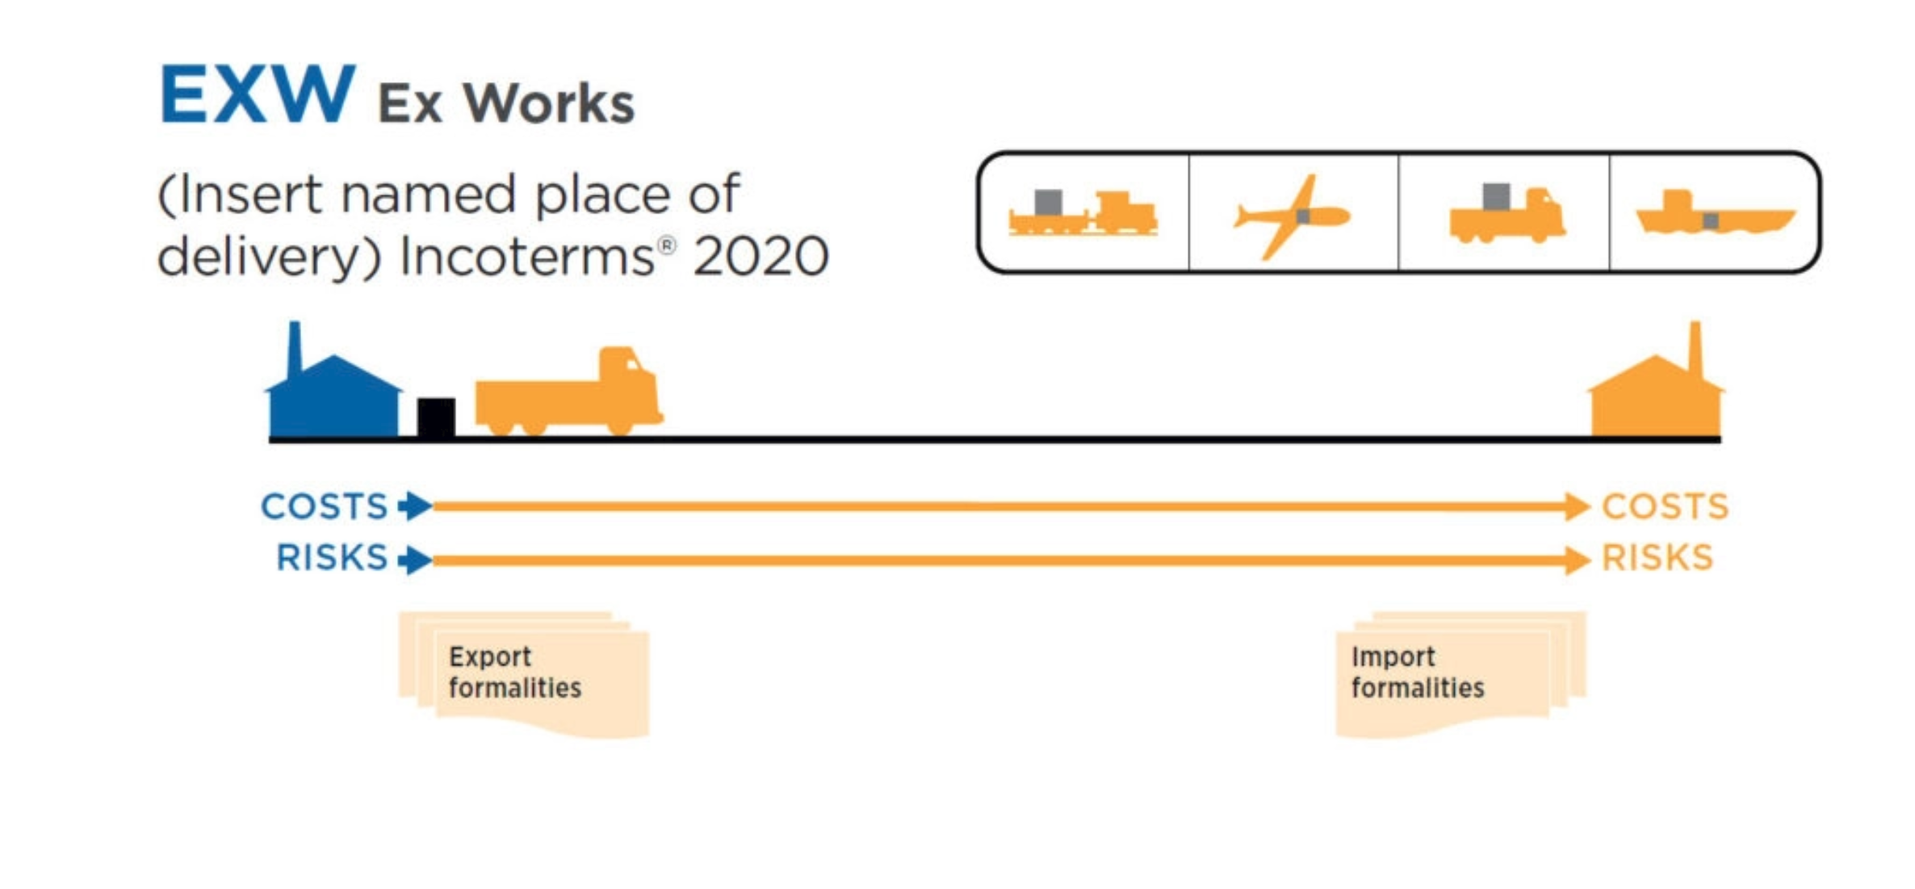

Slide 29
FCA Incoterm (Free Carrier)
The seller delivers the goods at the agreed place to the carrier nominated by the buyer.
Most often, the buyer hires a transport that picks up the goods at the seller’s warehouse. The seller must load the goods on the buyer’s transport, at which point the risk for the goods transfers to the buyer.

Slide 30
