Slide 1

INTERNATIONAL CONTRACT LAW
Prof. Tommaso Febbrajo
t.febbrajo@unimc.it

Slide 2
ROME I REGULATION
on the law applicable to contractual obligations

Slide 3
ROME I
Regulation (EC) No 593/2008 of the European Parliament and of the Council of 17 June 2008 on the law applicable to contractual obligations (Rome I).
This Regulation replaces the Rome Convention that established uniform rules for determining the law applicable to contractual obligations in the European Union (EU).

Slide 4
ROME I
It is based upon and replaces the Rome Convention on the Law Applicable to Contractual Obligations 1980.
The Rome I Regulation can be distinguished from the Brussels Regime which determines which court can hear a given dispute, as opposed to which law it should apply.

Slide 5
ROME I
The regulation applies to all EU member states except Denmark, which has an opt-out from implementing regulations under the area of freedom, security and justice.
While the United Kingdom originally opted-out of the regulation they subsequently decided to opt-in

Slide 6
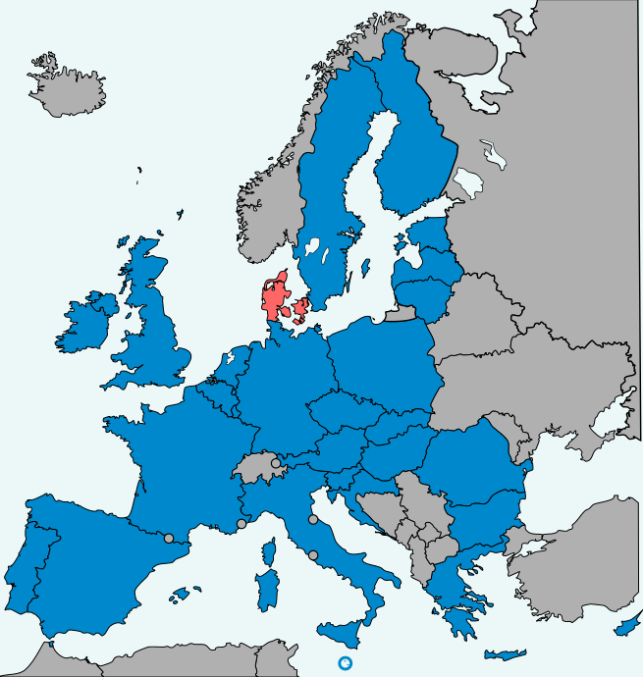
Rome I: states appling the regulation

Slide 7
ROME I: what is all about?
The regulation sets out which law be used to interpret contracts with an international element (i.e. contracts agreed by parties in different countries).
Under its Articles 28 and 29, the regulation came into force on 17 December 2009 and applies to contracts concluded after that date (beginning 18 December 2009).

Slide 8
ROME I: what is all about?
The regulation sets out which law be used to interpret contracts with an international element (i.e. contracts agreed by parties in different countries).
Under its Articles 28 and 29, the regulation came into force on 17 December 2009 and applies to contracts concluded after that date (beginning 18 December 2009).

Slide 9
ROME I
This Regulation applies to contractual obligations in civil and commercial matters in the event of a conflict of laws.
The law this Regulation determines as applicable to a contract will regulate several aspects of contractual law: interpretation, performance, penalties for breaching obligations, assessment of damages, termination of obligations, instructions for actions, and penalties for invalid contracts.

Slide 10
ROME I
MAIN RULE N. 1
Freedom of choice
The parties to a contract can choose the governing law.
It may be applied to only a part or the whole of the contract.
If all the parties agree, the applicable law may be changed at any time.

Slide 11
ROME I
MAIN RULE N. 2
Applicable law in the absence of choice
Where the parties have not chosen the applicable law for contracts, the regulation provides solutions on the ground of the type of contract.

Slide 12
ROME I
MAIN RULE N. 3
When no applicable law can be determined under the regulation, the applicabile law is the one of the country with which the contract is most closely connected.

Slide 13
ROME I
Applicable law in the absence of choice
In contracts for
the sale of goods
provision of services,
franchises or distribution,
The applicable law will be determined based on the country of residence of the principal actor carrying out the contract.

Slide 14
ROME I
Applicable law in the absence of choice
In contracts concerning
immovable property,
the law applicabile is the one of the country where the property is located

Slide 15
ROME I
Applicable law in the absence of choice
In the case of
sale of goods by auction,
the law of the country of the auction will apply.

Slide 16
ROME I
Rules applicable to specific contracts
For the following types of contract, the Regulation lays down options for the selection of applicable law and determines the law to be applied in the absence of choice:
contracts for the carriage of goods – in the absence of choice, the applicable law will be that of the country of residence of the carrier.

Slide 17
ROME I
Rules applicable to specific contracts
contracts for the carriage of passengers – in the absence of choice, the law of the country of residence of the passenger will apply, if it is also the place of departure or destination.
Yet, if the contract is more closely related to another country, then the law of that country will apply.

Slide 18
ROME I
Rules applicable to specific contracts
- consumer contracts between consumers and professionals – the applicable law is that of the country of residence of the consumer, provided that this is also the country where the professional carries out his/her activities or to which his/her activities are directed.

Slide 19
ROME I
Rules applicable to specific contracts
Insurance contracts – in the absence of choice, the applicable law will be that of the country of residence of the insurer.
However, if the contract is more closely related to another country, that country’s law will apply.

Slide 20
ROME I
Rules applicable to specific contracts
Individual employment contracts –the law governing the contract will be that of the country where, or from where, the employee carries out his/her tasks.
If this cannot be determined, the applicable law will be that of the country where the place of business is located.

Slide 21
United Nations Convention on Contracts for the International Sale of Goods (Vienna, 1980) (CISG)

Slide 22
The Vienna Convention
The United Nations Convention on Contracts for the International Sale of Goods (CISG; the Vienna Convention) is a treaty that is a uniform international sales law.
As of april 2022, it has been ratified by 95 countries that account for a significant proportion of world trade, making it one of the most successful international uniform laws (no UK, Malta, Ireland, India,…).

Slide 23
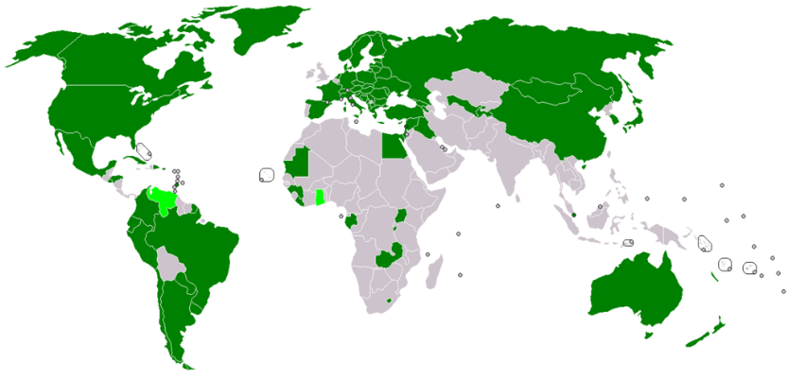
Countries that have ratified the CISG

Slide 24
The Vienna Convention
Hong Kong, India, South Africa, Taiwan, and the United Kingdom are the only major trading countries that have not yet ratified the CISG.

Slide 25
The Vienna Convention
Part I: Sphere of Application and General Provisions (Articles 1–13)
The CISG applies to contracts of the sale of goods between parties whose places of business are in different States, when the States are Contracting States (Article 1).
Given the significant number of Contracting States, this is the usual path to the CISG's applicability.

Slide 26
The Vienna Convention
Part I: Sphere of Application and General Provisions (Articles 1–13)
The CISG also applies if the parties are situated in different countries (which need not be Contracting States) and the conflict of law rules lead to the application of the law of a Contracting State.
Es. a contract between a British trader and a Brazilian trader may contain a clause that arbitration will be in Sydney under Australian law with the consequence that the CISG would apply.

Slide 27
The Vienna Convention
Part I: Sphere of Application and General Provisions (Articles 1–13)
The CISG also applies if the parties are situated in different countries (which need not be Contracting States) and the conflict of law rules lead to the application of the law of a Contracting State.
Es. a contract between a British trader and a Brazilian trader may contain a clause that arbitration will be in Sydney under Australian law with the consequence that the CISG would apply.

Slide 28
The Vienna Convention
Part I: Sphere of Application and General Provisions (Articles 1–13)
Key rules
The CISG only applies to international commercial sales of goods and not apply to contracts that include services.
The sale must be international in character. A sale is considered "international" if it involves "parties whose places of business are in different States."
The CISG only applies to commercial transactions. The CISG does not apply to auctions, ships, aircraft.The position of computer software is ‘controversial’ and will depend upon various conditions and situations.

Slide 29
The Vienna Convention
The CISG lays down rules about:
Formation of the Contract (Articles 14–24)
  The CISG attempts to resolve the common situation where an offeree's reply to an offer accepts the original offer, but attempts to change the conditions. The CISG says that any change to the original conditions is a rejection of the offer—it is a counter-offer—unless the modified terms do not materially alter the terms of the offer.

Slide 30
The Vienna Convention
The CISG lays down rules about:
Sale of Goods (Articles 25–88)
  Obligations of the seller, obligations of the buyer, passing of risk, obligations common to both buyer and seller.
  Remedies of the buyer and seller depend upon the character of a breach of the contract.
    If the breach is fundamental, then the contract may be avoided and the aggrieved party may claim damages
    If the breach is not fundamental, then the contract is not avoided and remedies may be sought including claiming damages, specific performance, and adjustment of price

