Slide 1

INTERNATIONAL CONTRACT LAW
Prof. Tommaso Febbrajo
t.febbrajo@unimc.it

Slide 2

Chapter III
The main types of international contract

Slide 3
INTRODUCTION

Slide 4
The main types of international contract
In their international commercial dealings, most companies, avail themselves of two main kinds of contract:
international sales contracts,
international distribution contracts

Slide 5
SALES CONTRACT

Slide 6
International sales contracts
DEFINITION:
An agreement between a seller and a buyer for the sale of goods, for an agreed upon value in money
PARTIES
Seller (or vendor) and buyer (or purchaser)

Slide 7
FORM OF A SALES CONTRACT
A sales contract may be formed either by a
written act negotiated by the parties,
by general terms and conditions of sale imposed by the seller or
by general terms and conditions of purchase imposed by the buyer.

Slide 8
General terms and conditions of sale
General terms and conditions of sale: enable companies to define the legal framework of their commercial transactions. Each exporting company has its own general terms and conditions of sale.

Slide 9
The sales contract can be concluded in several ways. 1) offer to sell goods
OFFER TO SELL GOODS
(from the seller)
ACCEPTANCE
(from the buyer)
CONCLUSION

Slide 10
1) Offer to sell goods
WHEN A SELLER receives an request from a buyer, one option is to return an OFFER TO SELL the goods in an informal format, such as a letter.
The letter usually is brief, containing only the essential terms of the offer.
Usually, additional contract provisions are printed on the reverse side of the letter.
If the buyer places an order, the contract is concluded.
The letter offer and the order will be sufficient evidence of the contract for enforcement purposes.
Used for one-time, smaller transactions when the parties are not establishing a continuing relationship.

Slide 11
[seller’s letterhead] [date] [buyer’s company name] [buyer’s address]
COMMENT: The contract is binding against the parties who sign it. These parties should be identified by their legal names, company names, and addresses. A party who later needs to give notice to the other should use the address specified in the contract.
Re: Sale of [identification of goods]
Dear [Sir/Madam]:
We thank you for your inquiry of [date] regarding the purchase of [identify goods]. We are pleased to offer you our most competitive price of [______]. The minimum order is[_____].Please note that your order will be subject to the conditions printed on the reverse of this letter.Special shipping terms for this order are as follows: [specify].We will deliver the goods ordered to your address as stated above, unless you specify a different address in your order. The delivery will be within [number] days of our receipt of your order, unless we otherwise inform you. The terms of delivery are as follows: [specify].
If we do not receive an order from you by [date], this offer is withdrawn. We look forward to hearing from you.
Sincerely yours,
[signature of seller]

Slide 12
The sales contract can be concluded in several ways. 2) Purchase order
PURCHASE ORDER
(from the Buyer)
ACCEPTANCE
(from the seller)
CONCLUSION

Slide 13
2) purchase offer
ONCE THE BUYER knows the goods being offered for sale, the price, and the sale conditions, the buyer may submit an order—commonly known as a purchase order, or P.O.—to the seller.
In effect, a purchase order is an offer to buy.
No contract is formed until the order has been accepted by the seller.
Standard clauses are often printed on the reverse side of the purchase order.
The parties should be careful that the standard clauses attached to the purchase order are not in conflict with any conditions that the seller has placed on the sale. Conflicting clauses should be renegotiated and changed before the parties sign the contract.

Slide 14
[buyer’s letterhead]
Purchase Order No: [number]
Dated: [date]
Issued to: [name and address of seller]
We are pleased to place the following order, subject to the conditions appearing on the reverse of this purchase order:
Model Number Description Quantity Price/Item Total Price
Terms of Shipping and Delivery: [specify, including import and export costs and documentation, destinations, delivery times, and insurance requirements].
[signature of buyer]

Slide 15
The sales contract can be concluded in several way. 3) Drafting a contract
DRAFTING A CONTRACT
CONCLUSION:
AS THE CONTRACT IN SIGNED BY BOTH PARTIES

Slide 16
On [date], this Agreement is made between [name], [a/an] [description and nationality] of [address] (the Seller) and [name], [a/an] [description andnationality] of [address] (the Buyer). The parties agree as follows:
SALE OF GOODS. The Seller agrees to sell and the Buyer agrees to purchase the following goods (the “Goods”): [list].
COMMENT : The description of the goods should be specific, including as appropriate model numbers, colors, quantities, and so forth. If specifications are furnished by the Buyer, they must be included as a separate attachment with a reference here incorporating them into the agreement.

Slide 17
2 . PURCHASE PRICE.
The Buyer agrees to pay [currency and amount, e.g., US$18,000] for the Goods (the “Purchase Price”) in accordance with the following schedule: [specify, e.g., US$6,000 in cash at the time this Agreement is signed by both parties; and the balance of US$12,000 in 6 equal monthly installments of US$2,000 each, to be paid on the tenth day of each month beginning on (date) and ending on (date)].

Slide 18
3 . TRANSPORT ARRANGEMENTS.
Determine the mode of transport that best suits the nature of the goods and the destination and offers the best security.
4. DELIVERY ARRANGEMENTS
Determine the date and place of shipment. Define time limits on the basis of the entry into force of the contract; provision must be made for specified penalties for late delivery.
INCOTERMS

Slide 19
5 . FORCE MAJEURE
It is a common clause in contracts that essentially frees both parties from liability or obligation when occur extraordinary and unforeseeable events beyond the control of the parties (such as hurricane, flooding, earthquake, volcanic eruption, etc.)
6. GUARANTEES
Define the guarantees to be given by each party

Slide 20
7. JURISDICTION and APPLICABLE LAW IN THE EVENT OF LITIGATION
Determine which jurisdiction and wich law is to apply for the resolution of disputes.
8. LANGUAGE
Determine the language of the contract.

Slide 21
DISTRIBUTION
CONTRACT

Slide 22
DISTRIBUTION CONTRACT
WHAT IT’S FOR:
A company can choose between hiring its own sales people to distribute its products or it can use distributors to provide the same function.
Most small businesses use distributors because it is less expensive, facilitates cash flow and because distributors have more knowledge and experience in the market area. The distribution agreement is the contract between a company in need of having its products distributed and the distributor that specializes in providing that function.

Slide 23
DISTRIBUTION CONTRACT
DEFINITION:
The distribution agreement is the contract between a company in need of having its products distributed and the distributor that specializes in providing that function
The agreement is usually between a manufacturer or vendor (SUPPLIER) and a DISTRIBUTOR.

Slide 24
DISTRIBUTION CONTRACT
DEFINITION:
This type of contract works best for companies with limited sales forces because it eliminates the need to hire additional employees.
Once a company enters into a distribution agreement, and depending upon the terms of the agreement as they vary by industry, the distributor assumes the risk for selling the product to retailers or to final end-users.
The distributor can also provide a range of after-sale services, such as technical support, repairs and servicing that would be costly -- if not impractical -- to do in-house.

Slide 25
DISTRIBUTION CONTRACT.
MAIN CLAUSES
Product and Territory:
Specify, in Annexes if necessary, the precise definition of the territory and the supplier’s product range to be distributed.

Slide 26
DISTRIBUTION CONTRACT.
MAIN CLAUSES
Obligations of the Distributor:
Establish the Distributor will take care of distribution in its own name and for its own account.
If necessary establish a system of direct sales commissions.

Slide 27
DISTRIBUTION CONTRACT.
MAIN CLAUSES
Distribution exclusivity:
On an exclusive agreement, the specified distributor will be the sole distributor with the right to sell the product within a particular geographic region or within multiple regions.
If the arrangement is non-exclusive, the manufacturer or vendor may supply other distributors.

Slide 28
DISTRIBUTION CONTRACT.
MAIN CLAUSES
Distribution exclusivity:
Non-exclusive agreements tend to be preferred by suppliers and opposed by distributors because suppliers want to evaluate distributor performance before committing to exclusivity.

Slide 29
DISTRIBUTION CONTRACT.
MAIN CLAUSES
Commitment not to compete:
Specify the prohibition for distributors to sale competing products

Slide 30
DISTRIBUTION CONTRACT.
MAIN CLAUSES
Sales Conditions
Establish, usually in an Annex, the terms of sale and the prices of the products.

Slide 31
DISTRIBUTION CONTRACT.
MAIN CLAUSES
Resale prices
Two options:
Declare that the Distributor is free to fix resale prices, but always respecting the product image.
Establish at which price goods must be re-sold

Slide 32
DISTRIBUTION CONTRACT.
MAIN CLAUSES
Commitment to inform the Supplier
On the local market situation, regulations, competitors, new products, etc.

Slide 33
DISTRIBUTION CONTRACT.
MAIN CLAUSES
Intellectual property:
Set the limits of the right of use of the brands by the Distributor and the prohibition for assignment and registration on his name.

Slide 34
DISTRIBUTION CONTRACT.
MAIN CLAUSES
Stocks
Remember the obligation of the Distributor to maintain a sufficient stock of products and the obligations for post-sales service.

Slide 35
DISTRIBUTION CONTRACT.
MAIN CLAUSES
Term of the Contract
Two options:
Set a duration (1, 3, 5 years)
Permanent contract (indefinite period). Contract could end anytime, with the respect of a notice period. Without a specified time frame outlined in the agreement's termination clause, some states require up to 90 days of advance notice for terminating a distribution agreement. The agreement may also require one party to compensate the other for the income lost because of the termination.

Slide 36
DISTRIBUTION CONTRACT.
MAIN CLAUSES
Early termination
Specify the conditions that justify early termination of the contract and situations that are considered non-compliance.

Slide 37
DISTRIBUTION CONTRACT.
MAIN CLAUSES
Compensation for termination of the Contract
Determine if the Distributor is entitled to compensation for customers in the event of early termination.

Slide 38
OTHER TYPES OF BUSINESS CONTRACTS

Slide 39

SALES REPRESENTATIVE CONTRACT

Slide 40
SALES REPRESENTATIVE CONTRACT
The International Sales Representative Contract regulates the relationship between a person or company (Agent) which acts as a sales agent on behalf of the exporting company (Principal), introducing its products to potential buyers in a foreign market.
An agent’s rights will vary depending on the agreement, but will generally include a right to be paid for providing agent’s services and a right to be insured in respect of any action taken on behalf of the Principal. The agent will also have the authority to create a contract between the Principal and customer.

Slide 41
SALES REP VS DISTRIBUTION CONTRACT
Under a distribution arrangement, the manufacturer sells products directly to the distributor, who then sells the products on to his customers, adding a margin to cover his own costs and profit.
Manufacturer
Distributor
Customer

Slide 42
SALES REP VS DISTRIBUTION CONTRACT
The Agent acts on behalf of the Manufacturer, whereas the Distributors acts on their own behalf
Agent
(on b. of Man.)
Customer

Slide 43
Advantages of appointing a distributor
The manufacturer/supplier may be able to pass on a large degree of the risk associated with the products.
A distributor is more motivated to sell the goods. He purchases them from the supplier, therefore he takes on greater risk of failing to sell than the sales rep.
Easier to get out of the agreement: unlike the Sales rep contract, distribution contract doesn’t fall under labour law, who protects the agents also in terms of duration of the contract.

Slide 44
Advantages of appointing a business agent
  A Supplier has more control over the activities of an agent than he would of a distributor. Therefore, an agency is more appropriate in situations where the supplier wishes to maintain tight control over the marketing and pricing of the products.
  An agency agreement does not fall under competition law.

Slide 45

FRANCHISE AGREEMENT

Slide 46
FRANCHISE AGREEMENT
An independent business enterprise (franchisee) distributes goods or services in connection with a network of other independent owners. Each owner of a franchise will benefit from the support (layout of the store; know-how, training, etc…) of the central organization (franchisor).
Franchisee must pay to the franchisor a fixed initial fee as well as monthly royalty payments.

Slide 47
FRANCHISE AGREEMENT
When it is useful?
When the goal is to minimize the risks of a start up.
Many new business owners decide to invest their money entering into a franchise agreement, because of the unknowns involved in a start-up.
The pros of a franchise agreement are:
  wide-spread brand recognition
  A built-in customer base
  Franchisor offer pre-opening support for site selection, design, training and financing
  Franchisor offer ongoing support in advertising, operations, management, and acquisition

Slide 48
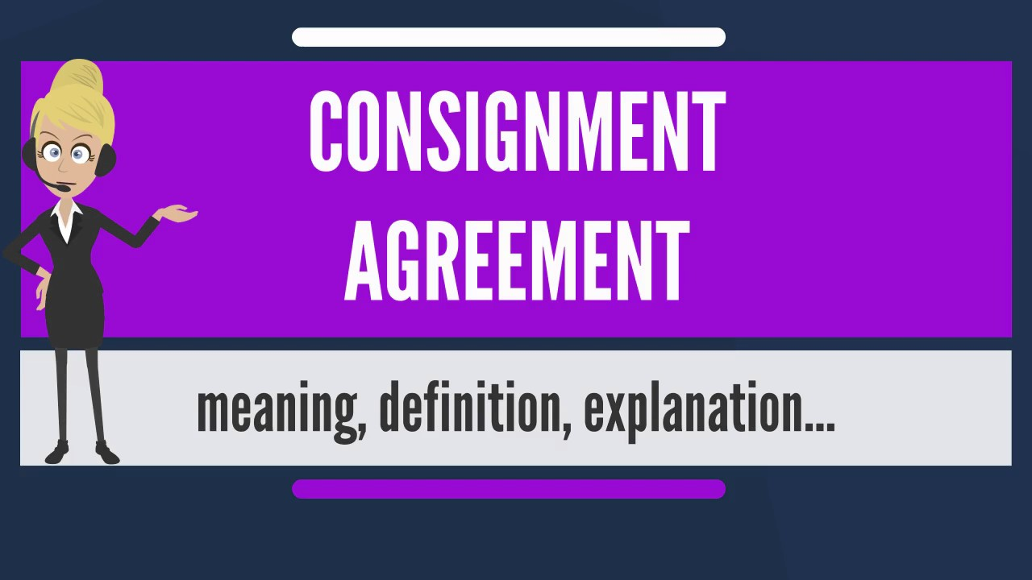
CONSIGNMENT AGREEMENT

Slide 49
CONSIGNMENT AGREEMENT. Definition
The owner of products (known as the consignor) gives possession of them to another party (the consignee), who sells them. Until the goods are sold, they remain the property of the owner. Title to the goods never passes to the person selling them (consignee).
Unsold or out-dated products can usually be returned by the Consignee. Therefore, all risks remain with the Consignor.

Slide 50

LICENSING CONTRACT

Slide 51
LICENSING CONTRACT. Definition
LICENSING CONTRACTS take a step beyond the mere sale of goods. These arrangements involve the sale of intellectual property to a local party who makes the goods in compliance with the licensing agreement.

Slide 52
LICENSING VS FRANCHISE
The licensing arrangement differs from a franchise in two major ways:
The licensee is the owner of the products that he creates, while the franchisee purchases the goods from the manufacturer.
The franchise involves an entire business structure, while a license allows the licensee more discretion over the business operation.

Slide 53
PAYMENTS
Payments from the licensee to the licensor usually take the form of:
guaranteed minimum payments
royalties on sales. Royalties typically range from 6 to 10 percent, depending on the specific property involved and the licensee's level of experience and sophistication

Slide 54
TIME FRAME OF THE DEAL
The licensing agreement will include:
provisions about the length of the contract,
renewal options and termination conditions
a strict market release date for products licensed to manufacturers

Slide 55
QUALITY
The licensor may insert conditions in the contract requiring the licensee to provide prototypes of the product.
Another common quality-related provision in licensing agreements involves the method for disposal of unsold merchandise. If items remaining in inventory are sold as cheap storage inventories, it can hurt the reputation of the licensor in the marketplace.

