Slide 1
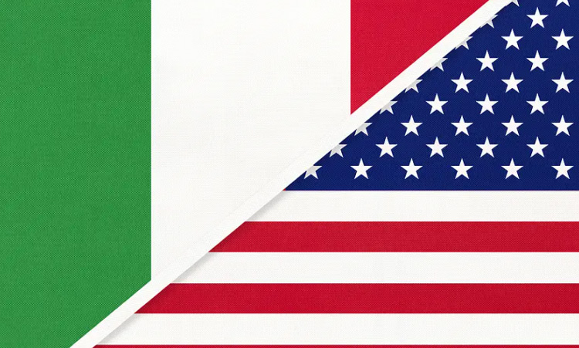
TRANSATLANTIC DIALOGUES:
ENCOUNTERS BETWEEN ITALY AND THE USA
INTRODUCTION

Slide 2

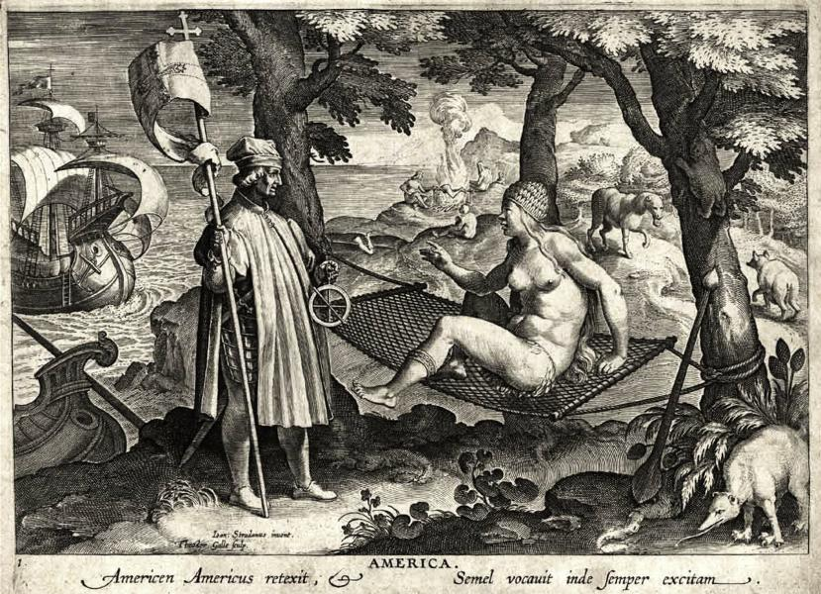
ITALIANS IN/AND AMERICA
Italy and America had an intimate relationship since the very beginning. After all, America was officially “discovered” (for Europeans) by an Italian – an event that inaugurated the Modern Age – and got its name after another one.

Slide 3
THE AMERICAN MYTH OF ITALY
Even if the European colonies in North America received very few Italians, Italy became a foundational (but very contradictory) myth in American culture at the time of the American Revolution, as the geographical location of that Ancient Roman Republic which was taken as a model for the political construction of the new nation (the advocates of a Federal Government with a strong central power published the Federalist Papers with the Latin pseudonym Publius), but also of the heart of that Roman Empire that strongly resembled the British Empire the revolutionaries were fighting against. Rome (and Italy) were also the center of Catholicism, seen as a corrupt degradation of the original Christian faith by both early Puritanism and later on by the Enlightenment and the more liberal strains of American Protestantism. In many ways, Italy has functioned, and somehow keeps functioning, as a (more or less) distorting mirror where American culture sees its own image reflected, enlarged, diminished, warped, and even anamorphically revealing of what America is and is not, wants to become and is afraid of becoming…

Slide 4
THE ITALIAN MYTH OF AMERICA
On the other side of the Atlantic, Italy (as many other European and non-European cultures) has always seen America as the very place where the myth of the New Beginning that every migrant dreams about could finally be realized. For Italian culture this became especially true at the turn of the 19th into the 20th century, when Italian migrants (Italy is the country with the largest number of emigrants in modern history) came to America (North and South) en masse. The United States in particular came to represent progress, prosperity, freedom, the right to pursue happiness – but the harsh reality of migration also transformed this new world into the land of prejudice, marginalization and exploitation.

Slide 5
CLASSICAL VS. GOTHIC ITALY
At the time of the birth of the United States of America, Italy for the Anglo-Saxon world was conceptualized as the site of two opposite cultural tendencies: on the one hand it was considered as the center of irradiation of Western civilization and of the classical values of civic virtue, harmony and order; on the other, it represented all the horrors of imperialism, bigotry and decadence, of a past that does not want to die, as fictionalized in gothic romances like Horace Walpole’s The Castle of Otranto (1764). The fashion of the Grand Tour, made popular by authors like Goethe (Italienische Reise, 1813-17), gradually conquered also the USA, where the ambiguous mixture of Classicism and Gothicism of the cultural image of Italy created a sort of love-hate attitude.

Slide 6
A FAMILIAR ORIENT
At the beginning of the 19th century Italy was also easily transformed into an exotic world, the locus of the alien and the distant, both because of its millennial history that created a sharp contrast with the young historical experience of American and of its present political fragmentation that looked as exactly the opposite of a country born under the motto of e pluribus unum (out of the many, one). But Italy was also eerily familiar, a country that every man (or woman) of culture necessarily knew even if s/he had never been there. So Italy became a sort of Near East, ‘‘a readily accessible and not too disquieting Orient” (Leonardo Buonomo).

Slide 7
THE “ITALIANIZATION” OF THE AMERICAN SPACE
Italy had a strong influence on how the United States built not only its political organization (Republican Rome was a much more influential example than Athens), but also its self-representation through public buildings and monuments. Italian Classical and Renaissance architecture was the model for the sites of political power such as the Capitol and for the places where the culture of the new nation was nurtured such as the University of Virginia at Charlottesville, planned by the main author of the Declaration of Independence, Thomas Jefferson (an American version of the versatile Italian man of genius à la Leonardo da Vinci, like Benjamin Franklin before him).

Slide 8

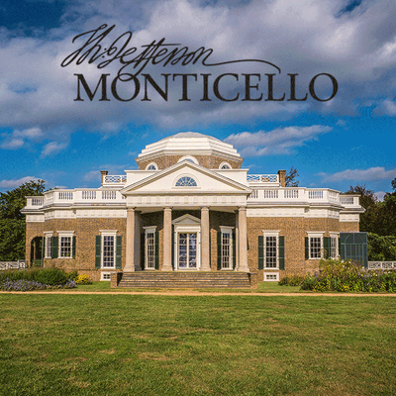


Slide 9
THE (ITALIAN) AMERICAN
URBAN GRID
Even American urban planning appropriated ideas developed in Italy, and especially the Roman urban grid that, opposite to the tortuous and twisted mosaic of streets and squares characterizing later medieval cities, privileged the rational organization of street crossings at right angles, with a main central square at the intersection of the two major thoroughfares (the decumanus maximus and the cardo maximus) dominating the city map.

Slide 10
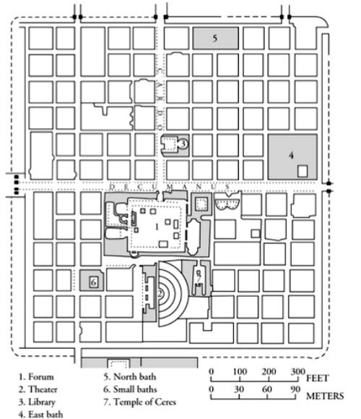
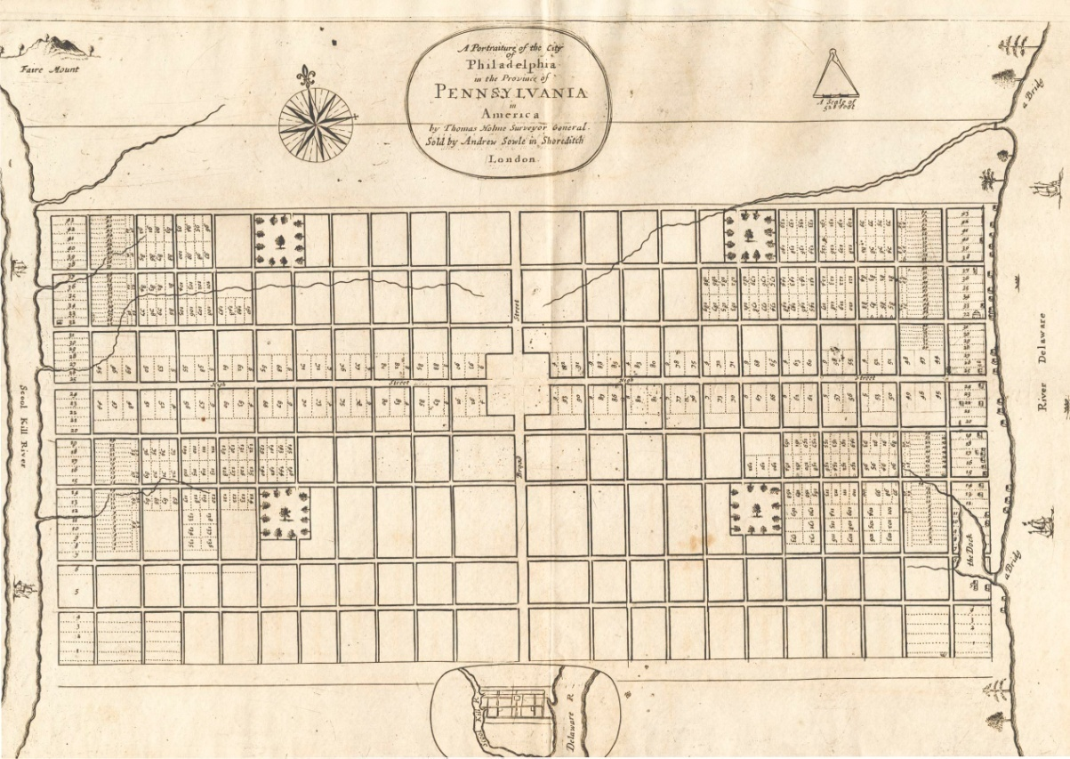

Slide 11
ITALY IN EARLY US LITERATURE
Anyway, Italy started to be a major object of representation in US literature only in the 1830s, with the publication of James Fenimore Cooper’s historical novel The Bravo (1831), set in early 18th-century Venice. In this first phase, Italy was mainly considered as the place where the weight of a long history, even if enriched by an extraordinary cultural heritage, almost crushed any hope of progress toward the future. Italy became the emblem of a splendid decadence, doomed to live forever in the shadow of the ruins of its magnificent past.

Slide 12
A NEW VIEW OF ITALY
A new perspective on Italy, more concerned with the dynamics of the Risorgimento as a progressive political movement that could be even a model for US culture, became to be elaborated at the middle in the 19th century, especially after Margaret Fuller, the leading transcendentalist and proto-feminist writer, went to Europe to send reports about the evolution of the European revolutions. Fuller actively participated in the short-lived 1849 Roman Republic, and died in a shipwreck while coming back home after the Pope’s power was restored with the help of the French army. In her letters published in the New York Tribune, Fuller did not represent Italy as a Romantic and exotic landscape, but as the site of an extremely modern political transformation that could have even taken socialist features. From the relic of the past, Italy became a possible harbinger of the future, even for the United States.

Slide 13
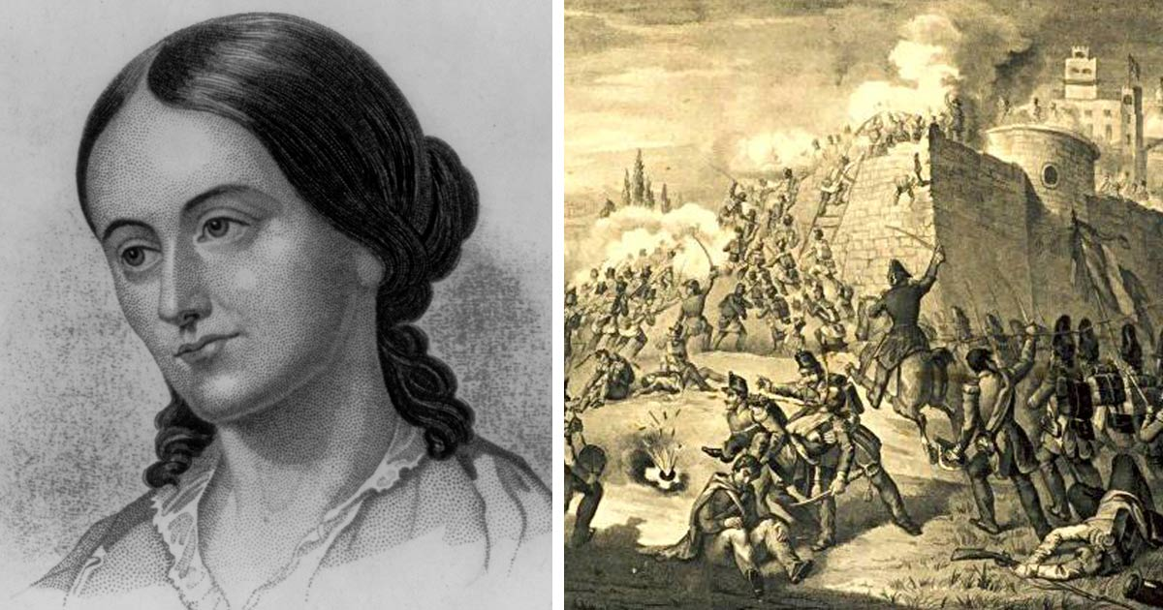

Slide 14
THE MIRROR OF ITALY
Fuller’s representation in Italy inaugurated an attitude, especially visible in Hawthorne’s The Marble Faun, to engage in a continuous play of mirror between Italy and the USA. Fuller insistently compares the Italian political situation to what is happening at home, and better still connects the two realities, as if they mirrored each other in a transatlantic continuum. Fuller was even critical towards all those American expatriates (especially artists and writers) that lived in Italy and totally failed to see the deep analogies between the Italian fight for national independence and the values of the American Revolution. The Italian predicament could even be seen as a lens through which the American historical experience could be reconsidered, highlighting many contradictions (the expropriation of the natives’ lands, slavery, the marginalization of women) that dominant US culture tended to obscure and redact.

Slide 15
SLAVES AND ITALIANS
A direct comparison between African American slaves and Italians allowed Fuller to criticize the American expats’ superficiality and retrograde ideology, masqueraded as social and cultural “superiority”: “they talk about the corrupt and degenerate state of Italy as they do about that of our slaves at home. They came ready trained to that mode of reasoning which affirms that, because men are degraded by bad institutions, they are not fit for the better.” What Fuller here implies is that the really degraded and passive mentality was not the slaves’ or the Italians’, but the one showed by the offspring of America’s best classes, unable to overcome their laziness in interpreting analogies and differences, closed inside their own narrow national cultural horizon.

Slide 16
“A CITY OF THE SOUL”
For Fuller Italy, and Rome especially, was not only the place where history could make a new start. It was also, as recorded in an 1848 private letter to her mother, a “city of the soul” (Fuller is quoting Byron’s Childe Harolde “O Rome, my country, city of the soul”): “Those have not lived who have not seen Rome.” This helped her to find her truer and refashioned self according to a mobile, flexible, even contradictory set of patterns of identifications with the people and events she was immersed in (Larry J. Reynolds and Susan Belasco stress how her writing about the Italian situation is “almost postmodern in its revelation of the reversals and ruptures attending history as lived”). Shortly before the arrival of the French, she clearly expressed her new conception of individual and collective identity, based on the transgression of all boundaries of class, gender, language and culture: “Mankind is one / And beats with one great heart.” Fuller had completed her turn toward a transnationalism which in some ways had always been present in her thought and writing, even if in the more “conventional” form of Romantic cosmopolitanism, that simply stated the existence of a world without cultural frontiers instead of questioning them while fighting at exactly the same time for the recognition of single national identities.

Slide 17
A COSMOPOLITAN PERSPECTIVE
Fuller’s Italian experience also helps to better understand, from an American perspective, the overall dynamics of the Romantic era as regards the interplay of the nationalist allegiances of most writers and intellectuals and the cosmopolitan (transnational, in more modern terms) outlook of their enterprise. Paradoxically, it was the nationalist project in itself that created a transnational network of movements aiming at the disruption of a system of cultural power based on forced homogeneization: the call to the collective soul of the “people” opened up a comparative horizon where the predicaments of the different emerging nations were found, notwithstanding all their differences, to be fundamentally alike – to fight for the freedom of one’s own country was to fight for the freedom of all, as Byron tragically demonstrated with his death while preparing an attack to the Turkish fortress of Lepanto in the name of the liberation of Greece. Fuller’s American gaze added a further dimension, activating a wider frame of reference, that of a transatlantic dialogue that reinforced and undercut at the same time all pretentions of “uniqueness” and “exceptionality” by showing that each nationalist ideology, on both sides of the Ocean, fundamentally shared those same assumptions.

