Slide 1
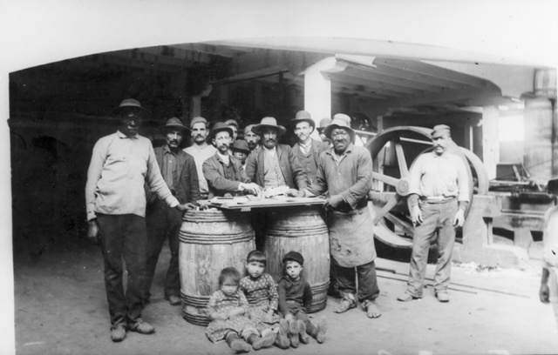
PIETRO DI DONATO,
CHRIST IN CONCRETE:
INTERSECTING RACE AND CLASS

Slide 2
AN INTERSECTIONAL/
COMPARATIVE READING
Italian American experience of the first half of the 20th century = complex and contradictory construction involving both the intersection of various processes of oppression and marginalization (and of the resistance to those processes) and of the inherently comparative dimension which is a typical factor in all migrant experiences.

Slide 3
INTERSECTIONALITY
Term coined by black feminist scholar Kimberlé Williams Crenshaw in 1989: it originally addressed the double structure of oppression produced by the “intersection” of the dominant cultural constructions of race and gender.
The term has gradually acquired a much broader meaning, and it has come to include various forms of social stratification, such as class, nationality, sexual orientation, age, religion, physical and mental disability, level of education, and so on.
Intersectionality may and must mean also the conscious activation of systems of solidarity and collaboration crossing the allegedly fixed and stable boundaries that aim at defining and distinguishing the various identities as if they were something totally distinct and isolated.
Anna Carastathis, Intersectionality: “reconceptualizing identities as coalitions enables us not only to form alliances across lines of experiential and political difference but also to constitute ‘coalitions of one’ where one is aligned with all aspects of one’s identity, particularly those that one has been encouraged to repress or deny.”

Slide 4
AN AMBIGUOUS RACIAL IDENTITY
Inter-subjective “coalitions” must inevitably be based, in the case of transnational migrant identities, on their inherently comparative dimension — something which is always already inside the migrant experience.
Italian Americans in the first half of the 20th century: besides being “racialized” as akin to Latinos (John Fante, Ask the Dust: reverse reaction of Arturo Bandini, who constructs his own “Americanness” through the negative comparison with the — gendered, female — “Mexicanness” of Camilla Lopez), Italian Americans were aligned with African Americans.
Like the African Americas, Italian Americans developed what Frederick Douglass and W.E.B. DuBois called “double consciousness,” the sensation of being the object of the dominant cultural representations and at the same time the subject who — living inside that culture — looks at him/herself as an object.
Italian Americans: the double consciousness redoubled itself, because they did not only looked at themselves through the eye of the “dominant Other” but also as “doubles” of the African Americans.
Post-World War 2: erasure of this ambiguous racial identity in the Italian American community → African American DJ Chuck Nice: “Italians are niggaz with short memories.”
Jennifer Guglielmo: long tradition of similar remarks by black or non-white writers and intellectuals (DuBois, Bernardo Vega, James Baldwin, Malcolm X, Ann Petry, Ana Castillo, Piri Thomas…).

Slide 5
RELATING BY COMPARISON
Samuele F.S. Pardini, In the Name of the Mother (2017): autobiographical episode of a Black kid exclaiming “I knew you weren’t white!” upon discovering that Pardini was Italian American → this “gave me an identity, one that at once he defined along racial lines on the basis of his blackness and that transcended the color of my skin because I am Italian American.”
Pardini also stresses how this racial alignment intersects with social positioning in terms of class as well as with the sharing of a (however different) experience of migration, so that their two predicaments must be addressed from a comparative perspective, defined as they were “by migratory movements that affected the physical as well as the mental relocation and dislocation of millions of people, both Italians and African Americans, an element that reverberates in generation after generation of descendants of the original migratory people, however differently.” And anyway, as John Gennari observes in Flavor and Soul (2017), the concept of race itself “is inherently relational and comparative: ‘black’ makes no sense without a sense of something different from ‘black,’ and we can say the same about all other racial categories.”

Slide 6
ON THE “BLACK” SIDE
David Richards: early 20th century “extraordinarily racist moment in American constitutional development” → National Origins Quota system (1924).
Racialization of Italian Americans: uneven process, which involved especially the Eastern and Southern States, with the Midwest (Thomas Guglielmo, White on Arrival) and the West Coast hardly challenging the “white” status of Italian migrants (Stefano Luconi, “Black Dagoes? Italian Immigrants’ Racial Status in the United States”).
The racial identity of Italian Americans was culturally conceptualized, even if not never translated into factual legislative actions, as non-white, almost black, in some very specific cases even blacker than black, or at least less American than the African Americans.
Robert Orsi: working-class Italian migrants often came to live in blue-collar neighborhoods with a dense black population.
Double response: interethnic solidarity but also hostility — African Americans were perceived by Italians as “non-migrants,” as “Americans,” hostile to the newcomers + need to distance “Italian American identity” from the brand of social inferiority associated with blackness.

Slide 7
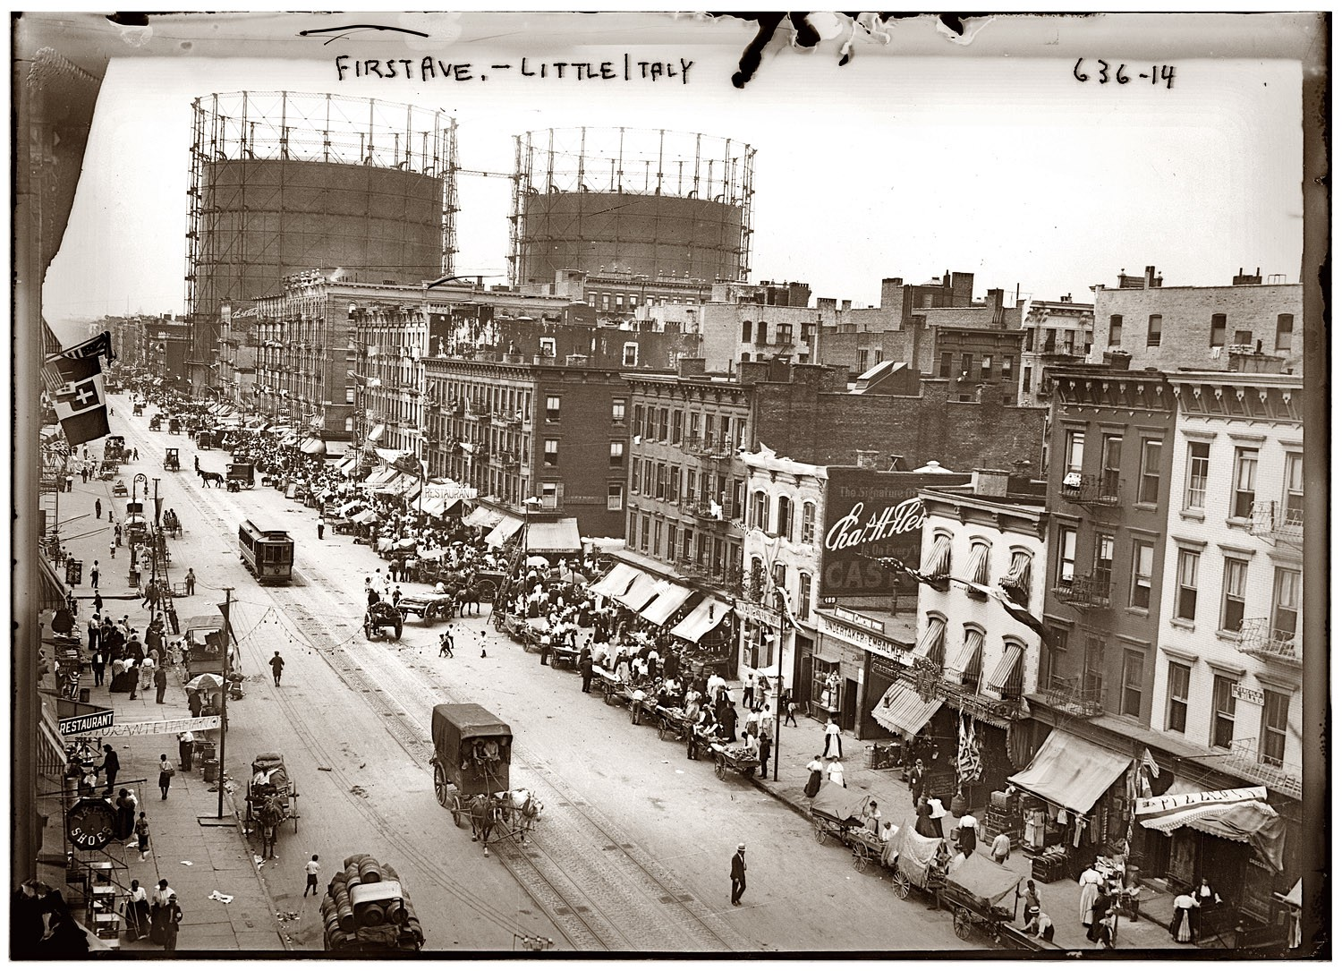
ITALIAN HARLEM
Before World War II: the Little Italy of East Harlem had three times the population (in 1930, almost 100,000 Italians of various regions, especially from the South) of the Little Italy centered around Mulberry Street.

Slide 8
EDUCATION AND RACIALIZATION
The “Eyetalyuns” did not know how to speak a “decent” English.
Early 20th century: “race psychologists” and the education system considered Italian Americans as a genetically inferior identity group.
Intelligence testing based in eugenics, aimed at detecting genetically inferior racial.
Test scores heavily influenced by familiarity with American culture and language.
W.E.B. Du Bois (1920): the only aim of these tests was to prove “scientifically” that northern Europeans were superior to all others.
Katherine Murdoch (1920): “On the whole the colored boys [African Americans] seem to be halfway between the Hebrews and the Italians. The Italians maintain their position at the foot of the four races.”
Arthur Sweeney, “Mental Tests for Immigrants” (1922): Italian immigrants are a “degenerate horde so depraved they hardly belong to our species,” “imbeciles” with primitive brain structures, who are “uneducable” → analogies with the 19th-century evaluations of African Americans as less-than-human justified the Italian migrants’ marginalization, if not exclusion, from the education system.

Slide 9
BECOMING FULLY “WHITE”
After World War II, Italian migrants first became “white ethnics,” and then, according to a “familiar narrative” which may or may not be correct but nonetheless had a deep influence in the Italian Americans’ perception of their own identity, they became “less and less ethnic and more and more white. A related narrative tells us that when Italian Americans self-consciously endeavored to revive and intensify their ethnic consciousness, they did so as part of an effort to resist the advances of African Americans and to create a zone of safety inside a nation they saw as falling hostage to the surging power of nonwhite racial minorities” (Gennari).

Slide 10
A NIGHTMARISH MELTING POT
In Christ in Concrete, Geremio loses his life submerged in “a gluey, stingy, hollow mass, yielding as wet macaroni” — then the concrete, “settling immutably” (29), melts his body once for all in the urban landscape of New York City. This image looks like the reverse of the myth of the Melting Pot, and also echoes (and clashes against) another image, that of America as an orchestra where all the voices and instruments are harmoniously blended, used by Horace Kallen in “Democracy Versus the Melting-Pot” (1915, seven years after the first staging of Israel Zangwill’s The Melting Pot: “‘American civilization’ may come to mean the perfection of the cooperative harmonies of ‘European civilization,’ the waste, the squalor, and the distress of Europe being eliminated — a multiplicity in a unity, an orchestration of mankind.”

Slide 11
A DISHARMONIC ORCHESTRA
While dying, Geremio deliriously imagines he is listening to an organ playing a tarantella from his childhood, and tries to moan with his very last breath “words and parts of words” that come “pitifully high and low from his inaudible lips.” Broken like his ribs and bones under the falling concrete, Geremio’s unheard words sound as a muted response to Kallen’s optimistic orchestral melting pot, revealing the racial and racist features of a myth which is based on a selection of the ethnic groups allowed to participate in its “cooperative harmonies”: they are harmonies of “European civilization,” excluding any possible contribution from other cultures and races, such as the African Americans and the Native Americans, and implying that their historical fate is to be exploited, drained and finally “buried” under the construction of American civilization.
A few pages before, di Donato compares the sounds made by the team of bricklayers at work to a “symphony of struggle,” and uses the word “civilization” when portraying a sonorous melting pot: “The multitudinous voices of civilization rose from the surroundings and melted with the efforts of the Job” (17). What really “melts” together the various ethnic identities is not the adhesion to some national system of values ― it is their being equally exploited, beyond any cultural and racial difference, by the indifferent god of capitalism, “Job.”

Slide 12
AN INTERETHNIC COALITION
“The Cripple” (her physical disability recalls that of Ci Luigi, who has lost a leg to “Job,” the real “God” of the novel) shows compassion toward Paul and Annunziata, even when she is patronizing and cheating them.
After the séance is finished she offers the “Eytalyuns” tea ― “the very first time they of Geremio had ever tasted tea.”
“Missus Schafer” (a regular client) is anxiously waiting for her turn, but the Cripple replies to her daughter and assistant: “Awright, tell her I’ve gotta have my tea here with the missus [Annunziata] and I’ll be ready for her in fifteen minutes.”
By privileging the poor “Eyetalyuns” to the possibly affluent (and white) Missus Schaefer, the Cripple aligns herself in a “coalition” with the “almost black” (in this case, even blacker than the blacks, less American than them).

Slide 13
SHARING FOOD
The almost ritual (it takes place again at the end of the second meeting) offering of tea “establishes that the Cripple identifies with and genuinely likes Annunziata” (Peter Kvidera), and also inter-racially reverberates with the sharing of food in the Italian American community so often represented in the novel as that “communal celebration of ethnicity” which for Donna Gabaccia is the basic meaning of eating Italian food in collective meals, and strongly contrasts with another scene: the inner splitting of the community along the social, economic and cultural divide is vividly displayed in the “wonderful table,” full of shiny porcelain plates containing “baked potatoes and cuts of brown dripping lamb and fresh peas and platters of food hot food cool food hard food soft food,” where Father John, the Catholic priest, is eating all alone, and refuses to give any help expect a slice of cake to the miserably pleading Paul.

Slide 14
PRIMITIVE ITALIANS
The comparison between Italian Americans and African Americans is also suggested through what might look like a racist depiction of Missus Nichols’s family, with three “half-naked children […] play[ing] in the center of the floor with dirt and water making mud-pies” and the “coffee and baloney smell mingl[ing] with the kitchen’s oppression of unwashed bodies and dry sewage.” But this unpleasant scene shares a number of features with the description of the behavior of Paul’s extended family at the end of the “Fiesta” for the marriage of Ci Luigi and Cola, a neighborhood widow. The last part of the wedding night is introduced by the only direct reference in the novel to “race,” by a clearly inebriated music master (Maestro Farabutti) who boasts the cultural superiority of Italians — “Richer than the richest, purer than the finest, more capable that an-y! an-y! race breathing under the stellar rays of night or the lucent beams of the day!—” What follows is first a further awkward celebration of Italian civilization (“—the I-tal-ian-ne is the flower of Christians—,” “are not Michelangelo and Raphaelo our own? Cellini!—,” “—our brother Dante who has scribed all that need be read—”), and then a sort of descent to an almost animal-like state when one of Paul’s fellow-bricklayers, Nick “the Lucy,” orders all those “who call themselves Italian” to “line up with hands tied behind and eat from the table with only the face!” — starting from someone aptly named “Head-of-Pig.” With the soundtrack of “Funiculi-Funicula” played on an accordion (at Missus Nichols’s place there was a phonograph playing “Indian Love Call,” showing the modern, technological superiority of African American musical culture), a dozen people attack a monstrous heap of spaghetti and red sauce spread on the table, looking far more “primitive” and finally dirtier than the Black kids in the Cripple’s kitchen.

Slide 15
IMPERIAL DELUSIONS
At the end of the “Fiesta” the revellers throw themselves into a frenzied Tarantella dance while, not coincidentally, Yellow-Fevered Giuseppe draws on the tablecloth, with “wine-soaked biscuiti” [sic], “the fateful battle between Baratire [misspelling for General Baratieri] and Menelik”:
  “Here, here, here and here were the columns of Italia, my father in the third, then — Zthaaaa! out from the earth sprang millions and mil-li-ons of hell-toasted charcoal Ethiops… signs of the cross made the sons of Italia and spine to spine they took to them each a hundred cutlass-in-mouth Nubian fiends… Forward, Baratire, Forward!”
The man’s incitement to the Italian general and the troops mixes with the dance-turns of the tarantella: “Heads in sinister direction and dexterous direction! Knobs rolling in the dust! Forward, banner of Italia! Forward, Baratire!” […] Faster, Tarantell, faster, and now leaps Paul gaily and takes mother Annunziata by hand.
Giuseppe’s imperial fantasy of Italian heroism and Black savagery ironically comments a scene characterized by the final description of the “victims” of the “Fiesta” — senseless bodies scattered in the room like war casualties: “In the chill isle of Dawn the paesanos were tangled one upon and across the other with lips wide in burned-up exhaustion amongst the children on coats and hats and piles of clothing throughout the room.” The irony is twofold: first, because compared to the “hell-toasted charcoal Ethiops” the sons and daughters of “Italia” do not look at all as harbingers of civilization — they seem even more hellish in their pagan revelries; second, because the battle nostalgically recalled (and reinvented contra historical reality) is the battle of Adwa, fought in 1896, whose final outcome was a disastrous defeat for the Italians, which positively ended their colonial ambitions in Africa for many years. These ambitions were revived at the middle of 1930s, when Mussolini launched one of the greatest colonial campaigns in 20th-century history, ending in May 1936 with the conquest of Addis Abeba and the proclamation of the Italian Empire.

Slide 16
(LACK OF) EDUCATION
AND EXPLOITATION
When Annunziata receives a letter for the State Compensation Bureau, she says: “Ah, but how can a widow without the American tongue tell her needs?”
Annunziata’s question: “Who is to pay me?” → response of a former colleague of Geremio’s: “it would be a good thing if one knew the American tongue – ‘for without it we are dumb and blind.’”
The ignorance of the “American tongue” is what reduces Italia Americans to the rank of slaves.
“Race” here is constructed not only by culture ― by dominant white culture: it is also enforced through the exclusion from that culture.

Slide 17
THE CRISIS OF
INTERETHNIC SOLIDARITY
The relationships between Italian-Americans and African Americans were severely exacerbated by the Italian-Ethiopian War (a number of “Italian-Negro Riots” took place), and was a major factor in creating a clear racial divide that put the two communities on different sides of the color line (and finally conflating the dimensions of “color” and “race,” because by now both Fascist Italy and mainstream Italian American culture were proudly declaring that the Italian “race” was uniformly “white”). The leading Italian American newspaper Il Progresso Italo-Americano, after decades of repeated denunciations of anti-Black structural racism in the USA, explicitly backed the “civilizing” mission of Fascist Italy in Ethiopia, and even invited Black Americans to side with Italians, because Ethiopians were not really “Black” (they could belong to the same race, but had a different color), were much more “backward” than both Italians and African Americans, and practiced slavery — an attempt that was not very successful.

Slide 18
A BITTER IRONY
The bitter irony of the novel also consists in its very ending, when the euphoria of the “Fiesta” is totally erased first by Nazone’s death in another accident at work and then by Paul’s final loss in Catholic faith, which causes Annunziata’s breakdown and possibly death. Some days before, Paul dreams of another visit to the Cripple, that even in his subconscious he sees as a helping figure — but this time her well-meaning white lies actually reveal the hidden truth, and even if Paul is even able to hug his father’s ghost, Geremio tells him that he was betrayed, that his “children also will be crushed, cheated. His father begins to absolve and sighs faintly, Ahhhh, not even the Death can free us, for we are… Christ in concrete…”

Slide 19
“IL DECENNIO DELLE TRADUZIONI”
Christ in Concrete was one of the many US novels to be almost immediately translated into Italian in a period when Italy was “invaded” by American literature.
Cesare Pavese: the 1930s will be known as the decade “delle traduzioni […]. Esso è stato un momento fatale, e proprio nel suo apparente esotismo e ribellismo è pulsata l’unica vena vitale della nostra recente cultura poetica. L’Italia era estraniata, imbarbarita, calcificata — bisognava scuoterla, decongestionarla e riesporla a tutti i venti primaverili dell’Europa e del mondo. […] Noi scoprimmo l’Italia — questo il punto — cercando gli uomini e le parole in America, in Russia, in Francia e in Spagna. E che questa amorosa simpatia coi forestieri non risultasse a nessun tradimento della nostra presunta realtà sociale e nazionale.”

Slide 20
“UN TESTO MESCIDATO”
Christ in Concrete can be considered as a “testo mescidato” (Pierangela Diadori).
“La mescolanza linguistica rappresenta un tratto distintivo di quegli autori, appartenenti ad una minoranza etnica, che non si riconoscono e non intendono uniformarsi alla lingua/cultura dominante e che, come nel caso degli scrittori italo-americani, alternano l’italiano all’inglese. Nello specifico, si parla di code-mixing se l’ibridismo linguistico avviene a livello intrafrasale, ovvero all’interno della stessa frase, mentre si parla di code-switching, quando la mescidanza linguistica fra più lingue avviene a livello interfrasale, quindi con alternanza di enunciati distinti in lingue diverse. È proprio in sede di traduzione che questo pluringuismo può essere mantenuto nel metatesto o, al contrario, uniformato alla lingua del testo di arrivo” (Eleonora Mercuri).

