Slide 1
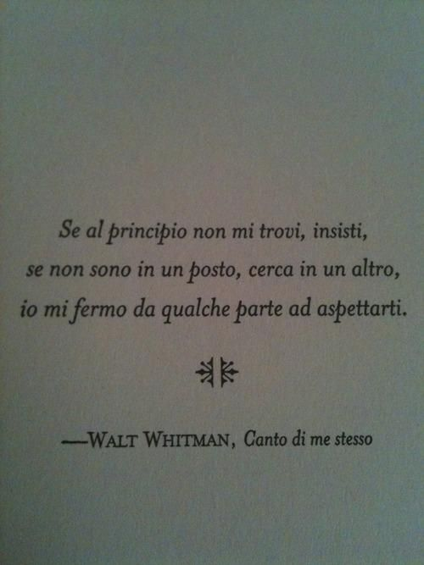
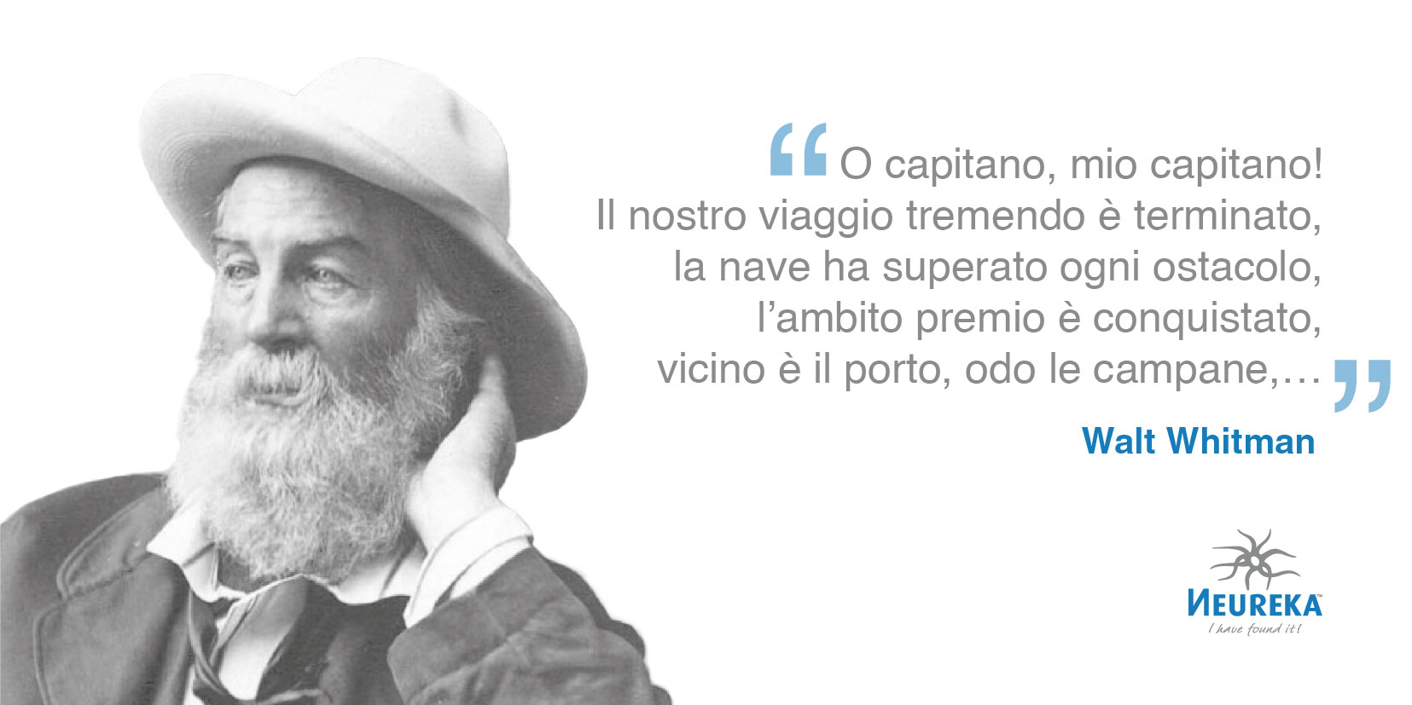


Whitman and Italian-US Negotiations (cont.d)

Slide 2
GIOVANNI PASCOLI’S (MIS)INTEPRETATION OF WHITMAN
Giovanni Pascoli became acquainted with Whitman through an 1899 article (“I fili d’erba di Walt Whitman”) in which Ragusa Moleti translated and reduced a passage from “New Poetry,” eliminating the part where Whitman attacked “arbitrary and rhyming meter” and explained the necessity to reproduce the natural rhythm of language. Pascoli therefore misinterpreted Whitman’s theoretical positions, but somehow, even in the Italian translation of Whitman’s prose, recognized the existence of an inner, “Biblical” rhythm, notwithstanding his impression that the American poet despised poetical rhythm. Pascoli will later develop his conception of “reflected rhythm,” which is in may ways to what Jannaccone had defined Whitman’s “psychic rhythm.” Pascoli’s interest in Whitman is confirmed by the fact that the 1907 translation by Gamberale came out in the “Biblioteca dei popoli” series he had created and directed for the Sandron publisher. Pascoli understood that one of the most important features of Whitman’s poetry was the attention to “natural” sounds, and he was probably at least inspired by the American poet (and also by Poe) in his own use of phonosymbolism and onomatopeias.

Slide 3
SIBILLA ALERAMO’S WHITMAN
Pascoli inaugurated a new attitude toward Whitman of the Italian literati, one that added a much more careful attention to poetic form to the interest for his themes and political ideas. In four articles published in Nuova Antologia between 1902 and 1909, Sibilla Aleramo (pseudonym of Rina Faccio) offered — under another pseudonym, NEMI — identified “a socialist-humanitarian and pacifist reading of Whitman, […] carried on a clear mythicization of Whitman’s personality (but dismissed any insistence on his supposed egotism) and demonstrated an advanced understanding of Whitman’s innovative poetic style. […] NEMI clarifies how Whitman’s ‘strange and chaotic’ style should then be seen not only as the result of a ‘desire of originality for himself and for the new art of his country,’ but as the natural outcome of the poetic aim described. Such an aim, argues NEMI, ‘required a new poetic instrument, varied and flexible enough to follow the fluttering, multiform, vast matter that the poet encountered when he decided to be the interpreter of modern democratic life’” (Bernardini).

Slide 4
GIOVANNI PAPINI’S APPROPRIATION
In 1908, also Giovanni Papini wrote an article on Whitman in Nuova Antologia, which echoed Aleramo, who in her turn in 1912 published a review of Papini’s collection of short stories Parole e sangue starting with a quotation from Whitman: “Give me your tone therefore o Death.” In his admiration for Whitman, Papini especially stressed the poet’s “masculinity” (totally ignoring its homosexual overtones), contrasting it with the dominance of female features (and even female authors) in Italian poetry. Papini also defended Whitman’s poetic energy against Ardengo Soffici’s criticism of the America poet’s lack of self-restraint. Papini’s reading of Whitman saw him as an example of the Nietzschean Übermensch, and provided the framework for the appropriation of Whitman by subsequent Fascist culture.

Slide 5
EMANUEL CARNEVALI’S “MODERNIST” WHITMAN
A totally new reading of Whitman by an Italian poet, which was particularly relevant for the construction of Modernist poetry in the United States, was that by Emanuel Carnevali, who had migrated in America in 1914, and had become a member of the US avant-garde. Carnevali criticized his fellow American poets for lacking authenticity and concentrating on technical details, and urged them to turn to Whitman for inspiration — a thing many of them recognized as necessary, and which inspired a more “concrete” dimension of US contemporary poetry as compared to European Modernism.

Slide 6
Dino campana, the “italian whitmaN”
In the very first letter that he sent Aleramo in 1916, Dino Campana asked her if she knew Whitman, and she replied that she loved him — so their ardent affair started under Whitman’s auspices.
Of all the Italian poets, Campana was probably the one most influenced by Whitman on the stylistic level. He directly quoted Whitman in his poems, and when he went to Argentina in 1907, he brough with him a copy of Leaves of Grass.
“Campana’s poetry abandons any strophic partition and plays with iterative parallelisms, obsessive repetitions, and rhythmical dissonance. Like Whitman, Campana had a preference for a nominal style made of catalogues, present participles, gerunds, and juxtaposed adverbs and adjectives, as well as anaphoras and homoeoteleutons (near rhymes). Like Whitman, he built a multilingual text by using English, French, German, vernacular, and dialectal forms, but also by mixing classical, erudite terms and archaisms with popular and technical ones” (Bernardini).

Slide 7
FUTURIST WHITMAN
The founder of Italian Futurism, Filippo Tommaso Marinetti, appreciated Gamberale’s translation, and when in France became acquainted with French Whitmanisme. In his first phase, Marinetti also adopted free verse, the typical Whitmanian verse, which he later abandoned when he turned towards a nationalistic, militant and belligerent poetics. But in the 1913 manifesto Distruzione della sintassi: Immaginazione senza fili: Parole in libertà, where he declared free verse to be dead, but Whitman remained central, because “associated with values that were closely tied to fascism: masculinity, rebellion, deletion of the literary past, and even violence” (Bernardini). This misreading allowed Whitman to be included in the American authors deemed as somehow “useful” to Fascist ideology by Mussolini himself, who declared in a 1931 address to the American people the all the Italians admired him, together with Poe and Emerson.

Slide 8
WHITMAN AND FASCISM
After having been celebrated for his love of freedom and democracy until World War I, under Fascism Whitman was turned into an epitome of the new Italian man: “‘Gagliardo’, e dopo la Prima Guerra mondiale, ‘ardito’, il giovane italiano doveva essere un camerata (‘comrade’) per i suoi amici. Attraverso la solidarietà maschile un’Italia femminilizzata e sottomessa alle nazioni egemoni sarebbe potuta essere trasformata in una nazione virile con un futuro imperialista. Il sangue che scorreva nelle vene dei futuristi e dei camerati, il sangue che li rendeva vivi e arditi era anche il sangue della comune stirpe. Per la loro razza, per la loro stirpe e per la loro nazione, questi giovani dovevano essere pronti a versare quel sangue e divenire martiri” (Marina Camboni). Of course his homosexuality and pacifism (even in the war poems titled Drum Taps) were totally excluded from this view of Whitman.

