Slide 1
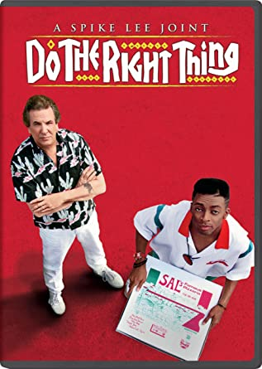
Spike Lee’s
Do The Right Thing
Italian Americans and African Americans (and Other Ethnicities…)

Slide 2
Spike Lee
Born 1957 in Atlanta, but soon moved to Brooklyn.
Attended all-male, black Morehouse College.
NYU film school. Master’s thesis film, Joe’s Bed-Stuy Barbershop: We Cut Heads, in 1981 (winner of the Academy of Motion Pictures Arts and Sciences Student Academy Awards Dramatic Merit Award).
  “In a few of his feature films, Lee uses his intimate knowledge of these racially integrated Brooklyn neighborhoods to dramatize the sometimes violent encounters that occur between African Americans and their nonblack New York City neighbors” (Mark Reid).

Slide 3

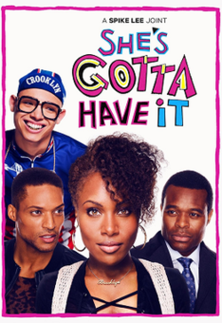
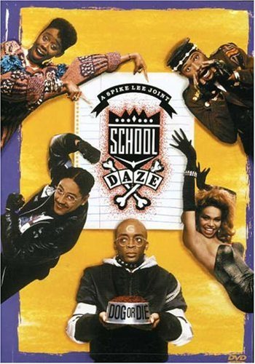
Before Do the Right Thing
1986: founds the production company 40 Acres and a Mule Filmworks.
Enrolls family members in his early films: sister Joie (actor), father Bill (composer), brothers David (photographer) and Cinque (crew).
She’s Gotta Have It (1986), about a woman who has sexual relationships with 3 men.
School Daze (1988), based on Lee’s experiences at Morehouse, about the tensions between light- and dark-skinned African American students.

Slide 4
Do The Right Thing (1989):
Awards
Oscar: Nomination for best supporting actor and original screenplay.
Cannes: Nomination for Palme d’Or.
LA Film Critics Best Director, Best Picture, Best Music and Best Supporting Actor (Danny Aiello).
Inaugurates low-budget movies by African American directors which receive funding from mainstream studios: Reginald Hudlin, House Party (1990), John Singleton, Boyz n the Hood (1991), Mario Van Peebles, New Jack City (1991).

Slide 5
A “Joint”
The title (as in almost all of Lee’s productions) is preceded by the definition “joint,” instead of “film” or “movie” – and the director has never fully explained the reason. “Joint” has a number of possible meanings, in African American slang: marijuana cigarette, song, thing or act, and also “current location” or “place to hang out.” Given the centrality of the representation of physical and social space in the movie, maybe it could refer to this latter aspect, but more generally it could suggest Lee’s movies are “joint” enterprises, the outcome of a collective effort – as it may be implied by the name of his production company, Forty Acres and a Mule, from General Sherman’s order towards the end of the Civil War, which allotted land to freed families, but no larger than 40 acres (plus a mule to cultivate them): Lee’s productions thus systematically link back to the African American collective experience.

Slide 6
DRAMATIC UNITY
The movie respects the Aristotelian principle of dramatic unity:
place (one setting, the Bedford-Stuyvesant neighborhood in Brooklyn);
time (only two days, the hottest of a summer);
action (one central story, with the secondary plots revolving around it).

Slide 7
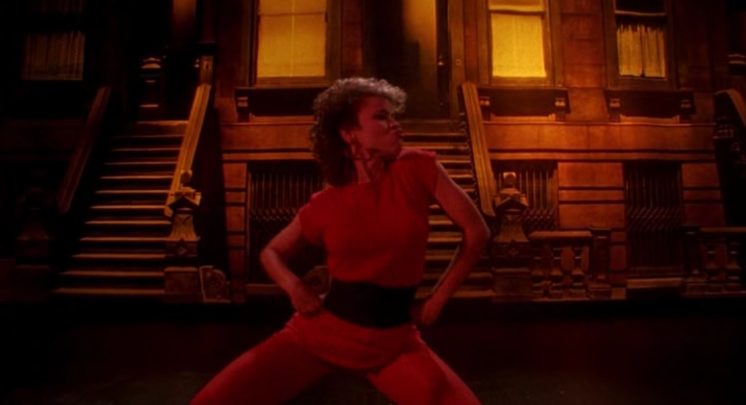
Fight the Power
The opening credits are superimposed on Tina (Rosie Perez) dancing to Public Enemy’s song “Fight the Power,” followed by Love Daddy’s (Samuel L. Jackson’s) call to “wake up.” Both the song and Love Daddy’s “call” are examples of African American poetic language, characterized by heavy rhythm effects and a virtuoso use of repetition and wordplay.

Slide 8
AFRICAN/ITALIAN AMERICAN
POETIC LANGUAGES
Lee may not be aware of this, but the African American popular tradition of using poetic language in everyday life, also as a tool to sublimate conflicts instead of making them explode in physical violence, has some analogies in Italian popular poetic tradition.
Playing the dozens (insulting the “enemy” with rhytmical improvised rhymes) recalls the Italian tradition of the “canti in ottava rima” (poetic improvisations used especially in Tuscany and Latium, in the “contrasti”).

Slide 9
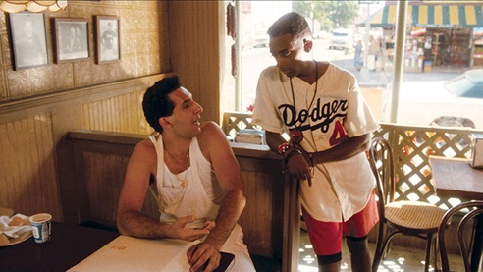
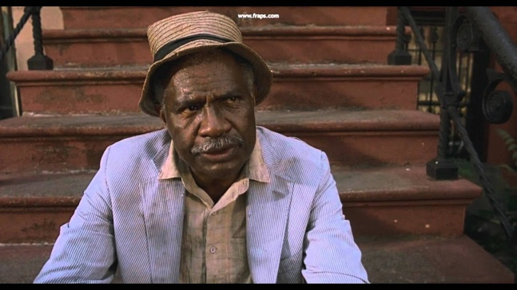
INTERETHNIC HARMONY?
At the beginning of the movie we are shown scenes of interethnic harmony, but when Mookie (Spike Lee) enters Sal’s pizzeria (11’) Pino (John Turturro) is the first to “question” this harmony, in a “broken Italian.” He also calls Da Mayor (Ossie Davis), the character who says “Always do the right thing,” “azupep” (or “azulpep”) a term that seems to have originally been a racial slur for the swarthy Southern Italians (it should literally indicate a kind of black pepper or an eggplant).

Slide 10
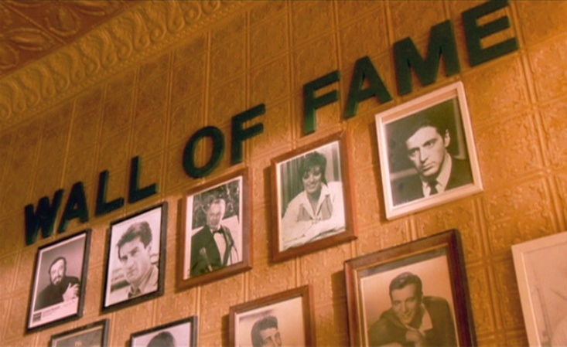
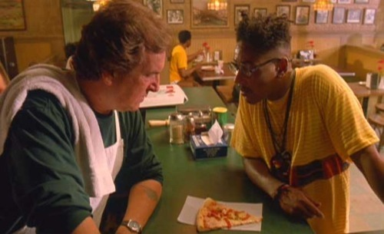
THE WALL OF FAME
Sal’s has a wall of fame full of white (Italian) Americans. Buggin Out (Giancarlo Esposito) is offended by the lack of African Americans on the wall and asks for pictures of Africans be hanged (19’). Sal refuses and Buggin Out is “expelled” from the pizzeria, with Mookie trying not to lose his job – Buggin Out tells him to “stay black.”

Slide 11
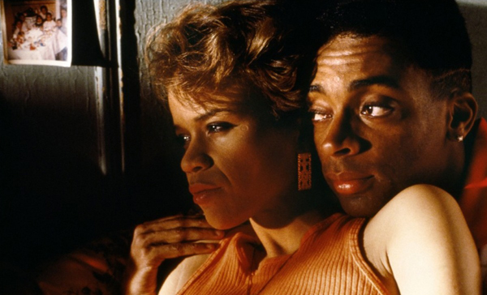
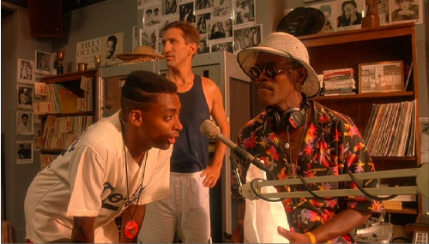
A MUSICAL FIGHT
When Mookie brings food to Love Daddy, he is asked to choose a song, and he picks up a salsa for Tina (Rosie Perez), which resonates through the Latin area of the neighborhood (30’), kindling a skirmish with Radio Raheem’s (Bill Nunn’s) rap on his boombox.

Slide 12
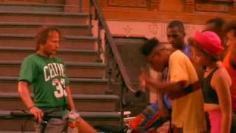
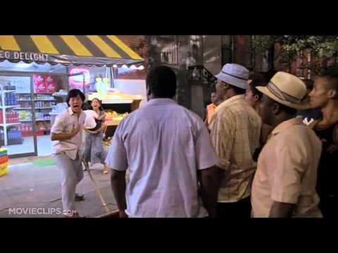
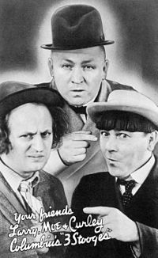
REVERSED RACISM
In the following scene (34’), a white cyclist (John Savage) ruins Buggin Out’s (white…) sneakers, and the crowd reacts with a parody of white racism, telling him to go back to Boston (the birthplace of WASP America) – and the cyclist replies that he is Brooklyn-born.
Then the same racist attitude is shown by three cronies (who look like a black version of the Jewish-American Three Stooges) towards a Korean shopkeeper.

Slide 13
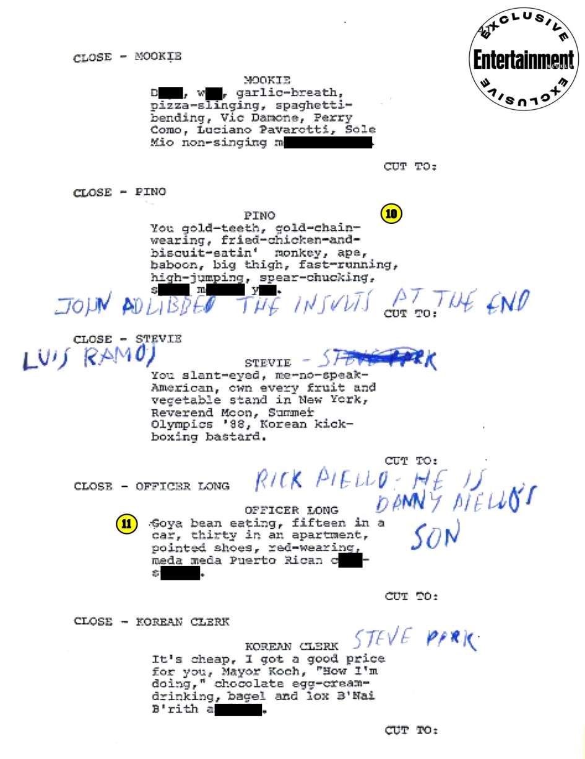
RACISM EVERYWHERE
After Pino’s list of Blacks who are not Blacks, or are more than Blacks, a series of racist stereotypes are pronounced by members of an ethnic community against the members of another (44’). The last are the Korean shopkeeper’s, and the target is the Jewish-American community (not portrayed in the movie), whose main representative is the city Mayor himself at that time, Ed Koch. So the shopkeeper identifies Jews with the system of power (a common anti-Semitic stereotype), as if they were simply “white,” and nobody actually denounces the “true” whites’ responsibilities – nobody really “fights the power”…

Slide 14
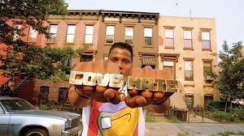
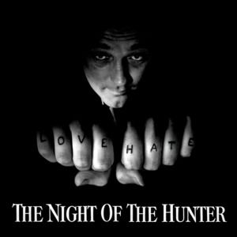
LOVE/HATE
Radio Raheem makes his speech on the relationships between love and hate, implicitly introducing the dichotomy represented in the Martin Luther King and Malcolm X photo, repeatedly shown by Smiley, and the double quotation at the end of the movie. But the words on his knuckles also recall the preacher/serial killer played by Robert Mitchum in The Night of the Hunter (1955).

Slide 15
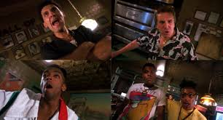
A HISTORY OF SUSPICION
In the dialogue with Vito Pino tells him not to trust Mookie, because history teaches that Blacks are treacherous (1h22’).
Outside Sal’s, Buggin Out and Radio Raheem plan a boycott of the pizzeria (which nobody adheres to…).
The conflict between “noise” (Raheem’s Public Enemy) and “pictures” (Sal’s Wall of Fame) erupts when Sal destroys Raheem’s boombox.

Slide 16
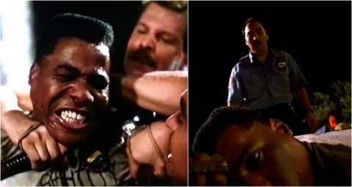
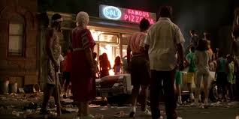
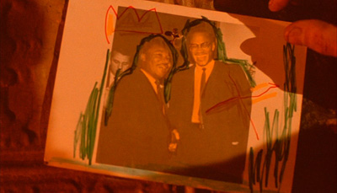
THE RIOT
When the police kills Radio Raheem, who is trying to kill Sal, the crowd turns against Sal and the other “Eytalians.” Mookie throws a trashcan into Sal’s pizzeria, and the crowd assaults the joint, destroying it, chanting “Howard Beach, Howard Beach.” The scene closes with Smiley sticking the photo of Martin Luther King and Malcolm X together on the ruins of the Wall of Fame.

Slide 17
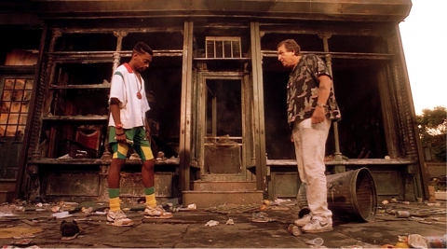
THE AFTERMATH
The morning after, Mookie and Sal have the last confrontation (1h43’) – Sal claims his right to live there because he has literally built the place, and Mookie wants to get paid by his former employer, stressing their power relationships. They end up with a sort of truce.

Slide 18
THE KILLINGS OF MICHAEL GRIFFITH AND YUSEF HAWKINS
On August 23, 1989, black teenager Yusef Kirriem Hawkins was shot to death in the predominantly Italian-American working-class Brooklyn neighborhood of Besonhurst. Hawkins, his younger brother, and two friends were attacked by many white youths, some of them wielding baseball bats. A decade and a half after Hawkins’s murder, mobster Joseph D’Angelo confessed having shot Hawking for racial reasons. This episode, which took place after the filming of Do the Right Thing, marked the lowest point in Italian American-African American relationships.
On December 20, 1986, African American Michael Griffith was killed in a racist attack by a group of white men in Howard Beach, in the Queens borough of New York.

Slide 19
WHICH IS THE RIGHT THING?
Is Mookie doing “the right thing” when he throws the garbage can through the window, and so triggers the riot that destroys Sal’s pizzeria? or is he only ushering an endless and meaningless cycle of violence, where two ethnic groups fight one against the other instead of “joining” forces against “the power”?
But some critics have also argued that Mookie’s action is “really” the right thing, because it redirects the crowd’s anger away from Sal to his property – so that African Americans destroy things (that can be rebuilt, and anyway Sal has an insurance, even if he says that it is not money that matters), but not lives.

Slide 20
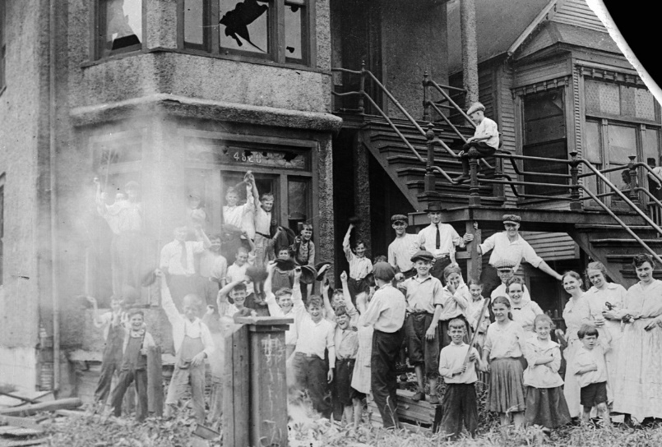
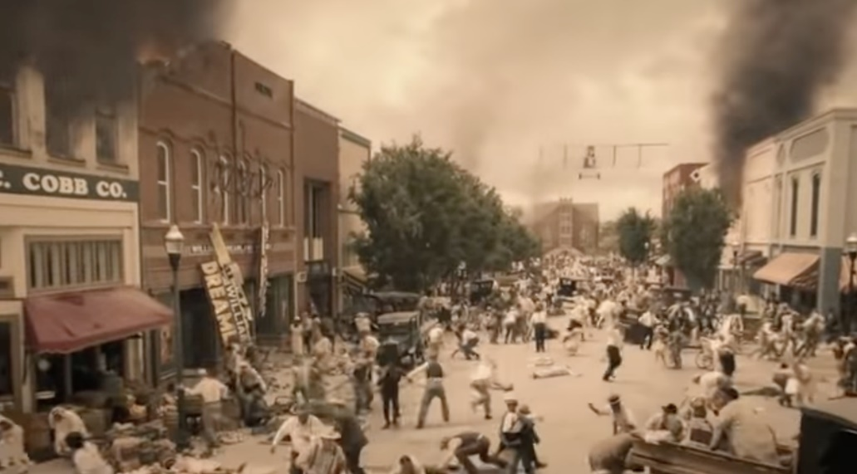
A TRADITION OF RIOTS
Throughout African American history, violence has been one of the weapons used to claim human dignity and equal rights, but almost never with any practical effect. The various rebellions during slavery (the most famous ones being those of slave Nat Turner in 1831 and white abolitionist John Brown in 1859) failed, while the riots that shook the cities during the Red Summer of 1919 were acts of resistance to white supremacists’. In 1921, what has been called “the single worst incident of racial violence in American history” took place in Tulsa, Alabama, when whites killed hundred of blacks using also airplanes (the event is reconstructed in the TV superhero series Watchmen, and it looks like science fiction (uchronia) – it’s real history…).

Slide 21
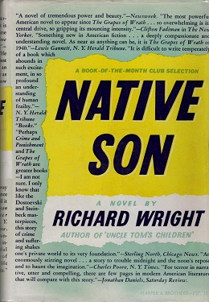
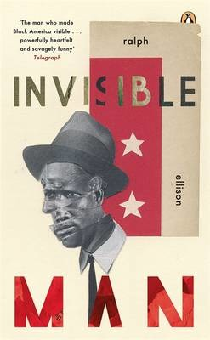
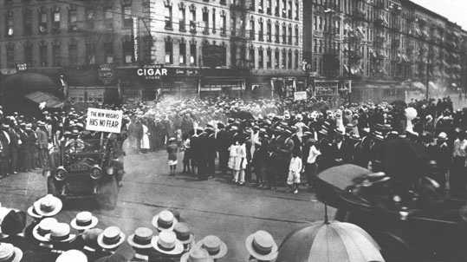
LITERATURE AND REBELLION
African American literature has often portrayed black rebellions, almost always stressing their inevitability on the one hand and their ineffectiveness on the other, as in Richard Wright’s Native Son (1940) and Ralph Ellison’s Invisible Man (1952), because these kinds of revolt do not change the status quo, and often destroy the neighborhoods where the African American themselves live.

Slide 22
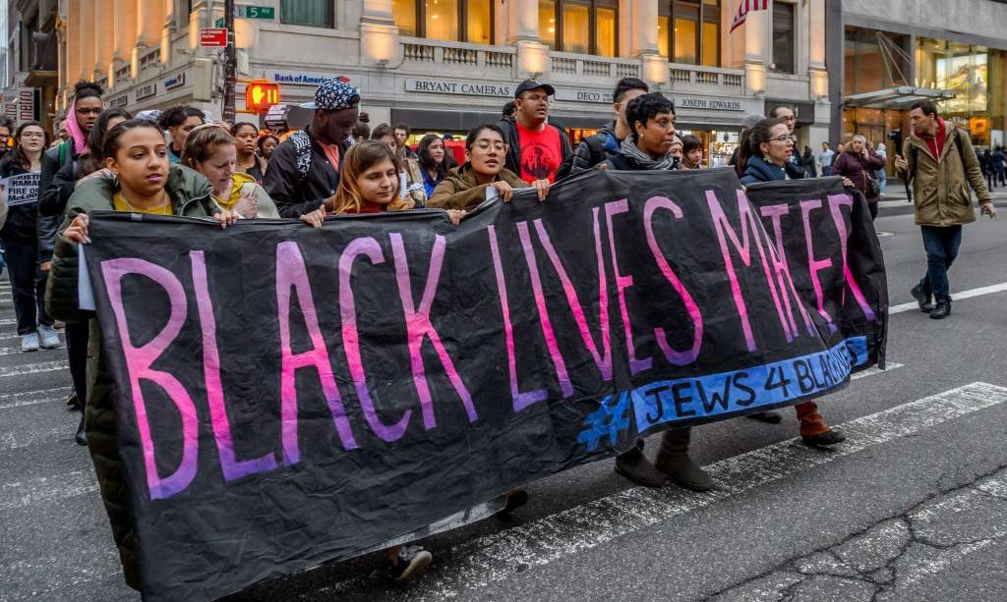
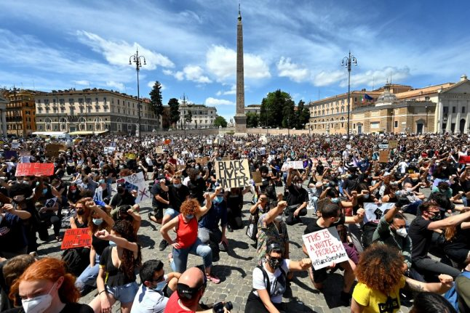
FROM RIOT TO MOVEMENT
The Movement for Civil Rights, led by Martin Luther King, managed though non-violent protest to obtain a number of reforms that gradually changed the condition of African Americans. Malcolm X’s apparently more radical activism never really led to physical violence. The Black Panthers advocated armed resistance, and sometimes used weapons, but they mostly did community work – their “belligerent” attitude was used by the establishment to effectively criminalize and destroy the movement.
#BlackLivesMatter, the recent and peaceful movement founded by three African American women, has instead managed to create a wide support beyond ethnic and even national frontiers, and has brought to the foreground of public opinion the continuing discrimination of African Americans and the violent practices of the police against them.

Slide 23
ITALIANS AND/
AGAINST BLACKS
Do the Right Thing represents a crucial phase in the relationships between Italian Americans (by now officially recognized as part of the American mainstream) and African Americans, whose role in society keeps being marginalized, even if many African Americans are among the most famous and celebrated representatives of American culture, literature, music, cinema, art and sports. The final “truce” between Sal and Mookie may on the other hand be a prophecy of a future re-establishment of some mutual solidarity – not even so future, considered that the movie is the result of a joint effort of African Americans and Italian Americans, and that the most “aggressive” of Black characters, Buggin’ Out, is interpreted by the only “real” (half Italian, half African American) Italian American actor, Giancarlo Esposito…

