Slide 1
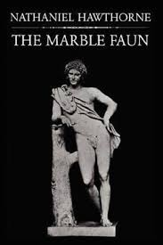
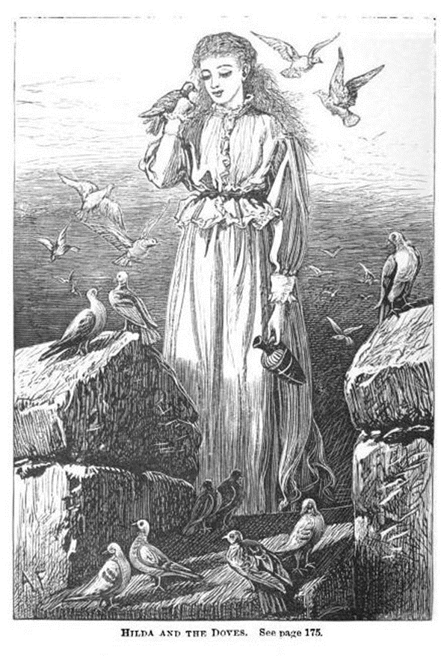
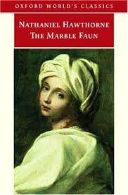
NATHANIEL HAWTHORNE AND THE MARBLE FAUN

Slide 2
Hawthorne: A «symbolic» life
Nathaniel Hawthorne’s life is in itself symbolic of a number of intersecting tensions that cross American history from the early colonial period to the middle of the 19th century. He was born (of all days…) on July 4, 1804, in Salem, Massachusetts. The first “American” Ha(w)thorne was William, Nathaniel’s great-great-great-grandfather, who became a prominent member of the Massachusetts Bay Colony as a magistrate and judge (he was especially harsh towards “heresies” like the Quakers’). William’s son, John, was one of the judges of the 1692-93 Salem Witch Trials. In his early twenties Nathaniel added the “w” to his last name, perhaps to both dissociate himself from his ancestors and to make his last name sound again as in the mid-17th century – so making a double contradictory movement of distancing and coming into closer contact with his past.
Hawthorne’s father, Nathaniel Hathorne, Sr., was a sea captain who died on the ocean in 1808. After his death, the Hathorne family moved in with maternal relatives, the Mannings, where Nathaniel grew up in an environment peopled almost exclusively by women and girls. Many critics attribute Hawthorne’s “feminine” style to his experience as a boy surrounded by female figures.

Slide 3
Hawthorne’s early career
Hawthorne graduated at Bowdoin College in 1836, and he became to publish short stories that made him known as a promising author. One of his earliest tales, “Alice Doane’s Appeal,” published only in 1835 but written ten years before, is a complex reconstruction of the Salem Witch Hunt, which ends with the declaration that a monument to the victims of the witch hunt should be erected to remember that historical horror. From the very beginning Hawthorne was therefore interested with the necessity of facing the more disquieting aspects of American history, and to make them part of collective memory. In 1837 he collected many of his short stories in Twice-Told Tales – the title referring both to the fact that the tales had been already published elsewhere, and to their being mainly a “rewriting” of historical events already more or well known through their historiographical representations.

Slide 4
A utopian tendency
After having begun a love story with painter Sophia Peabody, sister to the abolitionist educator Elizabeth Peabody who also helped Hawthorne in his publishing career (she made him publish, in 1841, three best-selling books for children, Grandfather’s Chair, in which he again re-wrote events of American history). In 1841 he became involved with the utopian experiment of Brook Farm, which he thought could make him save some money to marry Sophia. The experiment proved a failure, and it became the basis for his third romance, The Blithedale Romance (1852). Hawthorne married Sophia Peabody in 1842 and then moved to Ralph Waldo Emerson’s Old Manse in Concord, where he wrote most of the tales collected in Mosses from an Old Manse (1846).

Slide 5
Life at the Custom-House
In April 1846, thanks to his acquaintances in the Massachusetts Democratic Party, Hawthorne became Surveyor of the Salem Custom-House. When the Whig Zachary Taylor won the Presidential elections in 1848, Hawthorne was fired, and had to leave his post in 1849. During his years at the Custom-House, probably due to the pressures and responsibilities of his job, Hawthorne was unable to write, but he “reinvented” this “writer’s block” in the introductory sketch to The Scarlet Letter, in which he gave the most complex and nuanced description of the poetics of the romance we have – even if it is applied to what he was not able to do anymore.

Slide 6
A major writer
The Scarlet Letter was published in March 1850. It was one of the first mass-produced books in America, but it had only a limited success (2,500 sales in the first 10 days), at least compared to the much wider commercial success of novels written by women like Harriet Beecher Stowe’s Uncle Tom’s Cabin (1852), which sold 3,000 copies in one day, and about 300,000 copies in the USA and 200,000 in the UK in a year. Nonetheless, the romance won the author critical recognition, and it soon became a classic of American literature, even if the main issues addresses by the book were considered “unpleasant” by many – someone wrote that it almost seemed a direct outcome of the subversive movement that only a couple of years before had had its official birth with the Seneca Falls convention and the Declaration of Sentiments.

Slide 7
Hawthorne and Melville
At the end of March 1850, Hawthorne became friend with Herman Melville, who had just reviewed Mosses from an Old Manse, in which he declared that Hawthorne was a genius, because he had the “power of blackness.” In a 1851 letter Melville wrote: “There is the grand truth about Nathaniel Hawthorne. He says No! in thunder; but the Devil himself cannot make him say yes,” thus inaugurating a critical tendency to consider Hawthorne a “subversive,” oppositional author – contrary to another tendency that considers him a defender of the “liberal” status quo. Melville dedicated Moby-Dick (1851) to Hawthorne: “In token of my admiration for his genius, this book is inscribed to Nathaniel Hawthorne.”

Slide 8
An established author/ity
Hawthorne gradually became an established author with the two subsequent romances, The House of the Seven Gables (1851) and The Blithedale Romance (1852), and the 1851 collection of short stories retelling classic myths, A Wonder-Book for Girls and Boys (in 1853 he published a sequel, Tanglewood Tales). In 1852 Hawthorne wrote the campaign biography of his friend Franklin Pierce, who became President and rewarded him for his support with the position of United States consul in Liverpool.

Slide 9
The last years
In 1857, Hawthorne’s consulship ended, and the Hawthorne family (Nathaniel, Sophia, and their children Una, Julian and Rose) toured France and especially Italy, settling in Rome from February 1858 to the late summer of 1859. In 1860, he published The Marble Faun, based on his Italian experience and his last completed romance, which rapidly became a broad commercial success, and a sort of guidebook for all English-speaking travellers to Italy and Rome. He also tried to write other romance on the complex relationships between past and present, and Europe and America, but he never finished them. He died on May 19, 1864, in Plymouth, New Hampshire.

Slide 10
A Gothic travel book
The Marble Faun re-elaborates Hawthorne’s experience in Italy as recorded in his Notebooks by turning his tourist’s perception and interpretation of the Italian and especially Roman landscape into an extremely ambiguous Gothic tale, having as its point of origin the Roman marble copy of the Faun of Praxiteles he saw at the Capitoline Museum in Rome.
The Faun has as its living counterpart one the four main characters of the romance, the Italian “innocent” and “primitive” nobleman Donatello.
The plot mostly follows the movements through the Roman landmarks of Donatello and his three friends – the mysterious painter Miriam (whose nationality and ever race are unknown, and with whom Donatello falls in love), and the two American artists Kenyon (a sculptor) and Hilda (a copyist of the works of the “Old Masters”).

Slide 11
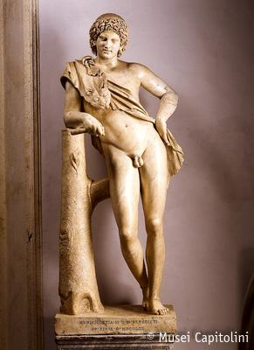

Slide 12
A circle of artists
If Rome in The Marble Faun on the surface looks almost exclusively as a background landscape where history and culture coalesce into monuments and works of art, the foreground is occupied by the community of American painters and sculptors that lived in the Eternal City at the middle of the 19th century. Kenyon strongly resembles William Wetmore Story, author of famous statues like Cleopatra (described as Kenyon’s work in progress in The Marble Faun). Miriam recalls Louisa Lander, a sculptor specialized, like Miriam with painting, in the representation of strong women such as Virginia Dare (she was later ostracized by the American expat community, and by the Hawthornes, because of her excessively free sexual life – and Miriam, too, is portrayed as a “free woman”). Hilda is a copyist, like Sophia Hawthorne was…

Slide 13
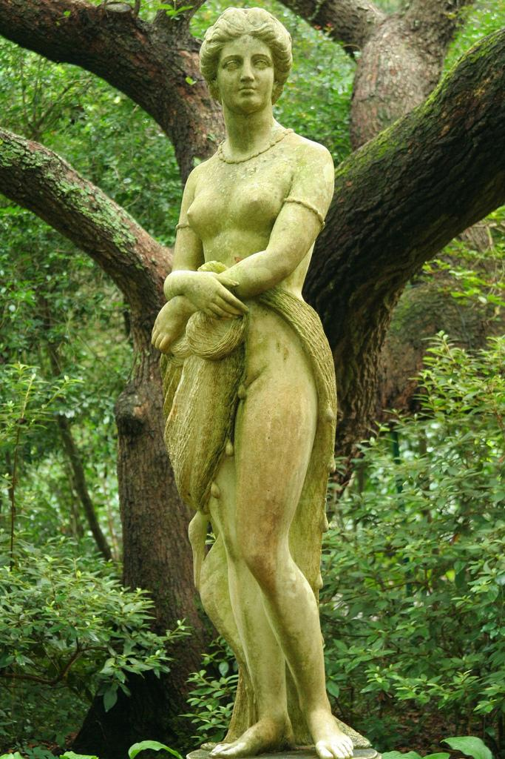
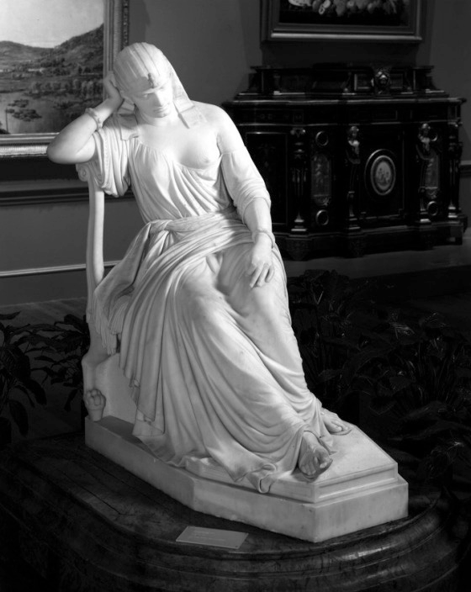

Slide 14
The Italian as primitive
The Marble Faun exploits the 19th-century “ethnographic” perspective through which “enlightened” Anglo-Saxon observers saw the “less developed” peoples of the Mediterranean area as passive objects of scrutiny – much like monuments and works of art.
Italians were heavily racialized as “primitives” who could only profit by the contact with the generous and benevolent “superior race.” Donatello embodies this backwardness, and can be rescued from his almost animal-like innocence only thanks to paradox of the Fortunate Fall – he must lose his timeless “state of grace” by committing a crime that plunges him into the world of “real” experience.

Slide 15
A(n) (Un)Fortunate Fall
Donatello’s crime is triggered by the probably Jewish Miriam, who urges him to liberate her from the mysterious Model that keeps haunting her.
When Hilda comes to know the crime committed by her two friends, she too loses her much more “advanced” innocence, but finally regains it by proxy when she lets a Catholic priest understand that Donatello has murdered a man under Myriam’s command. So she remains doubly “innocent” because she is not an accomplice of her two friends and she is not a betrayer because it is the priest who denounces them.
Donatello’s Fortunate Fall is lucky above all for the two young Americans, who come back to the Unites States enriched by their Italian experience but “uncontaminated.” For Donatello, who ends up in a prison, becoming fully “human” like his American friends only leads of the deprivation of freedom and happiness (quite the reverse of what the Declaration of Independence promised)…

Slide 16
Rome = America?
The representation of Rome in The Marble Faun conveys the idea that many of the main features that should ground the “commonplace exceptionality” of the “American Dream,” and should therefore be absent in its exact opposite, Italy as the epitome of all human history of tyranny and oppression, are instead splendidly actualized in the Italian landscape. On the other hand, the monumentalization of the basic tenets of American democracy as they are translated into Rome’s geography is construed in such a contradictory way, in The Marble Faun, so as to create a sort of distorted mirror where those tenets are shown in better, even if deformed, detail, and with a clearer indictment of their limitations and aporias. Hawthorne’s dislocating representational strategies create a relativistically complex image of both American and European historical cultures and political ideologies – thus questioning the cliché, dominant in Hawthorne criticism until a few years ago, that The Marble Faun consistently dodges “actual” historical and political issues.

Slide 17
De te fabula narratur…
In other words, The Marble Faun does not so much represent Rome (and Italy) – it rather represents the American representation of Rome (and Italy).
Richard H. Millington: “The Marble Faun is more about America than Italy,” not because it deals with what America means, but in its insistence on the Americans’ (the narrator’s as well as his characters’) codification of Rome and Italy as the historical and cultural horizon inscribing every attempt to make sense of America.
Robert Levine: “The Marble Faun’s foreign setting would have invariably prompted Americans to think about America.”
Mark Kemp: “Hawthorne’s Rome contains no events or people,” and instead conveys “a fantasy of stateless and apolitical subjectivity” whose “(post)colonial unconscious suggests a radically unstable national narrative that both worries over the demise of the nation-state – the United States – and endorses the imperial vision that will sustain it.”

Slide 18
A recapitulation of history
Even if the Italian Risorgimento or the other European national revolutions, and the American reactions to them, are visibly absent in The Marble Faun, their presentia in absentia helps Hawthorne to draw a broader context in which the Roman landscape, overburdened as it is by the weight of the past, symbolically recapitulates the evolution of Western civilization itself, with the United States as simply one of its present stages, and not necessarily its final and exceptional culmination.

Slide 19
An Eden After the Fall
Nathalia Wright, American Novelists in Italy (1965): first systematic study of the colony of American writers in 19th-century Italy.
The Marble Faun: Rome = an “Eden after the Fall,” an earthly paradise pervaded by images of corruption and death, the place where one of the founding American myths, that of the innocent new Adam and of a regenerate paradise on earth, is at the same time showcased and dismantled.
In contrast to the “commonplace prosperity” the Preface defines as a banally distinctive trait of Hawthorne’s homeland, and that the two American characters of The Marble Faun leisurely display in the narrative, the much more potent cultural images connected to that myth are used to portray not Kenyon and Hilda, but the European characters, Donatello and Miriam, located on the opposing poles of the oxymoronic tension between “Eden” and “Fall.” If Miriam is a clear example of the tragically fallen woman doomed to involve the pure and innocent male in her fate, Donatello perfectly embodies prelapsarian natural innocence. Or so it would seem…

Slide 20
Donatello’s “Primitiveness” and
American Imperialism
Nancy Bentley and Kristie Hamilton: Donatello shares a lot of features with African Americans as they are represented in other works by Hawthorne, and with Native Americans as they were mythicized, among others, by James Fenimore Cooper; more generally, Donatello embodies the “primitive man” as it was studied and used during the nineteenth century as a negative term of comparison for the more advanced and “civilized” (that is, Anglo-American) societies .
United States’ turn toward imperialism at the middle of the 19th century (myth of “Manifest Destiny”) → reinforcement of the discourses that “inner imperialism” had to construct to justify the subjugation of both Native Americans and African Americans.
Edward W. Said: imperium = “protracted, almost metaphysical obligation to rule subordinate, inferior, or less advanced peoples”→ the representation of these peoples and races stresses their inability to govern themselves, their being too “young and innocent,” due to a backwardness that situated them at the lowest steps of the ladder leading to high civilization.

Slide 21
Donatello as “Frontiersman”
No critic has seriously entertained the idea that Donatello might also be a figure of the frontiersman, but his identity is the result of a much more complex web of features than the ones usually emphasized (animal-like naturalness, cultural underdevelopment, mythical innocence). His being definitely “outside of rules” (The Marble Faun, 10) and inhabiting the middle ground between the actual world and fairy-land sets him in a frontier space much akin not only to the one designed by Hawthorne in “The Custom-House,” but also to Natty Bumppo’s (in the US Embassy in Germany website you can read that the creation “of the character of Natty Bumppo is probably the most significant thing that happened in American literature during the first 50 years of its history” – so Donatello also seems to embody the prototypical American hero...).

Slide 22
A “popular aristocrat”
Donatello = avatar of native folk simplicity but also the last of a long line of Italian aristocrats, who should be the bearers of the values of refinement and sophistication, even if old-fashioned and decayed (Donatello is instead always shown as preternaturally young and living in an eternal present: “Donatello has certainly the gift of eternal youth”; The Marble Faun, 10).
Donatello = not a noble savage, but a savage nobleman.
Donatello’s natural innocence and newness, and the consequent possibility of entering the blank page of life on totally equal standings with everyone else (the most American of identity myths), have full possibility of expression only in the most anti-democratic Western society of the time, and in a city where everything conspires against the new. The paradox of Donatello’s adhesion to the “democratic” laws of nature notwithstanding his ancient aristocratic heritage is reflected – in his American friends’ haughty attitude towards him, manifested above all in the condescension with which they, members of a culture which pretends to have abolished class differences, accept his company, as if his social position were as low as his “animal nature,” and not much higher than theirs: “our republican and artistic simplicity of intercourse has included this young Italian,” Kenyon boasts, “on the same terms as one of ourselves,” even if he recognizes that “if we paid due respect to rank and title” (something a true American of course never does) “we should bend reverentially to Donatello” (77). Donatello seems instead to be totally unaware of class differences (something a true American of course should always be…).

Slide 23
A place of freedom for women
In Rome, Miriam can forge a new self without being chained to a (mysterious) past that “would have operated unfavorably as regarded her reception in society, anywhere but in Rome” (The Marble Faun, 14). Kenyon says that nowhere else “but in Rome, and as an artist, could she hold a place in society, without giving some clue to her past life,” contrasting this freedom with the lack of it in “our New England villages, where we need the permission of each individual neighbor, for every act that we do, every word that we utter, and every friend that we make or keep” (109).
Hilda (typical young American girl) = “an example of the freedom of life which it is possible for a female artist to enjoy at Rome,” where “purity of heart and life are allowed to assert themselves, and to their own proof and security, to a degree unknown in the society of other cities” (41). The city where the past is as terribly insisted upon as no other city in the world is also the place where women may be free of their past, and move at liberty.

Slide 24
Sublimation of history into art
It is the oppressive pervasiveness of Italian history that allows the two Americans, Hilda and Kenyon, not to think about their own American past and above all present: in Rome, “the present moment is pressed down or crowded out,” because, side by side “with the massiveness of the Roman Past, all matters, that we handle or dream of, now-a-days, look evanescent and visionary alike” (The Marble Faun, 6) → sublimation of history into art history.
“Fairy precinct of romance” = time-space where all hopes and preoccupations about the fate of American history are projected onto the Roman landscape, to be transfigured and finally defused in the tourist’s passive perception of the spectacle of the testimonies of the tragic history that led the glorious Roman empire to crumble away in the ruins that are now no more than the cultural boon for the rampant Anglo-American middle class.
Brigitte Bailey: in the antebellum period Rome served “both as a posthistorical aesthetic spectacle and as an historical model for the idea of the US national capital as either the political center of a republic or as imperial capital.” But in The Marble Faun Rome as empire is mainly the model for historical disaster.
Hilda and Kenyon are happily oblivious of all this, even if they are surrounded by all possible symbols hinting at it,→ possible denunciations of America’s false historical consciousness, what Lauren Berlant calls its amnesiac national fantasy.
The apparent deletion of the signs of Italy’s present political situation is certainly due to Hawthorne’s inability to understand and even be interested in it, but it is also and above all a mirror of a general American attitude (Margaret Fuller is an obvious exception here) towards the complexities and ambiguities of contemporary social conflicts.

Slide 25
A Roman Melting Pot
The Roman landscape provides specific spaces where the (typically American) ideals of freedom and equality are perfectly fulfilled.
Villa Borghese = open-air space granting everyone the right to freely move everywhere: in Villa Borghese “priest, noble, and populace, stranger and native, all who breathe Roman air, find free admission” (The Marble Faun, 52).
Scene of the “Sylvan dance”: a motley of nationalities and social classes meets and mingles – Roman “plebeian damsels,” “contadinas” from the Campagna, the “modern Roman, from Trastevere,” “French soldiers,” “German artists,” “Swiss Guardsmen,” “English tourists (one of them a lord),” “a herdsman or two,” “a few peasants” (65).

Slide 26
The Place of All Places
St. Peter’s = “World’s Cathedral” (title of chapter 39) where (as in the New World of the American Promise) “there was space for all” (350). The multilingual culture of the world – what the United States, a nation without an official national language, would like to attract, absorb and contain within its boundaries – is reflected and magnified in the various confessionals, where each citizen of the world can speak in his or her own tongue: “there was room for all nations” (356).
In the Preface to the first edition of Leaves of Grass (1855), Walt Whitman writes, celebrating the USA: “Here is not merely a nation but a teeming nation of nations.”

Slide 27
American Absences
(and Italian Presences?)
The Marble Faun:
“a country where there is no shadow, no antiquity, no mystery, no picturesque and gloomy wrong, nor anything but a commonplace prosperity, in broad and simple daylight, as is happily the case with my dear native land.”

Slide 28
J. Hector St. John de Crèvecoeur, “What Is an American?” (Letter III of Letters from an American Farmer, 1782)
Here are no aristocratical families, no courts, no kings, no bishops, no ecclesiastical dominion, no invisible power giving to a few a very visible one; no great manufacturers employing thousands, no great refinements of luxury. The rich and the poor are not so far removed from each other as they are in Europe.

Slide 29
Henry James, Hawthorne (1879)
It takes so many things, as Hawthorne must have felt later in life, when he had made acquaintance of the denser, richer, warmer European spectacle – it takes such an accumulation of history and custom, such a complexity of manners and types, to form a fund of suggestions for a novelist. [...] One might enumerate the items of high civilization, as it exists in other countries, which are absent from the texture of American life, until it should become a wonder to know what was left. No State, in the European sense of the word, and indeed barely a specific national name. No sovereign, no personal loyalty, no aristocracy, no church, no clergy, no army, no diplomatic service, no country gentlemen, no palaces, no castles, nor manors, nor old country-houses, nor parsonages, nor thatched cottages, nor ivied ruins; no cathedrals, nor abbeys, nor little Norman churches; no great Universities nor public schools – no Oxford, nor Eton, nor Harrow; no literature, no novels, no museums, no pictures, no political society, no sporting class – no Epson or Ascot!

Slide 30
Langston Hughes,
“To Negro Writers” (1935)
We want a new and better America, where there won’t be any poor, where there won’t be any more Jim Crow, where there won’t be any lynchings, where there won’t be any munition makers, where we won’t need philanthropy, nor charity, nor the New Deal, nor Home Relief.

Slide 31
A citizen of somewhere else?
At the end of “The Custom-House” Hawthorne declares that he wants to be a “citizen of somewhere else,” leaving forever his birthplace behind: this “somewhere else” could be Rome, except for the fact that Hawthorne feels “at home” in Rome precisely when he is leaving it, or better, “her.” His “somewhere else” here becomes a place always deferred, a space of eternal transit, the sphere of never-ending transformation – the very first title of The Marble Faun, referring literally to Donatello’s transformation, but even more meaningfully to Hawthorne’s.
At the beginning of chapter 36, the narrator suddenly changes the narrative tone he has so far adopted, and embarks in a bitter tirade against Rome, to be surprisingly turned upside down at its very end. Almost every commentator has stressed Hawthorne’s supposedly “superficial” relationships towards Rome and Italy, and both the Italian Notebooks and The Marble Faun offer ample evidence for this accusation.

Slide 32
… or a “true Roman”?
But do we have to take at face value what Hawthorne writes, considering that in the preface to the romance Hawthorne states exactly the opposite of what he has been doing throughout his career, that it is impossible to write romances about America? Or should not we rather suspect that he willingly leaves out of his written records a much deeper his entanglement with Rome?
In Lacanian terms, it as if the Real, what cannot be said and nonetheless conditions everything is said with its very absence, and which can be glimpsed only through the voids the reader may (or may not) detect in the text, here makes some sort of appearance, hinting at everything Hawthorne has carefully left hidden, but which has finally managed to emerge so as to destabilize the architecture of distancing he has so far constructed.
In leaving Rome, he has discovered he has become a true Roman (like, say, Remo Remotti or Cranio Randagio) – that is, a transnational subject, a citizen not of somewhere else, but of anywhere else, a citizen of the world.

Slide 33


Remo Remotti & Cranio Randagio: Hawthorne-like Romans?
https://www.youtube.com/watch?v=WC0uBCEjEdY
https://www.youtube.com/watch?v=GW2H6IjC5t0

