Slide 1
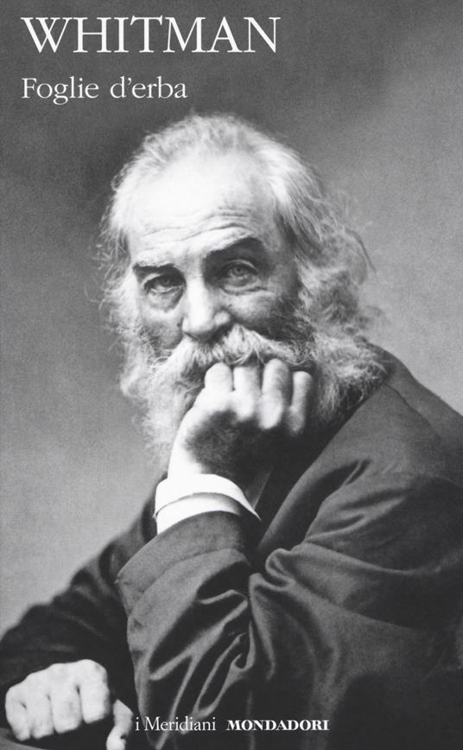
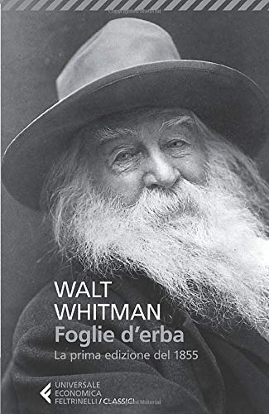
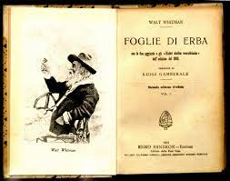
Whitman and Italian-US Negotiations

Slide 2
WHITMAN’S “ARRIVAL” IN ITALY
Caterina Bernardini:
When Whitman’s work arrived in Italy, in the 1870s and 1880s, the country had only recently been unified and was in a post-Risorgimento phase of transition and adjustment. […] In the newly formed Italy of the 1860s, the nation’s literati felt a huge responsibility: they had to try to build an adequate literature, and therefore an identity, for this renewed political entity. They had to leave behind an aristocratic tradition, with its anachronistic attachment to academism and classicism, and give shape to a new, more modern literature. […] The “cultural translation” of Whitman […] was shaped by – and responded to – the need for a true “Italianization,” a more homogeneous nationhood. Whitman’s poetry was evoked as a way to keep the democratic, humanitarian Mazzinian and Garibaldian ideals that had been the ideological core of the heroic struggles to achieve unification, not only unforgotten, but vital, in a potentially revolutionary sense.
Whitman was mainly appreciated for his political resonance, his writings about the potentialities of American democracy and identity, seen both as a geographical territory in exciting evolution and as the promising symbol of a modern writing space. He was also admired, often idealized and invoked as a model, for the renovated and yet classical weight of his diction.

Slide 3
FIRST ENCOUNTERS
First major encounter of Whitman and Italy: William Michael Rossetti’s edition of Poems by Walt Whitman (1868). Rossetti shared the ideals of the Italian Risorgimento and his edition was influenced by these democratic/nationalistic values. For Rossetti, Whitman was the poet “both of Personality and of Democracy; and, it may be added, of American nationalism.” Rossetti’s edition was read by Italian poets and critics, first of all by Florentine critic Enrico Nencioni, who published the first relevant Italian articles on Whitman, “Walt Whitman” (1879), “Nuovi orizzonti poetici” (1881) and “Mazzini e Whitman” (1884), all in the Fanfulla della Domenica, followed by “Il poeta della guerra americana” (1891), in Nuova Antologia. Whitman’s poems first started to be translated into Italian in the section on “humorous poets” (Rossetti had selected Whitman for the Humorous Poems anthology he had edited in 1872) of the very first Italian anthology of American literature, edited by Gustavo Strafforello in 1884, Letteratura americana (Whitman appears with “A Boston Ballad”).

Slide 4
A POWERFUL, BUT RUDE, POETIC GENIUS
Nencioni: image of Whitman as a powerful, but “barbaric” poet, to be appreciated for what he says, not for how he tells it, because he lacks the ability to control form (“Se il genio non fosse, com’è, una straordinaria conciliazione di ragione e di fantasia in uno stesso cervello; se bastasse il divus afflatus, la visione infinita, I’entusiasmo umanitario, Walt Whitman potrebbe ambire a quell’unico onore, ed esser il genio, la voce poetica della sua nobile terra” (Nencioni, “Walt Whitman”). Whitman is ““simple, strict, rude, and colossal (and, in all of these qualities, perhaps excessive).”

Slide 5
WHITMAN AND GIOSUÈ CARDUCCI
Giosuè Carducci = first major Italian poet to be influenced by Whitman, but more on the level of content than on that of language and form (following Nencioni’s critical evaluation of Whitman) → intention, never fulfilled, to “regularize” and “ennoble” Whitman by translating his poetry in hexameters:
I nuovi orizzonti vanno benissimo. Ciò che dici, con molto evidente ed efficace precisione, della falsa poesia odierna, è quello stessissimo che ne penso io; la colpa di quella poesia risale ad artisti che furono troppo ammirati per l'umana contraddizione e reazione contro i veri grandi poeti, i sani, i forti, che pensano cose grandi e grandemente le dicono. I pezzi del Whitman, scelti e tradotti, benissimo. Sai che il Fogliame americano io l'ho letto e tradotto a lettera tre volte col mio maestro d'inglese [Annibale Ferrari], un italiano che scappò in America di 17 anni, ci è stato 23 anni, e ha fatto il capitano al servizio della Repubblica nella guerra di secessione contro gli Stati del Sud? È una bestia, sempre ubriaco; ma sente e respira l'America; e non ha più quasi nulla d'italiano; e me lo commentava facendo gesti e urli feroci. E mi venne subito la voglia di tradurlo in esametri. Tutti quei nomi a catalogo! quelle enumerazioni, successioni, quelle serie di paesaggi, di sentimenti, di figure straordinarie e vere! lo ne rimasi e ne sono rapito! Dopo i grandissimi poeti colossali, Omero, Shakespeare, Dante e... ci sarà del più pensato, del più profondo, del più perfetto, ma nulla di cosi immediato e originale. Peccato e dannazione che io d'inglese capisco poco, e la prosa; ma la poesia mi è molto difficile.

Slide 6
LUIGI GAMBERALE’S TRANSLATIONS
Luigi Gamberale: self-taught the English language, and started translating Whitman encouraged by his friend Girolamo Ragusa Moleti, a Sicilian poet who had already directed Nencioni towards the American author.
First edition of Canti scelti (1887): selection that privileges Whitman’s most conventional political poems, those about the Civil War, and almost totally ignores “Song of Myself” (even if, in an article published in 1884, Gamberale had – correctly – written that “Song of Myself” contained Whitman’s poetical program).
Marina Camboni: in this first edition, Gamberale presented Whitman as unripe, imperfect, rough and stylistically naïve, but also as a prophetic precursor of the future.
1890 edition of Canti scelti: includes the 1855 Preface and more extended excerpts from “Song of Myself.”
1907: with the help of Ragusa Moleti and Giovanni Pascoli, Gamberale published the first full translation of Leaves of Grass (Foglie di erba) in Europe.

Slide 7
FOGLIE DI ERBA
Gamberale “normalized” Whitman’s rambling syntactical structures and, convinced that Whitman’s poetry is actually prose, also changed stanzas by often eliminating their inner sub-divisions. Gamberale ignored Pasquale Jannaccone’s 1898 analysis of Whitman’s prosody, that stressed how the peculiar form used by Whitman to build his stanzas was reminiscent of primitive and biblical forms, and even ancient Greek religious poems, but also that “this reproduction of ancient forms is not a return to the primitive stages because of a decline of the poetic organism; it is, instead, a necessary consequence of the evolution of verse. The form of the poems of Leaves of Grass marks, to put it simply, the first stage in the modern phase of the evolution of verse; it strengthens and gives relevance to the logical element, diminishes and sometimes even almost suppresses phonic rhythm, so that, between the two elements, a new balance and agreement can be formed. From this, more varied and more suggestive.”
Gamberale’s translation heavily influenced subsequent French and Spanish translations, and in all of them the sexual charge and the homoerotic component of the original text were generally downplayed and at times fully erased.
Even American readers who knew the Italian language appreciated Gamberale’s translation. One of them wrote in a letter to him: “I have just been examining with greatest interest your translation of Leaves of Grass into Italian. I know enough of Italian to understand the pronunciation and see how excellent you have caught the lilt and rhythm of those wonderful poems. As a friend and countryman of Whitman I wish to express my thanks and appreciation of your work.”

Slide 8
ADA NEGRI AND THE ITALIAN POLITICIZATION OF WHITMAN
Ada Negri, “Il gigante della libera America” (published in 1893 by Il figurinaio, and anti-clerical, liberal-democratic periodical): “the post-Risorgimento champion of democracy created by Rossetti, the ‘healthy’ writer capable of chanting America and the future with a renovated epic energy, as described by Nencioni, is being transformed into the legendary, absolute source of revolt that will alternatively appeal both to socialism and to early fascism. […] After Whitman’s death in 1892, the mythical aura that had already been assigned to him in his later life (as in the works of, among others, Rossetti, Nencioni, and Darío) tremendously intensified. And Whitman became, more and more, a standard-bearer for different political and cultural agendas” (Bernardini).
Negri also stressed the overtly sexual dimension of Whitman’s poetry, almost always censored by former Italian critics, even if she read it in exclusively heterosexual terms.

Slide 9
THE BARD AND IL VATE
One of the Italian poets most influenced by Whitman at the turn of the 19th into the 20th century was Gabriele D’Annunzio. In 1884, in a letter to Nencioni, he wrote: “why don’t you publish a full book on Whitman? [...] The aim of the book should be a vigorous revolt against the miserable small-mindedness of contemporary art. You should talk, a little more extensively, about the new horizons, the new tendencies, the new needs; you should charge headlong at the mechanical chiselers; then indicate and delineate the great figure of the American poet.”
In the 1893 collection Poema Paradisiaco a poem titles “L’erba” is included, and is strongly reminiscent (at least al the level of content) of Whitman’s notorious metaphorical conceptualization of grass.
In 1896 D’Annunzio was accused of plagiarism, because his “In Memoriam” (written after the death of admiral Simone Antonio Pacoret de Saint-Bon, too closely resembled one of Whitman’s most famous (and “patriotic”) poems, “When Lilacs Last in the Dooryard Bloom’d,” dedicated to the memory of Abraham Lincoln.
In his crusade for Fiume after World War I, in 1919 D’Annunzio wrote an appeal titles “To the Italians of America” that extensively used Whitman’s themes and rhetoric to justify Italy’s expansionism.

Slide 10
THE FIRST “TRUE” ITALIAN WHITMAN
The first Italian poet who came close to fully understand Whitman’s revolutionary contribution not only to the “democratization” of poetry but also to the renovation of poetic language was Luigi Capuana.
In 1883 Capuana published the collection Semiritmi, after having some of its poems issued by Il fanfulla della domenica, where he had published as editor Nencioni’s articles on Whitman. His use of free verse (that later influenced D’Annunzio himself) was possibly inspired by Whitman’s example.

