Slide 1
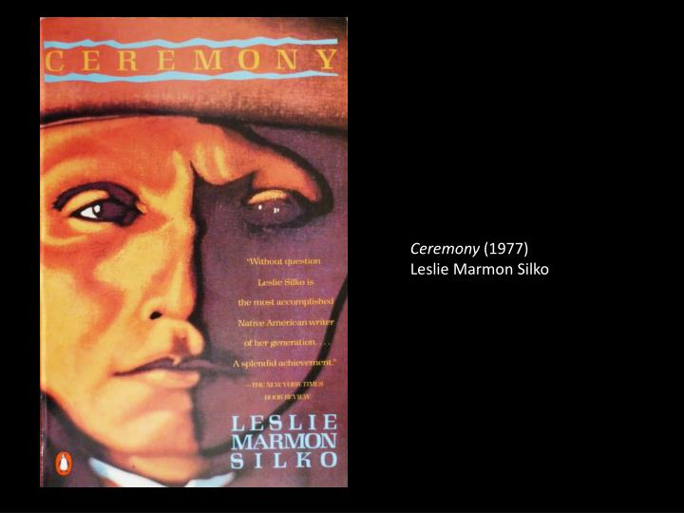

Slide 2
Race Is a Social Construction
Race
Phenotype
Ethnicity
Ancestry
Nationality

Slide 3
Critical Race Theory
Cristina Lombardi-Diop:
CRT is a theoretical and interpretative field of inquiry that examines race and racism across history, society, and cultural modes of expression.
CTR attempts to understand how victims of systemic racism are affected by cultural perceptions of race and how they are able to present themselves to counter prejudice.

Slide 4
Whiteness Studies
Whiteness Studies: analysis of unequal distribution of privileges, resources, and power between white people and people of color.
Richard Dyer: Whiteness presents itself as “transparent” or “invisible” because it is considered universal, it is often unnamed, and unmarked → white people are just people.

Slide 5
Race and Intersectionalty
Kimberlé Crenshaw, “Demarginalizing the Intersection of Race and Sex” (1989) and “Mapping the Margins” (1991): race, class, and gender interact to shape experiences of women of color, and create complex systems of oppression.
Women of color do not simply experience gender discrimination plus racial discrimination as two distinct systems of oppression. Race, gender, and other forms of subordination intersect and overlap, creating specific experiences and locations of subordination and vulnerability.
“Intersectional subordination need not be intentionally produced; in fact, it is frequently the consequence of the imposition of one burden that interacts with pre-existing vulnerabilities to create yet another dimension of disempowerment” (Crenshaw).

Slide 6
Ethnic Studies
Ethnic Studies = theoretical study of race and cultural pluralism, started by African American writers and intellectuals.
W.E.B. Du Bois: The Souls of Black Folk (1903), organization of the Atlanta University Conferences (1898-1914): first scientific studies of the (intersecting) dimensions of the lives of Black people (health, homes, wealth, education, religion, crime…)
Carter G. Woodson: founding of the Association for the Study of Negro Life and History (1915) and of the Journal of Negro History (1916).
Gradual adoption of European theories of language, textuality, gender and subjectivity to critique discourses of race and racial difference.
Expansion of the field so as to include other ethnicities, first of all Chicano/a and Native American cultures.

Slide 7
Us vs Them
Ethnic studies examine how dominant perceptions of cultural identities in Europe and North America tend to postulate a dichotomy between “Us” (the non-ethnic majority) and “Them” (colonized or old and new migrant communities, characterized as “ethnic”).
Ethnic identity or origin = an individual’s ancestral heritage.
Ethnocentrism = the belief that a cultural community or ancestry is superior.
Ethnicism = protest/resistance against the oppression and exploitation of “ethnics” by the dominant group.

Slide 8
Ethnicity, Ethnic Identity, Ethnic Group
Sian Jones (The Archaeology of Ethnicity, 1997):
Ethnicity = “all those social and psychological phenomena associated with a culturally constructed group identity.”
Ethnic identity = “that aspect of a person’s self-conceptualization which results from identification with a broader group in opposition to others on the basis of perceived cultural differentiation and/or common descent.”
Ethnic group = “any group of people who set themselves apart and/or are set apart by others with whom they interact or co-exist on the basis of their perceptions of cultural differentiation and/or common ancestry.”

Slide 9
Ethnicity and Practice Theory
Sian Jones: “ethnicity is not a passive reflection of similarities and differences in the cultural practices and structural conditions in which people are socialized,” nor is ethnicity “produced entirely in the process of social interaction.”
Ethnicity = result of both conscious and subliminal recognition of the collective and individual forms of human agency.
Practice theory = focus on “the relationship between objective conditions and subjective perceptions.”

Slide 10
The “Habitus”
Pierre Bourdieu: habitus = durable disposition towards certain perceptions and practices (regarding sexual divisions of labor, morality, tastes), which become part of an individual’s sense of self at an early age, and which can be transposed from one context to another.
Ethnicity = neither a static reflection of culture, nor produced entirely by social interaction and boundary maintenance.
“The intersubjective construction of ethnic identity is grounded in the shared subliminal dispositions of the habitus, which shape, and are shaped by, objective commonalties of practice” (Jones).

Slide 11
The Multidimensionality of Ethnicity
Habitus = multidimensional; it can vary in different social situations; it is in constant state of change and reproduction within different social contexts.
Collective ethnicity = shared dispositions of habitus, changing through time and according to the different historical contexts.
Timothy Baumann: ethnicity = “product of self and group identity that is formed in extrinsic/intrinsic contexts and social interaction. Ethnicity is not the same as nor equal to culture. Ethnicity is in part the symbolic representations of an individual or a group that are produced, reproduced, and transformed over time.”

Slide 12
THE VANISHING AMERICAN
Central myth of American identity: “true/new” American = descendant of the colonists who “made” America on the Frontier vs. Native American = mere obstacle on the road to progress (ultimately irrelevant presence of the “vanishing American.”
Frederick Jackson Turner, The Significance of the Frontier in American History (1893): “In the crucible of the frontier the immigrants were Americanized, liberated, and fused into a mixed race, English in neither nationality nor characteristics” – no mention of Native Americans (ghostly presence in many reconstructions of American history up to the middle of the 20th century).

Slide 13
FICTIONS OF AMERICANNESS
Werner Sollors: descent/consent dialectics in the construction of American identity.
Descent = “relations of ‘substance’ (by blood or nature)” vs. Consent = relations based on “‘law’ or ‘marriage.’”
Myths of American identity focus on consent, stressing “our abilities as mature free agents and ‘architects of our fates’ to choose our spouses, our destinies, and our political systems.”
But this emphasis on consent hides the fact that it is reserved only to descendants of a certain “race,” and creates fictions of American multiculturalism that obliterate the exclusion of other “races.”

Slide 14
THE INDIAN REMOVAL ACT
Indian Removal Act (1830), signed by President Andrew Jackson: the President could negotiate with southern and Mid-Atlantic Native American tribes for their removal to federal territory west of Mississippi River, leaving their ancestral lands available for white settlements → deportation of tens of thousands of Native Americans (Trail of Tears).

Slide 15
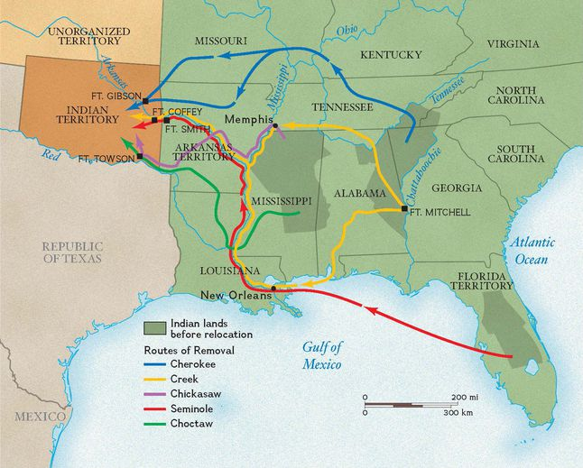
THE REMOVAL ACT (1830)

Slide 16
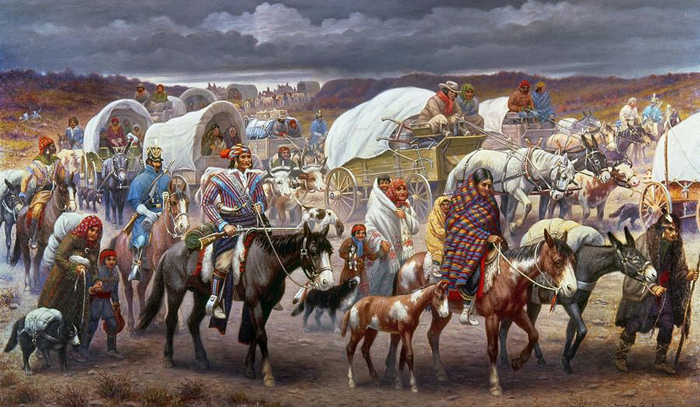
THE TRAIL OF TEARS

Slide 17
NATIVE AMERICAN RESISTANCE
1832: Chief Black Hawk and 1,000 Sauk and Fox Indians back to Illinois to reclaim their land → Indians greatly outnumbered by the US Army, militias and other Indian tribes → total defeat.
Sand Creek Massacre (1864): about 750 peaceful Cheyenne and Arapaho, forced to abandon their campsite in southeastern Colorado, set up camp at Sand Creek → volunteer Colorado soldiers slaughter about 150 men, women and children.
Red Cloud’s War (1866): development of the Bozeman Trail through Indian territory in Montana → resistance of Indian coalition led by Lakota Chief Red Cloud → US Army leaves the area → Treaty of Fort Laramie (1868): Black Hills of western South Dakota and northeastern Wyoming part of the Great Sioux Reservation → discovery of gold in the Black Hills → coming back of the US Army → resistance of Sioux and Cheyenne warriors led by Sitting Bull and Crazy Horse.
Battle of the Little Bighorn (1876): George Armstrong Custer’s 600 men overwhelmed and killed by about 3,000 Sioux and Cheyenne warriors led by Crazy Horse → the US government forces anyway the Sioux to sell the Black Hills and leave the land.
Geronimo (Goyaalé): leader of Apache resistance, 1876 to 1886, when is captured for the fourth and last time by the US Army → becomes protagonist of shows about American Indians (sells pictures of himself, bows and arrows, his hat), and features at the 1905 inaugural parade for President Theodore Roosevelt. Dies in 1909, as a prisoner of war.
Wounded Knee (1890): spreading of Indian “Ghost Dance” rituals to reunite the living with the dead and bring peace and prosperity → the US Army surrounds a group of Ghost Dancers near the Pine Ridge reservation of South Dakota → about 150 Indians are slaughtered.

Slide 18
NATIVE AMERICAN LITERATURE
Native American literature gains some recognition only after World War II, when the first substantial generation of native writers start publishing fiction and poetry in English.
Before the “birth” of Native American written literature a long poetic, narrative, and even dramatic tradition nonetheless already exists, but is mainly oral. American Indian literature is deeply influenced by this tradition, which does not only provide a “raw” material, but also many stylistic and structural devices and even an overall dynamic conception of the relationship between tradition and innovation already embedded within the native heritage itself, since in all American Indian culture(s) tradition is not the slavish reproduction on the past but an ever-changing adaptation of the already known to the needs of the present and the unknown, allowing the new native literature to immediately, almost “naturally,” entertain a dialogue first with Western Modernism and then with Postmodernism.

Slide 19
ORIGINS
First relevant texts = autobiographies.
William Apess, Methodist preacher and descendant of Metacomet (King Philip): A Son of the Forest (1829).
Black Hawk, The Life of Ma-Ka-Tai-Me-She-Kia-Kiak, or Black Hawk (1833).
First important “intellectual”: George Copway, friend to Henry Wadsworth Longfellow (author of the pro-Indian Song of Hiawatha, 1855) and the historian of “ the American Forest” Francis Parkman; author of The Life, History, and Travels of Kah-Ge-Ga-Gah-Bowh and editor of Copway’s American Indian.
First Native American novel: O Gi Maw Kwe Mit I Gwa Ki – Queen of the Woods (1890), by Simon Pokagon.
First Native American novel by a woman author: Cogewea: The Half-Blood (1927), by Mourning Dove (Hum-ishu-ma).
Turn of the 19th- into the 20th-century: autobiographies recorded by anthropologists – Geronimo’s Story of His Life by S.M. Barrett (1906) and Black Elk Speaks (1932) by John Neihardt.

Slide 20
THE WEB OF STORY-TELLING
In all these early literary or para-literary efforts the fundamental feature is the attempt of a connection of the present with the past and the individual with the community through the practice of story-telling. For Native American culture, telling stories means to weave a web and so costruct a meaningful collective identity.

Slide 21
NATIVE AMERICAN RENAISSANCE
After World War II, and in the wake of the Civil Rights Movement(s), Native American literature acquired a recognized status with the so-called Native American Renaissance, “officially” born with N. Scott Momaday’s House Made of Dawn (1968), winner of the Pulitzer Prize.
Other relevant authors are: James Welch (Winter in the Blood, 1974), Duane Niatum (Ascending Red Cedar Moon, 1974), Joy Harjo (The Last Song, 1975), Leslie Marmon Silko (Ceremony, 1977), Gerald Vizenor (Darkness in Saint Louis Bearheart, 1978), Simon J. Ortiz (From Sand Creek: Rising in This Heart Which Is Our America, 1981), Louise Erdrich (Love Medicine, 1984), Paula Gunn Allen (The Woman Who Owned the Shadows, 1984).

Slide 22
A MIXED (INTERSECTING) HERITAGE
Suzanne Lundquist, Native American Literatures: An Introduction (2004) – three main features of the Native American Renaissance:
reclamation of heritage through literary expression;
discovery and reevaluation of early texts by Native American authors;
renewed interest in customary tribal artistic expression (i.e. mythology, ceremonialism, ritual, and the oral tradition of narrative transmission).
Kenneth Lincoln, Native American Renaissance (1977): in the late 1960s and early 1970s, a generation of Native Americans were the first of their respective tribal communities to receive a substantial English-language education in colleges and universities, and a period of historical revisionism, as historians were more careful to represent events from the Native American perspective. This work inspired public interest in Native cultures and within Native American communities themselves, and was mirrored by a period of activism within Native American communities to achieve greater sovereignty and civil rights. The ferment also inspired a group of young Native American writers, who emerged in the fields of poetry and novel-writing. In the span of a few years, these writers worked to expand the Native American literary canon, by mixing in creative and experimental ways traditional heritage and (post-)modernity.

Slide 23
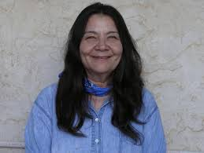
LESLIE MARMON SILKO
Leslie Marmon Silko, born in Albuquerque (New Mexico) in 1948: mixed Native American (Pueblo and Laguna), Mexican and Euro-American ancestry. Born and raised in the Laguna Pueblo reservation, where she still lives.
Works: Laguna Women Poems (1974), Ceremony (1977), Storyteller (1981; interweaving of short stories, some not by her, poems, photos and letters), Almanac of the Dead (1991; post-tribal epic mixing science fiction, spy-story and crime), Yellow Woman (1993; about Laguna society before the encounter with the whites; enlarged in Yellow Woman and a Beauty of the Spirit: Essays on Native American Life Today, 1996); Gardens in the Dunes (1998, historical international novel about a Native American girl who goes to Europe in the late 19th century); The Turquoise Ledge (2010; memoir about her life in a desert full of life).

Slide 24
CROSSING TIMES AND STORIES
One main preouccupation in Silko’s work is the intersection of different times (and even conceptions of time). Her storytelling is not aimed simply at reconstructing the historical memory of native peoples, but also at showing how, from the very beginning, that memory is interlaced with other memories. Silko’s “original” tribe, the Pueblo Laguna, on the one hand was one of the first to encounter European (Spanish) colonizers, and on the other has always been marked by hybridization (first with different Native tribes like the Navajo, and then with Spanish and English colonizers and also Meso-American tribes). Silko: “I suppose at the core of my writing is the attempt to identify what it is to be a half-breed or a mixed-blooded person; what it is to grow up neither white nor fully traditional Indian. It is for this reason that I hesitate to say that I am representative of Indian poets or Indian people, or even Laguna people. I am only one human being, one Laguna woman.”

Slide 25
AN (AB)ORIGINAL TRAUMA
Ceremony’s main plot is about coping with trauma. On the surface level, it is the Post-Traumatic Stress Disorder (PTSD) the protagonist, Tayo, is suffering from after having come back from the Pacific front, where his beloved cousin, Rocky, died. His is the “survivor’s syndrome,” so that he even fantasizes about being his own ghost, because it was he who had to die. But more deeply his trauma has always been there, due to his origins as a mixed-blood, since his mother ran away from the family and had him with a Mexican man: neither fully white nor Indian, he is not accepted by any of the two worlds (he has to live with his mother’s sister, “Auntie,” who on the one hand would like to be fully “Americanized” and on the other hates Tayo because he is the living sign of the contamination of native with white blood).

Slide 26
PUEBLO-LAGUNA/TRADITIONAL AND CHRISTIAN/MODERNIST MYTHOLOGY
The novel heavily relies on Pueblo Laguna mythology, which is strongly dualistic, and based on the dialectics (also present in the novel) between winter and summer, night and day, north and south, east and west, outside and inside, and death and life – but these dialectics do not necessarily imply a mutual exclusion or total opposition. Laguna ceremonies often represent a back and forth movement between the living and the dead.
Tayo is a dual character: his name comes form the traditional song of the sunrise bird (“TYOWI TYOWI he sings; / KAYO KAYO he is singing”; from Keresan texts collected by Franz Boas ).
This dualism is redoubled (a number of times…) by the double mythological references of the novel, which include a rewriting of the Christian myth of Parsifal, which is a rewriting of pagan myths, both modernistically re-written by T.S. Eliot in The Waste Land: like the Fisher King, he is responsible of the draught plaguing the land, and like Parsifal he is the “knight” who will finally heal the land.

Slide 27
A COMPLEX OF CEREMONIES
The ceremony Tayo must undergo to heal both himself and the land is actually a series of ceremonies, enacted through a series of journeys. In these journeys Tayo encounters various medicine men (and women) who will help him in redefining his conflicting relationships with his two (or more...) identities.
One of the medicine men, Betonie, weaves together the traditional figure of the shaman with that ot the modern “documentary historian” (he uses modern calendars and phone books in his rites). Silko thus deconstructs the binary dialectic that has always considered the native communities a “non-cultural,” purely “natural” universe, unable to historically transform itself. Even historians sincerely interested in promoting the value(s) of Native American culture(s) have remained trapped in the dichotomy nature vs. civilization – Calvin Martin has for example stated that in order to fully understand Native American history we should give up the idea of historical progress, because the Native Americans’ is a sort of “timeless” wisdom – their history would be a history without history. Betonie thinks that exactly the opposite is true: in order to fully understand the present predicament of Native Americans, he must not only reconstruct the supposedly unchanging past of Native traditions (which have always been changing, for change is the only unchanging thing), but he must also connect that past with the white past and the sense of time and history of white civilization (which is now inextricably intersected with Native American culture).

Slide 28
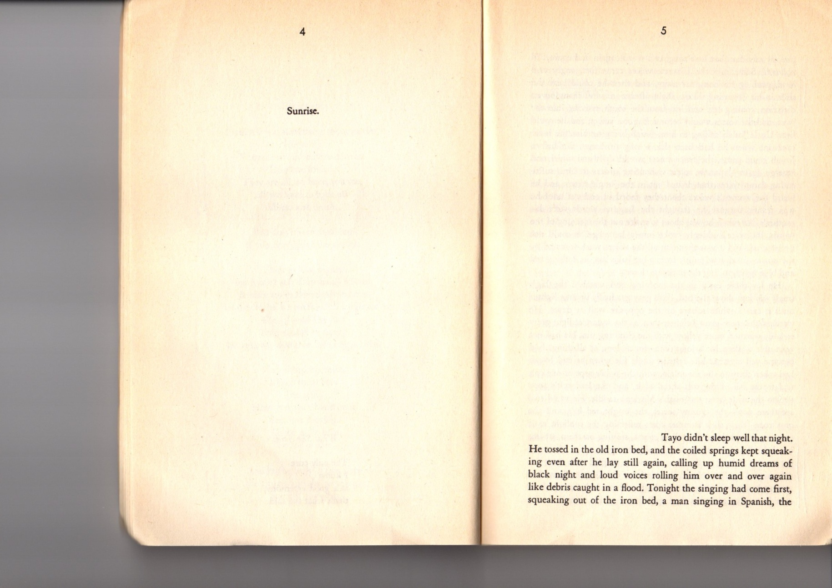

Slide 29
THE LAND AND THE PAGE
The inauguration of the main, contemporary plot of Ceremony shows the reader of the original edition of the novel two pages that reproduce the visual impact on the viewer of the New Mexico desert, where much of the action takes place. Most of the space of the pages is blank and white, like the white sands of the desert, with the word “sunrise” at the top of the left page, to mark the dominant position of the sun over the place, and the name of the protagonist, Tayo, at the bottom of the right page, so as to suggest his inferior and marginal position as a human being if compared to the vastness of cosmic (the sun) and earthly (the desert) nature. But this is only the beginning of the novel…

Slide 30
A MIXING OF TRADITIONS
The visual reproduction of native space does not only reflect the traditional native attitude toward the land – it also refers to another tradition, that of the European aesthetics of the picturesque and the sublime, which postulated the submission of the human subject to the overwhelming power of nature. The structure of many “picturesque” paintings is the same of Silko’s depiction of the desert, with vast unpeopled spaces dominating the center of the image and the human subject relegated to the right margin.

Slide 31
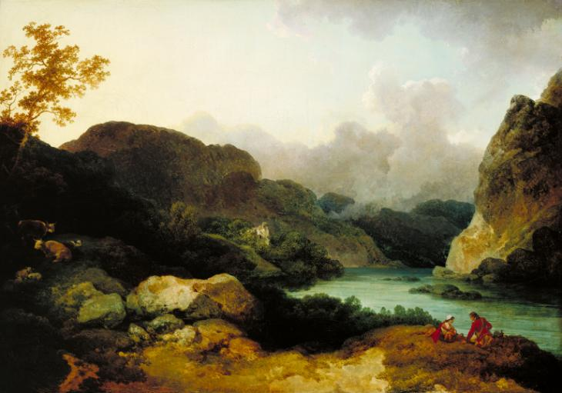
PHILIP JAMES DE LOUTHERBOURG,
LAKE SCENE, 1792

Slide 32
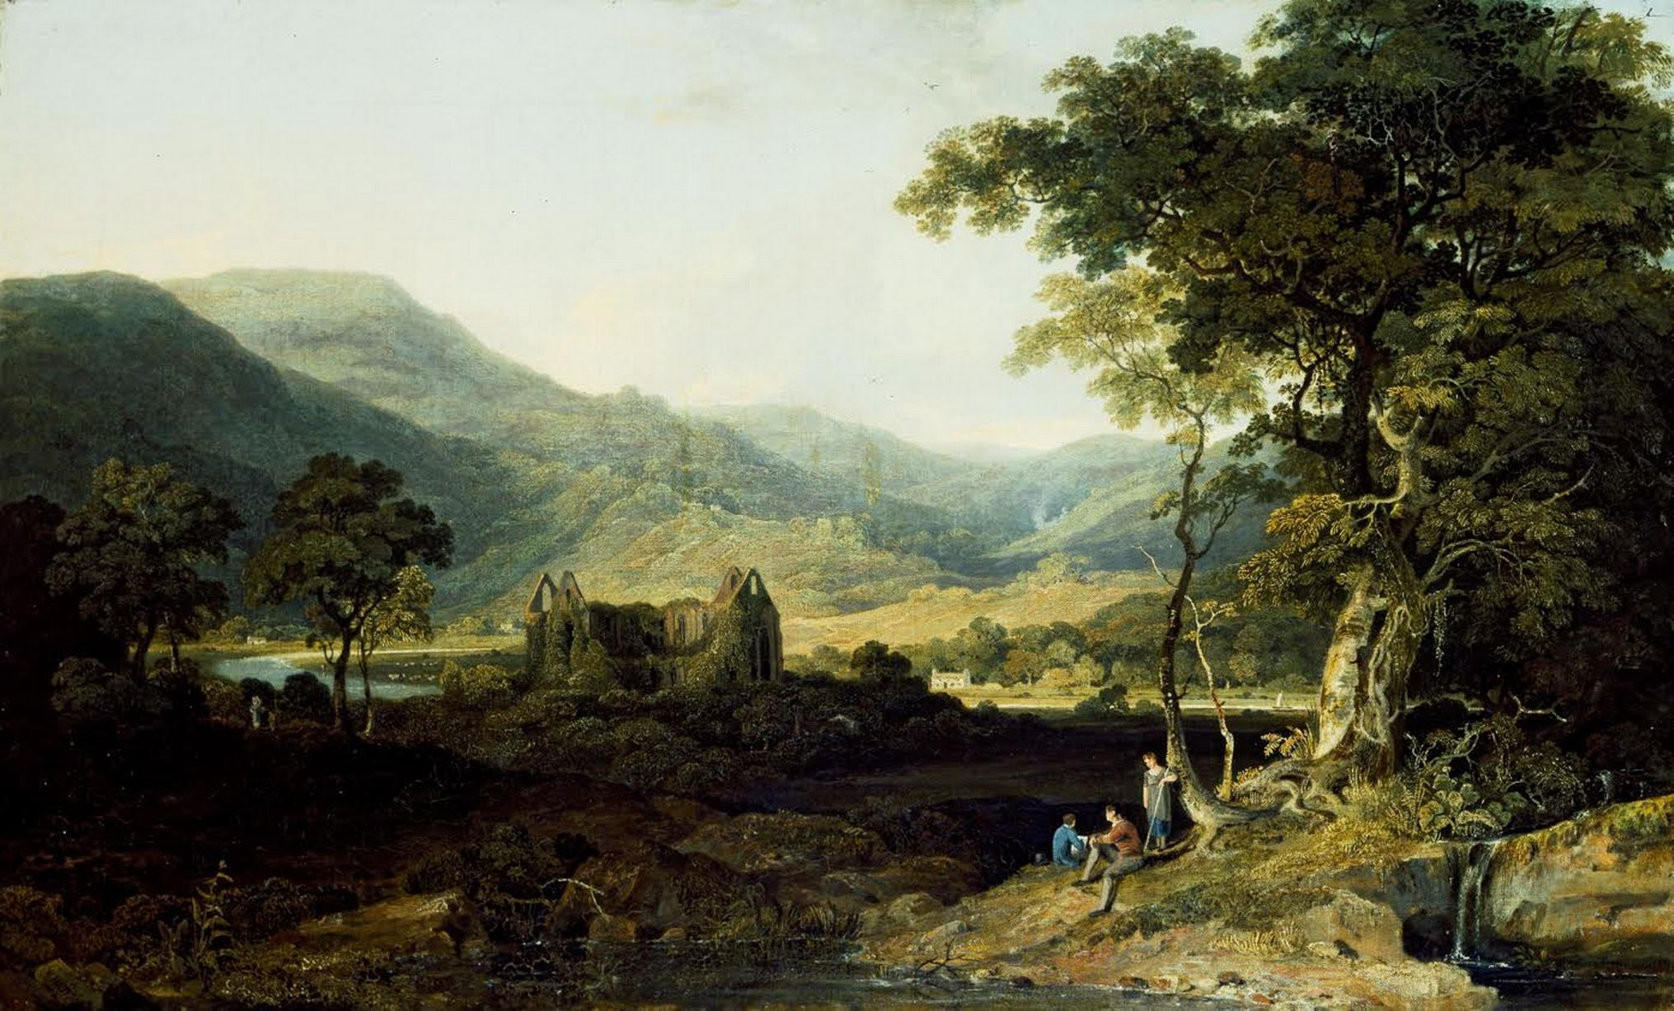
WILLIAM HAVEL, TINTERN ABBEY (1820)

Slide 33
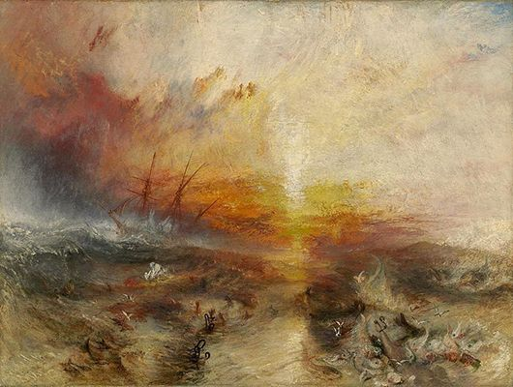
William Turner, Slavers Throwing overboard the Dead and Dying (1840)

Slide 34
WASTE LANDS
The whiteness of the page can also refer to the power white civilization and technology has exercised over Indian (often sacred) lands, as in the case of New Mexico, the major site of the US experimentation of nuclear weapons (at White Sands, near Los Alamos, the first atomic bomb was detonated in July 16, 1945) and of open pit uranium mines (like Jackpile, about 50 miles east of Gallup), which have transformed the area into a (nuclear) waste land.

Slide 35
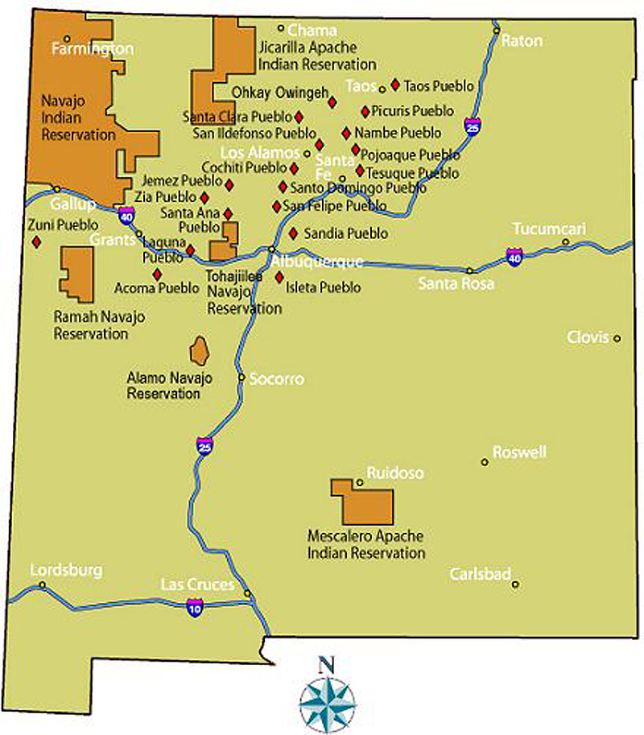

Slide 36
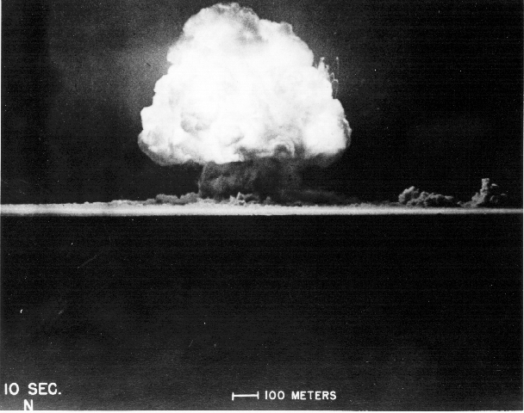
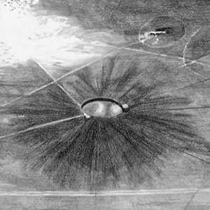
WHITE SANDS

Slide 37
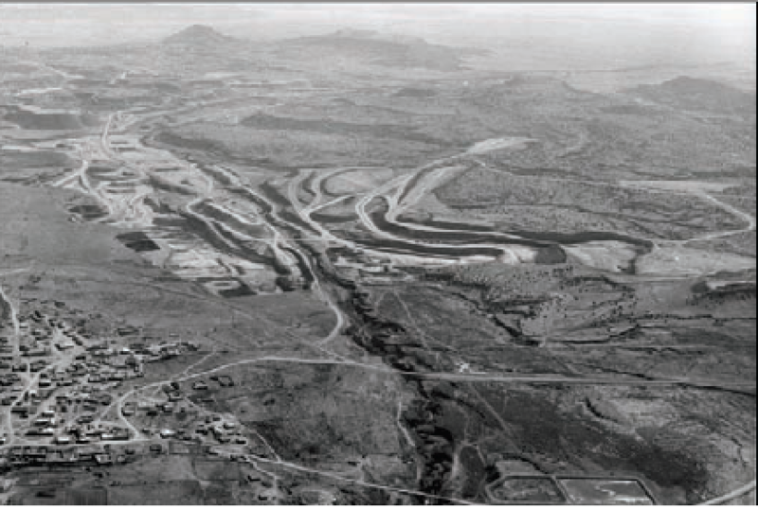
JACKPILE OPEN PIT URANIUM MINE

Slide 38
MYTHS OF ORIGINS
Close to the Laguna Pueblo Reservation there is Ácoma, probably the most ancient stable human settlement in today’s USA, dating back to the 12th century or even earlier. Ácoma is set upon a mesa, which guarantees visual control over the surrounding area. It was also known as “Sky City,” because like the sly was unreachable. Only in 1598 the Spaniards managed to conquer the city, killing almost all of its 2,000 inhabitants. The pueblo was later repeopled by the natives, who still preserve the original traditions in the way they were traditionally preserved – by constantly changing them…
The Ácoma Origin Myth, orally transmitted through the generations, was finally translated into English by anthropologist Matthew Sterling in 1928, who recorded the translation from the ancient Keresan language spoken by old Pueblo Indians to modern Keresan by younger Pueblos. It is therefore the final product of a series of transmissions and negotiations across languages and cultures, which must have inevitably changed the original meaning of the myth – but this is the way Native traditions work…

Slide 39
A MOBILE WEB OF TRADITIONS
T.S. Eliot, “Tradition and the Individual Talent” (1919): “the existing order is complete before the new work arrives; for order to persist after the supervention of novelty, the whole existing order must be, if ever so slightly, altered; and so the relations, proportions, values of each work of art toward the whole are readjusted; and this is conformity between the old and the new.”
Mobile conception of tradition, structured as a dynamic web which constantly changes the interrelations among its parts at every insertion of a new item → analogy with the Native conception of time-space, based on the relational simultaneity and overlapping of times and places (as quantum physics is…).

Slide 40
FIGHTING WITCHERY, BECOMING A MEDIATOR
Reconstructing tradition/history and personal identity is for Betonie (and then for Tayo) also “creating” it, because enacting a ceremony means also reinventing it, by telling new stories that may held Tayo to recognize and accept his duplicity, and so fighting that “witchery,” materially represented by the nuclear site, which is not simply white civilization, but its reduction to a total “otherness” (for Native Americans), while instead “whiteness” is by now part of their own selves.
Tayo must therefore be initiated (or maybe re-initiated, or better de-initiated) neither to the passage into modern civilization, nor to the return to American Indian tradition, but to the awareness that his role is that of staying between the two (and more) worlds, as a mediator of different cultures, races, languages and times, to be inserted and intersected in a continuity cycle.
In some sense, the rewriting of tradition and modernity of the ceremonies of Ceremony replicates the function of the novel itself, a typical example of that “border thinking” (Gloria Anzaldúa) and “border writing” (D. Emily Hicks) which aims at destabilizing the distinction between “(ab)original”/ traditional and “alien”/modern cultures): Ceremony is in itself a rite of transcultural mediation taking place on the border between two (or more) cultural spaces.

Slide 41
A PLACE IN THE WORLD
What Tayo’s search is about is also, and primarily, a place in the world. When he comes back to the reservation, he has “the feeling that there was no place left for him; he would find no peace in that house where the silence and the emptiness echoed the loss. He wanted to go back to the hospital. Right away. He had to get back where he could merge with the walls and the ceiling, shimmering white, remote from everything.” He wants to become a “nothing,” to merge into empty space (symptom of a schyzophrenic syndrome). In this attempt, Tayo becomes aware of at least a third world he has to restore its connection with – the land itself, not simply as “place,” but above all as living environment, full of other species with which he repeatedly identifies, crossing and even erasing the boundary that Western civilization has tried to set between “nature” and “culture.”

Slide 42
REFUSING TO BE PART OF SOMEONE ELSE’S STORY
Finally returning to the reservation with the lost cattle he was looking for (metaphor for the search and retrieval of traditions), Tayo feels almost cured, but the drought persists. He spends the summer together with the medicine woman Ts’eh, but as it draws to an end Tayo discovers that Emo, Harley and Leroy have denounced him to the white police, and are now coming for him. Tayo hids in an abandoned uranium mine, the last station of his ceremony, which incorporates an element of white culture, and which incidentally takes place on the Autumn solstice. From a hiding place, Tayo watches Emo and Pinkie torture Harley to death, but restrains himself from killing Emo when he has the occasion – not doing again what he almost did in the past when he let fury take control of him. He finally returns home, to the kiva, hopefully on the right path to the restoration of the health of his body and mind, mirrored by the end of the drought. In the meantime, Harley and Leroy are found dead in their wrecked car, and Pinko is killed by Emo, who is sent to jail. In this way, Tayo avoids being the sacrificial victim of a ritual organized by witchery, and can create his own story.

Slide 43
BUT AT THE END…
The ending of the novel sometimes contradicts its premises, which downsize and relativize the place of the human subject in the universe – in American mainstream culture the human subject is always at the center of the stage, in a dominating position, even when facing the awe-inspiring power of nature, as in some paintings which celebrate the aesthetics of the sublime.

Slide 44
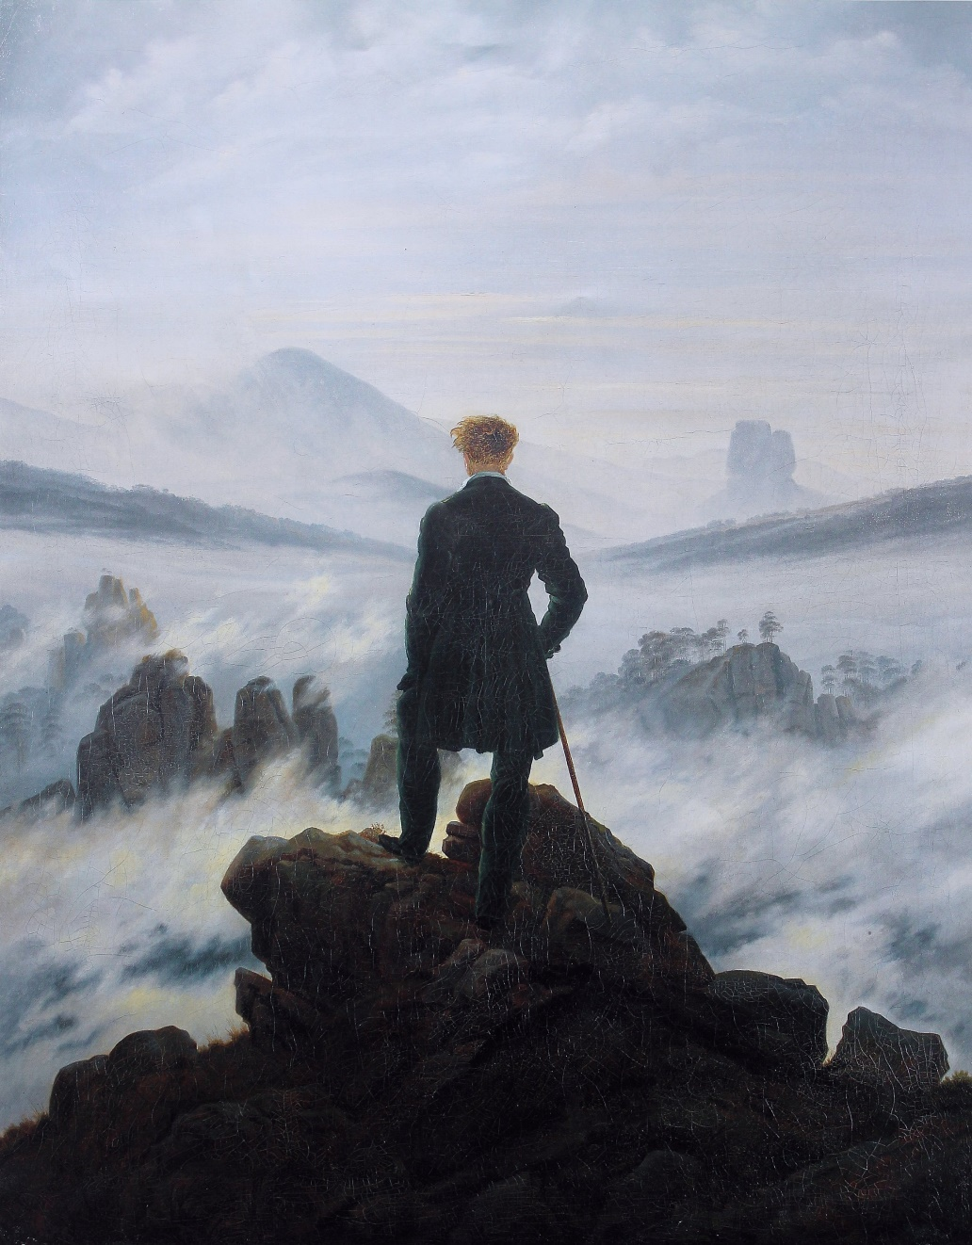
Caspar David Friedrich,
Wanderer above the Sea of Fog (1818)

Slide 45
…BACK TO THE CENTER
The epilogue of the novel sees Tayo creating his own story, where he is at its very center, as an almost god-like figure who is even able to make rain come down again. His own body becomes a cosmic body, and the whole world is contained inside it (as in Whitman…):
“nothing was lost; all was retained between the sky and the earth, and within himself” (Ceremony)
“Do I contradict myself? / Very well then I contradict myself, / (I am large, I contain multitudes.)” (Leaves of Grass)

Slide 46
MULTIPLE TIMELINES
Tayo’s journey as a hero (see Joseph Campbell, The Hero with a Thousand Faces, 1949, about the typical western hero), ends with his reaching the superior, Parsifal-like (if not even Christ-like, given the relevance of his own body in the text) status of savior, but the plot does not linearly follow his trajectory.
Four timelines with Tayo at the center + one mythical, “timeless” timeline.

Slide 47
THE MAIN, “CONTEMPORARY” TIMELINE
(1945-1948)
1945-1948: Tayo at the Veterans’ hospital, diagnosed as suffering from PTSD.
May 1948: Tayo leaves the hospital and goes back to the Laguna Pueblo reservation, hit for years by a severe drought, and Auntie’s house; first ceremony, with Ku’oosh, without great success.
Late July 1948: second ceremony, with Betonie, who starts making Tayo understand that he is at the crux of two (or more…) cultures; friction with his friends (especially Emo, Harley, and Leroy) – Tayo is horrified by their (and his) tendency to drunkenness.
Late September 1948: third ceremony, on Mt. Taylor, where Tayo goes to to retrieve the lost spotted (and mixed-blood) cattle (metaphor of his own identity, “spotted” by sin and hybrid), and where he meets Ts'eh, sleeps with her; Tayo finds the cattle, that had been stolen by white ranchers, cuts the fence imprisoning them and brings the cattle home.
Winter 1948-1949: Tayo lives with Auntie and looks after the cattle (metaphor of his having found some sort of stability and control).
Summer 1949: Tayo meets Ts'eh again, and she warns him that “they” will be coming for him.
Late September 1949: during the fall equinox, Tayo gets drunk with Harley and Leroy; he and Emo have their final confrontation near Jackpile Uranium mine and Trinity Site; Tayo hides and does not attack Emo (as he had done in the past, ending in prison) with a screwdriver; Emo kills Harley and Leroy; Tayo tells Ku’oosh and the Laguna elders everything that he has seen.
And it starts to rain…

Slide 48
OTHER TAYOS
The other three timelines having Tayo as their main character follow his complicated life before he comes back from the war:
Boyhood – around 1922: Tayo is born, son of an unknown white/Mexican man and Laura, a Laguna Pueblo woman who prostitutes in Gallup during the “Ceremonials” (a fake Native American fair for white tourists) and then leaves him to her sister, Auntie.
Early manhood: Tayo makes best friend with Rocky, his cousin, who is attracted by the white way of life and wants to become fully American; Tayo admires him and considers him as a brother.
The war:
- 1941: Tayo and Rocky enlist and are sent to the Pacific Front, like Harley, Emo, and Leroy; Josiah dies on the pueblo; Tayo and Rocky are taken prisoner
- April–May 1942: Rocky is wounded, and dies on the Bataan Death March; Tayo curses the incessant rain; drought begins in the Pueblo Laguna reservation.

Slide 49
THE MYTHICAL TIMELINE
Parallel to the “realistic,” 20th-century timelines runs a mythical timeline based on Pueblo Laguna legends, which reverberates the former and gives them further meaning – like the mythical plots in Eliot’s The Waste Land or Joyce’s Ulysses, analyzed by Eliot himself in “Ulysses, Order And Myth” (1923): “In using the myth, in manipulating a continuous parallel between contemporaneity and antiquity, Mr Joyce is pursuing a method which others must pursue after him 8[…] a way of controlling, of ordering, of giving a shape and a significance to the immense panorama of futility and anarchy which is contemporary history.”

Slide 50
A NATIVE PARSIFAL/ULYSSES/(CHRIST?)
The poems and stories inserted in the novel retell traditional Laguna drought stories → several characters of Ceremony are updated versions of traditional characters (Tayo as Arrow Youth, Ts’eh as Yellow Woman).
These drought stories are inserted in a wider mythical plot, which includes:
myths of origins, with Ts’its’tsi’nako (Thought Woman/Spider Woman) and her daughter/sisters Nau’ts’ity’i (Corn Woman) and I’cts’ity’i (Reed Woman) giving life to the world (analogies with biblical Genesis);
myths of separation and crisis (analogies with the biblical Fall from Eden):
  Corn Woman scolds Reed Woman for being lazy, and she leaves → drought begins
  a sort of trickster comes, fascinates Corn Woman’s sons, who neglect their duties as carers of the corn altar → Corn Woman takes away food, babies, and clouds
  another trickster, the Gambler, wins the clouds at a game and locks them up in his house
myths of recovery: Spider Woman’s Grandson engages in the mission to recover the clouds from the Gambler, and he wins them back by outplaying the Gambler at his own game.
Through Tayo’s character Silko fuses these traditional native American myths with classical/Christian ones: Tayo is also Parsifal in search of the Sacred Grail, Ulysses who only wants to come back home, and even Christ ready to sacrifice himself for the salvation of his people (he almost “resurrects,” at the end…).

