Slide 1
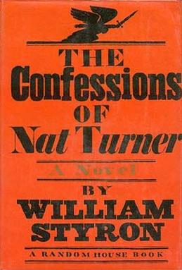
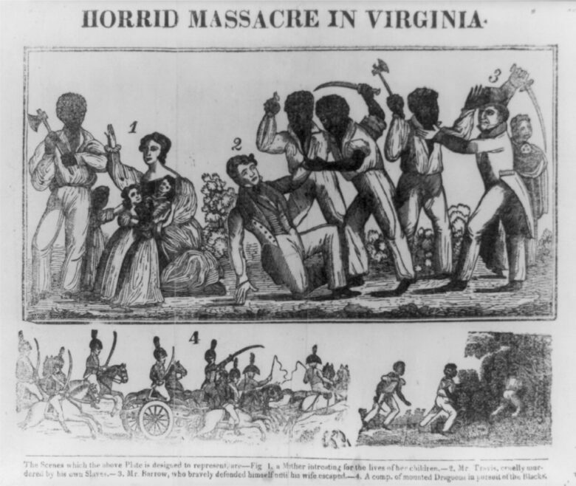
WILLIAM STYRON, THE CONFESSIONS OF NAT TURNER

Slide 2
THE MEMORY OF SLAVERY
The historical experience of African Americans was marked for more than two centuries by a loss of identity, and by the resistance to this loss. The slaves who were brought from the Western African coast and were secluded into the Southern plantations were forced to live a brutal transition from the active control everyone has over one’s own body and motion through space to a state of total passivity and stasis – the crisis of the “normal” relationships between one’s own body and the space designating one’s own place in the world.

Slide 3
BODY AND SPACE
The condition of slavery pushed to the extreme the equation body=space made by Henri Lefebvre, echoing Jacques Lacan’s formulation about the “mirror stage” as the preliminary phase of the construction of individual identity. According to Lefebvre, space “is first of all my body, and then it is my body counterpart or ‘other’, its mirror-image or shadow: it is the shifting intersection between that with touches, penetrates, threatens or benefits my body on the one hand, and all other bodies on the other” (The Production of Space). Being a slave meant erasing every possible intersection between body and space (that is, other bodies, the whites’ bodies, untouchable for the slave, while the slave’s body was simply an extension of the white master’s). At the beginning of the African American experience, therefore, the racial hierarchy between whites and blacks was based first of all on their being located on the opposite sides of the diagram of power extending from total power over body and space (the whites’) to total lack of that power (the blacks’).

Slide 4
AN INFERIOR RACE
US official culture considered blacks as inferior from the very beginning – so contradicting the basic principle of the Declaration of Independence, that “All men are created equal.”
Thomas Jefferson, Notes on the State of Virginia: “the blacks, whether originally a distinct race, or made distinct by time and circumstances, are inferior to the whites in the endowments both of body and mind.”

Slide 5
SLAVERY IN THE
19TH CENTURY
More than 12 million Africans were shipped to the New World, and about 10 survived the Middle Passage. Only about 400,000 were transported directly from Africa to North America, starting in 1619, but their children and grandchildren were slaves from birth. After the transatlantic slave trade was banned in 1808, slavery in the USA did not diminish – quite the contrary: the masters pushed the “natural” reproduction of slaves, even personally participating in it, and in 1860 the number of US slaves reached the peak of about 4 million.
The larger the number of slaves, the harder the measures that were taken by the masters to control them…

Slide 6
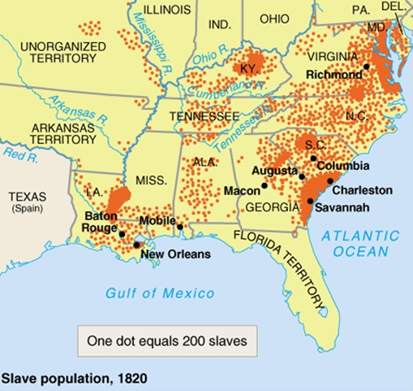
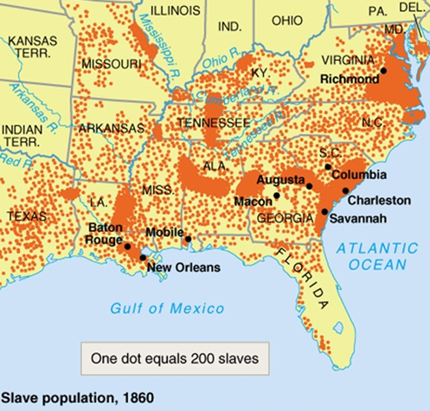

Slide 7
FORMS OF RESISTANCE
In order to survive their “social death” slaves used a number of strategies of resistance, besides trying to run to non-slave States – from open armed rebellion (Nat Turner’s revolt, 1831) to devising hybrid cultural forms which on the surface only imitated white cultural formations, like religious syncretism (fusing Christian saints and African deities) and musical language, which fused European and African harmonic, melodic and rhythmic structures, and adapted biblical psalms to covertly express the slaves’ search for freedom (spirituals).

Slide 8
DOUBLE CONSCIOUSNESS
Being at the same time at the very heart of the socio-economic structure (the free work of millions of slaves allowed American economy to grow very rapidly) and at the utmost margin of society and culture, the African American was in fact given the perceptual power of double consciousness (W.E.B. Du Bois, The Souls of Black Folk, 1903), constantly moving inside and outside American society, able to look at it both as one of its member and as external observer.

Slide 9
SIGNIFYING
The African Americans’ double consciousness allowed them to use the “enemy’s language” against itself through the practice of “signifying” (cf. Henry Louis Gates, Jr., The Signifying Monkey, 1988) – that is, of using the codes of dominant culture but adding hidden sub-codes understandable only by those who share the sub-codes (like in the case of spirituals).

Slide 10
PSALMS AND SPIRITUALS
One example of “signifying” is Psalm no. 137, often sung to covertly express the African Americans’ desire of freedom – like, roughly in the same years, “Va’ pensiero” (1842) from Giuseppe Verdi’s Nabucco did for the Italian struggle for independence.

Slide 11
Psalm 137
By the rivers of Babylon, there we sat down, yea, we wept, when we remembered Zion.
We hanged our harps upon the willows in the midst thereof.
For there they that carried us away captive required of us a song; and they that wasted us required of us mirth, saying, Sing us one of the songs of Zion.
How shall we sing the Lord's song in a strange land?
If I forget thee, O Jerusalem, let my right hand forget [her cunning].
If I do not remember thee, let my tongue cleave to the roof of my mouth; if I prefer not Jerusalem above my chief joy.
Remember, O Lord, the children of Edom in the day of Jerusalem; who said, Rase it, rase it, even to the foundation thereof.
O daughter of Babylon, who art to be destroyed; happy shall he be, that rewardeth thee as thou hast served us.
Happy shall he be, that taketh and dasheth thy little ones against the stones.
“Va’ pensiero” (Temistocle Solera, 1842)
Va’, pensiero sull’ali dorate
Va’, ti posa sui clivi, sui colli,
Ove olezzano trepide e molli
L’aure dolci del suolo natal!
Del Giordano le rive saluta,
Di Sionne le torri atterrate...
“By the Rivers of Babylon” (The Melodians, 1970)
By the rivers of Babylon, there we sat down, also we wept at our remembrance of Zion.
On the willows, in the midst thereof, we hung up our lyres.
For there our captors demanded a song, and our desecrators, mirth: “Sing us from the song of Zion.”
How can we sing the song of God in a strange land?

Slide 12
THE SLAVE NARRATIVE
The autobiographical narratives of former slaves before and after the Civil War are (together with spiritual and blues songs) the foundation of African American literature. Used by the abolitionist movement as tools of propaganda, slave narratives had a big popular success thanks to authors like Frederick Douglass, William Wells Brown and Harriet Jacobs.
Their basic narrative structure conflates traditional autobiography, which usually tries to turn the autobiographical self into a “representative model” (like in Benjamin Franklin, who invents the image of the American self-made man), with captivity tales – the accounts of white colonists (especially women, like Mary Rowlandson) made prisoners by Natives.
Traditional autobiography usually follows the pattern of Bildung (the gradual construction of psychological and social self of the subject), while captivity tales adopt the initiation pattern, by telling some fundamental episodes of radical transformation of the subject.
Slave narratives deal both with the growing up of the subject’s awareness and with his/her conquest of freedom thanks to the overcoming of some crucial trial.

Slide 13
AFTER THE CIVIL WAR
After the Civil War Black literature started to affirm itself beyond the scope of the slave narratives, even if the autobiographies of former slaves had an even wider success as powerful tools through which African Americans could share the trials and triumphs of Black life.
Up From Slavery (1901) by Booker T. Washington is a classic example, but Washington also believed that Blacks should (at least for the time being) accept the lower steps of the social ladder.
Turn of the century: Black authors sought to revise the stereotypes produced by white imagination which dominated plantation fiction, blackface minstrelsy and vaudeville acts.

Slide 14
W.E.B. DU BOIS
W.E.B. Du Bois, The Souls of Black Folk (1903): problematic exploration of racial identity and of the conflicted relationship of “the Negro” to “the American” → double consciousness.
“The problem of the 20th century is the problem of the color line – the relation of the darker to the lighter races of men in Asia and Africa, in America and the islands of the sea.”
The fundamental motivation of racism is economic.
European colonialism = process that generated modern racism.
Racial discrimination precedes prejudice, which is its consequence, and its post-facto justification: blacks (and Native Americans) were deprived of their rights in order to be more effectively exploited.
Imperialism = evolution of colonialism, adding political dominance to economic dominance → Native populations and black slaves reduced to a condition of total submission to white power.
Human nature = neither fixed and immutable, determined by genetics, nor inherently “good” or “bad.”
Prejudices are cultural products, and can be removed only through culture and education.

Slide 15
DU BOIS’S INTERSECTIONALISM
All social and cultural phenomena “intersect,” and each influences the other.
Racism cannot be dealt with separately from issues of social class, gender and religion.
The frontiers separating whites and Blacks overlap with those separating higher and lower social classes, men and women, and different creeds.
Only way to overthrow these boundaries: demonstrating their artificiality, and the basic equality and interdependence of all human beings.

Slide 16
THE BIRTH OF THE
HARLEM RENAISSANCE
Late 19th-century Great Black migrations from the South to the North-East and New York City → Harlem: residential neighborhood for African Americans.
1919: first Pan African Congress (in Paris, organized by Du Bois); Red Summer Riots; creation of Marcus Garvey’s Black Star Shipping Line; Benjamin Brawley’s The Negro in Literature and Art in the United States; parade of the 369th Regiment (the Hellfighters) in Manhattan, from the Fifth Avenue to Harlem (Jim Europe, the Regiment’s bandleader, started the jazz vogue in Europe).

Slide 17
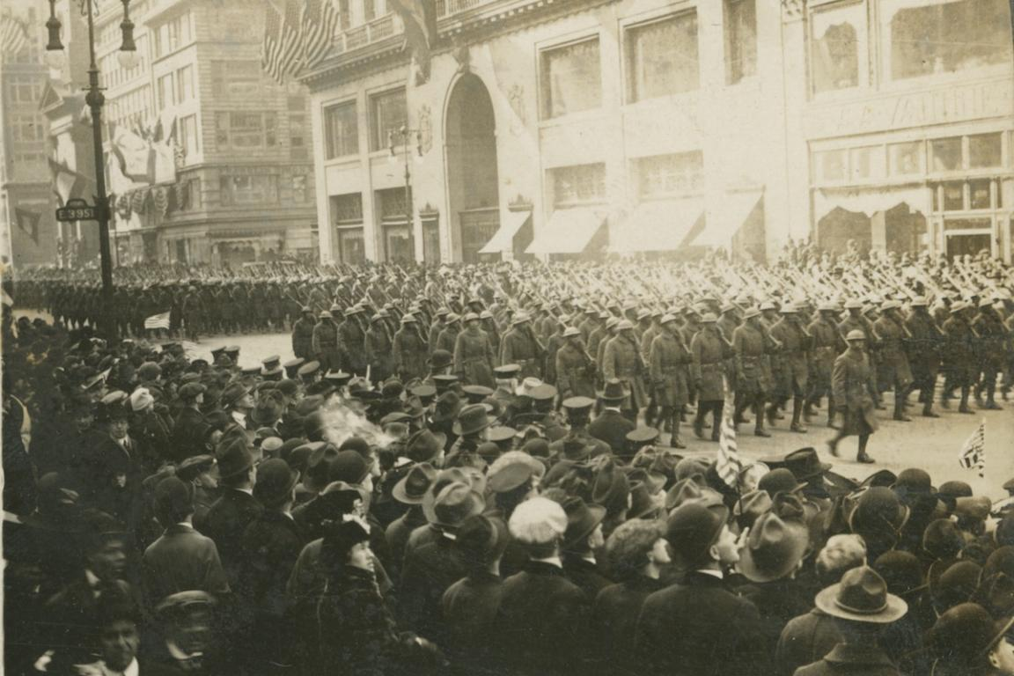
HELLFIGHTERS’ PARADE

Slide 18
A MIGRATION OF CULTURES
African Americans brought to the great cities their cultural traditions, and especially the forms of musical expression elaborated during the 19th century, with their roots in the era of slavery and in the slaves’ African cultures.
First generations of slaves: adaptation to Christian religion with inserts from African animism.
Musical traditions: centrality of rhythm (use of percussions) and tendency to participate in a more direct and emotional way.
In African musical culture instruments “talk,” imitating the human voice and sending coded messages.
Slave owners banned African music and instruments (and cults) → slaves merged African musical and religious elements with those of European religion and music → religious syncretism: Christian saints fused with African deities + adaptation of the psalm structure with the addition of the preacher-congregation call and response.

Slide 19
SPIRITUALS AND GOSPELS
Spiritual: adaptation of European traditional hymns, based on Bible psalms, with the addition of rhythms and vocal expressions deriving from African traditions; used in informal ceremonies, often in the open air (camp meetings).
Gospel: more sophisticated, with choirs and instrumental accompaniment; used in official church rites; importance of the role of the soloist-improviser.

Slide 20
THE BLUES
Autochthonous American musical expression: result of the merging of English, Scottish and Irish ballads with African forms like the griot.
“Blues” probably from Elizabethan culture (“to have the blue devils” = to have a “dark” mood).
First American occurrence in the musical field (but in generic terms): Washington Irving (1807).
The tradition of African American blues starts around 1860.

Slide 21
THE JAZZ AGE
1920s: explosion of the jazz phenomenon (New Orleans, Chicago, Kansas City, New York),
From blues to jazz = emphasis on instrumental expression, centrality of improvisation, collective form.
Harlem = pole of attraction for the rising black middle class but also for whites fascinated by the new music (F. Scott Fitzgerald, Tales from the Jazz Age).
Prohibition era → proliferation of night clubs (speakeasies), where whites could use forbidden substances and also attend an exciting and mysterious “other” world – the Blacks.
Extreme “elasticity” of jazz, not linked to fixed codified forms but characterized by an ever-going flux of change.

Slide 22
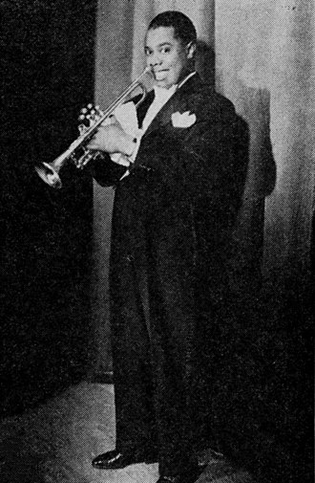
“If you have to ask what jazz is, you’ll never understand”
(Louis Armstrong)

Slide 23
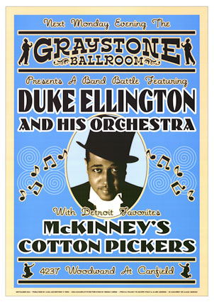

Slide 24
A MODERNIST MOVEMENT
Modernism was an eminently urban movement and coincided with the affirmation of American modernity as a model for the whole (Western) world (New York = model of the modern metropolis), but modernist movements preferred the older European cities (London and Paris, but also Berlin, Vienna, Prague, Madrid, and to a lesser degree Rome, Florence and Trieste)
Only organized modernist movement located in the USA: Harlem Renaissance, created by the supposedly most backward (ethnic) American community – the African Americans.

Slide 25
AFRICAN AMERICAN CULTURAL HERITAGE
Besides religious syncretism and music:
Black English (African American Vernacular English) with its aural and rhythmic peculiarities;
pre-Emancipation African American literature (Phillis Wheatley, Frederick Douglass, Harriet Jacobs);
expressive strategies of double talk/signifying, a coded language that tells a thing and means another, and which can be decoded only by those who share the code → enhancement of the metaphorical power of language.

Slide 26
THE NEO-SLAVE NARRATIVE
Neo-slave narratives (term coined by Ishmael Reed in the novel Flight to Canada, 1976) appeared after World II and the disappearance of the last former slaves to re-elaborate the trauma of slavery.
To make up for the loss of living memory, neo-slave narratives had to reinvent the forgotten trauma of slavery by using the techniques of parody, satire and the fantastic, so that contemporary subjectivity could reconstruct a past which had left almost no trace in official, objective history.
Most important works: Margaret Walker’s Jubilee (1966), William Styron’s Confessions of Nat Turner (1967), Octavia Butler’s Kindred (1979), Toni Morrison’s Beloved (1987), Colson Whitehead’s The Underground Railroad (2016).

Slide 27
THE CONFESSIONS OF NAT TURNER
When Styron’s novel The Confessions of Nat Turner came out, in1967, the neo-slave narrative was not yet officially born.
Styron’s enterprise is meaningful and bold, because he, a white author, tries to reconstruct the memory of slavery from the point of view of a first-person narrator that is also the protagonist of the bloodiest slave revolt in US history. The book was an immediate success (wins the Pulitzer Prize), but also triggered a huge debate in the African American community, which responded with William Styron’s Nat Turner: Ten Black Writers Respond.

Slide 28
AN ANTIRACIST RACIST NOVEL?
The ten black writers denounced that Styron had distorted Turner’s real story. The protagonist’s sermons sound fake, his doubts and hesitations have no documented evidence, the rebels act like savage animals, and above all Turner is described as a religious fanatic (which he seems to have been, according to what we may infer from historical documents) and as a black male obsessed by his sexual desire for a white woman (feature totally devoid of any factual match).

Slide 29
THE GENESIS OF THE CONFESSIONS
Styron started working on the novel in 1960, in his house in Roxbury (MA), where he was hosting one of the most influential (and radical) African American authors of the time, James Baldwin, who was then working on an essay on Martin Luther King. The two writers developed a deep friendship, and systematically exchanged opinions and suggestions (but not on what they were writing), discovering that they shared, from two opposite positions and therefore two different perspectives, the same indirect experience of slavery.

Slide 30
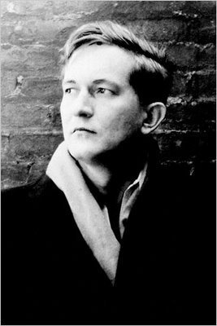
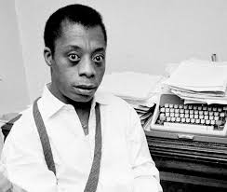

Slide 31
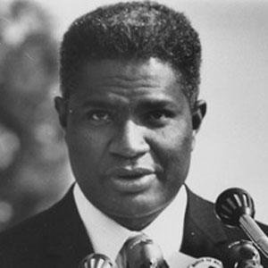
THE DEBATE WITH OSSIE DAVIS
In 1968 Styron replied to the accusations of racism in a public debate, chaired by Baldwin, with African American actor and activist Ossie Davis. Baldwin defended the right to creative freedom for every writer, but Davis responded by saying that the novel was a public intervention that could have consequences in the behavior of people, spreading old stereotypes of the violent, vindicative and sexually dangerous black male.

Slide 32
ANOTHER NAT TURNER
2016: Nate Parker’s The Birth of a Nation.
The movie tells (radically reinventing it) the story of Nat Turner, emphasizing his connections with the African roots and the abuses suffered by his various masters (in his real confessions, and even in Styron’s novel, Turner does not describe especially brutal behaviors against him, and recognizes that he had the possibility to study and to become a preacher, whose religious world was totally limited to the – Protestant – Christian faith).
His wife Cherry (absent both in the novel and in Turner’s true confessions) is a central figure, and there is no reference to Nat’s desire for white women (as there are none in his “true” confessions).
In the final scene the black child who probably gave the alarm and allowed the whites to set a trap for the rebels is shown watching Turner’s execution and then morphing into an adult fighting in the Civil War.

Slide 33
ANOTHER BIRTH OF A NATION
Nate Parker used the same title of a fundamental movie in American cultural history, David Wark Griffith’s The Birth of a Nation (1915), which reinvented from an explicitly racist perspective the history of the Civil War, of the Reconstruction and of the birth of the Ku Klux Klan (which in its turn was resurrected by the success of the film and started to systematically adopt the by now famous outfit, that in the movie is shown as having incidentally invented to exploit the “natural” superstition of blacks, who are afraid of those white figures because they mistake them for ghosts).

Slide 34
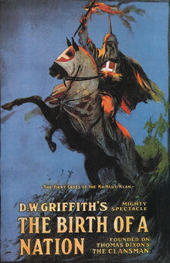
THE BIRTH OF A NATION (1915)

Slide 35
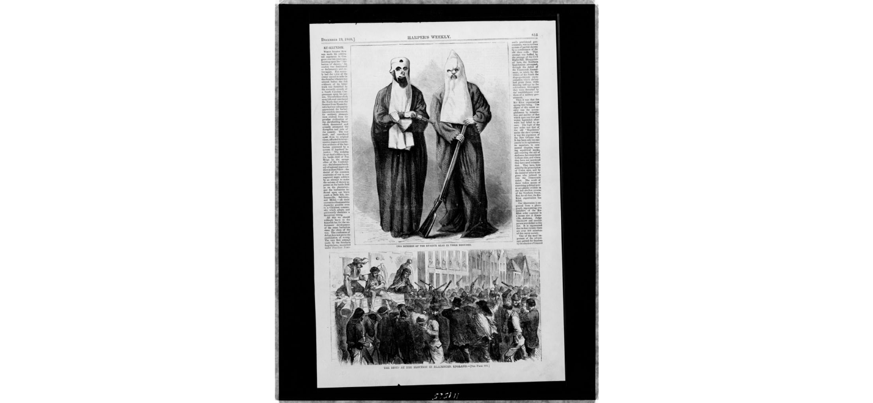
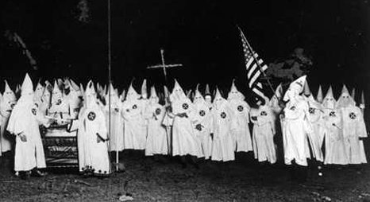

Slide 36
DE ME FABULA NARRATUR…
In adopting the perspective of the black protagonist-narrator William Styron is making a very complex operation of personal and cultural self-awareness, because he tries to show to himself and to white society the destructive effects of the “peculiar institution” on the victims of that system.
More than Nat Turner’s story, the novels tells the story of an unsolved sense of guilt, and inevitably shows the traces of a racism still actively present – but it does so with a creative honesty that Baldwin did not fail to recognize.

Slide 37
James Baldwin:
“Styron is probing something very dangerous, deep and painful in the national psyche. I hope it starts a tremendous fight, so that people will learn what they really think about each other.”
“He had to try to put himself in the skin of Nat Turner. […] It was a white Southern writer’s attempt to deal with something that was tormenting him and frightening him. I respect him very much for that.”

Slide 38
A “PECULIAR” HISTORICAL NOVEL
The Confessions of Nat Turner is more than a historical novel. Usually, historical novels, even when they are narrated in the first person by a protagonist who has a real existence in history (a relatively rare case: in order to have more “freedom of movement,” authors prefer invented protagonists, relegating historical figures, like Cardinal Federico Borromeo in The Betrothed or Montcalm in The Last of the Mohicans, to secondary roles), are built up either on the basis of historical documents that describe the lives and adventures of these characters “from the outside,” or on the characters’ autobiographical writings. The Confessions of Nat Turner is a novel that even bears the same title as another famous text, really existing in history, which is the main source of Styron’s operation.

Slide 39
“TRUE” CONFESSIONS?
The Confessions of Nat Turner is in fact the title of the (“supposedly…”) “true” confessions that the black slave preacher Nat Turner gave to a lawyer, Thomas Gray (who was not his lawyer, but someone probably interested in publishing a gory and sensational story of the revolt), while he was in jail waiting for the verdict that would ultimately condemn him to the death penalty.
Turner was found guilty of having led the rebellion that in August 1831 murdered about 60 whites (men, women and children) and involved about 80 black slaves in Virginia. The revolt was suffocated in blood – besides many of the rebels, in the following days from 150 to 200 blacks were executed, with or without trial (most of them had nothing to do with the revolt).
Turner confessed to have killed only a person, Margaret Whitehead (her last name being incidentally symbolic), who in the novel becomes the object of his sexual desire.
But we have no way of ascertaining that what Gray transcribed was what Turner had really told him…

Slide 40
WHICH NAT TURNER?
So we do not know whether the Nat Turner of the Confessions “edited” by Gray is the “real” Turner, or a fictional fabrication, or something in-between (besides, we cannot even know if what Turner confessed corresponded to the “truth”…).
From a certain point of view, Turner’s Confessions are in their turn a “peculiar” text, since they are both an autobiography “as-narrated-by himself” (the oral narration of the protagonist translated onto the page by an editor) and a legal document, which in its turn is fairly ambiguous (Gray was not Turner’s lawyer, and he took advantage of some personal acquaintances to gain access to the prisoner and interrogate him).
Gray succeeded in transforming the Confessions in a sensationalist text, which made him rich (the book sold about 50,000 copies), even if they were less gory that the Authentic and Impartial Narrative of the Tragical Scene Which Was Witnessed in Southampton County (Virginia) on Monday the 22d of August Last, the pamphlet published immediately after the rebellion.
We cannot know to what extent Gray manipulated Turner’s confessions: for example, we do not know why Turner’s wife, Cherry, is totally absent: maybe it was Turner himself that did not want to involve her, or maybe it was because he had already abandoned the world of earthly pleasures to embark in his God’s crusade, and so Cherry had no part anymore in his life – or maybe Gray did not want to show some “humane” and loving side of the ferocious Nat Turner...

Slide 41
AFTER THE REBELLION
Turner explicitly wanted to spread the “fear of God” among the whites, and in this he really succeeded. The debate that followed (among the whites, especially in Virginia), opposed those who asked for an improvement of the slaves’ conditions of life, precisely to avoid other revolts, and those who stated that the rebellion had demonstrated how slavery was the only way to keep the blacks’ “savage instincts” in check, and that it had to be made even more severe.
The latter position prevailed, and laws were emanated that forbade to teach blacks (slaves but also free) to read and write; to hold religious meeting attended only by blacks without a white minister; to own abolitionist publications.
But Nat Turner also became a myth of emancipation for African Americans, and inspired the event popularly considered as the prelude to the Civil War, the assault on the arsenal at Harpers’ Ferry (Virginia) led in October 1859 by the white abolitionist John Brown, who wanted to start a generalized revolt of the slaves.
The assault failed, and Brown was executed, but he became a hero much more popular than Turner (probably because he was white…), and later the protagonist of the universally famous song by Pete Seeger (he, too, a white man….), “John Brown’s Body.”

