Slide 1
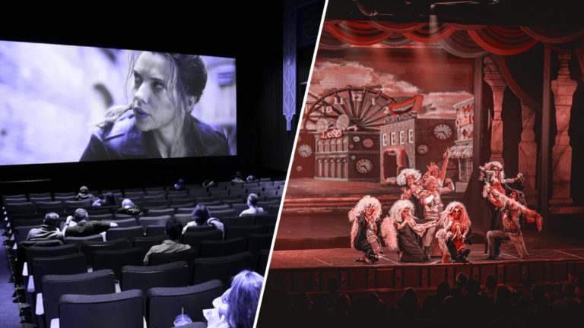
Translating for the Stage and the Screen

Slide 2
DRAMATIC ECONOMY
Tadeusz Kowzan: distinction between natural and artificial signs.
In literature natural signs may acquire a metaphorical meaning (as in the so-called “pathetic fallacy”), but this metaphorical dimension is exalted in theater, where each sign that in real life is simply a manifestation of nature is in itself artificial, because it must be reproduced through some kind of artificial trick. This means that everything in theatrical representation is artificially meaningful.
In written literature the author may try to offer the reader the so-called effet de réel (Barthes), the illusion that what he or she is reading is “real.” In theater we are instead always totally aware that everything is artificial, and that everything is meaningful per se, because if the author or the director has chosen to put a certain object or to recreate a certain natural phenomenon this must be meaningful, according to the rules of what we may call “dramatic economy.”
Anton Chekov once said (referring to narrative – but he was a dramatist…): “If you say in the first chapter that there is a rifle hanging on the wall, in the second or third chapter it absolutely must go off. If it’s not going to be fired, it shouldn’t be hanging there” (this rule is known as “Chekhov’s gun”).

Slide 3
KOWZAN’S DRAMATIC SIGN SYSTEMS
1. word 2. tone | spoken text | actor | auditive signs | time | auditive signs- (actor)
3. mime 4. gesture 5. movement | expression of the body |  | visual signs | space and time | visual signs - (actor)
6. make-up 7. hairstyle 8. costume | actor's external appearance |  |  | space | visual signs - (actor)
9. props 10. decor 11. lighting | appearance of the stage | outside the actor |  | space and time | visual signs - (outside the actor)
12. music 13. sound effects | inarticulate sounds |  | auditive signs | time | auditive signs - (outisde the actor)

Slide 4
TEXT AND STAGE
Roman Ingarden: Nebentext (the part of the text containing the stage directions) vs Haupttext (the main body of the text): their combination creates a proairetic function, insofar as it determines the course of dramatic action.
While the written text is one text, and is based on the diegetic function, the play as represented on the stage in only one of the virtually infinite possibilities of its enacting, and is based on the mimetic function – that is, on imitation, on one of the many ways in which it is possible to imitate what is written.

Slide 5
TRANSLATING PERFORMABILITY
In translating a play the translator must always bear in mind the fact that the written text will eventually become a “visual” and “aural” text. Of course, there is a difference in attitude when the translator must create a text in the target language that is intended only for a readership (the dominant criteria would be those of readability), and when instead he or she must create a text to be specifically used by director and players (here the criteria would be those of “performability”).
The translator must always be aware that, while the written text can be read and re-read, and thus the reader may try to understand more clearly what at the first reading may have looked obscure, the performed text exists only once, in an unrepeatable and unretrievable stretch of time – thus, it must be immediately understandable.

Slide 6
THE TRANSLATION OF REALIA
One of the main problems of dramatic translation resides in the translation of realia. The director might use culturally meaningful physical objects on the stage, but in some cases they could be unintelligible for most of the target audience. This explains why in many cases the Italian translations of foreign dramatic texts, when brought onto the stage, substitute the culturally meaningful realia of the foreign culture with realia that are meaningful for our own culture, or into “neutral” objects (objects that have the same meaning in more or less every culture), or simply erase them.

Slide 7
TRANSLATING MOVIES
Even more than drama, film is a multimedia, both a visual medium and an aural one. Translating for film (that is, for its soundtrack – the so-called dubbing) demands that the target language should cope with the original images in the film as naturally as possible, because films and TV plays are supposed to act more directly on the sense of sight of the audience than on the sense of hearing. The translation of utterances should be synchronized with the settings of the scenes, the identity of the characters, their movements, gestures, facial expressions, pauses and lip movements.
The “shots” of films last only seconds and usually cannot be replayed, which makes it impossible for the audience to refer back to the previous parts of the story to recollect or reflect upon the information as a reader does with a book. The transience of pictures demands that the translator conveys as much message as the duration of each “shot” allows, and the message must be so intelligible as to allow the audience to absorb it immediately as possible. Of course, when watching a movie on DVD or in Internet streaming the spectator may interrupt the narrative flux at his/her ease, and go back and forth to re-watch any scene he/she likes, but the film translator must consider as his/her primary audience the people going to the theaters to watch movies (and anyway watchers rarely re-play scenes while watching a film or a TV series).

Slide 8
LITERARY TRANSLATION VS
FILM TRANSLATION
General literary translation follows the traditional translation pattern: Author (Ideal/Proto- Text )→ Original text→ Translator → Translated Text → Receptors. The author and the original are the focuses in this procedure.
The procedure of film translation is more complicated: Screenwriter (Ideal/Proto- Text ) → Original text → Translator → Translated Screenplay → Dubbing Director (Dubbing Actors) → Dubbed Screenplay → Translated Film → Audience. The screenwriter replaces the author, and is mainly ignored by the audience and by translation researchers. When the first translation is completed, it has to be tested for its harmony with visual frames. In the later stage of production, the dubbing actors and the director join in the procedure. The dubbing director is the one in charge of guiding dubbing actors to a correct and faithful performance. The translated script undergoes considerable changes in this stage. Finally, the new soundtrack in the target language is dubbed onto the film.

Slide 9
DUBBING
Dubbing attempts to entirely cover the spoken source text with a target text adjusted to fit the visual lip movements of the original utterances. Dubbing, which is sometimes called (post)-synchronization, is the replacement of the dialogue and narration in a foreign language into the language of the viewing audience, the target language. Dubbing involves a translation of speech into writing, and then its translation back to the target spoken language. Dubbing also requires the substitution of the voice of each actor on the screen with the voice of another actor.

Slide 10
SUBTITLES
Subtitles are captions displayed at the bottom of a cinema or television screen (sometimes also above or below the theater stage) that translate or transcribe the dialogue or narrative. They are the words printed or superimposed on a film in a foreign language in order to translate what is being said on the soundtrack. Subtitling can be defined as the translation of the spoken (or written) source film text into a written target text which is added onto the images of the original product.
Subtitles can be categorized into three types. Those appearing at the beginning of the film include the film title, director, leading actor(s), or actress(es) and major production members, and are called “open credit titles”; those appearing after the main feature film include detailed cast and production members, sponsors and many other production information, and are usually called “end credit titles”; the other subtitles cover the main feature film and are called “main subtitles”.
According to specific functions in the entire film, main subtitles can be further categorized into spoken subtitles, subtitles for music, graphical subtitles, etc. (also consider that some viewers can be audibly impaired).

Slide 11
DUBBING VS SUBTITLING
Dubbing modifies the source aural text to a large extent and thus makes it familiar to the target audience through domestication. Its aim is to make the audience feel as if they were listening to actors actually speaking the target language.
Subtitling is the form that alters the source text to the least possible extent and enable the target audience to experience the foreign and be aware of its “foreignness.” But it changes the visual text and it may alter its reception.

Slide 12
SYNCHRONIES
Synchrony of time: agreement in time of different signals that communicate a unit of information.
Spatial synchrony: the signals occupy neither more nor less space than that which corresponds to them.
Content synchrony: the meanings transmitted by different signals contradict neither each other nor the whole message.
Phonetic synchrony: synchrony of sound signals of spoken dialogue with the visible speech movements on the screen.
Character synchrony: the harmony between the image of the character and his or her voice and words.

Slide 13
LIP SYNCHRONIZATION
Lip synchronization is usually seen as the strongest constraint in dubbing. The script translator modifies each utterance in order to match it with the lip movements of the person seen on the screen. Indeed it is difficult to find target language words to match the lip movements in the source text. If translation aims at conveying the general tone of each scene rather than locating meaning in each sentence, there will be more freedom to find appropriate words for lip synchronization. There should also be a strict equivalence of extra-linguistic features of voice, especially gender and age. Other markers of speech such as personality, class and ethnicity are most difficult because these features are not universally available or comparable (for example, it is virtually impossible to find an Italian equivalent for an African American English accent). Another requirement is the compatibility of the dubber’s voice with the facial and body expressions, such as pause, stress and gesture, visible on the screen.

Slide 14
THE CONSTRAINTS OF SUBTITLING
The ideal in subtitling is to translate each utterance in full, and display it synchronically with the spoken words on the screen. However, the medium imposes serious constraints on full text translation. Subtitles can only occupy the space of at most two/three lines at the lower part of the screen, but each subtitle should be able to accommodate a satisfactory portion of the (translated) spoken text and minimize the need for original text reduction and omission.

Slide 15
TIME AND SUBTITLES
The time of presentation of subtitles is dictated by a) the duration of the utterance in the original version; b) the reading speed of the audience; c) the visual information given on the screen, which also needs to be perceived clearly by the viewers; and d) the editing style adopted in the film.

Slide 16
TRANSLATING ORALITY
Nearly all the languages in film are colloquial languages in forms of either monologue or dialogue. Thus orality is the priority in film translation. High degree of parallelism, the loose paratactic sentence structure, the predominance of coordination and the paucity of subordination are found to be characteristic of unplanned spoken discourse. Translated speech should be as natural as possible. The actors should be “speaking in the target language” just as naturally as the audiences do.

