Slide 1
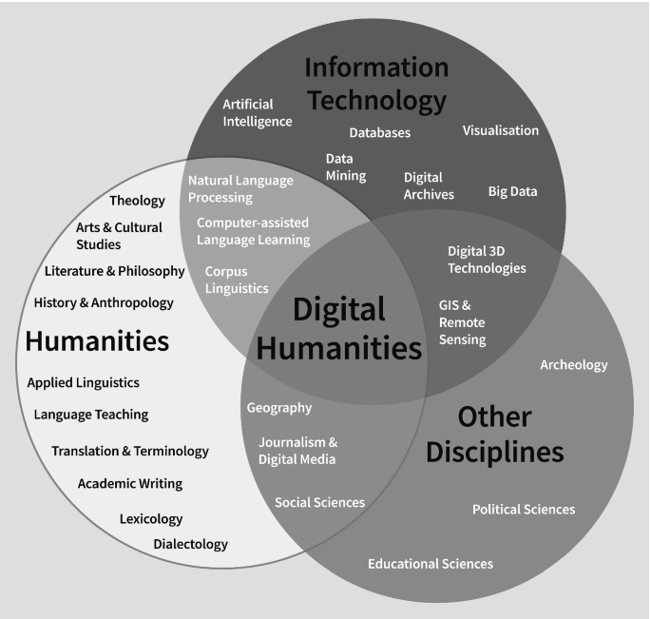
Literary Translation and Digital Humanities

Slide 2
WHAT WE TALK ABOUT WHEN WE TALK ABOUT DIGITAL HUMANITIES
Digital Humanities (DH) approach the issues addressed by the humanities by applying the new technological tools and techniques to both digitized and digitally born texts and materials. They involve:
using computing technologies to make research
digital communication
using digital technology in teaching activities
creating databases and archives
studying the history and theory of digital technologies and media
The use of computers in the field of the arts and humanities began in the late 1940s, with the work of Jesuit scholar Roberto Busa, who, in collaboration with IBM, created a computer-generated concordance to Thomas Aquinas’s writings known as Index Thomisticus.
But up until the 1990s the interplay of computing and the humanities was mostly limited to scholars, programmers and “selected” students, with most of the potential users having only a limited and difficult access to the field.

Slide 3
THE RISE OF THE INTERNET
In the 1990s, the expansion of technologies which allowed the immediate sharing of knowledge and communication like the WWW (Internet) and later the birth of social networks (the first one, SixDegrees, started in 1997; Facebook was launched in 2004) made possible the creation and dissemination of non-textual files like images, sound, and moving images. Major projects were established to create digital editions and archives of texts and cultural artifacts from many various periods and civilizations. By now, an increasing share of the work of governments, writers and artists exists only in digital form.

Slide 4
THE DIGITAL HUMANITIES MANIFESTOS
In 2009 and then in 2015 different groups of people working in the increasingly interconnected fields of the humanities and the new technologies drafted two Digital Humanities Manifestos. The Digital Humanities Manifesto 2.0 especially stressed that the DH were not (anymore) simply the application of the new (computer science and the Internet) to the old (the humanities), but an inter- and trans-disciplinary field that implied the systematic and organic crossing of the traditional boundaries between “soft” and “hard” sciences.

Slide 5
DH AND LITERARY TRANSLATION
Judy Wakabayashi, “Digital Approaches to Translation History” (2019):
Digital translation requires not only “source evaluation and comparison, contextualization, critical interpretation, the imagination to envisage new questions and approaches”, but also “considering who created the digital material, for what purpose, when, what was excluded, whether the digital source is a coherent body of materials since its origin or an assembly from diverse sources, and whether non-digital materials were altered during digitization […]. Although digitized texts might seem to be a textual and visual facsimile, they are often decontextualized” – hence the importance of always going back to the original text, the original medium, the original experience.

Slide 6
THE ADVANTAGES OF DH FOR LITERARY TRANSLATION
Capacity and comprehensiveness: digital media are much less expensive and so allow to collect and make available massive data sets (so that the translator can find for both similar expressions inn the SL and similar translations in the TL).
Accessibility: virtually everyone can access digital material for free, or (usually…) at a very low cost.
Time-saving: text-mining methods allow researchers (and translators) to (almost) immediately find what they are looking for.
Flexibility: digital media can deal with sounds, images and moving pictures, beyond the textual medium.
Diversity and manipulability : digital media allow non-experts from all languages and cultures to access all kinds of digital texts and materials, and to comment on them and their translations (OK, this has some drawbacks…).
Interactivity: the Web facilitates the dialogue between professionals and nonprofessionals, teachers and students, people remembering the past and the new generations – authors and translators.
Hypertextuality: links allow the movement through different data or narratives, and can enhance digitally published translations, incorporating supplementary material such as definitions, textual variants and bibliographic references, without interrupting the immediate overall effect of the translated text.

Slide 7
CORPORA AND CANONS
DH make huge corpora of texts (and translations) available, without needing someone to select what is “culturally relevant” and what is not
The availability of non- selected texts resists the arbitrariness of the “canons.”
Corpora help identify what is typical and what is anomalous, the (dis)continuities and the clusters, both in the original texts and in their existing translations.

Slide 8
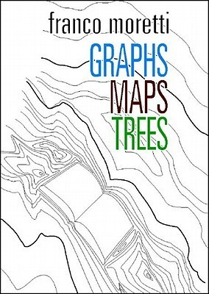
DISTANT READING (AND TRANSLATING)
Franco Moretti (Stanford Literary Lab): “distant reading” of massive numbers of canonical and non-canonical texts, through text analysis methods such as word frequencies, sentiment analysis (the identification and classification a writer’s attitudes on a particular topic and their comparison with the ones found in other authors), topic modeling, pattern recognition, and visualization through graphs, maps, trees and clouds.
“Distant” translating shifts the attention from the (supposed) idiosyncracies of the single author’s style to his/her belonging to a shared language and culture (and makes the translator aware that if the author’s language does not deviate so much from the “ordinary” SL the same should happen in the translated text as compared to the TL).

