Slide 1
PHILIP K. DICK AND
THE MAN IN
THE HIGH CASTLE

Slide 2
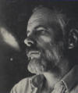
Philip K. Dick
A month after his birth (Chicago, 1928), Philip Kendred Dick loses his twin sister Jane in a domestic accident. The family moves to San Francisco, and the conflictuality beyween his parents creates a series of problems to the child, who starts having a recurrent nightmare: he is in a bookstore, where he is looking for the journal that has published the short story, “The Empire Never Ended,” which could reveal the secrets of the universe (Dick will come to believe that the Roman Empire never fell down, and that we live in a virtual world hiddenly ruled by the Empire): the stack of periodicals gets smaller and smaller, and he does not find what he knows could lead him to madness (Dick loves Lovecraft…).

Slide 3
Psychology and psychotropy
Dick’s mother is addicted to psychotropic drugs, and her son does badly at school, suffers from panic attacks, has almost no friend. Her mother takes him to a psychiatrist.
So Dick directly or indirectly lives the experience of psychotropic substances that produce visions. He gets fascinated with psychology, and by how the rational mind is deeply influenced by the subconscious.
When elaborating the loss of his twin sister, Dick is convinced by the psychiatrist of his latent homosexuality (Dick will marry five times…).

Slide 4
The early career
1952: PKD publishes his first tale “Roog,” and becomes a professional writer. In 1955 his first novel, Solar Lottery, is published. Dick and his second wife, the Communist activist Kelo Apostolides, are repeatedly interrogated by FBI.
1956: the movie Invasion of the Body Snatchers tells the story of an alien conspiracy to substitute humans with “clones” without an identity, and Dick suspects that the movie plagiarizes one of his stories.
1956: publishes the short story “The Minority Report,” on the possible distorting effects of predictive profiling.
1957: gets interested in the ideas of Koinos kosmos (what people believe is objective reality) and Idios kosmos (the abstract version of the universe any individual builds in his and her own mind).

Slide 5
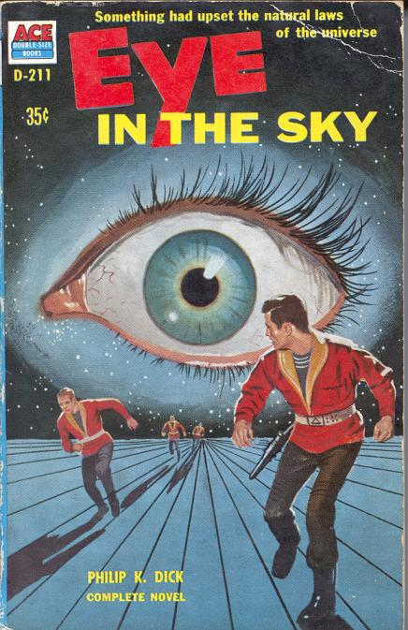
Eye in the Sky (1957)
After a nuclear accident, eight characters share the various realities created by the idios kosmos of each of them in turn. At the end of the novel we are not sure that reality has come back to “normal.”

Slide 6
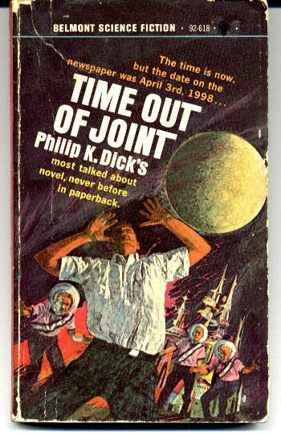
Time Out of Joint
(1958)
PKD lives the so-called “lamplight cord accident” when he looks for the suspended light in the bathroom and finds that it is instead inserted in the wall – this leads him to think that some things are actually “out of place” (feeling of Unheimlich). Time Out of Joint is based on this experience.

Slide 7
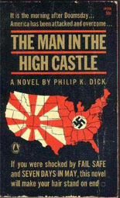
The I Ching and The Man in the High Castle
In 1961 Dick gets obsessed with the
I Ching, the traditional Chinese
divining system. He comes to believe that
the I Ching has predicted that he will finally
write a great novel or will die in the attempt.
Gets interested in the hand-made jewelry.
Starts working on The Man in the High Castle.
Used other sources like the studies on “small worlds”
by Stanley Milgram (who postulated the interconnection of every human being though six degrees of separation) and those by Solomon Asch on social conformism.
In 1963 The Man in the High Castle wins the Hugo Award.

Slide 8
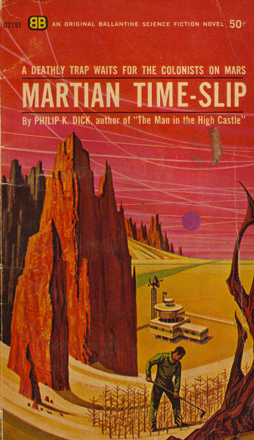
Martian Time-Slip (1964)
Martian Time-Slip = the world as it is seen by an autistic child.
Gets interested in St. Paul’s Letters.
After the vision of a gigantic robot face in the world, converts to Episcopalianism.

Slide 9
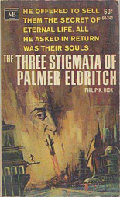
The Three Stigmata of Palmer Eldritch (1965)
Mix of PKDs passion for Lovecraft and psychoanalisis. “Eldritch” is Freud’s Unheimlich with the addition of a good dose of panic. The novel deals with “artificial paradises” and the commercialization of the illusions that we use to survive to reality.

Slide 10
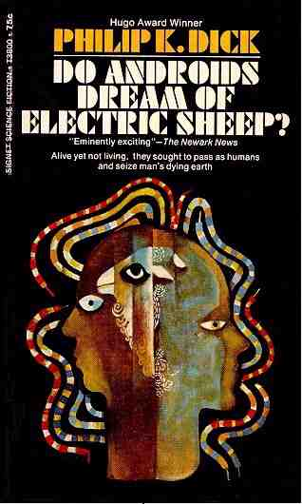
Do Androids Dream of Electric Sheep? (1968)
PKD has the first psychedelic experience with LSD. Reads the essay in which Alan Turing describes his test to check if a machine can think.
In Do Androids Dream of Electric Sheep?, which will be adapted by Ridley Scott in Blade Runner (1982), the test is used to identify androids (“replicants”) who cannot feel human empathy.

Slide 11
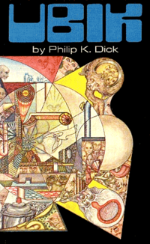
Ubik (1969)
Product of some of Dick’s last paranoias, and especially that about the uncertain statute of reality. The hallucinated atmosphere is the result of the interference of two plans of reality (and one on them keeps changing…). Gnosticism and the figure of the Demiurge should be instrumental to reach some kind of understanding, but there is no ultimate truth.

Slide 12
Strange visions
In the Seventies Dick starts having the strangest visions. In 1972 tries to kill himself.
In 1974 comes to believe that he has lived a former life as the Christian Thomas at the time of the Roman Empire.
He also starts believing that his visions are sent to him by a sort of God he calls VALIS – Vast Active Living Intelligent System.
“March 20, 1974: It seized me entirely, lifting me from the limitations of the space-time matrix; it mastered me as, at the same time, I knew that the world around me was cardboard, a fake. Through its power of perception I saw what really existed, and through its power of no-thought decision, I acted to free myself. It took on in battle, as a champion of all human spirits in thrall, every evil, every Iron Imprisoning thing”.

Slide 13
VALIS
The visions of VALIS inspire his three last, delirious novels: VALIS (1980), The Divine Invasion (1981) and The Transmigration of Timothy Archer (1982).
Visits the Blade Runner set, and is fascinated, but the movie is substantially different from Do Androids Dream of Electric Sheep.

Slide 14
Heritage
Dick dies in 1982, and leaves some 8,000 manuscript pages that will be titled Exegesis.
“I am a fictionalizing philosopher, not a novelist; my novel & story-writing ability is employed as a means to formulate my perception. The core of my writing is not art but truth. Thus what I tell is the truth, yet I can do nothing to alleviate it, either by deed or explanation. Yet this seems somehow to help a certain kind of sensitive troubled person, for whom I speak. I think I understand the common ingredient in those whom my writing helps: they cannot or will not blunt their own intimations about the irrational, mysterious nature of reality, &, for them, my corpus is one long ratiocination regarding this inexplicable reality, an integration & presentation, analysis & response & personal history.”

Slide 15
The dystopian world of The Man in the High Castle
PoD: US President Franklin D. Roosevelt is murdered by Giuseppe Zangara (the Italian anarchist who actually tried to assassinate him) in 1933 → continuation of the Great Depression and US isolationism at the beginning of World War II
The Man in the High Castle imagines a reality in which Nazi Germany and the Japanese Empire have won World War II. In this universe the fate of America is similar to that of post-1945 Germany: the East Coast is under German rule, the West Coast is controlled by the Japanese, and between them we have the neutral zone of the Rocky Mountains States. Italy has performed badly in the war, and is now in a subordinate position to the Reich. The Mediterranean Sea has been drained and an attempt to exterminate all Africans has been almost successful. The Nazis are planning the colonization of outer space, starting from Mars, and a nuclear attack to Japan, but their élite is riddled with intestine struggles for the succession to power after Hitler’s death. A novel, The Grasshopper Lies Heavy, hypothesizes an alternative reality in which World War II has been won by the Allies – but it is not our reality…

Slide 16
A plot of plots
Tha main plot follows four characters whose stories variously intertwine. No single story-line is more important than the others.
Main characters:
Jewish jewel-maker Frank F(r)ink quits Wyndam-Matson, the big firm that produces fake historical crafts, and starts a new profession as “authentic” craftsman.
His former wife Juliana, martial arts instructor, is involved, without knowing it, in a conspiracy to kill the author of The Grasshopper Lies Heavy
Antiquarian Robert Childan (base, racist and filo-Nazi) discovers the fraudolent activities of Wyndam-Matson, and finally accepts to sell the “really American” artifacts made by Frink.
Japanese functionary Nobosuke Tagomi collaborates with the German spy Baynes and comes to know about the Nazi plans to destroy Japan, intervenes to stop Frink’s deportation, buys one of his jewels, and while playing with it is transported to another plan of reality (maybe ours?).

Slide 17
The “High Castle”
Philip K. Dick’s letter to Patricia Warrick:
“When the Protestant Frederick, Elector of the Palatinate, revolted against Ferdinand, Emperor of the Holy Roman Empire, the High Castle came to symbolize the center of religious and political freedom against the autocratic Catholic Hapsburgs. I used the mention of it in the title of my novel as a symbol of Abendsen’s ‘revolt’ against the tyranny of the Nazis.”
Through this historical connection with the Thirty Years’ War (1618-1648) Abendsen’s “revolt” is again connected to the world of the reader. We, and not the characters, are expected to make the connection (also because Abendsen’s house is definitely not a castle…).
Other historical connection: “Various lofty and beautiful castles […] were taken over by the SS and used as places to train young SS men into an elite body cut off from the ‘ordinary’ world. […] You can seen, then, that the two castles are bipolarized in the book: the legendary High Castle of Protestant freedom and resistance in the Thirty Year War versus the evil castle system of the elite youth corps of the SS.”

Slide 18
The Grasshopper Lies Heavy
The Grasshopper Lies Heavy is the novel-within the novel, written by Hawthorne Abendsen, that narrates a uchronia-within-the-uchronia.
The title “seems” a quotation from Ecclesiastes 12:5, but this version does not appear in the most common English translations of the Bible. The most similar ones are “the grasshopper drags himself along,” “the grasshopper is weighed down,” “the grasshopper shall be a burden,” “the grasshopper loses its spring” (but of course maybe in the world of The Man in the High Castle there is some other version...).
This passage is usually interpreted in relation to old age, represented as a dying grasshopper that slowly drags on. But the expression that gives the title to Abendsen’s novel is also an oxymoron, since a grasshopper “lying heavily” is in contradiction with the average image of grasshoppers lightly leaping. This could allude to the fact that the world of The Man in the High Castle is actually a world turned upside down.
But “lies heavy” could also mean that the grasshopper tells really false stories...

Slide 19
The I Ching
The other book-within-the book is of course the I Ching (now transliterated with Yìjīng), the Chinese Book of Changes written around the 10th century BC, that the Japanese have first appropriated and then “exported” to America, and that some of the characters use to interpret the past and the future.
Dick declared that he wrote the novel following the “directions” of the I Ching (what Abendsen says about the writing of The Grasshopper Lies Heavy).
The popularity of The Man in the High Castle triggered the rise of sales of the I Ching in the USA.
At the end of the novel Juliana and Abendsen must interpret the hexagram “Inner Truth.” Both believe that it refers to the “truth” inside The Grasshopper Lies Heavy, that is the victory of the Allies in World War II, but that “truth” is different from “ours,” because after a “cold war” is “fought” between the USA and not the USSR, but the UK. Which would be the “Inner Truth,” then? The novel gives no ultimare answer. Or maybe the inner truth is that there is no ultimate truth. (By the way, in 1964 Dick publishes another novel, titled The Penultimate Truth).

Slide 20
Authentic vs. fake
Central theme: conflict between authenticity and forgery, in the sub-plot of the production of fake “historical” objects to satisfy the passion of the Japanese “conquerors” for American history and culture.
In a dialogue with his lover, the owner of the most important factory of “historical fakes,” Wyndam-Matson, states that “historicity” is not something intrinsic to the object, but is rather the historical meaning and value we give to it.
Frank F(r)ink avoids being entrapped in this logic by deciding to create something which is “authentic” not because it is connected to a more or less documented past, but on the contrary because it is totally new and original, even if of little intrinsic value.

Slide 21
Other worlds
Nobosuke Tagomi: only character to have a direct experience of an alternative reality, in which the Japanese are not “ruling” the US West Coast.
Tagomi experiences a brief stay in this parallel universe while meditating with a “a single small silver triangle ornamented with hollow drops” created by Frink in his hands. Tagomi has just killed a German agent with a “fake” Colt .44, perhaps built by Frink himself, and is in shock for having been forced to take a life.

Slide 22
Destiny and choice
The inter-dimensional slippage helps Tagomi to find some emotional balance, and this new condition makes him refuse to sign the extradition order to the German zone of Frank Frink (whom Tagomi does not know to be the creator of both the silver triangle and maybe the handgun).
The perception of the possible existence of other worlds makes Tagomi act in a different way in his world, even if he is not aware of the web of coincidences he is moving through.
The I Ching does not offer any enlightenment. Eventually, the only protocol of action is that of an ethical choice dictated by personal responsibility, beyond any rational calculation (or foretelling of a future destiny…).

Slide 23
Multiple historiographies
In The Man in the High Castle three different histories (or better, historiograhies) coexist and compete, in a complex example of what Linda Hutcheon calls “historiographic metafiction.”
“Historiography” literally means “the writing of history,” but history begins with the invention of writing. So history and writing are inextricably linked together – they are interwoven, also due to the etymology of “history,” from the Greek istos, meaning “tissue” or “texture.” So history is a text/ure, a text with a “plot” (in Italian it sounds even better: “un testo con una trama”). History is the emplotment of events so that their text/ure can mean something.
An alternate history is therefore (at least for Dick) not the construction of a fictional world as opposed to the “real” world – it is another way of putting together the various building blocks of a story in order to arrive at some meaning (which does not mean “truth,” but simply a self-reflective awareness of the impossibility of objectively knowing reality, so that every choice a subject makes is not dependent on truth, but on ethics).

Slide 24
Three textual realities
In Dick’s novel the relationships between history and fiction is indeed not localized on the level of the dialectic between factual reality and fictional invention. What really counts here is the reciprocal influence of the (not so?) different strategies of composition of the narratives that we call “history” and “fiction,” which both aim at constructing a meaning.
Carlo Pagetti has called the three “textual realities” of The Man in the High Castle the “zero” text (reality as it is emplotted by “our” historiographies), the “primary” text (the dystopian main narrative of The Man in the High Castle), and the “secondary” text (the counter-narrative told by Hawthorne Abendsen in The Grasshopper Lies Heavy).

Slide 25
Hawthorne and Dick
The fact that the author of The Grasshopper Lies Heavy is called Hawthorne Abendsen of course is not a coincidence (even if almost no critic has noted this – and there is also an Anne Hawthorne in The Three Stigmata of Palmer Eldritch).
Nathaniel Hawthorne is the American writer that more than any other author has worked on the re-writing of history through fiction. His first collection of stories was titled Twice-Told Tales, because they had already been published in periodicals, but also because they re-told stories that belonged to “official history” and were already well-known. This meant that every alteration of “real events” was immediately recognized by their readers. And Hawthorne not only alters the facts as they had been officially recorded and “emplotted” – he also explicitly denounces the incongruities of his own re-telling history...

Slide 26
Multiplicity of interpretations
Dick’s most “Hawthornian” feature: the multiplicity of interpretations The Grasshopper Lies Heavy elicits in the various characters, that we even see in the act of reading it (and trying to make some sense both of the book itself and of the nature of their “reality” as compared to the one represented in it).
Hawthorne: “formula of alternative possibilities” (F.O. Matthiessen) or “system of multiple choices” (Yvor Winters) → I Ching = system of multiple choices used to manage the various alternative possibilities of action → “fourth” and -nth historiographies? I Ching = system of combinatorial models that can generate a virtually endless series of possible alternative stories/histories/ historiographies.

Slide 27
Apocalyptic revelations
Tagomi’s sudden awareness of the apocalypse Germany is about to unleash makes him think that his conception of reality as “fact,” based on the rules of commons sense, is groundless: “I can’t believe it. I can’t stand it. […] All our religion is wrong.”
But Tagomi’s religion is based on the I Ching, that have not given him any advice on what is about to happen.
Besides, “apocalypse” literally means “revelation,” and this is another case of a multiple self-reflectiveness, in the novel: the imminent apocalypse (i.e. total destruction) is for Tagomi “apocalyptic” (i.e. revealing) because it makes him understand that the I Ching (which should provide “apocalyptic” revelations) has not revealed anything – and this is what may have caused the oncoming apocalypse (again, total destruction).

Slide 28
The I Ching and
The Grasshopper Lies Heavy
The I Ching does not reveal the future but, according to Hawthorne Abendsen himself, has literally dictated the text of the novel-inside-the-novel, a book which is apocalyptic, because it reveals not the existence of another, “true” world (it is not our “real” world), but the possibility that the world of The Man in the High Castle is a fake. This prevents the reader to easily acquiesce at that common-sense alternative between “real” and “fictional” history (or historiography).
The problem is, do we really believe that Abendsen has been only the “medium” – the “editor” – used by the I Ching to reveal this truth? This is exactly what Nathaniel Hawthorne declares in “The Custom-House” as regards his role in writing The Scarlet Letter: he has been only its “editor” – but we know that this is not true…
The postmodern dimension of The Man in the High Castle lies precisely (heavily) in this: the only truth we can “really” grasp is that reality is a construct – but this does not mean depriving the subject of any possibility of action. Quite the reverse: if reality is a construct, the individual (but also the community) can deconstruct it, and then rebuild it in a different way…

Slide 29
The sequel
In a 1976 interview Dick revealed that he wanted to write a sequel: “And so there’s no real ending on it. I like to regard it as an open ending. It will segue into a sequel sometime.” He stated that he had “started several times to write a sequel” but never got far because he was too disturbed by his original research for The Man in the High Castle and was not able “to go back and read about Nazis again.”
Two chapters of the sequel were published in The Shifting Realities of Philip K. Dick. In these pages, we come to know that the Gestapo has made visits to a parallel world in which they have not won the war. Scientific superweapons have been developed, including an incredibly powerful bomb.
The title of the sequel had to be Ring of Fire, and had to deal also with the gradual rise of a hybrid Japanese-American culture.

