Slide 1
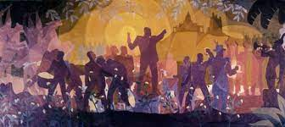
THE AFRICAN AMERICAN EXPERIENCE

Slide 2
THE MEMORY OF SLAVERY
The historical experience of African Americans was marked for more than two centuries by a loss of identity, and by the resistance to this loss. The slaves who were brought from the Western African coast and were secluded into the Southern plantations were forced to live a brutal transition from the active control everyone has over one’s own body and motion through space to a state of total passivity and stasis ‒ the crisis of the “normal” relationships between one’s own body and the space designating one’s own place in the world.

Slide 3
BODY AND SPACE
The condition of slavery pushed to the extreme the equation body=space made by Henri Lefebvre, echoing Jacques Lacan’s formulation about the “mirror stage” as the preliminary phase of the construction of individual identity. According to Lefebvre, space “is first of all my body, and then it is my body counterpart or ‘other’, its mirror-image or shadow: it is the shifting intersection between that with touches, penetrates, threatens or benefits my body on the one hand, and all other bodies on the other” (The Production of Space). Being a slave meant erasing every possible intersection between body and space (that is, other bodies, the whites’ bodies, untouchable for the slave, while the slave’s body was simply an extension of the white master’s). At the beginning of the African American experience, therefore, the racial hierarchy between whites and blacks was based first of all on their being located on the opposite sides of the diagram of power extending from total power over body and space (the whites’) to total lack of that power (the blacks’).

Slide 4
AN INFERIOR RACE
US official culture considered blacks as inferior from the very beginning – so contradicting the basic principle of the Declaration of Independence, that “All men are created equal.”
Thomas Jefferson, Notes on the State of Virginia: “the blacks, whether originally a distinct race, or made distinct by time and circumstances, are inferior to the whites in the endowments both of body and mind.”

Slide 5
SLAVERY IN THE 19TH CENTURY
More than 12 million Africans were shipped to the New World, and about 10 survived the Middle Passage. Only about 400,000 were transported directly from Africa to North America, starting in 1619, but their children and grandchildren were slaves from birth. After the transatlantic slave trade was banned in 1808, slavery in the USA did not diminish – quite the contrary: the masters pushed the “natural” reproduction of slaves, even personally participating in it, and in 1860 the number of US slaves reached the peak of about 4 million.
The larger the number of slaves, the harder the measures that were taken by the masters to control them…

Slide 6
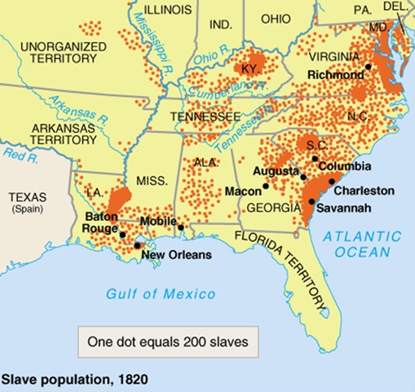
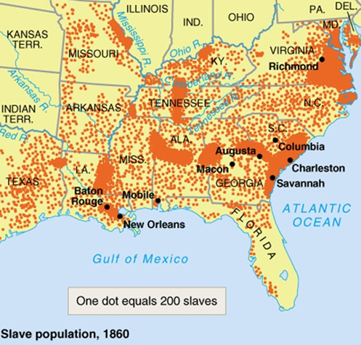

Slide 7
FORMS OF RESISTANCE
In order to survive their “social death” slaves used a number of strategies of resistance, besides trying to run to non-slave States – from open armed rebellion (Nat Turner’s revolt, 1831) to devising hybrid cultural forms which on the surface only imitated white cultural formations, like religious syncretism (fusing Christian saints and African deities) and musical language, which fused European and African harmonic, melodic and rhythmic structures, and adapted biblical psalms to covertly express the slaves’ search for freedom (spirituals).

Slide 8
DOUBLE CONSCIOUSNESS
Being at the same time at the very heart of the socio-economic structure (the free work of millions of slaves allowed American economy to grow very rapidly) and at the utmost margin of society and culture, the African American was in fact given the perceptual power of double consciousness (W.E.B. Du Bois, The Souls of Black Folk, 1903), constantly moving inside and outside American society, able to look at it both as one of its member and as external observer.

Slide 9
SIGNIFYING
The African Americans’ double consciousness allowed them to use the “enemy’s language” against itself through the practice of “signifying” (cf. Henry Louis Gates, Jr., The Signifying Monkey, 1988) – that is, of using the codes of dominant culture but adding hidden sub-codes understandable only by those who share the sub-codes (like in the case of spirituals).

Slide 10
PSALMS AND SPIRITUALS
One example of “signifying” is Psalm no. 137, often sung to covertly express the African Americans’ desire of freedom – like, roughly in the same years, “Va’ pensiero” (1842) from Giuseppe Verdi’s Nabucco did for the Italian struggle for independence.

Slide 11
Psalm 137
By the rivers of Babylon, there we sat down, yea, we wept, when we remembered Zion.
We hanged our harps upon the willows in the midst thereof.
For there they that carried us away captive required of us a song; and they that wasted us required of us mirth, saying, Sing us one of the songs of Zion.
How shall we sing the Lord's song in a strange land?
If I forget thee, O Jerusalem, let my right hand forget [her cunning].
If I do not remember thee, let my tongue cleave to the roof of my mouth; if I prefer not Jerusalem above my chief joy.
Remember, O Lord, the children of Edom in the day of Jerusalem; who said, Rase it, rase it, even to the foundation thereof.
O daughter of Babylon, who art to be destroyed; happy shall he be, that rewardeth thee as thou hast served us.
Happy shall he be, that taketh and dasheth thy little ones against the stones.
“Va’ pensiero” (Temistocle Solera, 1842)
Va’, pensiero sull’ali dorate
Va’, ti posa sui clivi, sui colli,
Ove olezzano trepide e molli
L’aure dolci del suolo natal!
Del Giordano le rive saluta,
Di Sionne le torri atterrate...
“By the Rivers of Babylon” (The Melodians, 1970)
By the rivers of Babylon, there we sat down, also we wept at our remembrance of Zion.
On the willows, in the midst thereof, we hung up our lyres.
For there our captors demanded a song, and our desecrators, mirth: “Sing us from the song of Zion.”
How can we sing the song of God in a strange land?

Slide 12
THE SLAVE NARRATIVE
The autobiographical narratives of former slaves before and after the Civil War are (together with spiritual and blues songs) the foundation of African American literature. Used by the abolitionist movement as tools of propaganda, slave narratives had a big popular success thanks to authors like Frederick Douglass, William Wells Brown and Harriet Jacobs.
Their basic narrative structure conflates traditional autobiography, which usually tries to turn the autobiographical self into a “representative model” (like in Benjamin Franklin, who invents the image of the American self-made man), with captivity tales – the accounts of white colonists (especially women, like Mary Rowlandson) made prisoners by Natives.
Traditional autobiography usually follows the pattern of Bildung (the gradual construction of psychological and social self of the subject), while captivity tales adopt the initiation pattern, by telling some fundamental episodes of radical transformation of the subject.
Slave narratives deal both with the growing up of the subject’s awareness and with his/her conquest of freedom thanks to the overcoming of some crucial trial.

Slide 13
AFTER THE CIVIL WAR
After the Civil War Black literature started to affirm itself beyond the scope of the slave narratives, even if the autobiographies of former slaves had an even wider success as powerful tools through which African Americans could share the trials and triumphs of Black life.
Up From Slavery (1901) by Booker T. Washington is a classic example, but Washington also believed that Blacks should (at least for the time being) accept the lower steps of the social ladder.
Turn of the century: Black authors sought to revise the stereotypes produced by white imagination which dominated plantation fiction, blackface minstrelsy and vaudeville acts.

Slide 14
W.E.B. DU BOIS
W.E.B. Du Bois, The Souls of Black Folk (1903): problematic exploration of racial identity and of the conflicted relationship of “the Negro” to “the American” → double consciousness.
“The problem of the 20th century is the problem of the color line – the relation of the darker to the lighter races of men in Asia and Africa, in America and the islands of the sea.”
The fundamental motivation of racism is economic.
European colonialism = process that generated modern racism.
Racial discrimination precedes prejudice, which is its consequence, and its post-facto justification: blacks (and Native Americans) were deprived of their rights in order to be more effectively exploited.
Imperialism = evolution of colonialism, adding political dominance to economic dominance → Native populations and black slaves reduced to a condition of total submission to white power.
Human nature = neither fixed and immutable, determined by genetics, nor inherently “good” or “bad.”
Prejudices are cultural products, and can be removed only through culture and education.

Slide 15
THE NEO-SLAVE NARRATIVE
Neo-slave narratives (term coined by Ishmael Reed in the novel Flight to Canada, 1976) appeared after World II and the disappearance of the last former slaves to re-elaborate the trauma of slavery.
To make up for the loss of living memory, neo-slave narratives had to reinvent the forgotten trauma of slavery by using the techniques of parody, satire and the fantastic, so that contemporary subjectivity could reconstruct a past which had left almost no trace in official, objective history.
Most important works: Margaret Walker’s Jubilee (1966), William Styron’s Confessions of Nat Turner (1967), Octavia Butler’s Kindred (1979), Toni Morrison’s Beloved (1987), Colson Whitehead’s The Underground Railroad (2016).

