Slide 1
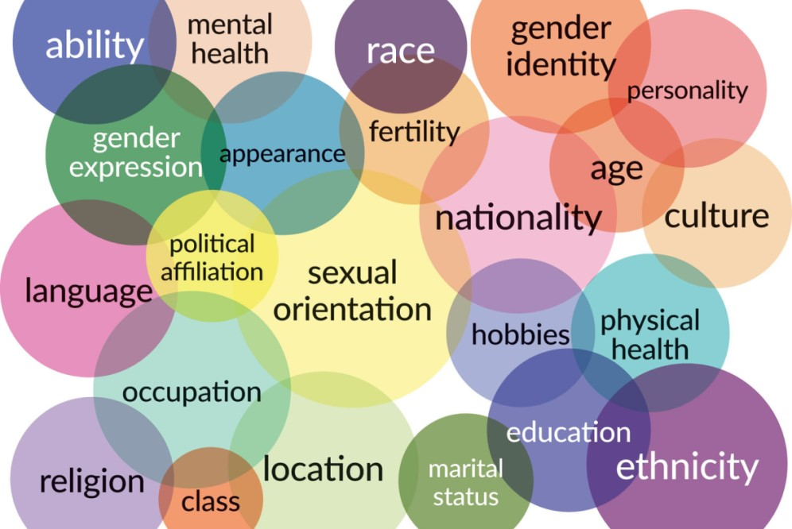
INTRODUCTION
CROSSINGS AND INTERSECTIONS

Slide 2
Intersectionality (also called intersectional feminism)= branch of feminism asserting how all aspects of social and political identities (gender, race, class, sexuality, disability, etc) “intersect.”
Term coined by black feminist scholar Kimberlé Williams Crenshaw in 1989.
Purpose of intersectionality = identify how different forms of discrimination are related to one another, but also how different forms of resistance to oppression and of affirmation of identity can intersect and each reinforce the other(s).
We will use “intersectionality” as a 360°concept, as a way of defining all the complicated and contradictory tensions that converge and interact inside individual and collective identities. In some sense this could even involve the fact that being, for example, a black woman does not inevitably entails only a fate of marginalization and exploitation, but can also mean the possibility of having the widest range of opportunities to fully realize her aspirations.
WHAT IS INTERSECTIONALITY?

Slide 3
INTERSECTIONAL COALITIONS
Intersectionality may and must mean also the conscious activation of systems of solidarity and collaboration crossing the allegedly fixed and stable boundaries that aim at defining and distinguishing the various identities as if they were something totally distinct and isolated. As Anna Carastathis suggests, “reconceptualizing identities as coalitions enables us not only to form alliances across lines of experiential and political difference but also to constitute ‘coalitions of one’ where one is aligned with all aspects of one’s identity, particularly those that one has been encouraged to repress or deny.”

Slide 4
A NEW CONCEPT OF IDENTITY
This course will analyze a series of texts of American literature and culture where identities are represented, criticized, deconstructed, but also celebrated by highlighting the inextricable intersections of the various dimensions of individual and collective identities (a term we should question, since intersection somehow deconstructs the notion of “identity” itself, that is of being one self and one self only). Carastathis: “Intersectionality-as-challenge urges us to grapple with and overcome our entrenched perceptual-cognitive habits of essentialism, categorial purity, and segregation,”

Slide 5
INTERSECTIONALITY AS AN ANALYTIC TOOL
Intersectionality will be for us a perspective that should enable us to better understand how the multiple dynamics and stratifications of the dimensions of individual and collective “identities” are represented in literary and cultural texts – and in most cases this will also mean that the representation of intersectionality as a social and cultural reality is also a critique of the intersecting systems of oppression which dominate American life (like in any other nation, society, culture, although in a number of different ways…).
We will therefore try to use the concept in a more “complex” way, as the concept itself developed from a more “simple” paradigm, variously named as “double jeopardy” (referring to dimensions of race and gender) “triple jeopardy” (adding social class), “interlocking oppressions,” and more recently and less simplistically “multiple jeopardy” and “matrix of domination.”

Slide 6
THE SYSTEM OF RACE
Race: a socially constructed concept, aimed at differentiating ethnic groups according to their physical features – no real scientific foundation.
Racism: prejudice, discrimination, or antagonism directed against a person or people according to their belonging to a given racial or ethnic group (usually a minority).
Structural/systemic racism: discrimination and marginalization by social, economic, legal and educational institutions.
The trauma of racism: the cumulative adverse emotional, psychological, health, economic and social effects of racism on the lives of “people of color.”
Ethnicity: system of shared cultural, linguistic and religious features. Ethnic groups tend to share a homeland, a cultural heritage, a language, a religion, a mythology, ritual systems, food habits, dressing styles, and also some general physical appearance.

Slide 7
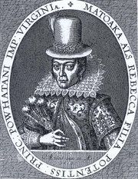
THE BIRTH OF THE BRITISH COLONIZATION
OF AMERICA/Of RACISM
1607: establishment of the Colony of Virginia (capital: Jamestown), first permanent British settlement in North America)
Conflicts with the Natives (but also collaboration)
John Smith captured by the Powhatan tribe; Pocahontas (born Amonute, a.k.a. Matoaka) “saves” Smith
1614: John Rolfe marries Pocahontas (renamed “Rebecca”) and brings her to England → improvement of European-Native relations
1619: twenty African “servants” arrive in Virginia
1636-38: Pequot War, ending with the extermination of the Indian tribe (first American genocide)
The exploitation of the Natives’ lands and of “free” Black labor needs an ideological justification → birth of modern racism, which postulates the existence of superior (white) and inferior (colored) races

Slide 8
THE ECONOMIC ORIGINS
OF MODERN RACISM
W.E.B. Du Bois:
Capitalism has an inherent “slavery character” → racism=product of the rising capitalist system.
Oliver Cromwell Cox:
“The slave trade was simply a way of recruiting labor for the purpose of exploiting the great natural resources of America. This trade did not develop because Indians and Negroes were red and black […] but simply because they were the best workers to be found for the heavy labor in the mines and plantations across the Atlantic […].This, then, is the beginning of modern race relations. It was not an abstract, natural, or immemorial feeling of mutual antipathy between groups, but rather a practical exploitative relationship.”
Virginia: capitalist enterprise, whose first aim was to exploit the natural resources of the land → original accumulation of capital guaranteed by the use of “free” labor, provided by subjects whose humanity had to be denied.

Slide 9
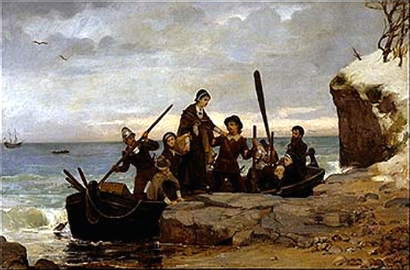
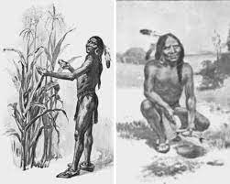
THE PILGRIM FATHERS
Pilgrim Fathers: Puritan Separatists led by William Bradford, who leave Leyden (in the Netherlands) and arrive to Plymouth at the end of 1620
Scarcity of food and diseases → half of the about 120 colonists die in first winter → the Pilgrims survive thanks to the Natives’ help (Tisquantum, or Squanto) and Samoset – the first American Thanksgiving celebrates the Pilgrims’ survival
1675-78: King Philip’s War between the Wampanoags led by Metacom/et (whose father, Massasoit, had been a friend of the Pilgrim Fathers) and the Massachusetts colonists → end of the possibility of Native resistance aganist white colonization

Slide 10
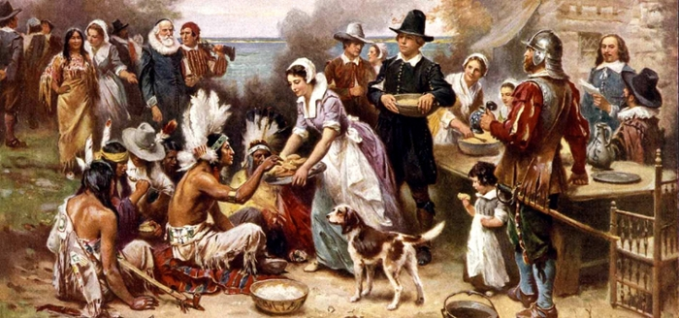
FIRST AMERICAN THANKSGIVING

Slide 11
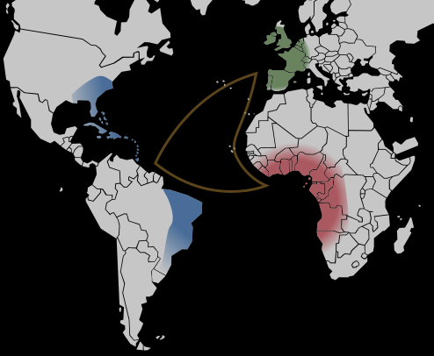
MODERN/AMERICAN SLAVERY
Atlantic slave trade starts in early to mid 1500s, and provides “free” labor to the European colonies in the Americas
1670s: slavery becomes, in the Americas, a legal institution based on race: all slaves are people of color (Natives – but in North American the enslavement of Natives fails – and especially Blacks)
About 12/15 million Africans are shipped to the New World, and about 15% of them die in the Middle Passage
About 400,000 are shipped directly to North America, and another 60-70,000 from the Caribbean
Note: Data taken from the Trans-Atlantic Slave Database

Slide 12
INSTITUTIONAL RACISM
Original US Constitution: Indians, blacks and other nonwhites are counted as less than full persons (women of any race are not counted at all, even if the words “man/men” are never mentioned in the Constitution, that refers only to “person/people”).
Slaves are denied any legal protection.
Native Americans are considered as having no rights over their lands, and so are forcibly displaced (Removal Acts, 1830) secluded in the reservations, and made victims of systematic repression and marginalization.

Slide 13
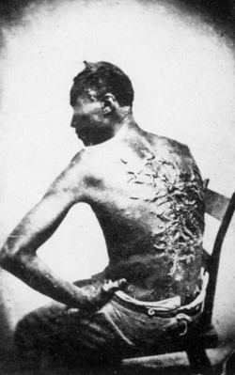
ABOLITIONISM AND EMANCIPATION
Slavery remains legal in all colonies until the Revolution – after that, some northern States eliminate slavery
US Constitution limits the power of Federal government to interfere with slavery or slave trade
1808: slave trade (not slavery) prohibited in the USA
First half of the 19th century: rise of the abolitionist movement (William Lloyd Garrison, Frederick Douglass, Harriet Tubman)
Growing tension between northern and southern States → Secession of the Confederate States → Civil War (1861-65)
1863: Emancipation Proclamation
1865: total abolition of slavery

Slide 14
AFTER THE CIVIL WAR
Reconstruction: attempt to integrate freed African American in US society → contradictory policies:
  substitution of the slavery system with a legal system based on equality
  maintaining racial hierarchies through specific laws (Black codes)
  “Equal” Segregation (Plessy v. Ferguson, 1896: “separate but equal”)
  stressing the competition between lower-class whites and Blacks → myth of the Blacks stealing the whites’ jobs and turning down whites’ “generosity” (the white men’s burden)
  scientific racism: “naturally inferior” races (not only Blacks, but also non-WASP immigrants) must be kept in the lower rungs of the social ladder, and must not “contaminate” pure white blood (eugenics)
  assimilation into mainstream society (myth of the melting pot)
  pluralism and multiculturalism (myth of the American salad bowl/patchwork)

Slide 15
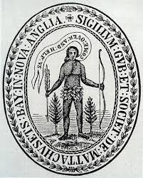
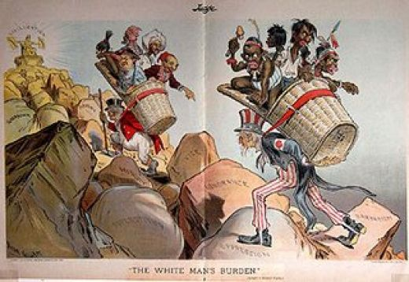
THE WHITE MAN’S BURDEN
  Take up the White Man’s burden –
  Send forth the best ye breed –
  Go, bind your sons to exile
  To serve your captives‘’need;
  To wait, in heavy harness,
  On fluttered folk and wild –
  Your new-caught sullen peoples,
  Half devil and half child.
  […]
  Take up the White Man’s burden –
  The savage wars of peace –
  Fill full the mouth of Famine
  And bid the sickness cease;
  And when your goal is nearest
  The end for others sought,
  Watch sloth and heathen Folly
  Bring all your hopes to nought.
  (Rudyard Kipling, 1899)

Slide 16
RACE, ETHNICITY, AND IMPERIALISM
Race and ethnicity are also central to the rise of US imperialism, starting from the 1845-48 war against Mexico, ideologically justified by the doctrine of Manifest Destiny (expression coined in 1845 by John L. O’Sullivan in the essay “Annexation”). For O’Sullivan, the USA has the moral right and an almost divine mission to spread freedom and democracy among “inferior” people who do not know how to govern themeselves. “And that claim is by the right of our manifest destiny to overspread and to possess the whole of the continent which Providence has given us for the development of the great experiment of liberty and federated self-government entrusted to us.” The Treaty of Guadalupe Hidalgo (1848) gives to the USA vast parts of Mexico (one third of today’s USA). Former Mexican citizens have to decide whether to “migrate” to Mexico or remain in their lands as US citizens. The white Americans’ sense of superiority over the “brown” Mexicans genertates all kinds of social, economic, cultural and linguistic discriminations. US imperialism is based on an asymmetrical perception of the characteristics of different races, and on the postulate that the new American Empire has the duty to “protect” inferior races, but the result is quite the opposite...

Slide 17
RACE AS SYMBOLIC CATEGORY
Race = “a symbolic category, based on phenotype or ancestry and constructed according to specific social and historical contexts, that is misrecognized as a natural category” (Matthew Desmond and Mustafa Emirbayer, “What is Racial Domination?”)

Slide 18
CRITICAL RACE THEORY
Cristina Lombardi-Diop:
CRT is a theoretical and interpretative field of inquiry that examines race and racism across history, society, and cultural modes of expression.
CTR attempts to understand how victims of systemic racism are affected by cultural perceptions of race and how they are able to present themselves to counter prejudice.

Slide 19
WHITENESS STUDIES
Whiteness Studies: analysis of unequal distribution of privileges, resources, and power between white people and people of color.
Richard Dyer: Whiteness presents itself as “transparent” or “invisible” because it is considered universal, it is often unnamed, and unmarked → white people are just people.

Slide 20
RACE AND INTERSECTIONALITY
Kimberlé Crenshaw, “Demarginalizing the Intersection of Race and Sex” (1989) and “Mapping the Margins” (1991): race, class, and gender interact to shape experiences of women of color, and create complex systems of oppression.
Women of color do not simply experience gender discrimination plus racial discrimination as two distinct systems of oppression. Race, gender, and other forms of subordination intersect and overlap, creating specific experiences and locations of subordination and vulnerability.
“Intersectional subordination need not be intentionally produced; in fact, it is frequently the consequence of the imposition of one burden that interacts with pre-existing vulnerabilities to create yet another dimension of disempowerment” (Crenshaw).

Slide 21
ETHNIC STUDIES
Ethnic Studies = theoretical study of race and cultural pluralism, started by African American writers and intellectuals.
W.E.B. Du Bois: The Souls of Black Folk (1903), organization of the Atlanta University Conferences (1898-1914): first scientific studies of the (intersecting) dimensions of the lives of Black people (health, homes, wealth, education, religion, crime…)
Carter G. Woodson: founding of the Association for the Study of Negro Life and History (1915) and of the Journal of Negro History (1916).
Gradual adoption of European theories of language, textuality, gender and subjectivity to critique discourses of race and racial difference.
Expansion of the field so as to include other ethnicities, first of all Chicano/a and Native American cultures.

Slide 22
US VS. THEM
Ethnic studies examine how dominant perceptions of cultural identities in Europe and North America tend to postulate a dichotomy between “Us” (the non-ethnic majority) and “Them” (colonized or old and new migrant communities, characterized as “ethnic”).
Ethnic identity or origin = an individual’s ancestral heritage.
Ethnocentrism = the belief that a cultural community or ancestry is superior.
Ethnicism = protest/resistance against the oppression and exploitation of “ethnics” by the dominant group.

Slide 23
RACE VS. ETHNICITY
Race: racial stratification according to a birth-ascribed status based on physical and cultural characteristics defined by the dominant group.
Ethnicity: birth-ascribed identity defined by the ethnic group itself.
Racial categories: mostly inaccurate and based on negative prejudices and stereotypes vs. ethnic categories: usually more accurate, because defined by the group itself.
Ethnic self-categorization can turn into ethnocentrism when the sense of cultural identity of the group becomes a sense of superiority (especially when the group is the socially dominant one) → exaltation of the positive aspects of the group’s ethnicity and erasure of the negative ones + the reverse as regards the other groups.

Slide 24
ETHNICITY, ETHNIC IDENTITY, ETHNIC GROUP
Sian Jones (The Archaeology of Ethnicity, 1997):
Ethnicity = “all those social and psychological phenomena associated with a culturally constructed group identity.”
Ethnic identity = “that aspect of a person’s self-conceptualization which results from identification with a broader group in opposition to others on the basis of perceived cultural differentiation and/or common descent.”
Ethnic group = “any group of people who set themselves apart and/or are set apart by others with whom they interact or co-exist on the basis of their perceptions of cultural differentiation and/or common ancestry.”

Slide 25
THE “PRIMORDIALIST” PARADIGM
Primordialism (origins in German Romantic thinking: Fichte, Herder; major authors: Peter Van den Berghe, Clifford Geertz, Steven Grosby):
ethnicity is a natural phenomenon with its foundations in family and kinship. H. Isaacs, “Basic Group Identity: Idols of the Tribe” (1974): primordial ties explain the power and persistence of ethnic identity (“basic group identity”), especially when confronted with other groups → evolution of ”tribal” identities into nationalist movements.
Problems: Primordial approaches are too general and vague; they suggest that ethnic identity is a determining and immutable dimension and that primordial attachments are involuntary and coercive; they imply that ethnic groups are constituted in sort of social and political vacuum; they do not take into account that their very concepts are historically situated and culturally constructed.

Slide 26
THE “INSTRUMENTALIST” APPROACH
Origins in Auguste Comte’s Logical Positivism; modern exponents: Nathan Glazer, Daniel Moynihan Fredrik Barth, Abner Cohen.
Ethnicity = socially constructed; people assemble pieces of a variety of ethnic heritages; their “ethnicity” is often instrumental to the negotiation of access to economic and political resources.
Objectivist instrumentalism: focus on the socio-structural and cultural dimensions of ethnicity.
Subjectivist instrumentalism: focus on the interpersonal and behavioral aspects of ethnicity.
Problems: Instrumentalist approaches use reductionist modes of explanation, tend to ignore the cultural and also the psychological dimensions of ethnicity, postulate that human behavior is essentially rational and directed toward maximizing self-interest, disregard the dynamics of power in intragroup and intergroup relations, and do not distinguish ethnic groups from other collective-interest groups such as race or class.

Slide 27
ETHNICITY AND PRACTICE THEORY
Sian Jones: “ethnicity is not a passive reflection of similarities and differences in the cultural practices and structural conditions in which people are socialized,” nor is ethnicity “produced entirely in the process of social interaction.”
Ethnicity = result of both conscious and subliminal recognition of the collective and individual forms of human agency.
Practice theory = focus on “the relationship between objective conditions and subjective perceptions.”

Slide 28
THE “HABITUS”
Pierre Bourdieu: habitus = durable disposition towards certain perceptions and practices (regarding sexual divisions of labor, morality, tastes), which become part of an individual’s sense of self at an early age, and which can be transposed from one context to another.
Ethnicity = neIther a static reflection of culture, nor produced entirely by social interaction and boundary maintenance.
“The intersubjective construction of ethnic identity is grounded in the shared subliminal dispositions of the habitus, which shape, and are shaped by, objective commonalties of practice” (Jones).

Slide 29
THE MULTIDIMENSIONALITY OF ETHNICITY
Habitus = multidimensional; it can vary in different social situations; it is in constant state of change and reproduction within different social contexts.
Collective ethnicity = shared dispositions of habitus, changing through time and according to the different historical contexts.
Timothy Baumann: ethnicity = “product of self and group identity that is formed in extrinsic/intrinsic contexts and social interaction. Ethnicity is not the same as nor equal to culture. Ethnicity is in part the symbolic representations of an individual or a group that are produced, reproduced, and transformed over time.”

