Slide 1
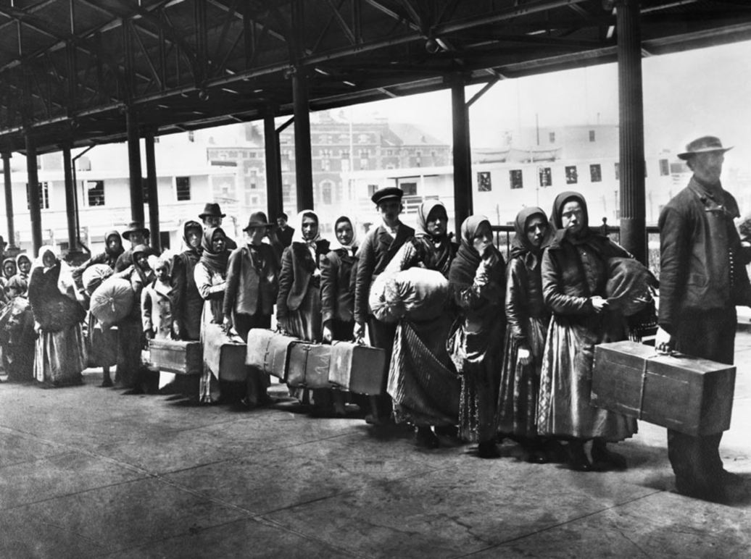
ITALIAN AMERICAN CULTURE AND LITERATURE

Slide 2
ITALIAN AMERICAN MIGRATIONS
Italian diaspora: largest in documented history up to the 20th century (about 30 million migrants).
2000: More than 15 million people in the United States identified themselves as Italian Americans – 6% of the US population, and the nation’s fourth largest European ancestry group.
1990 to 2000: a rise of 1 million in US citizens who claimed Italian ancestry.

Slide 3
THE FIRST MIGRATIONS
Christopher Columbus (probably Genoese), Giovanni Caboto, Giovanni da Verrazzano, Amerigo Vespucci.
After the American Revolution, skilled artisans, painters, sculptors, musicians, mainly from Northern Italy.
Failure of Italian revolutions until 1860 → small flow of political refugees (Giuseppe Garibaldi).
Second third of the century: entertainers, tradesmen, shopkeepers, artisans, and peasants.
Up to the last quarter of the century: majority of Italian migrants from Northern Italy (Venetia, Friuli, Lombardy and Piedmont).

Slide 4
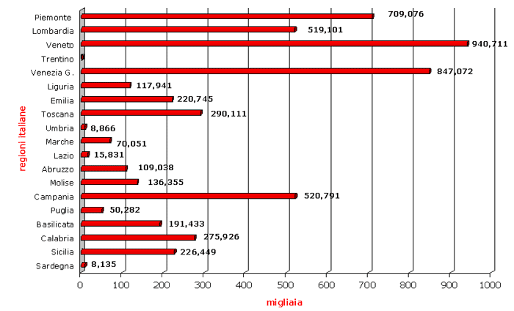
ITALIAN TOTAL EMIGRATION TO THE USA, 1876-1900

Slide 5
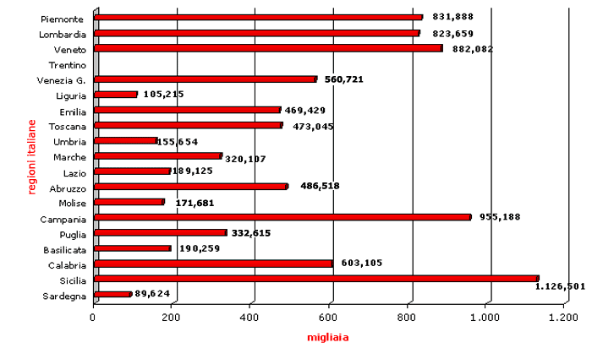
ITALIAN TOTAL EMIGRATION TO THE USA, 1901-1915

Slide 7
THE MASS MIGRATION
1880-1915: about four/five million Italians migrated to the United States (almost 70% from the South) – 10% of the total of foreign migrants to the USA.
Often temporary migrants (“sojourners”) in search of immediate employment, maximum savings, and quick repatriation.
Mostly young, single men who settled in the urban centers.
Within five years, about half of them returned to Italy (“ritornati,” or “birds of passage”).

Slide 8
LOCAL VS NATIONAL IDENTITY
Up to well into the 20th century, most Italian migrants identified much more with their local origins than with their nationality, spoke dialects instead of the standard Italian language, and often organized their communities on the basis of the villages or regions they came from.
The national identity of Italian migrants finally came to the fore because they were identified by the Americans as “Eyetalians.”

Slide 9
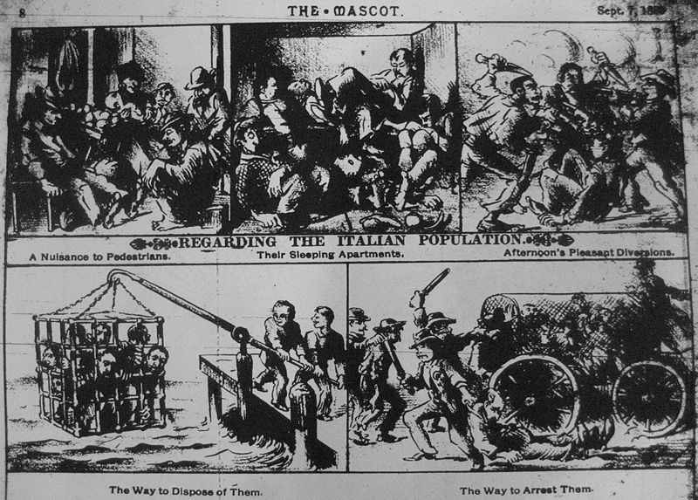
INTO THE MELTING POT
Italian migrants were required to immediately integrate into the American “Melting Pot.”
Italian migrants’ “resistance” to assimilation (religion, centrality of the family, musical tradition, food,) vs. xenophobic reaction of the “Nativist” movement.

Slide 10
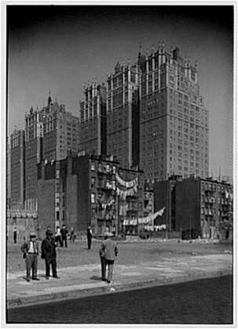
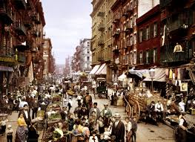
LIVING IN THE “LITTLE ITALYS”
Many Italian migrants settled in the centers of the major cities, where they tried to recreate the “Italian” space → “Little Italys.”
They often lived in buildings abandoned by middle-class residents which became “tenements,” soon called “slums.”
The heart of the New York Little Italy was Mulberry Street, in downtown Manhattan.

Slide 11
SUBSTITUTING AFRICAN AMERICANS
Many Italian American did not go to the cities, but tried to use their skills as farmers and peasants in the fields.
In some occasions they were led to believe that they would have owned the land they worked, but they actually became indentured servants (they thought they worked without salary to pay their ownership of the land, but they became rapidly indebted).
In the Southern plantations, they substituted former African American slaves, who after the Emancipation went to the North in search of work in the cities (Great Migration).

Slide 12
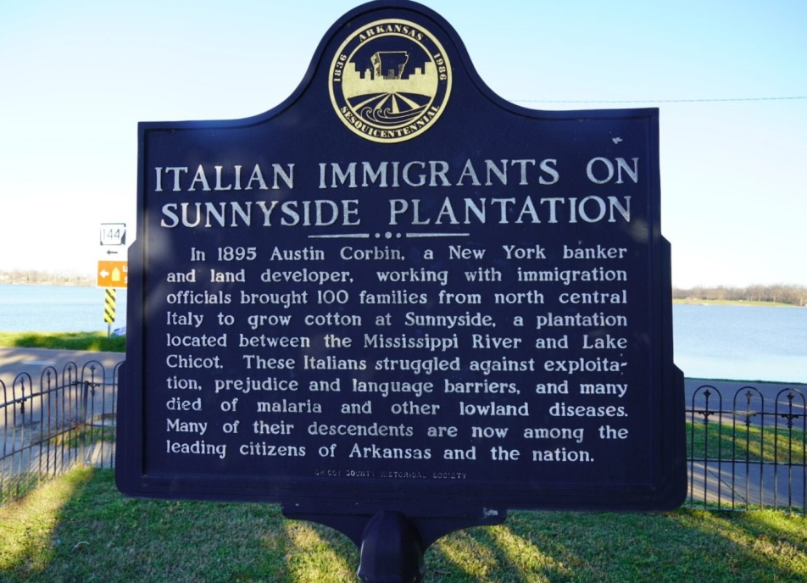
SUNNYSIDE PLANTATION
Sunnyside Plantation: cotton plantation in Arkansas, farmed using the forced labor of African American slaves until the Civil War.
1890s-1910s: immigrants from Northern and especially Eastern Italy came and were subject to peonage, to be later replaced by black sharecroppers.
Prince Emanuele Ruspoli (Mayor of Rome, 1892-1899) sent many peasants from his own plantations in the Marche to Sunnyside, promising them they would soon own the land, but they had to pay back for twenty years.
At the end of the century, a federal prosecution for peonage in Sunnyside was stopped in its tracks.

Slide 13

SWEET HOPE
In 2011, Mary Bucci Bush published Sweet Hope, a historical novel based on the experiences of Bush’s grandmother (born in Senigallia), who worked on the Sunnyside Plantation as a child.

Slide 14
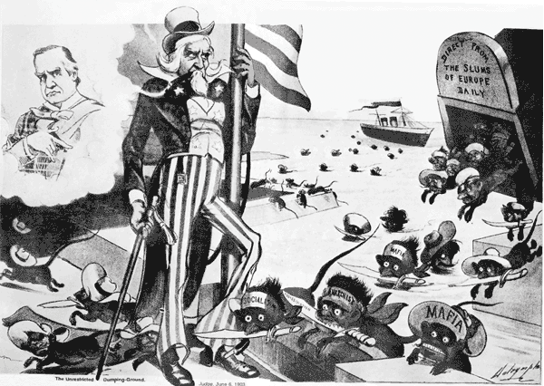
PREJUDICES
Italian migrants had to face the prejudices of dominant WASP culture, which considered them more or less on the same level (also in racial terms) with African Americans (and up to the end of the 19th century many Italians actually substituted former slaves in the Southern plantations).
The flux of migration from Italy gradually waned after World War I, due to the restrictions dictated by the Immigration Acts of 1920 and 1924.

Slide 15
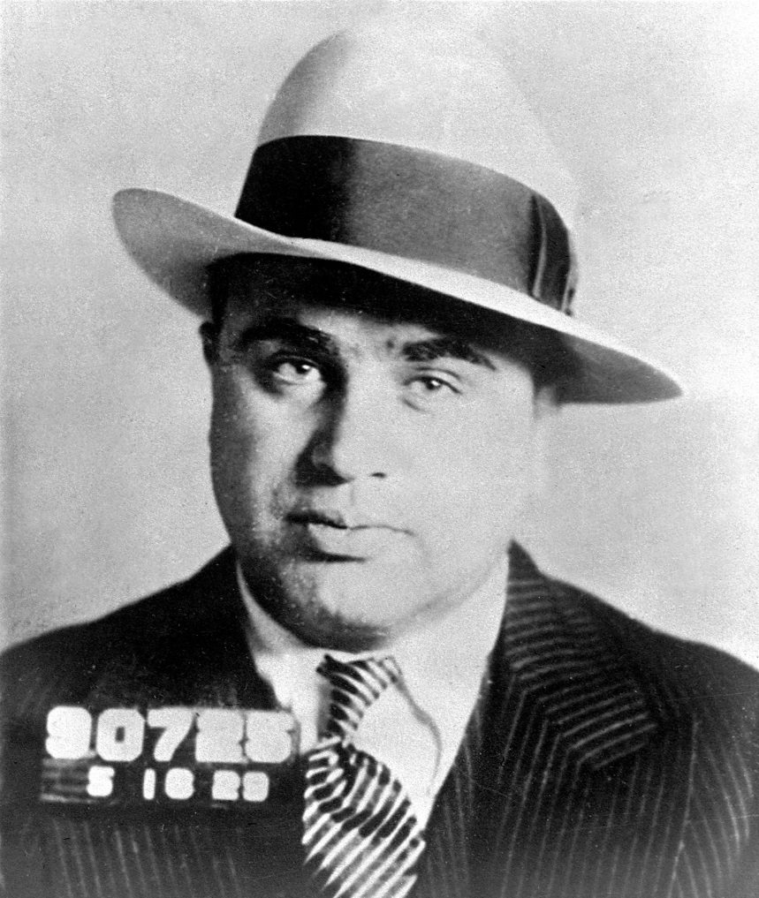
THE PADRONE SYSTEM
Padrone: a mediator between workers, trade unions (connected to the Mafia, which oversaw Sicilian and more generally Southern migrants) and political bosses.
The padrone negotiated the “indentured servitude” contracts, and was paid by both migrants and bosses. The close links of this system with the Mafia of course rapidly spread the negative cliché of the Italian migrant as mafioso, embodied above all by Al Capone.

Slide 16
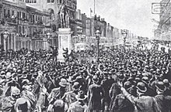
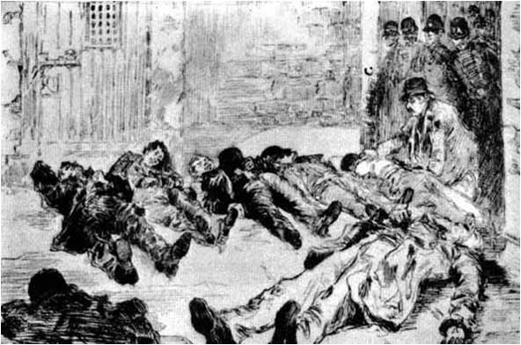
THE ITALIAN AS MAFIOSO
March 14, 1891: New Orleans mass lynching (3,000 to 20,000 participating) of 11 Italian migrants, mostly from Sicily (largest mass lynching in US history), accused of a Mafia killing.

Slide 17
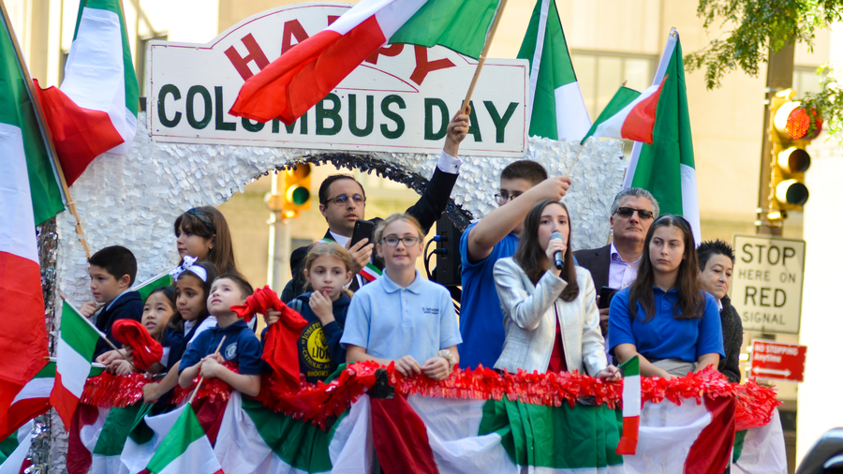
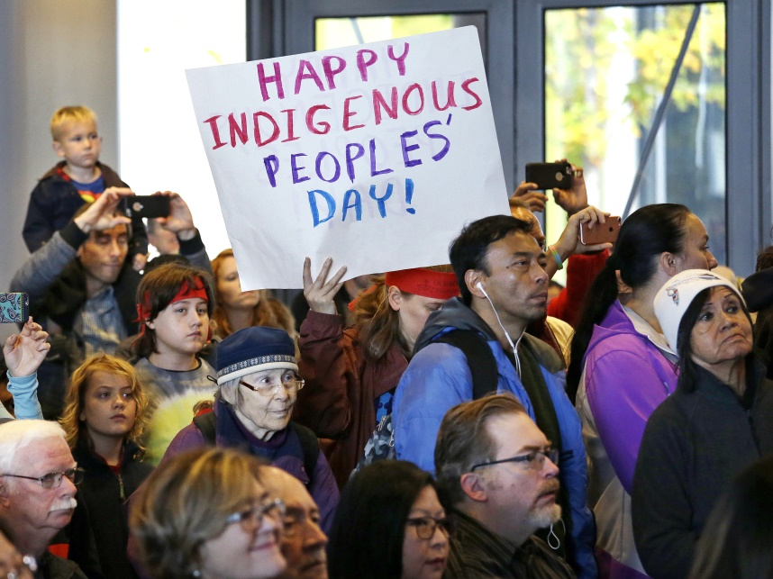
COLUMBUS DAY
The first Columbus Day celebration took place in the USA on October 12, 1792, to commemorate the 300th anniversary of the “discovery” of America by Christopher Columbus, organized by the Columbian Order of New York (Tammany Hall).
The day became gradually a festivity for the Italian American community, to show their “ethnic” pride.
For the 400th anniversary of Christopher Columbus's voyage in 1892, but above all as a sort of redress for the 1891 New Orleans lynching , President Benjamin Harrison declared Columbus Day as a one-time national celebration.
After various attempts to turn it into a national holiday, in 1971 Columbus Day became a Federal Holiday, to be observed on the second Monday in October.
Since the festivity basically celebrated the beginning of the European colonization and exploitation of America and the genocide of the Natives, after many polemical debates and a gradual growth of self-awareness in the Italian American community, in 2021 the Indigenous Peoples’ Day has been instituted, to be celebrated on the same day as Columbus Day.

Slide 18
ETHNIC SLURS
Dago (prob. from “Diego,” confusing Italians with Spaniards)
Gumbah (from “cumpa’”)
Greaseball or greaser (used also and above all for Mexicans, employed for Italians because also some of them worked as “greasers” of wagon axles)
Guinea (from the African area many African slaves had come from, thus equating Italians with Blacks)
Terrone or cafone
Wop (from “guappo,” or, according to a popular and probably inaccurate etymology, from the acronym for “with out papers” or “working on pavement”)

Slide 19
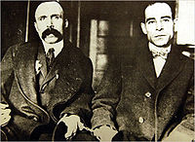
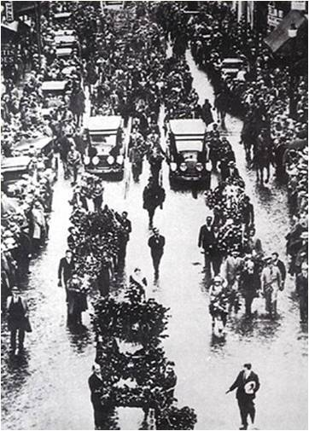
SACCO AND VANZETTI
Anarchists Nicola Sacco and Bartolomeo Vanzetti were arrested in 1920. After a long trial, they were judged guilty of the murder of an accountant and a guard, and executed in 1927, in Boston.
Many famous intellectuals and writers (George Bernard Shaw, Bertrand Russell, Albert Einstein, Dorothy Parker, Edna St. Vincent Millay, John Dewey, John Dos Passos, Upton Sinclair, H.G. Wells, Anatole France e Arturo Giovannitti) campaigned for a revision of the trial.
In 1971 Giuliano Montaldo’s movie Sacco and Vanzetti was a huge success, like the song “Here’s to You” by Ennio Morricone, sung by Joan Baez.
In 1977 Michael Dukakis, Governor of Massachusetts, recognized the errors of the trial and officially rehabilitated the memory of Sacco e Vanzetti.

Slide 20
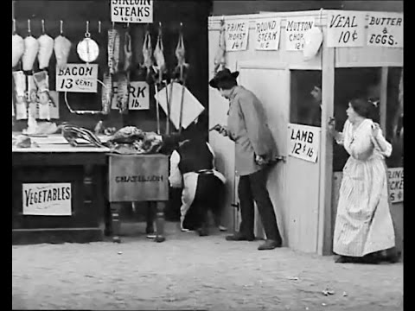
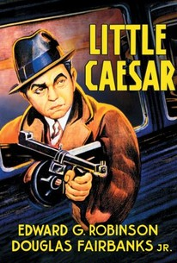
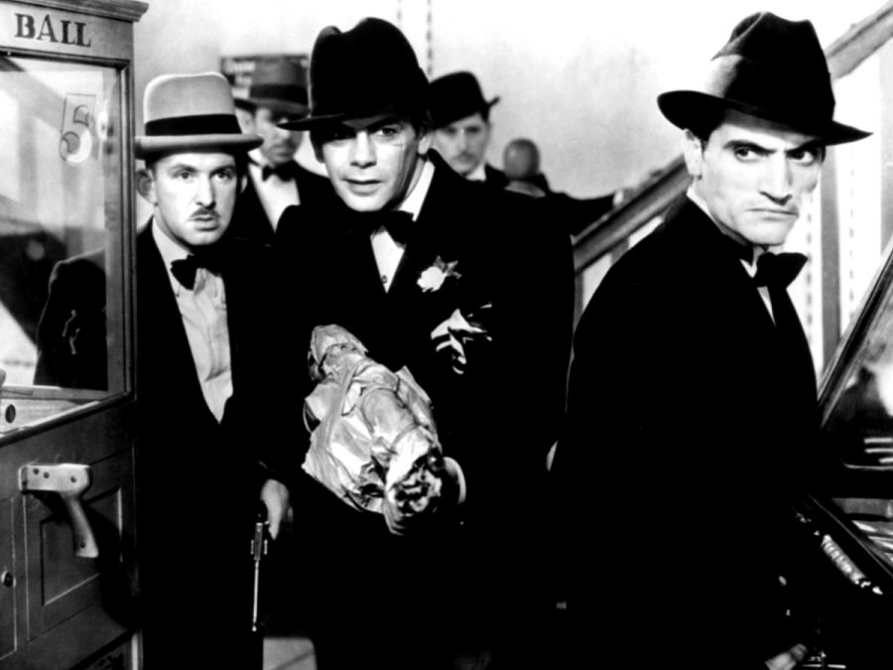
AT THE MOVIES
The first movies about Italian Americans were often about mafiosi, like the silent movies The Black Hand (1906), The Italian Blood (1911) and The Last of the Mafia (1915), and the talking pictures Little Caesar (1931) and Scarface (1932).

Slide 21
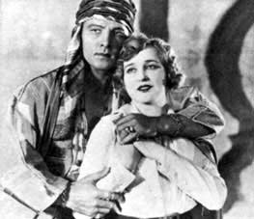
ITALIAN IMPERSONATORS
For some reasons, US cinema represented Italians or Italian Americans through “impersonators” (the Jewish-American Edward G. Robinson, the Austrian-Hungarian Paul Muni), and used Italian or Italian-American actors to play as European (but-non Italian) noblemen or even Middle-Eastern characters – see Rodolfo Valentino’s “sheikh.”

Slide 22
THE GREAT DEPRESSION
AND THE NEW DEAL
During the Great Depression, inaugurated in 1929 by the Wall Street stock market crash, many Italian migrants lost their jobs, and also many of the limited conquests they had gained.
With Franklin Delano Roosevelt’s New Deal, many Italian Americans (who had massively voted for Roosevelt) were given federal jobs (especially thanks to the Works Progress Administration and the Civilian Conservation Corp.). They became a leading force in the Democratic Party.

Slide 23
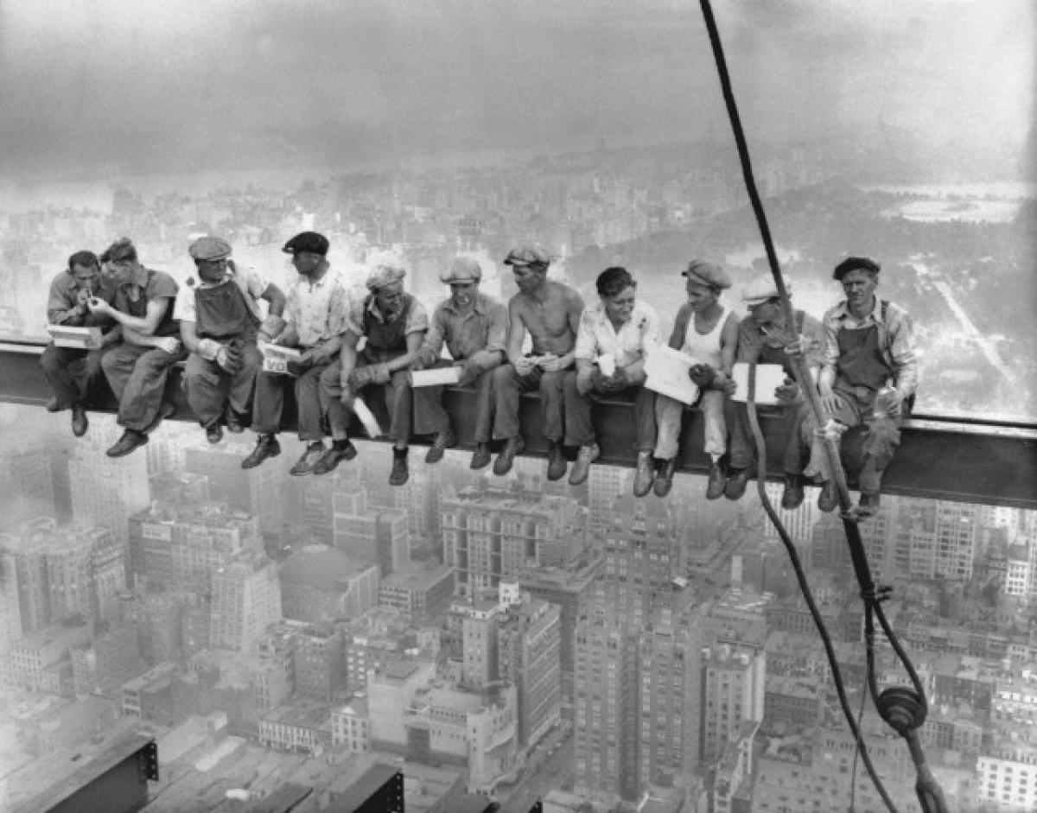
REBUILDING AMERICA
Italian Americans played a major role in literally rebuilding America in the 1930s as bricklayers and construction workers.
The famous photo “Lunch Atop a Skyscraper” (1932) by Charles Ebbets has long been believed to show Italian workers, but almost certainly they are mostly Irish, and maybe there is also a Mohawk.
The fact that this photo could be easily be thought to reproduce Italians suggests how intertwined (and confused, and confusing) the various immigrant (but also Native) identities were…

Slide 24
THE BIRTH OF
ITALIAN AMERICAN LITERATURE
First “official” Italian American work of literature: Peppino (1885) by Luigi Ventura – an example of self-translation, first published in French (Ventura was a teacher of foreign languages) and then in English, but there is also a version written in Italian: Italian American literature starts with an experiment in multiple self-translation…
1890s: Bernardino Ciambelli’s collections of melodramatic tales (I misteri di Mulberry).
1920s: Memoirs and autobiographical fiction (most authors were actually second-generation migrants, who had already made the “ethnic passage” from the Italian working class to a national or even international intelligencija).
“Real” working-class writers: outcasts from their old neighborhoods who still had to gain permanent admittance to the mainstream literary world → “caught in the middle,” located in a precarious in-between state.

Slide 25
LITERARY AUTOBIOGRAPHIES
The first “accepted” and recognized literary autobiographies were those written by “from alien to citizen” writers, as in the cases of sociologist Constantine Panunzio’s The Soul of an Immigrant (1921) and poet Pascal D’Angelo’s Pascal D’Angelo, Son of Italy (1924). But worth mentioning is also Louis Forgione’s Men of Silence (1928), a novelization of the famous Cuocolo murders featuring Joe Petrosino, a forebear of the true crime tradition, and also of the hard-boiled genre, whose invention is usually ascribed to Dashiell Hammett with Red Harvest (1929).

Slide 26
THE COMING OF AGE OF ITALIAN AMERICAN LITERATURE
The first Italian-American literary work to win both critical applause and a national audience was Pietro di Donato’s Christ in Concrete (1939), which was chosen by the Book-of-the-Month Club over John Steinbeck’s The Grapes of Wrath. This epic of the working-class Italian American community, made of bricklayers who physically build the “American Dream” but are excluded from it, subjugated as they are by the raw logic of capitalism, somewhat set the tone for much later Italian American fiction, but not for Jerre Mangione’s set of autobiographical sketches, Mount Allegro (1942), focused on the conviviality of his extended family, on the mystique of the dinner table, and on the art of storytelling while eating. John Fante went a step further by juxtaposing, in Wait until Spring, Bandini (1938) and Ask the Dust (1939), the backdrop of labor, poverty, and prejudice ailing the Italian American community with the individualist drive toward self-affirmation as a “worker of the pen” (or better, of the typewriter) of its protagonist. The most important Italian American poet of the period was the modernist/anarchist Arturo Giovannitti, author of Parole e sangue (1938).

