Slide 1
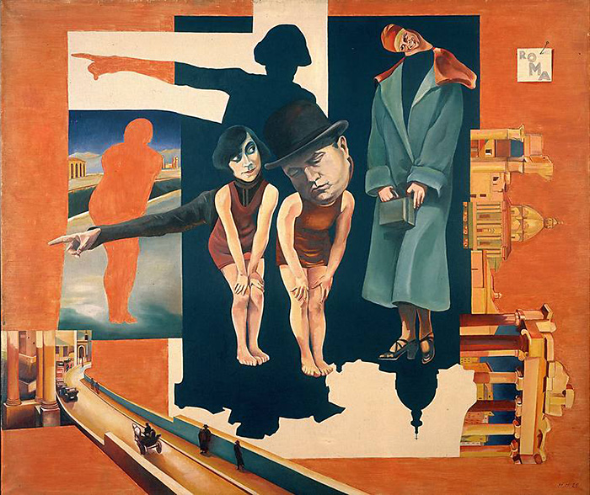
Intersectional Postmodernisms

Slide 2
What Is Postmodernism
The term was coined in 1949, and was applied in the field of architecture to define a polemical attitude against the aseptic rationalism of Modernism and to propose a new mobile and composite vision.
Robert Venturi: “I like elements which are hybrid rather than ‘pure,’ compromising rather than ‘clean’, […] accommodating rather than excluding. […] I am for messy vitality over obvious unity. […] I prefer ‘both-and’ to ‘either-or,’ black and white, and sometimes gray, to black or white. […] An architecture of complexity and contradiction must embody the difficult unity of inclusion rather than the easy unity of exclusion.”

Slide 3
Postmodernism vs. Modernism
Modernism is, generally speaking, a reaction against modernity and its presumption of rationality, but in architecture it totally accepts rational logic, planning regular structures devoid of aesthetic eccentricities – see the Flatiron Building di New York (1903).
Architectural Postmodernism privileges “Baroque” contaminations of styles and forms, like in the New Orleans Piazza d’Italia (1978).

Slide 4
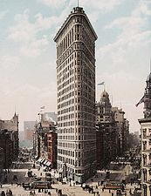
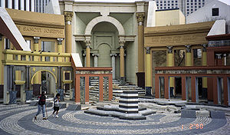

Slide 5
Epistemology vs Ontology
In more general terms, the main difference between Modernism and Postmodernism is a matter of approach and attitude, rather than of aesthetics and style (Modernist experimentations are not different per se from those of Postmodernism).
Modernism: emphasis on the subjective dimension of the perception of an incomprehensible reality whose existence nonetheless is never questioned → epistemological doubt: how can one find some meaning in “the immense panorama of futility and anarchy which is contemporary history” (T.S. Eliot).
Postmodernism: questioning of both the subject and of reality itself, because they are both artificial constructs → ontological doubt – any attempt to make “order” and find some meaning is inherently “false,” because the only existing reality is that of the empire of signs relating only to one another, and not to something external (paradox of the dictionary, where every lexical item can only refer to other lexical items).

Slide 6
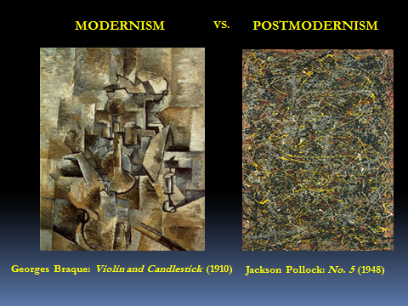

Slide 7
After the Holocaust(s)
World War I: inauguration of the crisis of Western modernity (and of the Modernist reaction)
World War II: global cultural shock, because the possibility of an ultimate apocalypse becomes clear and present with the Holocaust of millions of Jew and members of “inferior” groups, and the atomic bombings of Hiroshima and Nagasaki.

Slide 8
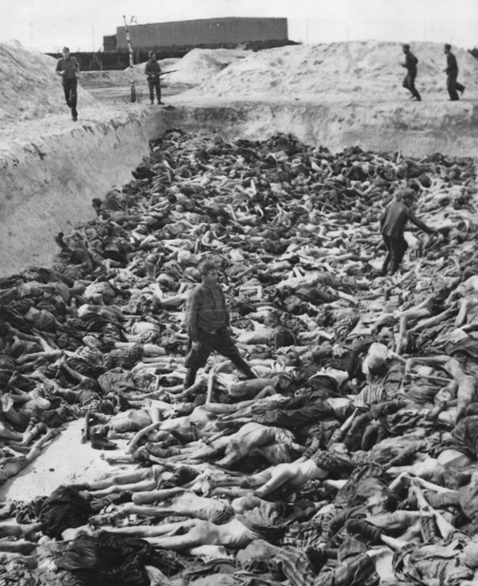
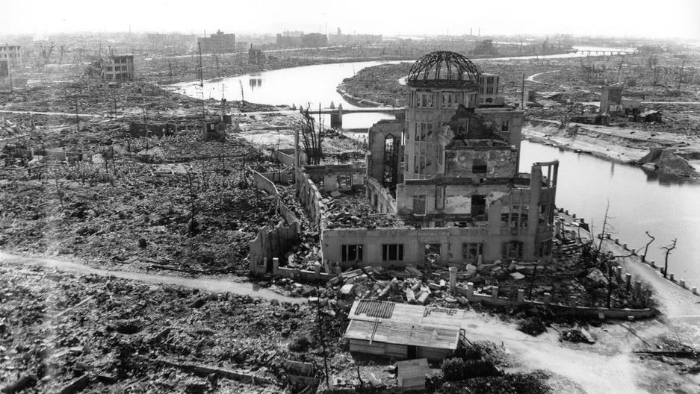

Slide 9
Postmodern Trauma
Postmodernism is the reaction to this collective trauma– it tries to elaborate it by substituting it with totally fictive creations that avoid to deal with the “Real,” because the Real is unbearable, and therefore erased from the plan of existence.
Modernism: Real = object of a never-ending quest (even if doomed to fail) of some “deep” meaning vs. Postmodernism: “surreality” made of reflecting surfaces, that do not mirror “reality,” but other mirrors → triumph of self-referentiality.

Slide 10
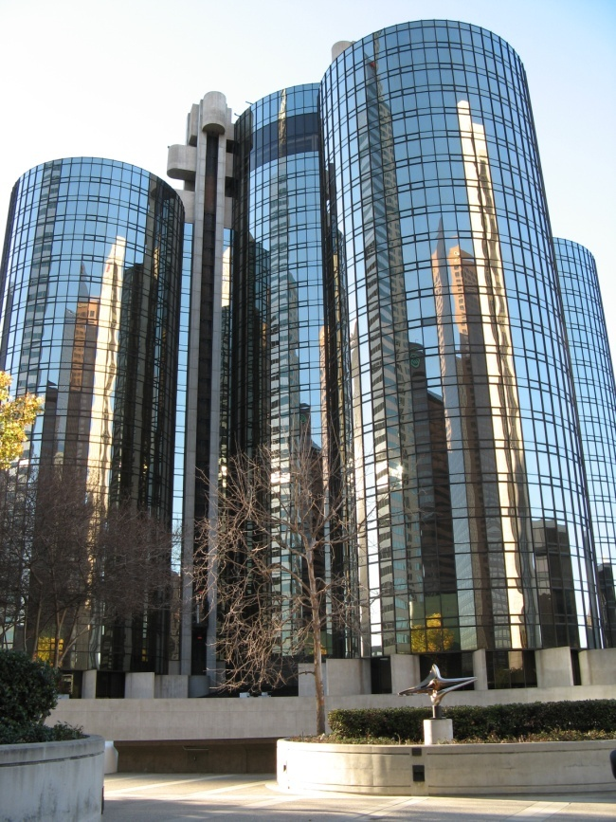

Bonaventure Hotel (Los Angeles) and Ambassador Grill at One United Nations Plaza (New York)

Slide 11
Flight from Reality
In Western culture, the advent of the Postmodern coincides with the triumph of mass society, dominated by a system of images which aims at controlling and “anesthetizing” potentially subversive impulses.
1950s: widespread penetration of household appliances, which turn the ideal of a perfectly organized society into a domestic utopia, “liberating” the human (especially female) subject from the burden of manual work.
The “Real” is expelled from everyday life, ruled by the television screen, which substitutes the Real with the Imaginary. Families on the sitting-room couch watch other families on the sitting-room couch in the sit-coms.
Birth of consumerism, promoted by TV advertising.

Slide 12


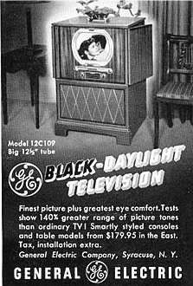


Slide 13
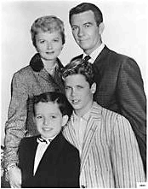
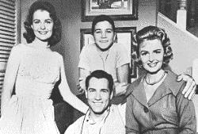
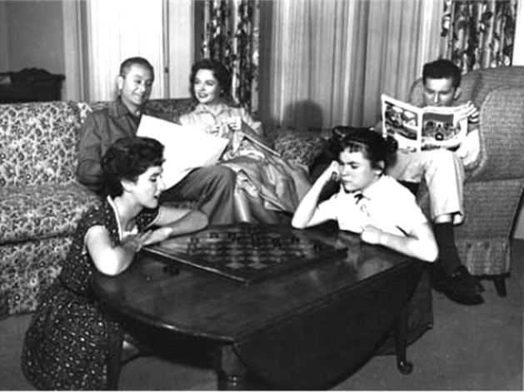
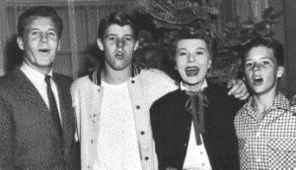
The Donna Reed Show
1958-1966
Leave It
to Beaver
1957-1963
Father Knows Best
1954-1958
The Ozzie & Harriet Show
1952-1966

Slide 14
A Suburban Utopia (or Dystopia?)
If American modernity is characterized by urbanization, postmodernity is marked by “suburbanization.” The families of the middle class, celebrated as the only American social class, move away from the downtowns, crowded and chaotic, to the new Arcadia of the suburbs, to live in single-family homes with all comforts. Suburban reality is de-centered, both because it is far from the city centers, but also because it has no center, no “downtown” – it is an undifferentiated agglomerate of housing units which are all alike, sprawled in spirals that do not converge anywhere, like a literal u-topia (a non-place). In some sense, postmodernity creates a “tranquilized” version of the dystopian nightmare announced da W.B. Yeats in “The Second Coming” (1920): “The center cannot hold” (and “Things fall apart” – “Mere anarchy is loosed on the world”…).

Slide 15
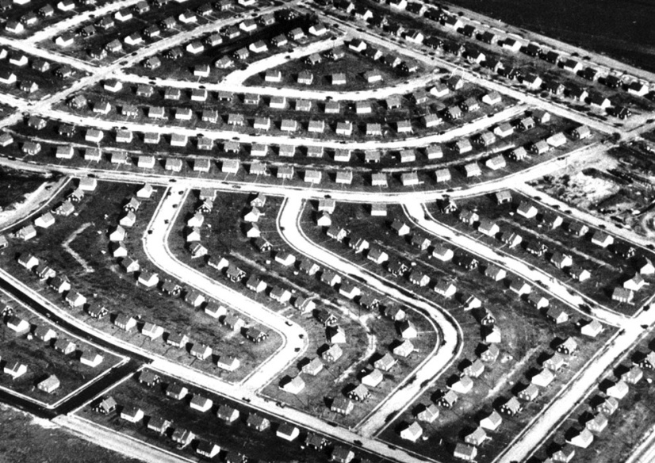


Slide 16
“Tranquilized” America
In the 1950s the USA are literally “tranquilized.” In a letter, poet Robert Lowell uses the expression “tranquilized Fifties,” but it is not only a metaphor: especially women, secluded in their “dream houses,” feel that they are somehow living in a nightmare, and become massively dependent on tranquilizers…

Slide 17
The Cold War
In the 1950s the USA are involved in the Cold War, the ideological, political economic and cultural conflict between the Western “liberal” world and the Communist bloc dominated by the USSR. The Commission for Anti-American Activities chaired by Senator Joseph McCarthy persecutes anyone suspected of Communist sympathies in a new Witch Hunt. In 1953 Julius and Ethel Rosenberg, accused of espionage for the USSR, are executed. In 1961 the Soviet Union builds the Berlin Wall, to separate the “communist” section from those controlled by the Western countries, and anti-Castro forces try and fail a coup d’état in Cuba. In 1962 the Cuban missile crisis brings the world on the verge of a nuclear war, finally averted after frantic diplomatic efforts. In 1947 the Bulletin of the Atomic Scientists begins to monitor the Doomsday Clock, that measures the time remaining before the end of the world…

Slide 18
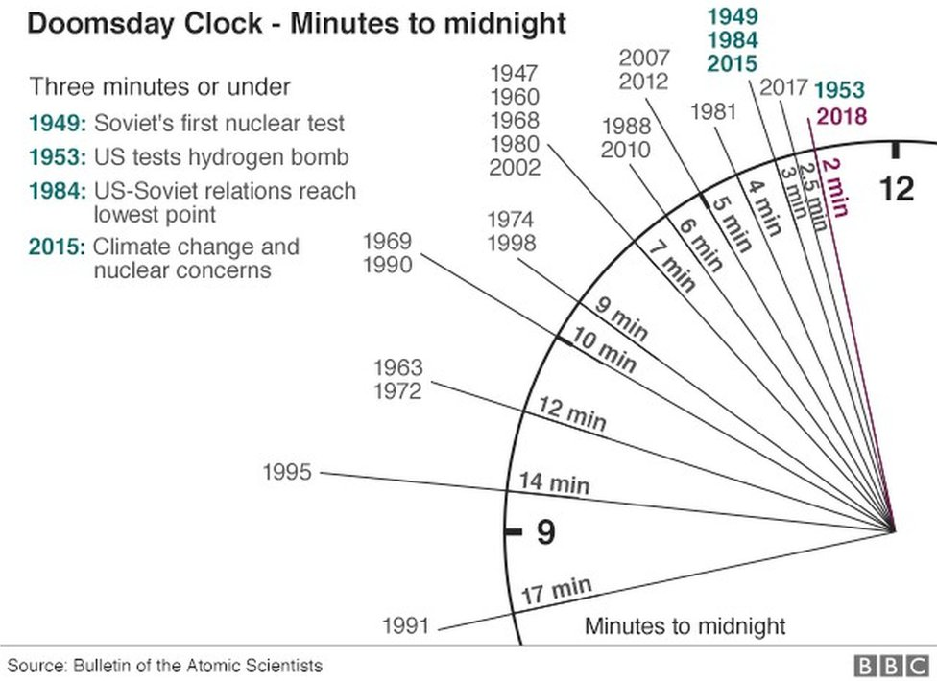

Slide 19
The (Brief) Kennedy Era
In 1960 John Fitzgerald Kennedy is elected US President and inaugurates a new “era,” characterized by faith in the future and the target of reaching and overcoming a New Frontier that is the final sum of a series of frontiers – social and economic, cultural, racial, and even space frontiers (the space race becomes one of the ways the Cold War is fought without weapons). On 11.23.1963 Kennedy is murdered in Dallas, opening an era of major political killings – in 1965 Malcolm X is assassinated, followed by John’s brother, Bob Kennedy, and Martin Luther King in 1968.

Slide 20
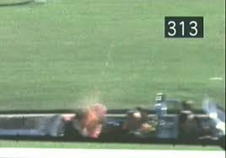
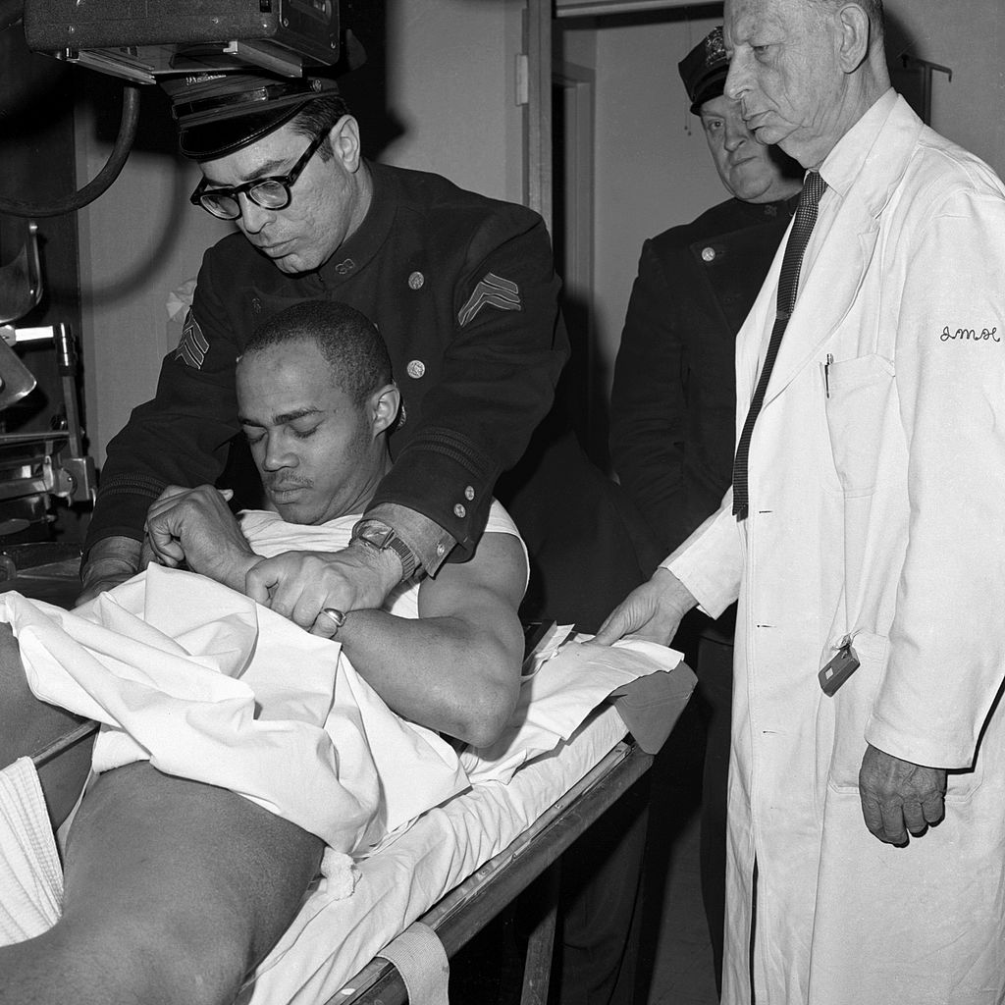
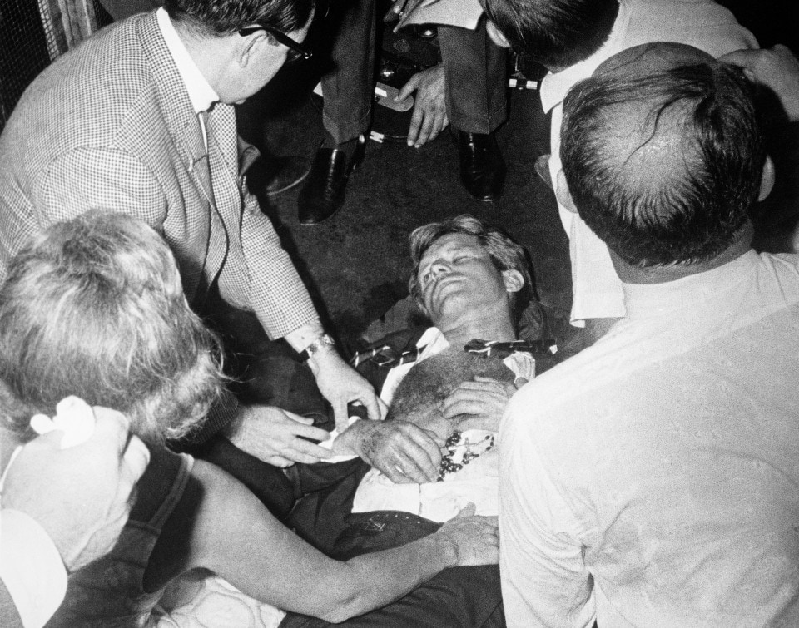
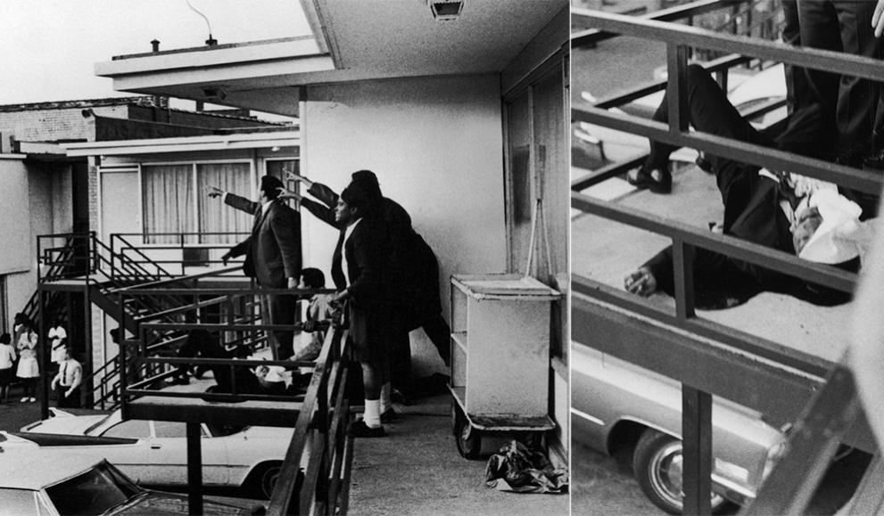

Slide 21
The Civil Rights Movement
The 1950s are “tranquilized,” but they are not quiet. In this period the feminist movement gains a relevance that will explode in the Sixties, and African Americans and other “ethnic minorities” start to vindicate their rights with a mass movement officially born on the day Rosa Parks refuses to give up her bus seat in the section reserved to whites, in 1955. The main leaders of the movement, Martin Luther King, Jr., and Robert Lewis, launch a vast non-violent protest campaign, which culminates with the 1963 March on Washington, where King delivers his famous “I Have a Dream” speech. More radical is the activism of Malcolm X, of the Nation of Islam, and of the Black Panthers. Starting from the mid-1960s these stuggles manage to dismantle much of segregation and many other racial discriminations.

Slide 22
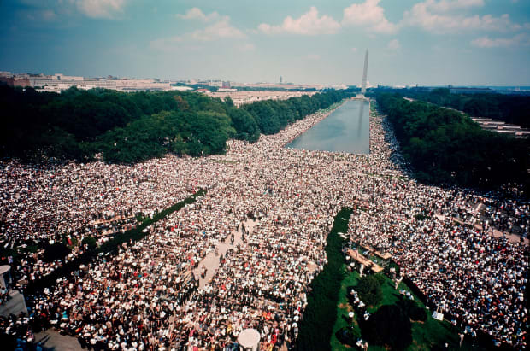
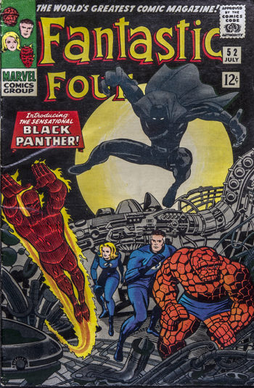
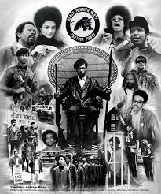

Slide 23
The Vietnam War
The Vietnam war breaks in 1955. In 1956 the elections that should have pacified the country, and would have presumably seen the victory of the Communist party, are boycotted under the pressure of the USA. President Kennedy increases the American involvement in the war, which further escalates under Lyndon B. Johnson, after the Tonkin Gulf incident (1964). At the beginning of 1968 the Têt Offensive turns the tide of the war in favor of North Vietnam. The War will end with the Communist victory in 1975, and the flight of the last officers of the US Embassy from Saigon.

Slide 24
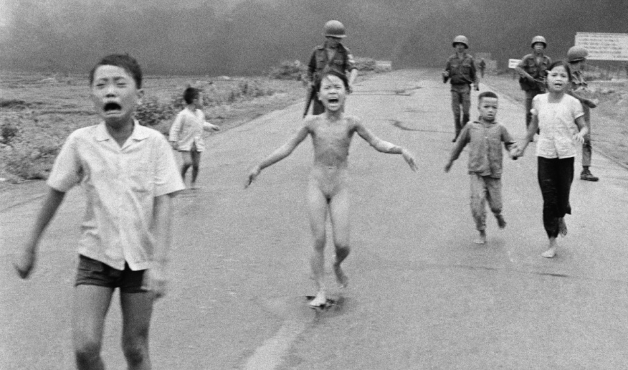
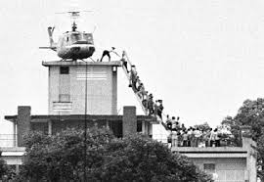

Slide 25
The Peace and Hippie Movements
The American involvement in the Vietnam war causes the reaction of the Peace Movement, which sees for the first time in history a huge participation of youth on the political and social scene with the so-called counterculture, based on the values of peace, equality, the return to nature and the breaking down of bourgeois morality (culminating with the 1967 Summer of Love and the 1969 Woodstock musical festival). The Hippies promote a totally free and unconventional behavior, and the refusal to adhere to the rules of “decency,” also as regards fashion, hairstyles and the consumption of drugs.

Slide 26
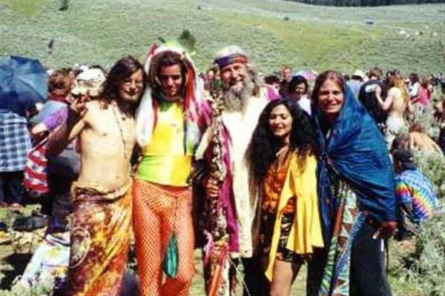

Slide 27
Postmodern literature
In the 1950s and especially in the 1960s literature becomes “postmodern.” Instead of projecting a more truthful image of reality than the one constructed by mass media, Postmodernism exasperates artificiality, openly revealing its non-naturalness, and turns it into a virtual reality not anchored anymore to the “true” reality, which is considered as irrelevant, or even non-existing. The space of the (literary, artistic, cinematic…) text becomes the only “real” space…

Slide 28
Postmodern pastiche
Pastiche:
  French term, derived from the Italiano pasticcio.
  It denotes a technique which “pastes” heterogenous elements together, without trying to harmonize them.
  Pastiche is often parodistic.
  It combines different genres and styles to reflect the incomprehensible chaos of “hyperreality” (a hyperbolic representation of reality which looks more “real” that the “real” itself).
  It questions the existence of “reality,” substituted the endless play of images produced by global communication.

Slide 29
Distortions of space and time
Postmodernism brings to its most extreme consequences the rupture in the orders of time and space introduced by Modernism, but rather than translating it into the ironical but also tragic forms of Joyce or Eliot, it uses it to promote a sort of “euphoric irresponsibility” toward the “external” world.

Slide 30
Postmodern identities
Modern identities: stable; based on social class, gender, race, religion and nationality, considered as non-equivocal concepts.
Postmodern identities: mobile; negotiated on an individual level, based on the intersections of also other factors (sexuality, education, consumption, lifestyle, ability/disability).

Slide 31
Hybrid identities
Postmodern identities: continually changing outcome of never-ending processes of combination of different types of identity, resulting in hybrid subjectivities, determined both by external factors (globalization, growing influence of mass media) and the individuals’ free choices, who “perform” the roles they deem fittest to this or that “environment.”
Transnational identities: migrant identities which overlap one with the other (and with the identities considered as “standard” by mainstream culture).

Slide 32
Back to the roots
Reactions against postmodern “hybridity” and “fluidity”:
entrenchment around “traditional” (ethnic, religious, gender) values, with a specific stress on nationality and locality;
retrieval and valorization of “forgotten pasts” by minorities who do not want to be “melted” in the postmodern and delocalized cauldron, that pretends not to have hegemonic aims, but can be also considered as the “cultural formation” of the new global elites, where all the other differences are at the same time valorized and defused by the only real “dominant” value – money (that is, class).

