Slide 1
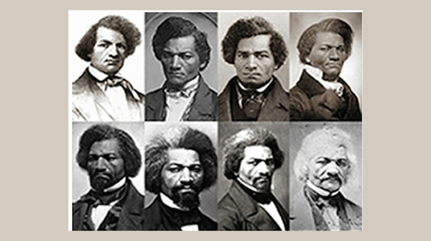
THE NARRATIVE OF
FREDERICK DOUGLASS

Slide 2
AN INITIATION TO FREEDOM
The African Americans’ reactions to the experience of slavery took many forms, and the most radical one, besides open collective revolt, was the individual flight to freedom. The decision of making the (very dangerous) attempt to run away was part of another three-stage process, which reversed the reversed initiation process brought about by enslavement:
the rising of the awareness of being a slave (that is, non-human) – it was a traumatic separation from a former, infantile, “innocent” self
the coming to the determination of breaking free, built up after a series of tests and trials that make the reality of slavery unbearable
the final flight, which ends with the achievement of freedom and the birth of a new identity
Almost all the texts produced by African Americans before and immediately after the Civil War and the abolition of slavery are autobiographical accounts of the experience of slavery and of the liberation from it.

Slide 3
THE SLAVE NARRATIVE
The (emerging) “cultural formation” which expressed the ambitions and hopes of the African American community was therefore the genre of the slave narrative, with three main typologies:
the “as told-to” narrative, that is a story written by someone who re-elaborates the (sometimes written) memories of a former slave, who is officially the author of the autobiography, like in the case of Twelve Years a Slave (1853) by Solomon Northup, mostly written by a white ghostwriter, David Wilson
the autobiography “narrated by himself/herself,” in which the protagonist (almost always illiterate) orally tells his/her story to an editor who writes it down and publishes it (as in the case of more than 2,000 interviews to the last former slaves collected in 1936-1938 by the Federal Writers Project)
the “real” autobiography, “written by himself/herself”, like Frederick Douglass’s

Slide 4
A HYBRID FORM
The slave narratives are hybrid forms which mix different narrative modalities:
the fundamental model is that of Benjamin Franklin’s Autobiography, especially as regards the will to acquire freedom and independence and the rationality of the means to this end
the most used value system is that of the Bible, through which the author “typologically” interprets African American slavery as the “antitype” of the bondage of the Chosen people in Egypt and Babylon
abolitionist literature furnished the ideological framework
the rhetoric is often indebted to the style of Puritan conversion narratives, also to win the favor of the reading public, mostly composed of white men who had to be persuaded to back the abolitionist movement
the narrative structure is basically that of the captivity narrative, like Rowlandson’s Narrative – but with the inversion of roles between “savage” and “civilized” (the true savages are the white slaveowners)
The most important slave narratives (besides Douglass’s) are The Interesting Narrative and the Life of “Olaudah Equiano” or Gustavus Vassa, the African (1789), Life of William Grimes, the Runaway Slave (1825), Narrative of William Wells Brown, a Fugitive Slave (1847), and Incidents in the Life of a Slave Girl by Harriet Jacobs (1861).

Slide 5
MODELS OF IDENTITY
Like Franklin’s Autobiography, slave narratives build up models of representative men (and women). Differently from Franklin’s, these autobiographical models do not call the reader to imitate them, because the audience is mostly white and most blacks were illiterate.
With the utmost awareness of what they are doing, the authors of slave narratives “invent” their narrative selves with the aim of demonstrating that their “humanity” is equal to the whites’, and that it is precisely the negation of this common humanity which de-humanizes whites.

Slide 6
THE INFLUENCE OF
SLAVE NARRATIVES
  Slave narratives will become models for some of the masterworks of American literature, like Harriet Beecher Stowe’s Uncle Tom’s Cabin (1852), Mark Twain’s The Adventures of Huckleberry Finn (1884), Octavia Butler’s Kindred (1979) and Toni Morrison’s Beloved (1987). Kindred and Beloved are neo-slave narratives, fictional texts which aim at recovering the memory of slavery after the disappearance of the last former slaves.

Slide 7
FREDERICK DOUGLASS
Frederick Augustus Bailey was born in February 1818, son of a white man and Harriet Bailey, a slave of African and Narive American descent). During slavery he learned to read and write, despite his master’s prohibition, and studied oratory. He escaped from slavery in 1838. In 1841 he delivered his first speech at the Massachusetts Anti-Slavery Society. He published three editions of his autobiography: Narrative of the Life of Frederick Douglass, an American Slave (1845), My Bondage and My Freedom (1855) and Life and Times of Frederick Douglass (1881).
He was a leading figure not only in the abolitionist movement: he participated in the writing of the Declaration of Sentiments at the Seneca Falls Women’s Convention (1848), collaborated with Abraham Lincoln, was consul to Haiti.

Slide 8
THE STRUCTURE OF THE NARRATIVE
Douglass’s first autobiography is made of two parts: the first part is an account of the experience of slavery; the second tells the story of his flight towards freedom.
First part: Douglass uses his own experience of slavery to highlight the horrors and aberrations of the so-called “peculiar institution.” He describes the practices the slaveowners used to “de-humanize” slaves, from the fragmentation of African families to the selling of slaves in auctions together with animals, and from bodily punishments to legalized murder. When his master, Thomas Auld, forbids his wife to teach him how to read and write, Douglass understands that education is the strongest weapon in the fight for freedom. Douglass also understands the value of physical resistance: when he stops a slavebreaker who wants to flog him, the latter leaves him alone fearing that the news about his incapacity to control a slave could compromise his authority.

Slide 9
THE STRUCTURE OF THE NARRATIVE (CTD.)
Second part: With a new and more “humane” master, Douglass is allowed to organize a school for slaves. Thanks to the web of relationships he builds up, he manages to set up his flight, to gain his freedom, and to become an abolitionist leader.
The Narrative is therefore a typical African American initiation story: we have the “loss of innocence” (when Douglass a as boy becomes aware he is a slave, and that he is separated from the rest of the human species), the series of trials the protagonist must endure, and the final winning of freedom and even fame.

Slide 10
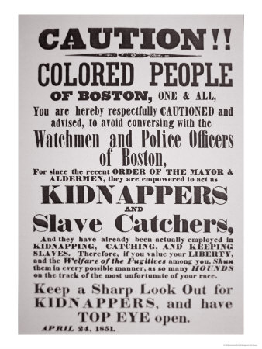
AFTER THE FLIGHT
After running away from the plantation on September 3, 1838, dressed up as a sailor Douglass took a train for the North, where he borrowed papers from a free African American saying that he was free. He then entered the abolitionist movement, and he gradually became one of its most popular orators. His popularity became especially dangerous with the approval of the 1850 Fugitive Slave Act, even if by then he already was a free man.

Slide 11
FREEDOM THROUGH EDUCATION
Many people did not believe that Douglass had been a slave since he had such a good education, and to prove that he really was a runaway slave he wrote his autobiography, which had a good commercial success (5,000 copies were sold within the first four months of its publication, and by 1850 over 30,000 copies had been published). His fame as orator and writer (that he gained thanks to his education) literally turned him into a free man: from 1845 to 1847 he traveled in England and Ireland to promote the abolitionist cause, and thanks to his European friends he raised the sum necessary to legally buy his freedom.

Slide 12
THE UNDERGROUND RAILROAD
Douglass hid escaped slaves at his home in New York and was a part of the Underground Railroad, a secret network of people, routes, and hiding places that helped slaves escape to freedom.
The Underground Railroad operated from 1831 to 1865, and it is estimated it helped between 20,000 to 100,000 people. One of its most active members was Harriet Tubman.
To communicate, members of the Railroad used messages with coded words, such as:
· Promised Land or Canaan: Canada (in the Bible, Canaan was the promised land to which Moses led the Jews out of slavery in Egypt – Tubman was known as the “Moses of her people”);
· station: safe house on the route north;
· freight or cargo: runaway slaves;
· station masters or agents: people who helped hide runaways;
· conductors: people who acted as guides for the runaways
· stockholders: people who donated money, food or transportation to runaways.
They also communicated by means of signals, such as bird calls, special knocks, coded letters and icons.

Slide 13
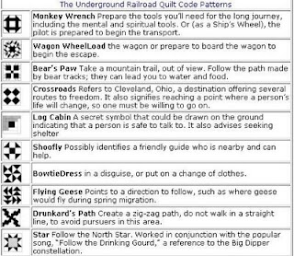

Slide 14
“THE MEANING OF JULY 4TH FOR THE NEGRO”
On July 5, 1852, Douglass gave a speech on Independence Day and asked, “What to the Slave is the Fourth of July?” He acknowledged the Founding Fathers of America for their commitment to “life, liberty and the pursuit of happiness,” but also denunciated the nation’s hypocrisy in celebrating democracy and freedom while nearly four million humans were being kept as slaves.

