Slide 1
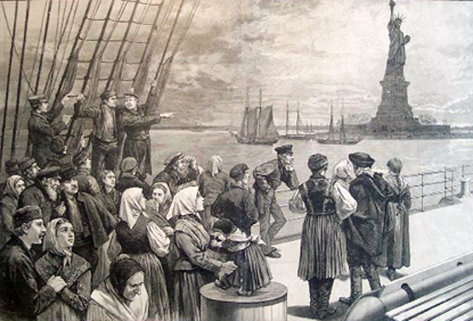
MIGRANT MEN AND WOMEN

Slide 2
THE NEW MIGRATIONS
Up to the Civil War the USA was mainly made of “whites,” plus African Americans (most of them slaves) and Native Americans, who were not considered “citizens.” The ethnic origins of the US population have their roots especially in the British Isles, Scandinavia, France and Germany. Until 1865 the USA was a WASP nation, with a minor presence of Catholics and Jews.
This situation radically changed in the last third of the 19th century, with the great migrations from other regions of Europe and other parts of the world, and the transformation of the USA into a multicultural society.

Slide 3
THE NEW EUROPEAN MIGRANTS
Reasons of the new migrations from Europe:
  poverty
  famines
  peasants expelled from the countryside due to the consolidation of the capitalist system in continental Europe
  religious and political persecutions
Between 1870 and 1920, more that 20 million migrants arrived from Europe, especially from its central, eastern and southern areas.

Slide 4
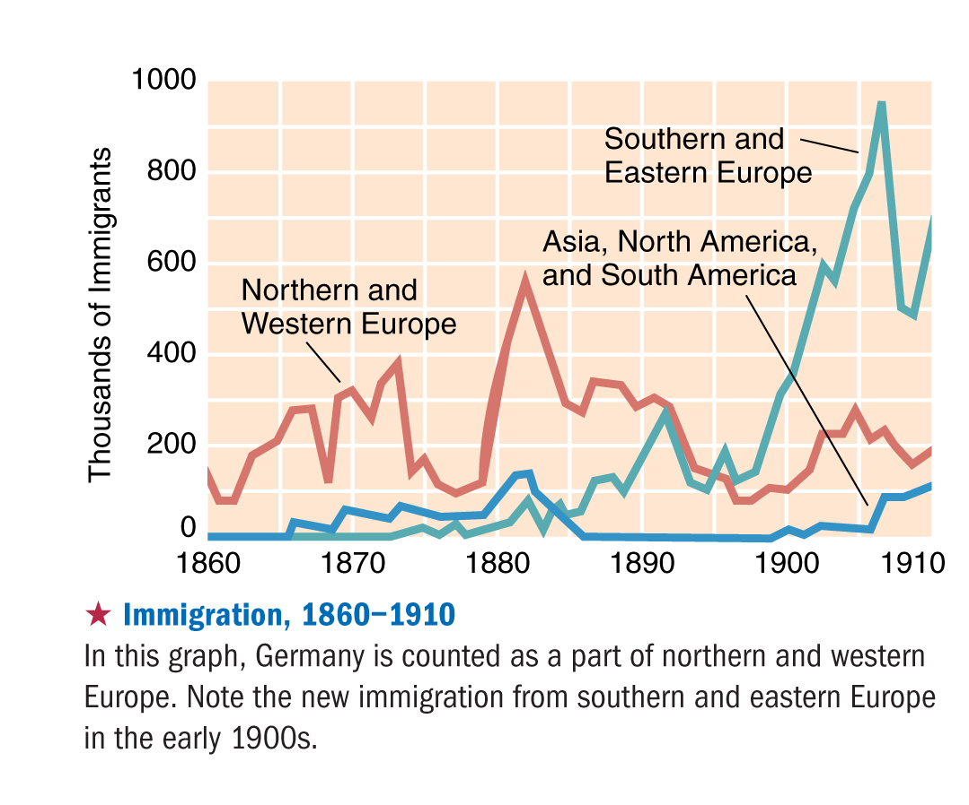

Slide 5
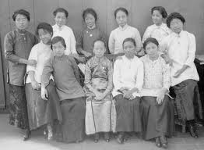
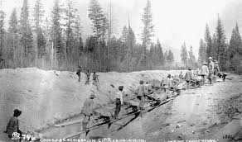
THE MIGRATIONS FROM ASIA
During post-Civil War Reconstruction, more than half a million Chinese and Japanese migrants came to the West Coast to work on the railroads, search gold and create family-owned shops and enterprises.

Slide 6
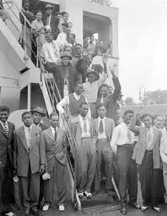
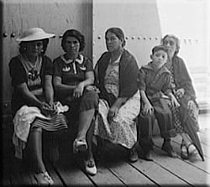
“AMERICAN” MIGRATIONS
In this period, more than 250,000 migrants arrive from the West Indies (the Caribbean) and settle especially in the South-Eastern States.
More than 700,000 Mexicans migrate to the South-Western States.

Slide 7
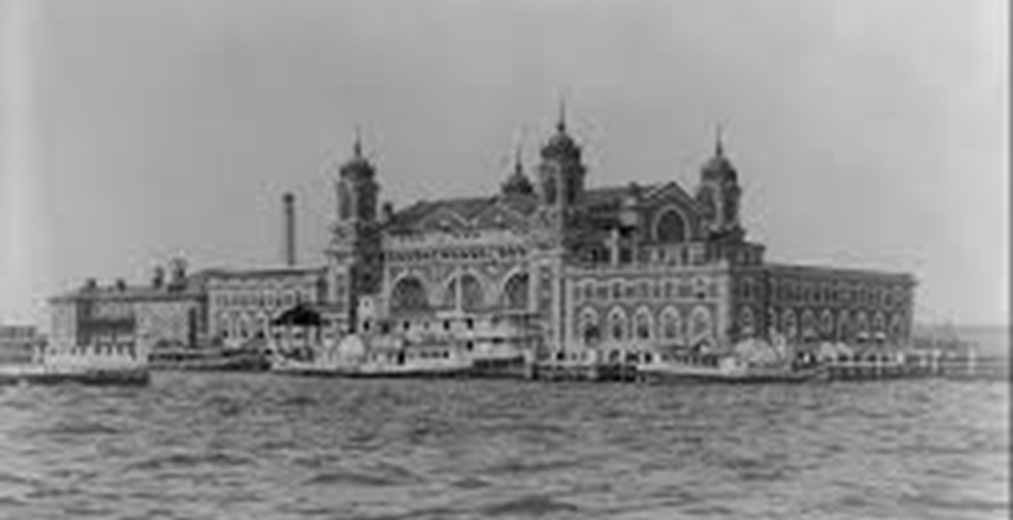
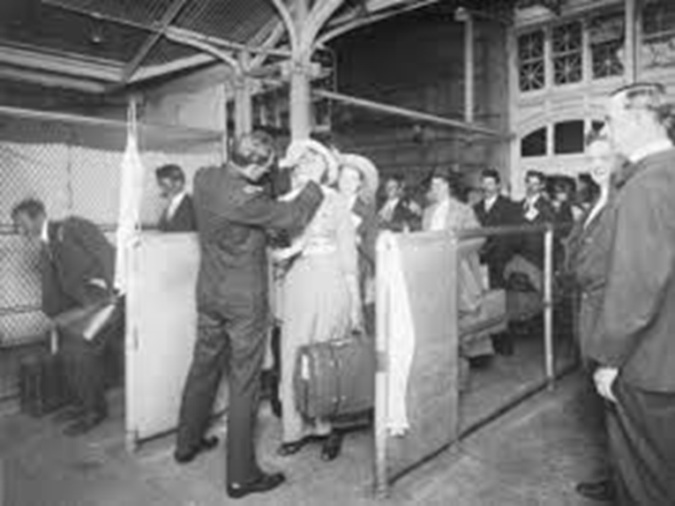
CROSSING THE OCEAN
Europe migrants arrive on steamships: they travel third-class, in suffocating and overcrowded spaces, with little water and food, and exposed to various diseases.
Their port of call is Ellis Island, a few miles from Manhattan, where they are submitted to a number of exams.

Slide 8
THE NEW AMERICANS
Migrants must adapt as soon as possible to the new reality – to a different language, to a new culture, and to new ways of life. They mostly came from rural areas, but they mainly settled in the big cities. They had to totally reinvent their identities, in order to become “Americans.”
At the beginning, migrants tried to converge in homogenous ethnic communities, and find support in various non-governmental institutions, like churches or synagogues, social clubs, mutual benefit societies. An important role was played by newspapers and periodicals in their native languages.

Slide 9
THE “NATIVIST” REACTION
The great migrations triggered xenofophobic reactions in the WASP population. The ideology of the Melting Pot (from the title of Israel Zangwill’s play, 1908), according to which migrants had to give up their cultures and “melt” in the “pot” of American society, also encountered the resistance of those migrants who wanted to preserve their roots. Nativist movements like the Ku Klux Klan stated that foreigners could not fully integrate into the USA and had to be maintained in a subordinate position. The Nativists’ hostility was especially against Asians, Jews and Italians.

Slide 10
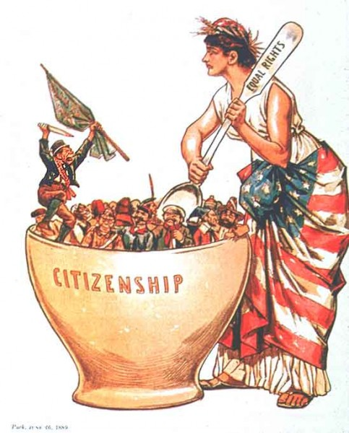
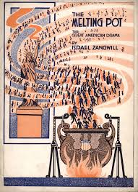

Slide 11
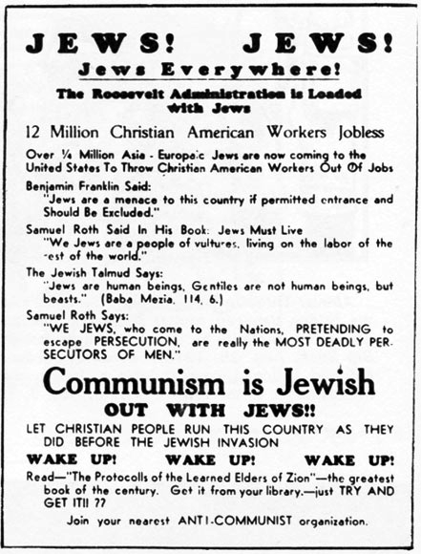
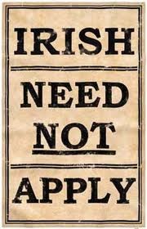
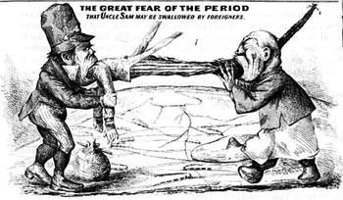

Slide 12
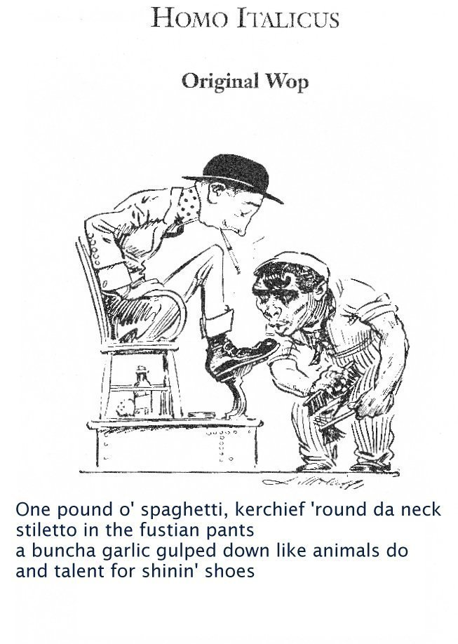
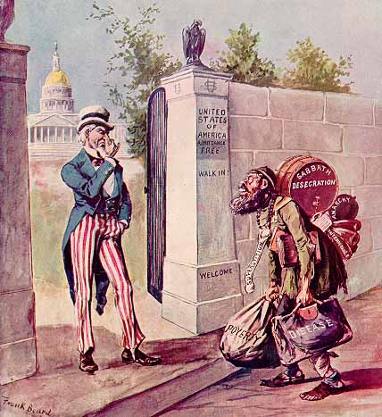

Slide 13
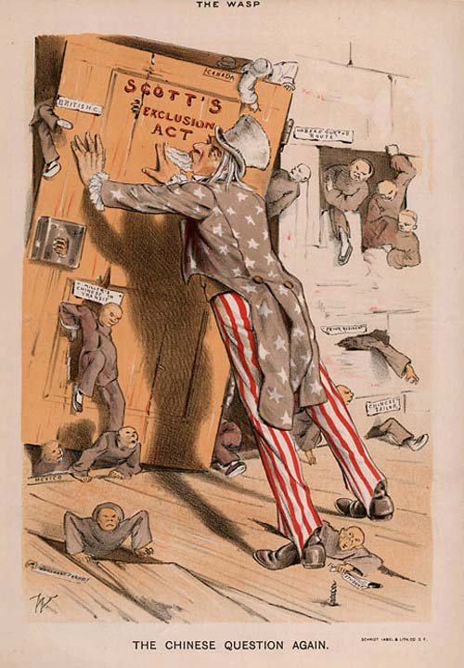
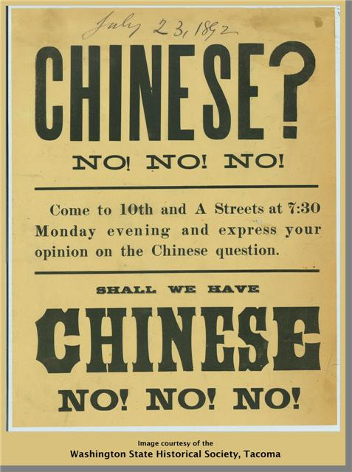

Slide 14
IMMIGRATION AND URBANIZATION
At the end of the 19th century the United States became a predominantly urban society. Most immigrants settled in the big cities, especially in the North-East and the Midwest. In 1910, more than half of the population of the 18 biggest US cities was made of immigrants.
The flux of migrants into the inner cities, where finding work was easier, created overpopulation problems (migrants often lived in tenement houses, big buildings with poor air ventilation and awful hygienic conditions), and pushed the “native” middle and high classes to move to the suburbs.

Slide 15
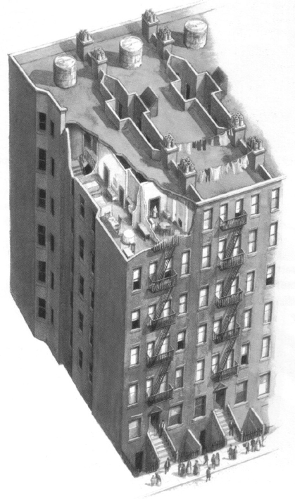
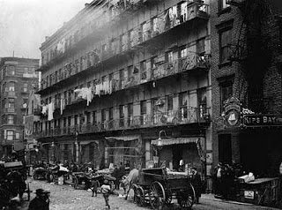

Slide 16
THE POLITICAL MACHINES
Mass migrations also produced a radical transformation of the US political system. The political machines, organized groups of politicians (“bosses”), were formed to control the parties in the big cities thanks to the support and the vote of migrants who were in turn granted work opportunities, health assistance and financial backing.

Slide 17
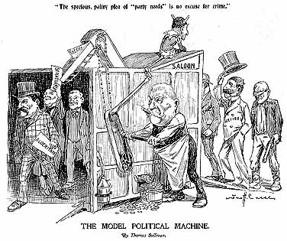

Slide 18
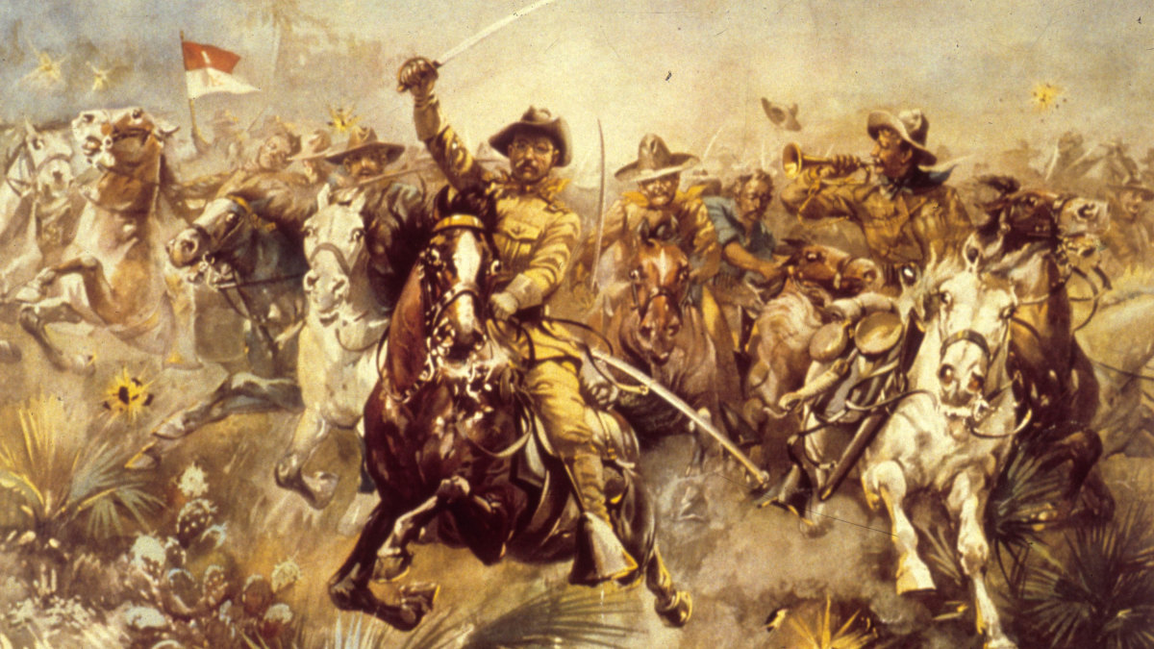
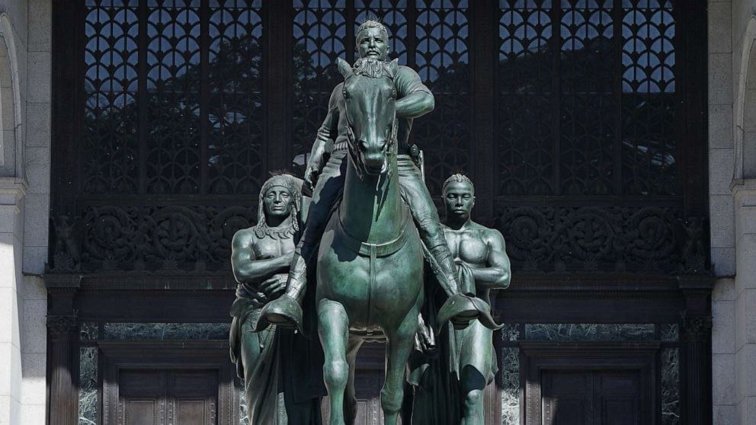
THEODORE ROOSEVELT’S AMERICANISM
Theodore Roosevelt (US President 1901-1909): “There is no room in this country for hyphenated Americanism… The one absolutely certain way of bringing the nation to ruin, of preventing all possibility of its continuing to be a nation at all, would be to permit it to become a tangle of squabbling nationalities.”

Slide 19
RANDOLPH BOURNE AND TRANSNATIONAL AMERICA
The term “transnational” was first used by Randolph Bourne in the article “Trans-National America” (1916). Influenced by Horace Kallen’s “Democracy Versus the Melting-Pot” (1915), Bourne stated that the USA should receive migrants in a “cosmopolitan America,” instead of trying to force them to assimilate in the melting pot of WASP culture. Bourne offered a multicultural vision of American society, starting from the assumption that (almost) all Americans are “foreign-born or the descendants of foreign-born.” Transnationalism has subsequently come to indicate the complex of connections and interactions linking individuals, communities and institutions across national borders, and also constituting the inherently “multiple” identities of the individual subjects.

Slide 20
THE JEWISH AMERICAN DIASPORA
One of the most numerous and influential late 19th-century migrations to the USA was that of the Jews coming from Central and Eastern Europe, especially from the Austrian Empire (mainly for economic reasons) and Czarist Russia (mainly running away from religious persecutions, deportations and even mass massacres). Although also in the USA the Jews must face intolerance and discrimination, their situation was nonetheless much better than in Europe. The myth of the Goldene Medine (the “Golden Land,” in yiddish, the German dialect with influences from ancient Hebrew most European Jews spoke and kept on speaking when in America) imagined the New World as the place where Jews could be free to profess their faith and to reach economic well-being.

Slide 21
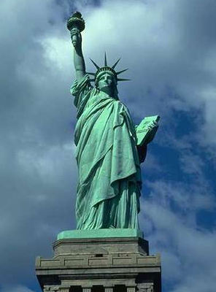
The Statue of Liberty was a present from France to the USA, to celebrate their alliance during the American Revolution, on July 4, 1884. It was inaugurated on October 28, 1886.

Slide 22
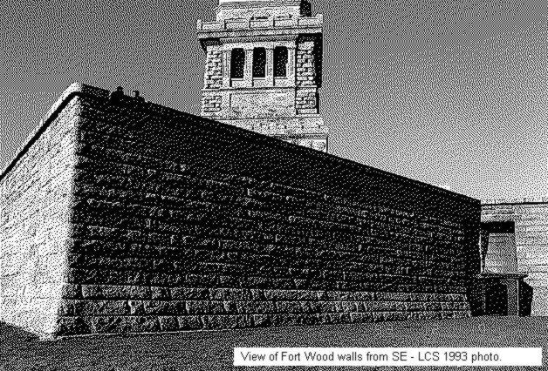
LIBERTY ISLAND
The Statue of Liberty is on Liberty Island, close to Manhattan, near Ellis Island. The Statue “welcomed” migrants entering the USA on the East Coast between 1892 and 1954.

Slide 23
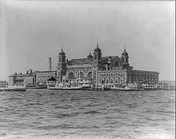
ELLIS ISLAND (1905)

Slide 24
EMMA LAZARUS,
“THE NEW COLOSSUS”
Not like the brazen giant of Greek fame,
With conquering limbs astride from land to land;
Here at our sea-washed, sunset gates shall stand
A mighty woman with a torch, whose flame
Is the imprisoned lightning, and her name
Mother of Exiles. From her beacon-hand
Glows world-wide welcome; her mild eyes command
The air-bridged harbor that twin cities frame.
“Keep, ancient lands, your storied pomp!” cries she
With silent lips. “Give me your tired, your poor,
Your huddled masses yearning to breathe free,
The wretched refuse of your teeming shore.
Send these, the homeless, tempest-tossed to me,
I lift my lamp beside the golden door!”

Slide 25
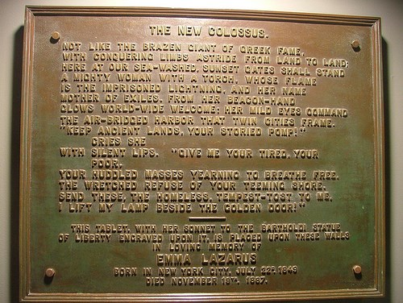

Slide 26
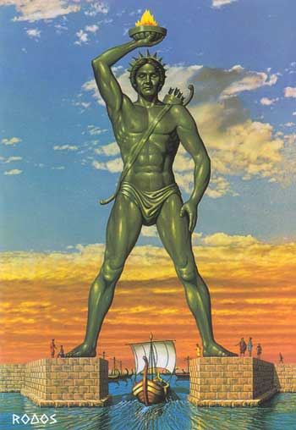
WHY A “NEW” COLOSSUS
In the sonnet, Lazarus juxtaposes the new symbol of the USA to one of the Seven Wonders of the Ancient World, the Rhodes Colossus, symbol of (male) power, built to celebrate the victory against the Macedonians and set according to the testimonies at the entrance of Rhodes harbor (or more likely in its acropolis).
The designer of the Statue of Liberty, Frédéric Auguste Bartholdi, with the collaboration of Gustave Eiffel, uses the Colossus as a model, and his intention is to turn the Statue into an instrument of political propaganda for France as emblem of democracy and freedom to the European countries still fighting for independence.
Emma Lazarus modifies this perspective by turning Lady Liberty into a maternal figure welcoming in her American arms the migrants who have left their own motherland.
These migrants, poor and marginalized in Europe, will become the new “wealth” of America.

