Slide 1

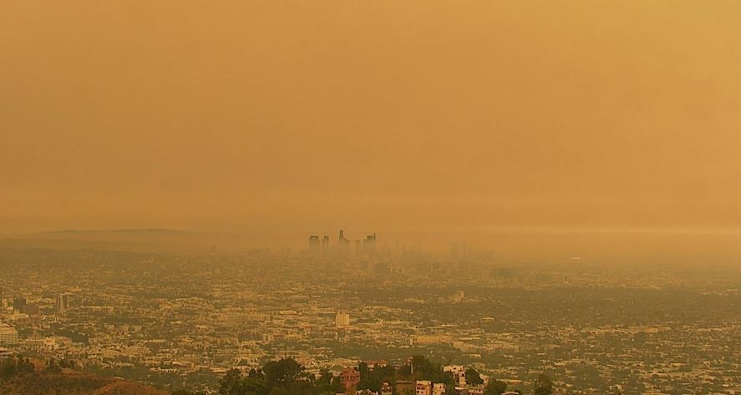
JOHN FANTE, ASK THE DUST

Slide 2
ITALIAN AMERICAN MIGRATIONS
Italian diaspora: largest in documented history up to the 20th century (about 30 million migrants).
2000: More than 15 million people in the United States identified themselves as Italian Americans – 6% of the US population, and the nation’s fourth largest European ancestry group.
1990 to 2000: a rise of 1 million in US citizens who claimed Italian ancestry.

Slide 3
THE FIRST MIGRATIONS
Christopher Columbus (probably Genoese), Giovanni Caboto, Giovanni da Verrazzano, Amerigo Vespucci.
After the American Revolution, skilled artisans, painters, sculptors, musicians, mainly from Northern Italy.
Failure of Italian revolutions until 1860 → small flow of political refugees (Giuseppe Garibaldi).
Second third of the century: entertainers, tradesmen, shopkeepers, artisans, and peasants.
Up to the last quarter of the century: majority of Italian migrants from Northern Italy (Venetia, Friuli, Lombardy and Piedmont).

Slide 4
THE MASS MIGRATION
1880-1915: about four/five million Italians migrated to the United States (almost 70% from the South) – 10% of the total of foreign migrants to the USA.
Often temporary migrants (“sojourners”) in search of immediate employment, maximum savings, and quick repatriation.
Mostly young, single men who settled in the urban centers.
Within five years, about half of them returned to Italy (“ritornati,” or “birds of passage”).

Slide 5
LOCAL VS NATIONAL IDENTITY
Up to well into the 20th century, most Italian migrants identified much more with their local origins than with their nationality, spoke dialects instead of the standard Italian language, and often organized their communities on the basis of the villages or regions they came from.
The national identity of Italian migrants finally came to the fore because they were identified by the Americans as “Eyetalians.”

Slide 6
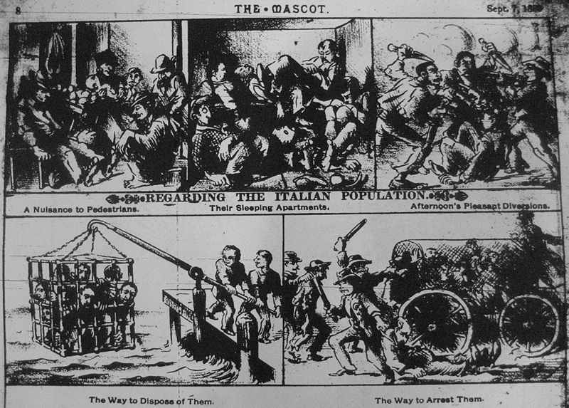
INTO THE MELTING POT
Italian migrants were required to immediately integrate into the American “Melting Pot.”
Italian migrants’ “resistance” to assimilation (religion, centrality of the family, musical tradition, food,) vs. xenophobic reaction of the “Nativist” movement.

Slide 7
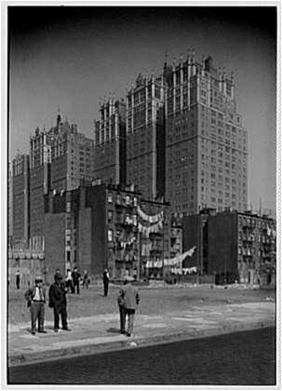
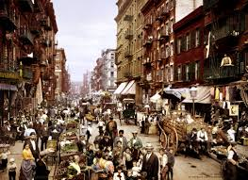
LIVING IN THE “LITTLE ITALYS”
Many Italian migrants settled in the centers of the major cities, where they tried to recreate the “Italian” space → “Little Italys.”
They often lived in buildings abandoned by middle-class residents which became “tenements,” soon called “slums.”
The heart of the New York Little Italy was Mulberry Street, in downtown Manhattan.

Slide 8
SUBSTITUTING AFRICAN AMERICANS
Many Italian American did not go to the cities, but tried to use their skills as farmers and peasants in the fields.
In some occasions they were led to believe that they would have owned the land they worked, but they actually became indentured servants (they thought they worked without salary to pay their ownership of the land, but they became rapidly indebted).
In the Southern plantations, they substituted former African American slaves, who after the Emancipation went to the North in search of work in the cities (Great Migration).

Slide 9
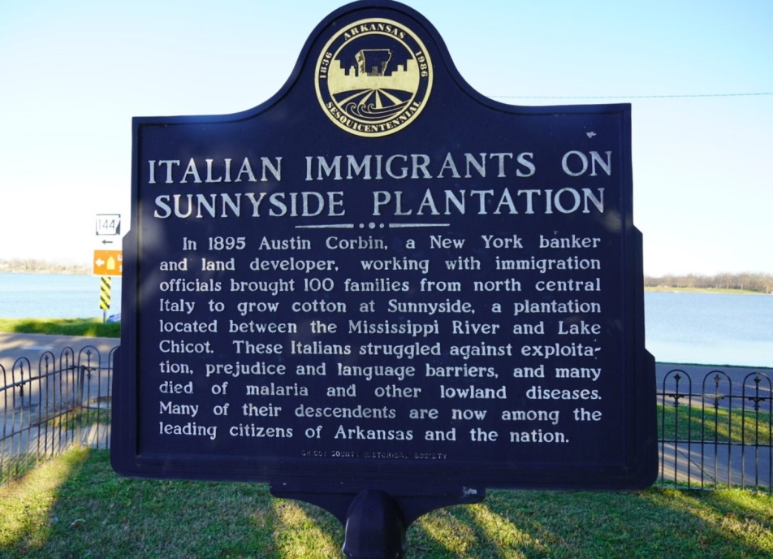
SUNNYSIDE PLANTATION
Sunnyside Plantation: cotton plantation in Arkansas, farmed using the forced labor of African American slaves until the Civil War.
1890s-1910s: immigrants from Northern and especially Eastern Italy came and were subject to peonage, to be later replaced by black sharecroppers.
Prince Emanuele Ruspoli (Mayor of Rome, 1892-1899) sent many peasants from his own plantations in the Marche to Sunnyside, promising them they would soon own the land, but they had to pay back for twenty years.
At the end of the century, a federal prosecution for peonage in Sunnyside was stopped in its tracks.

Slide 10

SWEET HOPE
In 2011, Mary Bucci Bush published Sweet Hope, a historical novel based on the experiences of Bush’s grandmother (born in Senigallia), who worked on the Sunnyside Plantation as a child.

Slide 11
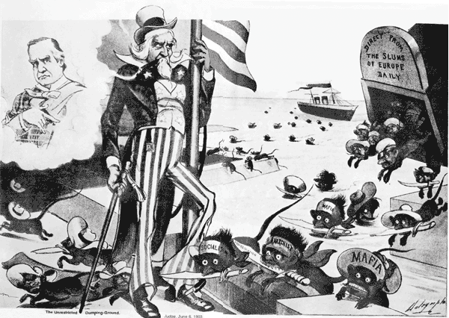
PREJUDICES
Italian migrants had to face the prejudices of dominant WASP culture, which considered them more or less on the same level (also in racial terms) with African Americans (and up to the end of the 19th century many Italians actually substituted former slaves in the Southern plantations).
The flux of migration from Italy gradually waned after World War I, due to the restrictions dictated by the Immigration Acts of 1920 and 1924.

Slide 12
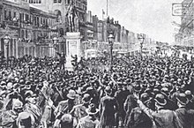
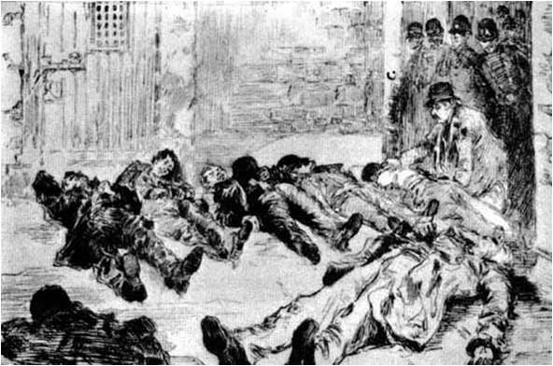
THE ITALIAN AS MAFIOSO
March 14, 1891: New Orleans mass lynching (3,000 to 20,000 participating) of 11 Italian migrants, mostly from Sicily (largest mass lynching in US history), accused of a Mafia killing.

Slide 13
ETHNIC SLURS
Dago (prob. from “Diego,” confusing Italians with Spaniards)
Gumbah (from “cumpa’”)
Greaseball or greaser (used also and above all for Mexicans, employed for Italians because also some of them worked as “greasers” of wagon axles)
Guinea (from the African area many African slaves had come from, thus equating Italians with Blacks)
Terrone or cafone
Wop (from “guappo,” or, according to a popular and probably inaccurate etymology, from the acronym for “with out papers” or “working on pavement”)

Slide 14
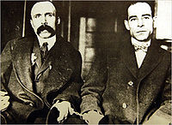
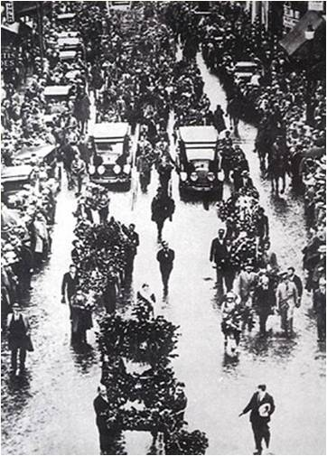
SACCO AND VANZETTI
Anarchists Nicola Sacco and Bartolomeo Vanzetti were arrested in 1920. After a long trial, they were judged guilty of the murder of an accountant and a guard, and executed in 1927, in Boston.
Many famous intellectuals and writers (George Bernard Shaw, Bertrand Russell, Albert Einstein, Dorothy Parker, Edna St. Vincent Millay, John Dewey, John Dos Passos, Upton Sinclair, H.G. Wells, Anatole France e Arturo Giovannitti) campaigned for a revision of the trial.
In 1971 Giuliano Montaldo’s movie Sacco and Vanzetti was a huge success, like the song “Here’s to You” by Ennio Morricone, sung by Joan Baez.
In 1977 Michael Dukakis, Governor of Massachusetts, recognized the errors of the trial and officially rehabilitated the memory of Sacco e Vanzetti.

Slide 15
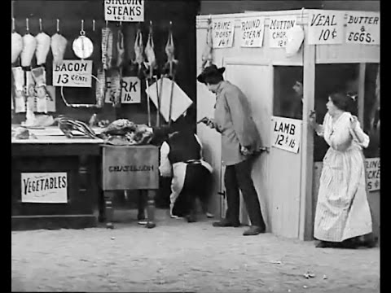

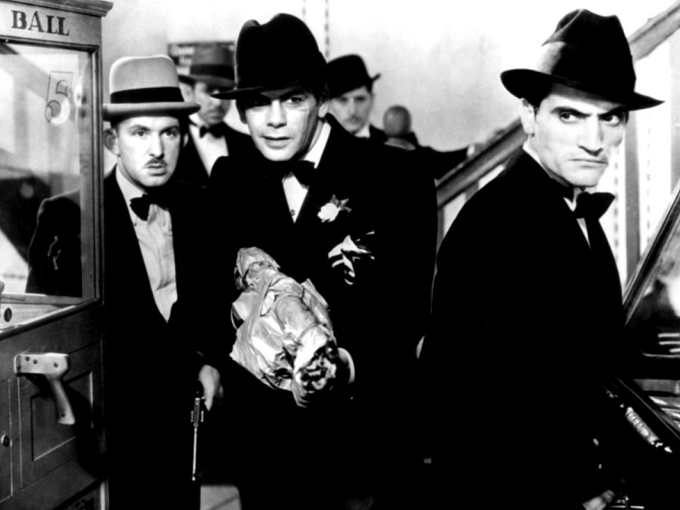
AT THE MOVIES
The first movies about Italian Americans were often about mafiosi, like the silent movies The Black Hand (1906), The Italian Blood (1911) and The Last of the Mafia (1915), and the talking pictures Little Caesar (1931) and Scarface (1932).

Slide 16
THE GREAT DEPRESSION
AND THE NEW DEAL
During the Great Depression, inaugurated in 1929 by the Wall Street stock market crash, many Italian migrants lost their jobs, and also many of the limited conquests they had gained.
With Franklin Delano Roosevelt’s New Deal, many Italian Americans (who had massively voted for Roosevelt) were given federal jobs (especially thanks to the Works Progress Administration and the Civilian Conservation Corp.). They became a leading force in the Democratic Party.

Slide 17
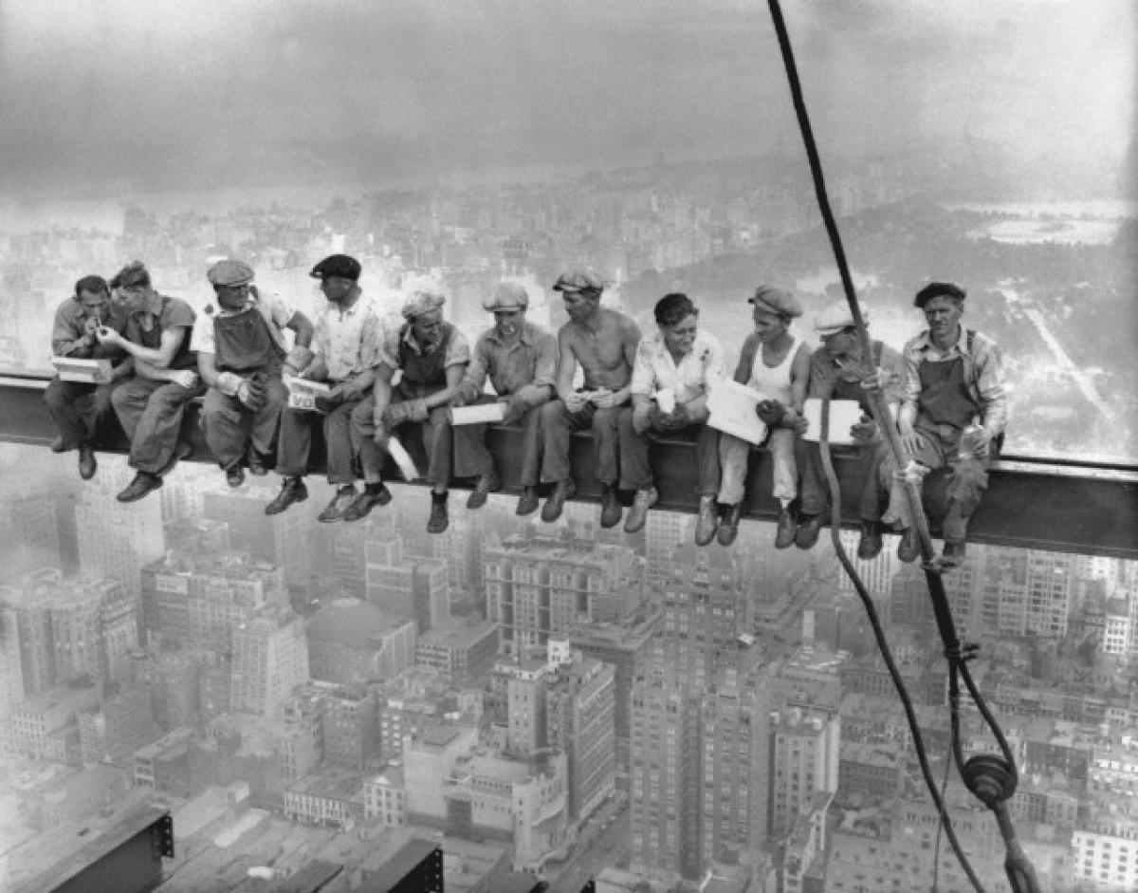
REBUILDING AMERICA
Italian Americans played a major role in literally rebuilding America in the 1930s as bricklayers and construction workers.
The famous photo “Lunch Atop a Skyscraper” (1932) by Charles Ebbets has long been believed to show Italian workers, but almost certainly they are mostly Irish, and maybe there is also a Mohawk.
The fact that this photo could be easily be thought to reproduce Italians suggests how intertwined (and confused, and confusing) the various immigrant (but also Native) identities were…

Slide 18
THE BIRTH OF
ITALIAN AMERICAN LITERATURE
First “official” Italian American work of literature: Peppino (1885) by Luigi Ventura – an example of self-translation, first published in French (Ventura was a teacher of foreign languages) and then in English, but there is also a version written in Italian: Italian American literature starts with an experiment in multiple self-translation…
1890s: Bernardino Ciambelli’s collections of melodramatic tales (I misteri di Mulberry).
1920s: Memoirs and autobiographical fiction (most authors were actually second-generation migrants, who had already made the “ethnic passage” from the Italian working class to a national or even international intelligencija).
“Real” working-class writers: outcasts from their old neighborhoods who still had to gain permanent admittance to the mainstream literary world → “caught in the middle,” located in a precarious in-between state.

Slide 19
LITERARY AUTOBIOGRAPHIES
The first “accepted” and recognized literary autobiographies were those written by “from alien to citizen” writers, as in the cases of sociologist Constantine Panunzio’s The Soul of an Immigrant (1921) and poet Pascal D’Angelo’s Pascal D’Angelo, Son of Italy (1924). But worth mentioning is also Louis Forgione’s Men of Silence (1928), a novelization of the famous Cuocolo murders featuring Joe Petrosino, a forebear of the true crime tradition, and also of the hard-boiled genre, whose invention is usually ascribed to Dashiell Hammett with Red Harvest (1929).

Slide 20
THE COMING OF AGE OF ITALIAN AMERICAN LITERATURE
The first Italian-American literary work to win both critical applause and a national audience was Pietro di Donato’s Christ in Concrete (1939), which was chosen by the Book-of-the-Month Club over John Steinbeck’s The Grapes of Wrath. This epic of the working-class Italian American community, made of bricklayers who physically build the “American Dream” but are excluded from it, subjugated as they are by the raw logic of capitalism, somewhat set the tone for much later Italian American fiction, but not for Jerre Mangione’s set of autobiographical sketches, Mount Allegro (1942), focused on the conviviality of his extended family, on the mystique of the dinner table, and on the art of storytelling while eating. John Fante went a step further by juxtaposing, in Wait until Spring, Bandini (1938) and Ask the Dust (1939), the backdrop of labor, poverty, and prejudice ailing the Italian American community with the individualist drive toward self-affirmation as a “worker of the pen” (or better, of the typewriter) of its protagonist. The most important Italian American poet of the period was the modernist/anarchist Arturo Giovannitti, author of Parole e sangue (1938).

Slide 21
A SHIFTING IDENTITY
Narrator/protagonist of John Fante’s Ask the Dust (1939), Arturo Bandini: a writer trying to cope with his various cultural and ideological identities as an Italian American second-generation migrant.
Bandini = foreign Italian other and nativist American, satirical Marxist and devout, practicing Catholic, would-be chauvinist “conqueror” of women and someone who cannot become a real “violator” of a “racialized” female (who finally escapes him).
Modernist identity in its “performativity” and mobility: even if the various (and inauthentic) selves he embodies might seem to make him an already postmodern figure, he never becomes a “hybrid” character, someone who is the sum and total of all the identities he is made of – he instead “modernistically” plays one role at a time, according to the context he is inscribed in, but always feeling awkwardly out of place, and in more than one occasion this “playing” is unconscious, is simply a reaction to the environment or the situation.

Slide 22
BANDINI’S RACISM
Earlier readers’ focus on how Bandini navigates the space between assimilation and cultural identification vs. more recent critics: emphasis on Bandini’s more or (most likely) less convinced complicity with racist ideology.
Bandini essentializes whiteness, and denigrates people of color and individuals from other diasporic communities such as the Filipina/o community and especially the Chicana/o community.
Arturo Bandini proclaims to be “an outcast incapable of winning true acceptance in an urban society whose vision of white American culture only intermittently includes Italian Americans”; so his own “investment in joining this white society is matched by his disdain for the non-white city residents with whom he is so routinely associated in the eyes of others” (Suzanne Roszak, “Diaspora, Social Protest, and the Unreliable Narrator”).

Slide 23
AN UNRELIABLE NARRATOR
Matthew Elliott, “John Fante’s Ask the Dust and Fictions of Whiteness”: “Arturo’s apparent reconnection with the margins is the emotional crux of his narrative, and is perhaps all the more compelling for its contrast to the earlier moments when he echoes the discriminatory rhetoric once directed at him […]. Arturo Bandini remains an unreliable narrator even at the end of the novel. […] To use Thomas Ferraro’s phrase, Arturo comes to ‘feel Italian’ at the end of the novel, which in his case means identifying with those who suffer from ethnic or racial discrimination as he once did. Yet, such sentiments do not always translate into antihegemonic ideology, and Arturo Bandini provides a case in point for this distinction. Even as he articulates an increasing emotional connection to the margins, his narrative suggests that in fundamental ways he begins to define himself through racial terms that both enable his own assimilation into the mainstream and separate him from the very outsiders of whom he speaks and writes so eloquently.”

Slide 24
A RACIAL REFASHIONING
Elliott: “Ask the Dust is less the story of Arturo Bandini’s ethnic rediscovery than of his racial refashioning. His tale, in fact, provides a compelling illustration of what Matthew Frye Jacobson calls the ‘racial alchemy’ of the melting pot, whereby certain groups assimilate into the mainstream of American culture by becoming white. As several critics have noted, Arturo reflects what whiteness studies scholars have dubbed the ‘in-between’ or ‘middle-ground’ racial status of Italian Americans in the first half of the twentieth century. […] this middle ground marks only the starting point of Arturo’s racial journey in the novel. Beyond the initial efforts to gain acceptance that others have noted, he begins to deeply internalize the idea of his racial whiteness. Yet, in characteristically Fantian fashion, his narrative exposes what he does not admit to himself. It reveals his development of a white consciousness; in the end his outpouring of affection for those on the margins serves as a form of self-deception, protecting him from the knowledge that he has indeed become ‘one of them.’”

Slide 25
BANDINI’S “NEGATIVE EXAMPLE”
Roszak: “I argue that Fante’s novel encourages readers to protest white supremacist logic – and, in particular, racist depictions of Chicana/o culture – in the same way that it encourages us to challenge class hierarchy: via negative example. I also argue that to understand how this occurs, we must consider Bandini as a diasporic character struggling and failing to cope with the intersection of his own diasporic trajectory with those of other displaced individuals – most importantly, the Chicana waitress whose ethnic identity Bandini repeatedly insults and essentializes.” Writing in 2016, Roszak adds: “This is a new approach that previous criticism has not considered in depth.” As a matter of fact, “previous criticism” may have “not considered” this aspect “in depth,” but the author’s ironic representation of Bandini’s racist statements is something which is easily detectable at the very first surface reading of the novel: Bandini is portrayed as a racist (and as an unreliable, narcissistic, judgmental, delusionary character).

Slide 26
A COMPETITION OF DIASPORAS
(AND GENDERS)
Roszak: “In colliding Arturo Bandini with Camilla Lopez, Ask the Dust creates a diasporic triangle that connects Italy and Mexico with Bandini and Camilla’s shared adopted homeland of the United States. Interestingly, rather than modeling the type of solidarity that we might imagine stemming from such a collision, Ask the Dust instead presents us with a cautionary tale of intersecting diasporas: Fante illustrates what occurs when one diasporic community competes for class standing and acceptance into white ‘majority culture’ rather than resisting claims of both white superiority and socioeconomic elitism. Fante’s text is narrated by an often misguided diasporic voice: the voice of a very young man who as often succumbs to classist aspirations and judgments as he resists or battles them, and who as often resorts to stereotyping or bigoted views of other diasporic communities as he denounces such views.” What the text ultimately gives the reader is the depiction of the process through which white dominant culture “absorbs” and defuses potentially subversive stances by diasporic subjects through the competition it creates among them. Italian Americans have just begun to be accepted as “legitimate” members of white society, and therefore they turn back towards members of other diasporas which are still marginalized, in order to prove their own “belonging to the center.” Besides, Bandini systematically stresses not only his whiteness, but also his masculinity, opposite to Camilla’s femininity (that on the other hand often dismantles the stereotypes associated to chicana women).

Slide 27
AN AMERICAN MAN,
BORN IN AMERICA
Roszak: “Of course, if we were to take Fante’s protagonist at his word in some moments, we might not think of his own particular experience as diasporic, as Bandini is a self-professed assimilationist. He repeatedly speaks in ways that suggest that his connections to the diasporic community of Italians living abroad are weaker than his sense of affiliation with US culture and society or with the particular landscape and community of Los Angeles. For instance, Bandini refers to the US as ‘[his] country’ and, in one moment, exclaims, ‘I was an American and goddamn proud of it.’ What’s more, this sense of connection sometimes seems almost physical, geographic – which gives it a profound sense of realness. When he speaks of the ‘dust and sand that blew in from the Mojave and Santa Ana deserts,’ Bandini displays a knowledge of local geography that subtly bespeaks his connection to the land he now inhabits.” Fact is, this is the land he has always inhabited – he is a local, an American-born citizen. As a second-generation migrant, he is actually not an immigrant at all – he has never been physically involved in the diasporic movement for a (certain) space of origin to a space of (uncertain) destination, which is the predicament of every immigrant. And the diaspora he is a (non-diasporic) member of is by now almost not ethnically marked anymore…

Slide 28
A MAN IN-BETWEEN
But the Italian American diaspora in only almost not ethnically marked anymore. Roszak: “Although he is a US-born American citizen, Bandini must cede to the claims of an American who interrogates him about his ethnic background (‘Young man… are you a Mexican?’ the hotel owner asks) and then presumes to know more about his own country than he does, simply because he appears more foreign. The only way that Bandini is able to gain acceptance into the hotel community and avoid being expelled onto the street is to humbly deny what he knows is true about his own hometown [Boulder, which the hotel owner insists is in Nebraska, instead of Colorado…]. Likewise, Bandini recalls painful memories of racial slurs directed at him during his childhood, memories of being called ‘Wop and Dago and Greaser,’ which lead him to proclaim, ‘they hate me and my father, and my father’s father, and they would have my blood and put me down.’ Such moments clearly contribute to Bandini’s impression that he ‘cannot be… fully accepted’ by US society, illustrating an essential element of Bandini’s diasporic identity.” Bandini is still a man in-between, no more an Italian, and not yet completely an American, and all the more hostile towards the members of other diasporas because they could endanger his legitimation (a thing they cannot do, but that dominant ideology persistently insinuates as a possibility, by comparing Italians to Mexicans).

Slide 29
ARTURO’S APPROPRIATION
OF THE (FEMALE) “OTHER”
Elliott: “Often read as a Künstlerroman, the tale of Arturo’s development as a writer certainly begins with a false start at the Alta Loma, where the first words he writes are erased and revised, and the truth of his past is ultimately misrepresented in the register. Thus, when he writes and publishes what he insists are authentic ‘slice out of life’ stories about the marginalized and excluded, based on his experiences with these two women [Camilla and Vera Rivken], he is seen as having matured as both a man and an artist and as having completed an arc of development beginning at the Alta Loma. As Charles Scruggs maintains, though Arturo begins as a ‘wise guy,’ arrogantly pursuing selfish ends at the expense of others, he ends up an ‘honest man’ whose art reflects authentic connections to those on the margins, links that also reconnect him with his own ethnicity and past.” But what he actually manages to do is to become famous as an American (not Italian American writer) thanks to the appropriation of the lives of the two women he claims to have loved…

Slide 30
BECOMING WHITE…
Elliott: “Jennifer Guglielmo has argued that, although upon arriving in the US, Italian immigrants were ‘positioned as white’ and thus allowed to access to a variety of rights and privileges, their ‘sense of identity as white took much longer to form.’ In Ask the Dust , the development of Arturo’s white consciousness takes shape in a gradual way, and is marked by moments of doubt and contradiction, often brought to the surface through his exposure to Camilla’s struggles. But despite these flashes of resistance to the hegemony of whiteness, Arturo never fully rejects that racial worldview. Though at the end of the novel he no longer expresses his dedication to this logic of race in the bombastic way he does earlier, in his internal monologues he remains committed to the fiction of his racial whiteness.”

Slide 31
…OR NOT BECOMING WHITE
Elliott: “In response to the failed promises of whiteness, Arturo turns specifically to his sense of ethnic belonging. But the whiteness of his face has become to him a signifier of ethnicity lost. He sees himself at the end of the novel as one of the ‘uprooted’ – the term he earlier applies to ‘Smith and Parker and Jones,’ who, like Nathanael West’s Angelinos in The Day of the Locust, came to Los Angeles ‘to die in the sun’ – but he perceives his uprootedness in specifically ethnic terms. Indeed, he comes to see his whiteness as a kind of death, as implied by the ‘colors’ that are ‘draining fast’ from his face. […] he yearns for ethnic belonging because he imagines he has lost it, and implies that, though he would rid himself of his whiteness, he is fated to a life ‘white and ghostlike.’ Moreover, his implication contradicts the conscious acts of racial self-fashioning and overt expressions of consent to the racial order described by his narrative.”

Slide 32
WHITE OR NON-WHITE?
Elliott: “Just as he alters his representation of whiteness without disrupting its logic, [Arturo] refigures the meaning of Camilla’s racial otherness while still defining himself against the racial difference he insists she represents. Although she no longer represents difference as alienating, as when he insisted her ‘Mayan’ features appeared ‘too strange’ for him, she becomes in the end an image of racial difference as a romanticized ideal. Thus he continues to see her primarily as the embodiment of an ethnic category; she is still ‘Mayan’ in his eyes, though, as George Guida has noted, her perceived ‘Indianness’ is refigured in his imagination as a preferable ‘alternative’ or escape from assimilation. Such an alternative is not available to him, Arturo insists, but only to Camilla, whom he perceives to be ‘deeper rooted than I.’ While he becomes one of the pale anxious faces of the modern American city, he imagines, she cannot be contained in this way, for she would ‘lay havoc upon any such little as this.’ Instead, she ‘belonged to the rolling hills, the wide deserts, the high mountains.’”
So at the end Camilla goes into the desert, where she probably dies (or not? after all, she belongs there…), finally escaping Arturo’s attempt to “contain” her and her ethnicity, which will remain more “American” that his will ever be...

Slide 33
CAMILLA’S MODERNITY
Roszak: “readers who are paying attention will note that Camilla is neither a fiery sexpot nor a docile girl-child, and that her life and personality are much more contemporary than they are stereotypically pre-Columbian. Camilla chooses decidedly modern insults when she first expresses her hatred for Bandini: ‘I hope you die of heart failure,’ she says with near-medical precision. Likewise, in happier moments, Camilla drives Bandini around town with her foot dangling out the window and her leg exposed, shouting that the men who catcall her ‘ought to mind their own business.’ While Camilla is passionate, she uses that passion to defend a strikingly contemporary view of gender relations; she rejects the conventional wisdom that (especially non-white) women’s bodies are objects for men to visually consume, scoffing at Bandini’s suggestion that she should cover herself up to avoid unwanted attention. Finally, while Bandini imagines Camilla as a ‘princess’ in a ‘castle,’ the reality is that Camilla lives in an unrelentingly modern apartment.”

