Slide 1
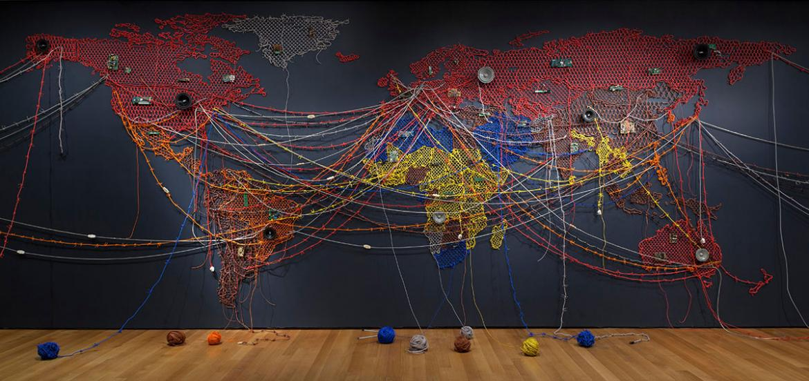
MIGRATIONS:
CROSSINGS AND INTERSECTIONS

Slide 2
Intersectionality (also called intersectional feminism)= branch of feminism asserting that all aspects of social, political, and also personal identities – of course starting from gender but including also race, class, sexuality, disability, etc. – “intersect.”
Term coined by black feminist scholar Kimberlé Williams Crenshaw in 1989.
Purpose of intersectionality = identify how different forms of discrimination are related to one another, but also how different forms of resistance to oppression and of affirmation of identity can intersect and each reinforce the other(s).
We will use “intersectionality” as a 360°concept, as a way of defining all the complicated and contradictory tensions that converge and interact inside individual and collective identities. In some sense this could even involve the fact that being, for example, a migrant non-white woman does not inevitably entails only a fate of marginalization and exploitation, but can also mean the possibility of having a wider range of opportunities to fully realize her aspirations.
AN INTERSECTIONAL APPROACH

Slide 3
INTERSECTIONAL COALITIONS
Intersectionality may and must mean also the conscious activation of systems of solidarity and collaboration crossing the allegedly fixed and stable boundaries that aim at defining and distinguishing the various identities as if they were something totally distinct and isolated. As Anna Carastathis suggests, “reconceptualizing identities as coalitions enables us not only to form alliances across lines of experiential and political difference but also to constitute ‘coalitions of one’ where one is aligned with all aspects of one’s identity, particularly those that one has been encouraged to repress or deny.” These forms of “intersectional alliances” are of course particularly relevant for migrant subjects.

Slide 4
A NEW CONCEPT OF IDENTITY
This course will analyze a series of texts of American literature and culture where migrant identities are represented in their intersection with – especially but not only – the gender dimension, by highlighting the inextricable intersections of the various aspects of individual and collective identities (a term we should question, since intersection somehow deconstructs the notion of “identity” itself, that is of being one self and one self only). Carastathis: “Intersectionality-as-challenge urges us to grapple with and overcome our entrenched perceptual-cognitive habits of essentialism, categorial purity, and segregation.”

Slide 5
INTERSECTIONALITY AS AN ANALYTIC TOOL
Intersectionality will be for us a perspective that should enable us to better understand how the multiple dynamics and stratifications of the dimensions of individual and collective “identities” are represented in literary and cultural texts – and in most cases this will also mean that the representation of intersectionality as a social and cultural reality is also a critique of the intersecting systems of oppression which dominate American life (like in any other nation, society, culture, although in a number of different ways…), specifically as regards the condition of migrant subjects and their gendered identities.
We will therefore try to use the concept in a more “complex” way, as the concept itself developed from a more “simple” paradigm, variously named as “double jeopardy” (referring to dimensions of race and gender) “triple jeopardy” (adding social class), “interlocking oppressions,” and more recently and less simplistically “multiple jeopardy” and “matrix of domination.”

Slide 6
INTERSECTIONALITY AND MIGRATIONS
In the migrant experience intersectionality is a feature that is even more prominent that in other more “stable” subject positions.
First, any migrant must necessarily “intersect” his/her “original” national or local identity with the national or local social and cultural configurations of the “new” place s/he is living in.
Second, since every subject position is inherently intersectional, the subjectivity of a migrant individual or community is doubly so, because the two “intersectionalities” (the “original” one and that of the “new world”) cross one another – come into conflict, open a dialogue, negotiate and find ways to intermingle, choose to entrench themselves in fictions of non-contamination with the other, and so on.
Third, migrant subjectivity is eminently mobile – this means that its “intersections” are mobile too, changing with the different situations the migrants come to inhabit.

Slide 7
THE SYSTEM OF RACE
In the migrant experience, more often that not the dimension of “race” is central.
Race: a socially constructed concept, aimed at differentiating ethnic groups according to their physical features – no real scientific foundation.
Racism: prejudice, discrimination, or antagonism directed against a person or people according to their belonging to a given racial or ethnic group (usually a minority).
Structural/systemic racism: discrimination and marginalization by social, economic, legal and educational institutions.
The trauma of racism: the cumulative adverse emotional, psychological, health, economic and social effects of racism on the lives of “people of color.”
Ethnicity: system of shared cultural, linguistic and religious features. Ethnic groups tend to share a homeland, a cultural heritage, a language, a religion, a mythology, ritual systems, food habits, dressing styles, and also some general physical appearance.

Slide 8
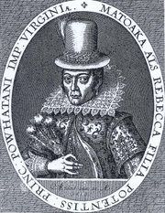
THE BIRTH OF THE BRITISH COLONIZATION
OF AMERICA/OF RACISM (AND OF GENDERED CONCEPTUALIZATIONS OF AMERICA)
1607: establishment of the Colony of Virginia (capital: Jamestown), first permanent British settlement in North America
The name of the colony comes from the “Virgin Queen,” Elizabeth I, but also hints at the idea that America was a “virgin” (and “female”) land
Conflicts with the Natives (but also collaboration)
John Smith captured by the Powhatan tribe; Pocahontas (born Amonute, a.k.a. Matoaka) “saves” Smith
1614: John Rolfe marries Pocahontas (renamed “Rebecca”) and brings her to England → improvement of European-Native relations
1619: twenty African “servants” arrive in Virginia
1636-38: Pequot War, ending with the extermination of the Indian tribe (first American genocide)
The exploitation of the Natives’ lands and of “free” Black labor needs an ideological justification → birth of modern racism, which postulates the existence of superior (white) and inferior (colored) races

Slide 9
THE ECONOMIC ORIGINS
OF MODERN RACISM
W.E.B. Du Bois: Capitalism has an inherent “slavery character” → racism=product of the rising capitalist system.
Oliver Cromwell Cox: “The slave trade was simply a way of recruiting labor for the purpose of exploiting the great natural resources of America. This trade did not develop because Indians and Negroes were red and black […] but simply because they were the best workers to be found for the heavy labor in the mines and plantations across the Atlantic […].This, then, is the beginning of modern race relations. It was not an abstract, natural, or immemorial feeling of mutual antipathy between groups, but rather a practical exploitative relationship.”
Modern race relations were thus born with a forced mass migration, that of the African slaves to America.

Slide 10
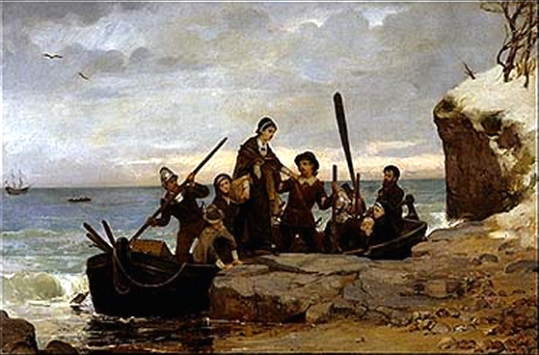
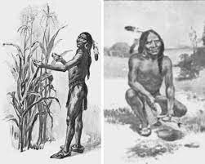
THE PILGRIM FATHERS
Pilgrim Fathers: Puritan Separatists led by William Bradford, who leave Leyden (in the Netherlands) and arrive to Plymouth at the end of 1620
Scarcity of food and diseases → half of the about 120 colonists die in first winter → the Pilgrims survive thanks to the Natives’ help (Tisquantum, or Squanto) and Samoset – the first American Thanksgiving celebrates the Pilgrims’ survival
1675-78: King Philip’s War between the Wampanoags led by Metacom/et (whose father, Massasoit, had been a friend of the Pilgrim Fathers) and the Massachusetts colonists → end of the possibility of Native resistance against white colonization
Birth of Anglo-American culture = migration from Europe + contact/conflict with the Native Americans

Slide 11
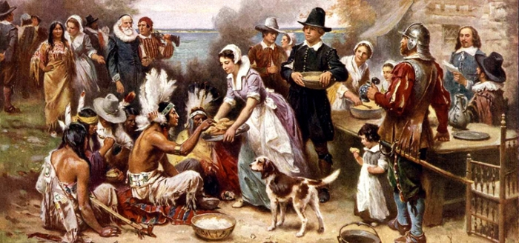
THE FIRST AMERICAN THANKSGIVING

Slide 12
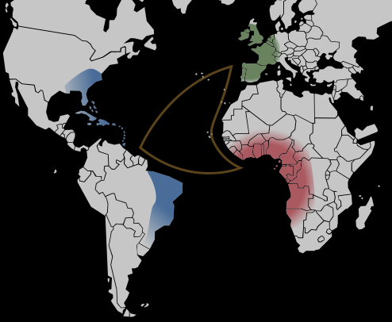
MODERN/AMERICAN SLAVERY
Atlantic slave trade starts in early to mid 1500s, and provides “free” labor to the European colonies in the Americas
1670s: slavery becomes, in the Americas, a legal institution based on race: all slaves are people of color (Natives – but in North America the enslavement of Natives fails – and especially Blacks)
About 12/15 million Africans are shipped to the New World, and about 15% of them die in the Middle Passage
About 400,000 are shipped directly to North America, and another 60-70,000 from the Caribbean
Note: Data taken from the Trans-Atlantic Slave Database

Slide 13
INSTITUTIONAL RACISM
Original US Constitution: Indians, blacks and other nonwhites are counted as less than full persons (women of any race are not counted at all, even if the words “man/men” are never mentioned in the Constitution, that refers only to “person/people”).
Slaves are denied any legal protection.
Native Americans are considered as having no rights over their lands, and so are forcibly displaced (Removal Acts, 1830) secluded in the reservations, and made victims of systematic repression and marginalization.

Slide 14
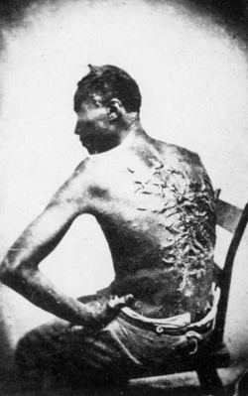
ABOLITIONISM AND EMANCIPATION
Slavery remains legal in all colonies until the Revolution – after that, some northern States eliminate slavery
US Constitution limits the power of Federal government to interfere with slavery or slave trade
1808: slave trade (not slavery) prohibited in the USA
First half of the 19th century: rise of the abolitionist movement (William Lloyd Garrison, Frederick Douglass, Harriet Tubman), with many women involved in it (intersection of race and gender, which will lead to the birth of the first protofeminist movements)
Growing tension between northern and southern States → Secession of the Confederate States → Civil War (1861-65)
1863: Emancipation Proclamation
1865: total abolition of slavery

Slide 15
AFTER THE CIVIL WAR
Reconstruction: attempt to integrate freed African American in US society → contradictory policies:
  substitution of the slavery system with a legal system based on equality
  maintaining racial hierarchies through specific laws (Black codes)
  “Equal” Segregation (Plessy v. Ferguson, 1896: “separate but equal”)
  stressing the competition between lower-class whites and Blacks → myth of the Blacks stealing the whites’ jobs and turning down whites’ “generosity” (the white men’s burden)
  scientific racism: “naturally inferior” races (not only Blacks, but also non-WASP immigrants) must be kept in the lower rungs of the social ladder, and must not “contaminate” pure white blood (eugenics)
  assimilation into mainstream society (myth of the melting pot))
  pluralism and multiculturalism (myth of the American salad bowl/patchwork)

Slide 16
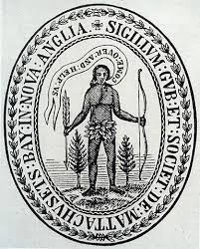
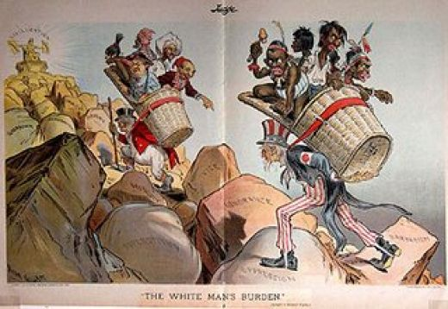
THE WHITE MAN’S BURDEN
  Take up the White Man’s burden –
  Send forth the best ye breed –
  Go, bind your sons to exile
  To serve your captives’ need;
  To wait, in heavy harness,
  On fluttered folk and wild –
  Your new-caught sullen peoples,
  Half devil and half child.
  […]
  Take up the White Man’s burden –
  The savage wars of peace –
  Fill full the mouth of Famine
  And bid the sickness cease;
  And when your goal is nearest
  The end for others sought,
  Watch sloth and heathen Folly
  Bring all your hopes to nought.
  (Rudyard Kipling, 1899)

Slide 17
RACE, ETHNICITY, AND IMPERIALISM
Race and ethnicity are also central to the rise of US imperialism, starting from the 1845-48 war against Mexico, ideologically justified by the doctrine of Manifest Destiny (expression coined in 1845 by John L. O’Sullivan in the essay “Annexation”). For O’Sullivan, the USA has the moral right and an almost divine mission to spread freedom and democracy among “inferior” people who do not know how to govern themeselves. “And that claim is by the right of our manifest destiny to overspread and to possess the whole of the continent which Providence has given us for the development of the great experiment of liberty and federated self-government entrusted to us.” The Treaty of Guadalupe Hidalgo (1848) gives to the USA vast parts of Mexico (one third of today’s USA). Former Mexican citizens have to decide whether to “migrate” to Mexico or remain in their lands as US citizens. The white Americans’ sense of superiority over the “brown” Mexicans genertates all kinds of social, economic, cultural and linguistic discriminations. US imperialism is based on an asymmetrical perception of the characteristics of different races, and on the postulate that the new American Empire has the duty to “protect” inferior races, but the result is quite the opposite...

Slide 18
RACE AS SYMBOLIC CATEGORY
Race = “a symbolic category, based on phenotype or ancestry and constructed according to specific social and historical contexts, that is misrecognized as a natural category” (Matthew Desmond and Mustafa Emirbayer, “What is Racial Domination?”)

Slide 19
CRITICAL RACE THEORY
Cristina Lombardi-Diop:
CRT is a theoretical and interpretative field of inquiry that examines race and racism across history, society, and cultural modes of expression.
CTR attempts to understand how victims of systemic racism are affected by cultural perceptions of race and how they are able to present themselves to counter prejudice.

Slide 20
WHITENESS STUDIES
Whiteness Studies: analysis of unequal distribution of privileges, resources, and power between white people and people of color.
Richard Dyer: Whiteness presents itself as “transparent” or “invisible” because it is considered universal, it is often unnamed, and unmarked → white people are just people.

Slide 21
RACE AND INTERSECTIONALITY
Kimberlé Crenshaw, “Demarginalizing the Intersection of Race and Sex” (1989) and “Mapping the Margins” (1991): race, class, and gender interact to shape experiences of women of color, and create complex systems of oppression.
Women of color do not simply experience gender discrimination plus racial discrimination as two distinct systems of oppression. Race, gender, and other forms of subordination intersect and overlap, creating specific experiences and locations of subordination and vulnerability.
“Intersectional subordination need not be intentionally produced; in fact, it is frequently the consequence of the imposition of one burden that interacts with pre-existing vulnerabilities to create yet another dimension of disempowerment” (Crenshaw).

Slide 22
ETHNIC STUDIES
Ethnic Studies = theoretical study of race and cultural pluralism, started by African American writers and intellectuals.
W.E.B. Du Bois: The Souls of Black Folk (1903), organization of the Atlanta University Conferences (1898-1914): first scientific studies of the (intersecting) dimensions of the lives of Black people (health, homes, wealth, education, religion, crime…)
Carter G. Woodson: founding of the Association for the Study of Negro Life and History (1915) and of the Journal of Negro History (1916).
Gradual adoption of European theories of language, textuality, gender and subjectivity to critique discourses of race and racial difference.
Expansion of the field so as to include other ethnicities, first of all Chicano/a and Native American cultures.

Slide 23
US VS. THEM
Ethnic studies examine how dominant perceptions of cultural identities in Europe and North America tend to postulate a dichotomy between “Us” (the non-ethnic majority) and “Them” (colonized or old and new migrant communities, characterized as “ethnic”).
Ethnic identity or origin = an individual’s ancestral heritage.
Ethnocentrism = the belief that a cultural community or ancestry is superior.
Ethnicism = protest/resistance against the oppression and exploitation of “ethnics” by the dominant group.

Slide 24
GENDER THEORIES
In the current Italian debate about what is a legitimate “identity” the so-called “teoria gender” is often mentioned in order to denounce the attempt to dismantle the natural configurations of “male” and “female” subjectivities. The dubious syntactical correctness (“gender” used as an apposition – quite usual, in English, but quite rare in Italian) and the incongruous use of English (“gender” is perfectly translatable with “genere,” and the Italian expression should translate “gender theory,” that is, “teoria del/sul genere”) suggest either a poor familiarity with the object the expression should designate, and/or a totally ideological intention to define “gender” as something exclusively belonging to the abstract and unpractical realm of “theory.”
But “gender” is not a “theory” – it is a real dimension of existence that determines the personality of every single human being. As it happens with any other dimension of human reality, on “gender” all kind of theories can be built – included those that state the absolute and “natural” binarity of gender: one can only be (biologically) either male or female (but this of course should be called “sex” instead, and besides “sex,” too, is far from unequivocal). All these disparate theories address the issue starting from the most different ideological positions, and lead to the most different conclusions. People who attack the “teoria gender” are simply applying their own specific “gender theory” (that is, theory about gender) – and this is perfectly legitimate, provided that all this is based on the recognition that “gender” exists as such (and we may debate about what it means), and that it does not entail discriminatory practices regarding people who do not fit into this binary scheme.

Slide 25
WHAT DO WE TALK ABOUT WHEN WE TALK ABOUT GENDER
The concept of “gender” applied to individual identity or subjectivity was born in the 1960s, in the USA (it already existed as a grammatical/morphological concept), to distinguish the psychosexual orientation of a person from his/her anatomical sex. But “sex” itself never belongs only to the sphere of biology. Trying to separate a culturally constructed “gender” from a biologically given “sex” overlooks the complexity of human beings and the role of social and cultural factors in the construction of what we call “male” and “female” (not mentioning all the other possible configurations, that can be also non-binary and fluid). Any subject builds up his/her own identity/subjectivity by negotiating his/her corporeality and so his/her sexuality with the social and cultural context s/he is living in. Of course anyone can accept or criticize the attempt to “distantiate” from the “original” corporeal/sexual dimension in order to assume a gender identity thought by the subject to be “truer” to his/her inner self. But this depends from the ideological position we have chosen, from the “value” we assign to this or that decision – but this does not in any way, I repeat, question the “reality” of gender, neither can it justify the discrimination, marginalization or even criminalization of people who do not adhere to our notion of what is “right.”

