Slide 1
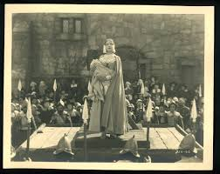
Hester Prynne, a Migrant
Notes:
Lillian Gish as Hester Prynne in Victor Sjöström’s adaptation of The Scarlet Letter (1926)

Slide 2
Hawthorne: A “symbolic” life
Nathaniel Hawthorne’s life is in itself symbolic of a number of intersecting tensions that cross American history from the early colonial period to the middle of the 19th century. He was born (of all days…) on July 4, 1804, in Salem, Massachusetts. The first “American” Ha(w)thorne was William, Nathaniel’s great-great-great-grandfather, who became a prominent member of the Massachusetts Bay Colony as a magistrate and judge (he was especially harsh towards “heresies” like the Quakers’). William’s son, John, was one of the judges of the 1692-93 Salem Witch Trials. In his early twenties Nathaniel added the “w” to his last name, perhaps to both dissociate himself from his ancestors and to make his last name sound again as in the mid-17th century – so making a double contradictory movement of distancing and coming into closer contact with his past.
Hawthorne’s father, Nathaniel Hathorne, Sr., was a sea captain who died on the ocean in 1808. After his death, the Hathorne family moved in with maternal relatives, the Mannings, where Nathaniel grew up in an environment peopled almost exclusively by women and girls. Many critics attribute Hawthorne’s “feminine” style to his experience as a boy surrounded by female figures.

Slide 3
Hawthorne’s early career
Hawthorne graduated at Bowdoin College in 1836, and he became to publish short stories that made him known as a promising author. One of his earliest tales, “Alice Doane’s Appeal,” published only in 1835 but written ten years before, is a complex reconstruction of the Salem Witch Hunt, which ends with the declaration that a monument to the victims of the witch hunt should be erected to remember that historical horror. From the very beginning Hawthorne was therefore interested with the necessity of facing the more disquieting aspects of American history (and, in the case of the witch hunt, involving especially women), and to make them part of collective memory. In 1837 he collected many of his short stories in Twice-Told Tales – the title referring both to the fact that the tales had been already published elsewhere, and to their being mainly a “rewriting” of historical events already more or well known through their historiographical representations.

Slide 4
A utopian tendency
After having begun a love story with painter Sophia Peabody, sister to the abolitionist educator Elizabeth Peabody who also helped Hawthorne in his career (she made him publish, in 1841, three best-selling books for children, Grandfather’s Chair, in which he again re-wrote events of American history). In 1841 he became involved with the utopian experiment of Brook Farm, which he thought could make him save some money to marry Sophia. The experiment proved a failure, and it became the basis for his third romance, The Blithedale Romance (1852). Hawthorne married Sophia Peabody in 1842 and then moved to Ralph Waldo Emerson’s Old Manse in Concord, where he wrote most of the tales collected in Mosses from an Old Manse (1846).

Slide 5
Life at the Custom-House
In April 1846, thanks to his acquaintances in the Massachusetts Democratic Party, Hawthorne became Surveyor of the Salem Custom-House. When the Whig Zachary Taylor won the Presidential elections in 1848, Hawthorne was fired, and had to leave his post in 1849. During his years at the Custom-House, probably due to the pressures and responsibilities of his job, Hawthorne was unable to write, but he “reinvented” this “writer’s block” in the introductory sketch to The Scarlet Letter, in which he gave the most complex and nuanced description of the poetics of the romance we have – even if it is applied to what he was not able to do anymore.

Slide 6
A major writer
The Scarlet Letter was published in March 1850. It was one of the first mass-produced books in America, but it had only a limited success (2,500 sales in the first 10 days), at least compared to the much wider commercial success of novels written by women like Harriet Beecher Stowe’s Uncle Tom’s Cabin (1852), which sold 3,000 copies in one day, and about 300,000 copies in the USA and 200,000 in the UK in a year. Nonetheless, the romance won the author critical recognition, and it soon became a classic of American literature, even if the main issues addresses by the book were considered “unpleasant” by many – someone wrote that it almost seemed a direct outcome of the subversive movement that only a couple of years before had had its official birth with the Seneca Falls convention and the Declaration of Sentiments.

Slide 7
Hawthorne and Melville
At the end of March 1850, Hawthorne became friend with Herman Melville, who had just reviewed Mosses from an Old Manse, in which he declared that Hawthorne was a genius, because he had the “power of blackness.” In a 1851 letter Melville wrote: “There is the grand truth about Nathaniel Hawthorne. He says No! in thunder; but the Devil himself cannot make him say yes,” thus inaugurating a critical tendency to consider Hawthorne a “subversive,” oppositional author – contrary to another tendency that considers him a defender of the “liberal” status quo. Melville dedicated Moby-Dick (1851) to Hawthorne: “In token of my admiration for his genius, this book is inscribed to Nathaniel Hawthorne.”

Slide 8
An established author/ity
Hawthorne gradually became an established author with the two subsequent romances, The House of the Seven Gables (1851) and The Blithedale Romance (1852), and the 1851 collection of short stories retelling classic myths, A Wonder-Book for Girls and Boys (in 1853 he published a sequel, Tanglewood Tales). In 1852 Hawthorne wrote the campaign biography of his friend Franklin Pierce, who became President and rewarded him for his support with the position of United States consul in Liverpool.

Slide 9
The last years
In 1857, Hawthorne’s consulship ended, and the Hawthorne family (Nathaniel, Sophia, and their children Una, Julian and Rose) toured France and especially Italy, settling in Rome from February 1858 to the late summer of 1859. In 1860, he published The Marble Faun, bases on his Italian experience and his last completed romance, which rapidly became a broad commercial success, and a sort of guidebook for all English-speaking travellers to Italy and Rome. He also tried to write other romances on the complex relationships between past and present, and Europe and America, but he never finished them. He died on May 19, 1864.

Slide 10
The Scarlet Letter: Space and time
The location of the story is colonial Boston, and the time can be inferred by John Winthrop’s death (March 26, 1649), which takes place at the end of the romance. The plot starts seven years before, and thus in 1642. 1642-1649 are the years of the Puritan Revolution in England. But Hawthorne makes Winthrop die on “an obscure night of early May,” because he wants the red meteor (or scarlet A) appear in the sky, and be seen by Dimmesdale, only a a few days before the election of the new governor, and the new governors were elected in May or June, and also because at that time May Day was when the fair season began, and nature came back to life, so reinforcing the sense of renewal, but also the connection with the new governor, John Endicott, for Hawthorne the embodiment of the authoritarian rigidity of Puritanism (as in “Endicott and the Red Cross” and especially “The May-Pole of Merry Mount”).

Slide 11
Alterations of history
The change of the date of Winthrop’s death is only one of Hawthorne’s conscious (and visible) historical alterations.
Hester’s own name is an “adulteration” of that of her historical counterpart, Esther of the Biblical book – so resembling the author’s alteration of his last name from “Hathorne” to “Hawthorne.”
When Hester is condemned, the governor is Richard Bellingham, but in 1642 it was Winthrop. With Bellingham as the governor, Hawthorne can link him to the figure of his sister Ann Hibbins, considered as a witch by the villagers, and he can also make him the judge in a case of adultery when he himself was involved in a legal controversy because he wanted to marry a young woman already promised to another man (and Winthrop opposed his wish).
Hester’s punishment (wearing a red A) was introduced only in 1694: before, whipping was the standard punishment for fornication at Salem, and sometimes even death. In “Endicott and the Red Cross” Hawthorne had already anachronistically made a woman wear the red A, so juxtaposing her harsh treatment (and that of a number of other people) by the embodiment of patriarchal power with Endicott’s act of stripping the red cross from the flag of the Massachusetts Bay Colony, an event commonly considered as the first instance of the “planting” of the principle of freedom in America.

Slide 12
Scarlet letters
Hester’s last name comes from William Prynne, an English Puritan dissenter who in 1634 was condemned, for his attacks to the queen and the Anglican Church, to the cutting of the ears and to the branding on his cheeks, with red-hot iron, of the letters “SL” (“Seditious Libeller” – an accusation that Hawthorne did in some way received by some critics who denounced his being influenced by the equally seditious women of the 1848 Seneca Falls Convention).

Slide 13
Out of/into the prison
The romance begins with Hester coming out of the prison, and entering another one, that of Boston village, with the whole community as her jailer. The first scene presents Hester as the very center of the judging gaze of the whole town, which should reduce her to “the figure, the body, the reality of sin.” Hester is constantly “the object of severe and universal observation,” almost as if Boston were turned into a Panopticon (the system of social control devised by Jeremy Bentham in 1791).

Slide 14
Who watches the watchers
Hester is not simply the passive object of the gaze of the members of her community – she watches them in her turn, and she judges them as not legitimized to judge her – something the narrator declares about the judges themselves (“it would not have been easy to select the same number of wise and virtuous persons, who should be less capable of sitting in judgment on an erring woman’s heart, and disentangling its mesh of good and evil, than the sages of rigid aspect towards whom Hester Prynne now turned her face”).

Slide 15
A new, paradoxical power
Being transformed into the “general symbol at which the preacher and moralist might point” to illustrate how those who break the rules are punished, Hester acquires a paradoxical power which enables her “to convert the scene into a kind of lurid triumph.” Afterwards, Hester starts to feel or fancy “that the scarlet letter had endowed her with a new sense. She shuddered to believe, yet could not help believing, that it gave her a sympathetic knowledge of the hidden sin in other hearts” – hearts which could be those of “a venerable minister or magistrate, the model of piety and justice,” or “some matron, who according to the rumor of all tongues, had kept cold snow within her bosom throughout life,” or even “a young maiden glancing at the scarlet letter, shyly and aside.”

Slide 16
Intersections of class, race, age, gender, religion
When Hester is about to come out of the prison, hypotheses are made about who the prisoner can be: “It might be that a sluggish bond-servant, or an undutiful child, whom his parents had given over to the civil authority, was to be corrected at the whipping-post. It might be, that an Antinomian, a Quaker, or other heterodox religionist, was to be scourged out of the town, or an idle and vagrant Indian, whom the white man’s fire-water had made riotous about the streets, was to be driven with stripes into the shadow of the forest. It might be, too, that a witch, like old Mistress Hibbins, the bitter-tempered widow of the magistrate, was to die upon the gallows.” Puritan law can exercise its punishing power over people who are lower-class (and implicitly compared to black slaves), non-adult, of a deviant creed, non-whites, or “eccentric” women.

Slide 17
Nature vs. civilization
As a woman, Hester is aligned with nature and against civilization from the very beginning. The description of the prison sets the parameters of this conflict: “Like all that pertains to crime, it seemed never to have known a youthful era. Before this ugly ediﬁce, and between it and the wheel-track of the street, was a grass-plot, much overgrown with burdock, pig-weed, apple-peru, and such unsightly vegetation, which evidently found something congenial in the soil that had so early borne the black ﬂower of civilized society, a prison. But, on one side of the portal, and rooted almost at the threshold, was a wild rose-bush, covered, in this month of June, with its delicate gems, which might be imagined to oﬀer their fragrance and fragile beauty to the prisoner as he went in, and to the condemned criminal as he came forth to his doom, in token that the deep heart of Nature could pity and be kind to him.”

Slide 18
The art of excess
The first image of Hester is that of a «resisting» woman, who expresses her resistance to the patriarchal “law of the letter/letter of the law” by immediately exceeding, with her art, the literal meaning of the letter: “On the breast of her gown, in ﬁne red cloth, surrounded with an elaborate embroidery and fantastic flourishes of gold thread, appeared the letter A. It was so artistically done, and with so much fertility and gorgeous luxuriance of fancy, that it had all the eﬀect of a last and ﬁtting decoration to the apparel which she wore; and which was of a splendor in accordance with the taste of the age, but greatly beyond what was allowed by the sumptuary regulations of the colony.”

Slide 19
Spelling “A”
The letter has a mysterious power which makes Hester the very center of the community, as the object/subject of gaze. The scarlet A becomes a “spell,” a linguistic item which can transform reality, by enclosing Hester in a secluded but also protected space: “the point which drew all eyes, and, as it were, transﬁgured the wearer, – so that both men and women, who had been familiarly acquainted with Hester Prynne, were now impressed as if they beheld her for the ﬁrst time, – was that Scarlet Letter, so fantastically embroidered and illuminated upon her bosom. It had the eﬀect of a spell, taking her out of the ordinary relations with humanity, and inclosing her in a sphere by herself.”

Slide 20
A fallen Adam, a new Christ
Hester’s lover, the minister Arthur Dimmesdale, is a frail man, a fallen Adam who becomes even more successful as a preacher, an considered as more saintly, when he denounces himself (in very ambiguous ways – he never reveals that he is Pearl’s father, and Hester never betrays him) as a sinner like Hester – so the two criminals are treated in opposite ways according to their gender. Toward the end, Hester takes charge of the situation, and organizes their flight back to Europe – e new migration, with the woman as the leader, but the project fails.
In the scene of Dimmesdale’s sermon for the election of the new governor the minister manages to represent himself as a sort of New Christ, who takes upon himself all the sins of the world (“the one sinner of the world”). Hester witnesses the scene alone, outside of the church, and she cannot hear what Dimmesdale says (we will know what the sermon is about from the words of the audience) – Hester is at the margins, Arthur at the center, until the end, when he asks her to go up the scaffold platform with him, and dies in her arms, cradled like Christ by the Virgin Mary.

Slide 21
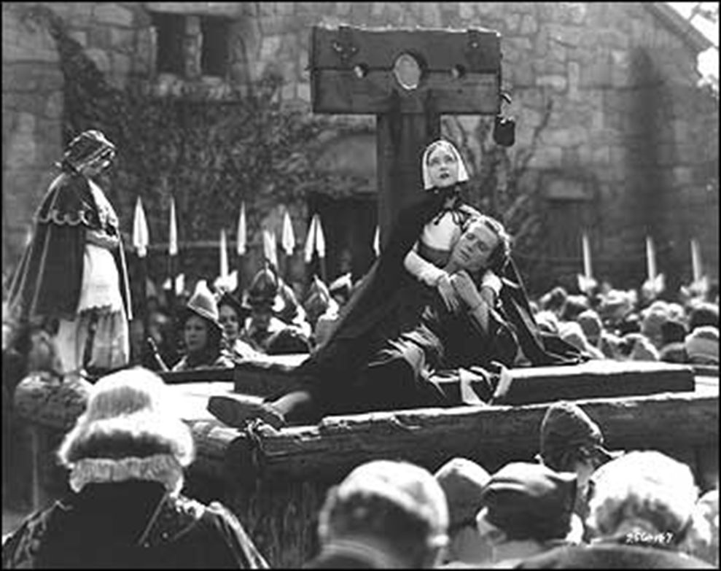
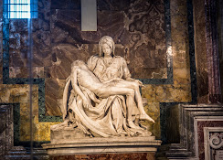

Slide 22
An American Satan
In the love/hate triangle of The Scarlet Letter, which should reproduce che original Adam-Eve-Satan triangle, Satan’s role is played by Hester’s husband, Roger Prynne, who has sent his wife to the colony alone, while he went into the wilderness to study nature and Indian knowledge. When he finally meets her, is on the day of her public exposure as an adulteress, with her newborn daughter Pearl in her arms. So he takes the pseudonym Chillingworth, makes Hester promise not to betray her, and begins his search for her fellow “criminal” (The Scarlet Letter is also a detective story). He is also a vampire, inaugurating in the imaginary chronohistory built by American literature a figure already invented (in female form) by Edgar Allan Poe in some of his tales. In two chapter titles he is called “The Leech” (meaning doctor, but also bloodsucker), and he is also said to be able to “spread bat’s wings and flee away.” His victim is of course Arthur, whom he chooses as his spiritual guide – then he goes to live with him as his doctor (and there are some very subtle allusions to a potentially homosexual relationships). But instead of getting better, Arthur get worse, and Chillingworth begins to look as a prototype of the mad scientist who ruthlessly experiments on human guinea pigs.

Slide 23
A Pearl of great value
Hester’s daughter, Pearl, is systematically represented (by the community as well as by her mother) as a small sprite, an elf-child, an unmanageable breaker of rules who only wants to know who her father is (she is the real “detective,” in the story, the person who asks questions). Always identified with nature, she is also the positive force that makes Hester survive through her ordeal, the embodiment of a “natural” love that exceeds the patriarchal politics of sexual control. Like Hester, she will survive both Arthur and Roger (contra adultery European novels like Madame Bovary or Anna Karenina, where the women die and the men go on with their lives), and thanks to the latter’s only act of generosity will become a rich heiress.

Slide 24
Hester Prynne, c’est moi
At the beginning of “The Custom-House,” Hawthorne denounces his “autobiographical impulse,” which has led him to write the introductory sketch. The denunciation can be applied also to The Scarlet Letter as a whole, since, as many critics have stressed, Hawthorne clearly identifies with his heroine – an article about Hawthorne’s gender anxieties by Robert K. Martin is aptly titled “Hester Prynne, C’est moi.” In the romance, the complex intersections of the gender, race and class dimensions obliquely mirror Hawthorne’s ambiguous perception, interpretation and evaluation of these interconnecting issues inside mid-19th-century American society, and of his own positioning inside that web of contaminations and conflicts. One issue that criticism has generally overlooked is that this intersection takes place inside a subject who is, first of all, a migrant, and much less an enterprising colonizer like most of the male citizens of Boston. Hester’s sense of displacement (both from her own country and from the community she has been forced to join) mirrors Hawthorne’s, who was certainly not a migrant neither was consciously interested in representing the migrant experience, and nonetheless describes himself, as the end of “The Custom-House,” as such.

Slide 25
An author with no identity
Hawthorne’s difficulty in finding a cultural identity in America can be signaled by his statement that he is following the example of the “famous ‘P.P., Clerk of this Parish,’” the never existed author of an 18th-century mock autobiography. Besides, he comments that “the printed book, thrown at large on the wide world,” must “find out the divided segment of the writer’s own nature, and complete his circle of existence by bringing him into communion with it” – thus stressing again that his self is not “stable” and independent, but must rely on others (the readers) completing the communication cycle and thus acquiring the status of “author.” In the romance, Hester is at the beginning excluded by this “community of communication,” and is secluded into her own “magic circle” together with her child (and Pearl is often implicitly compared to a book which is difficult to be read, and without an “author” – a father). Once again, this sense of exclusion from mainstream society and culture is something Hawthorne shares with Hester (even if maybe he exaggerated his own…).

Slide 26
A search for A-uthority
“The Custom-House” is about how Hawthorne came to write The Scarlet Letter – or better, how the story of Hester Prynne finally turned Hawthorne into a major author (something of course Hawthorne did not know yet when he was writing the sketch…). Throughout the sketch Hawthorne is in search for his lost (or not yet attained, at that time) authority as a writer. He even comes to the point of summoning a ghost, that of his predecessor as custom surveyor, Jonathan Pue, in order to project on this figure of past authority his need to have a different forefather from those he has somewhat dismissed (mirroring his own dismissal by them) at the beginning of the sketch. Hawthorne’s choice of a different authority, based on writing and the power it has of giving a voice to those (like the women) who are not allowed to have it, is reflected in Hester’s refusal to acquiesce to the Puritan authority, and in her re-writing of the scarlet letter through the art of embroidery (just like Hawthorne “embroiders” the manuscript with his own art). One intersection (here between gender, class – Hester is a woman worker – and art) comments the other’s, and this complex dynamics between the search for a recognized authority by dominant culture and the refusal to kneel to its values (instead re-working them and turning into something new) is something that, once again, is a typical feature of migrant literature and art.

Slide 27
Distance from power
Another feature that connects Hawthorne in “The Custom-House” to Hester in The Scarlet Letter is their distance from public power, even if they are at the very heart of it (Hawthorne as a public officer, Hester first as the living embodiment of what the Puritan community is not and then as its most appreciated “professional” worker). Hawthorne’s uneasiness with established power is first represented through the hostile symbol of the American Eagle, and at the end by the political plot that brings about his own demise, putting him on a “scaffold” where he will be “decapitated,” just like Hester is exposed to the public gaze on the scaffold. Hawthorne’s uneasiness with the emblems of political power closely resembles that of migrants, who always feel the established power of the host country not as a source of protection, but as a menace to their safety.

Slide 28
A betrayer of his/her class, religion, gender, family (and race?)
Hawthorne represents both himself and Hester as betrayers of a number of power systems. As a “writer of story-books” he is considered by his ancestors, in “The Custom-House,” as “degenerate” (“ethnic” migrants are almost always considered by dominant culture as not belonging to the legitimate “genus”) because he does not comply with the requirements of his class (he should have some “business in life”), his religion (he does not “glorify” God), of his gender (he is implicitly not “manly” enough), of his family of course, and maybe even of his race, because he is depicted as a “fiddler,” like the street musicians who were usually of black or not exactly white (like the Italian migrants…) descent. Hester betrays her class because she works instead of leaning on his husband as breadgiver, her religion because she breaks the sacred bond of marriage, her gender because her behavior is not “womanly,” her family through her husband, and maybe her race, as it is implied by the comparison with the Indians (and her cottage is on the margins of Boston, close to the forest, to the wilderness).

Slide 29
Migrating back home, and back again
At the very end of the romance, Hawthorne and her daughter go back to Europe, where Pearl, now a rich heiress, probably marries some aristocrat – so for her the migrant’s American Dream, which had turned into a nightmare for her mother, becomes a European dream. But then Hester comes back to Boston, resumes her scarlet A, and opens a sort of protofeminist help group, where especially women come and talk about their problems (with Hester inspiring them with a vision of a future in which men and women will share an equal status).

